Slide 1

Miro-Credit Defaulter Model
By:
Vedant Singh Shankar

Slide 2
Problem Statement
This project is mainly aimed to help the telecom industries for better selection of the customers for their micro-credit services.
A customer is claimed to be a ‘Defaulter’ if he/she deviates from paying back the loaned amount within 5 days.
It is therefore, very important to predict the defaulters before hand for better customer selection process, which can be achieved using various supervised Machine Learning Techniques.

Slide 3
Summary of the Work Done
In this project we have applied 4 different kinds of supervised Machine Learning Algorithms to build predictive models for the use case.
We have applied appropriate sampling techniques to deal with this issues like data imbalance.
We have done various statistical analysis and used techniques to understand the relationship between variables.
Also considering data imbalance, we have tuned the models as well as adjusted the probability threshold for the models to improve classification performance.

Slide 4
Algorithm Used
The supervised learning algorithms used consists of simple algorithms like:
Logistic regression
Gaussian Naive Bayes
And also, relatively complex and tree-based algorithms like:
Random Forest
Light Gradient Boosting Machine (LightGBM)

Slide 5
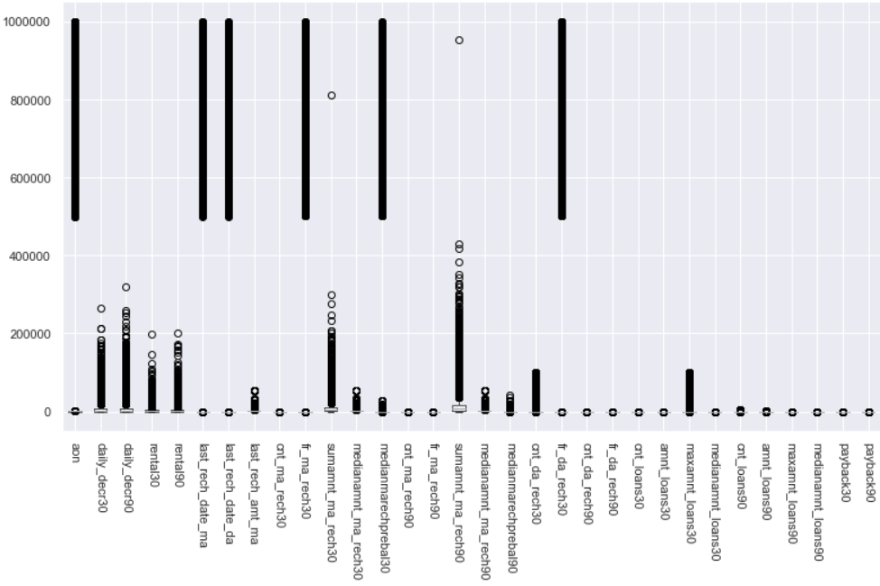
Distribution of numerical data
Boxplots of all Numerical Data

Slide 6
As seen previously, the numerical data had many irregularities, one of them consisting of abnormally large range of values.
And the other is the presence negative values, that is not realistic according to the domain knowledge.
Therefore, these large values were discarded and assuming that the negative sign is a typographical error, we have therefore, changed only the sign of the negative values to positive.
Also, for categorical values that had one or all unique values were discarded before further analysis.

Slide 7
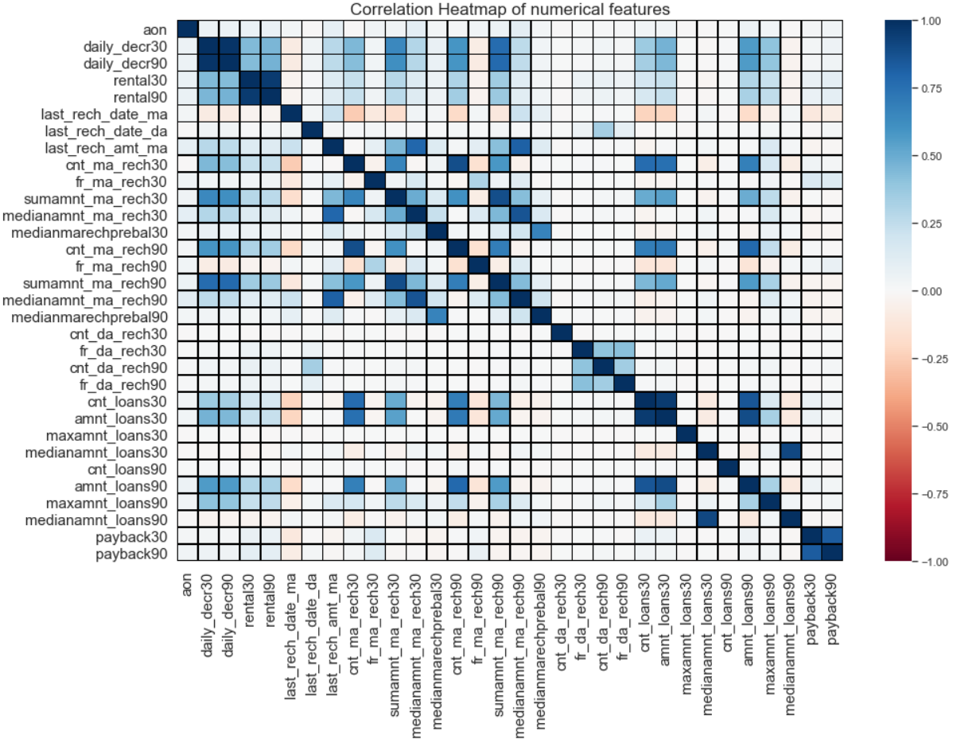
Multi-collinearity
Correlation Heatmap

Slide 8
Dealing With Multi-collinearity
As seen from the previous slide, the numerical features had may correlations among them, especially along the diagonal where the correlations between the adjacent variables shown to have correlation more than 0.95. Also, multi-collinearity reduces model’s interpretability, that is, we will not know definitely how a particular feature may affect the model.
Therefore, one of these highly correlated variables were discarded form the dataset.
And for the rest of the variables, Variance Inflation Factor(VIF) is used, which is the measure of how well the variable is explained by other independent variables.

Slide 9
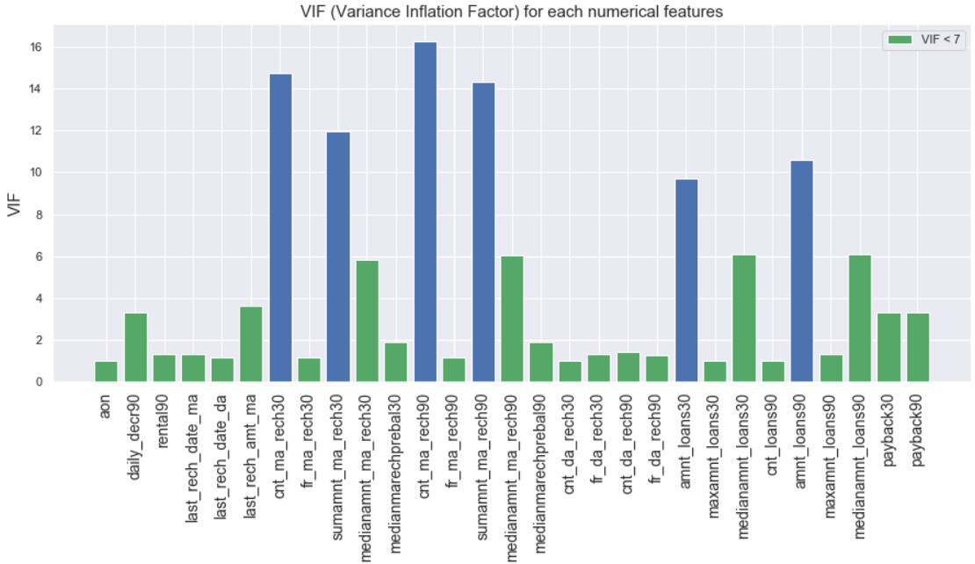
From above plot we can see that features like ‘cnt_ma_reach30’, ‘sumamnt_ma_reach30’, ‘cnt_ma_reach90’, ‘amnt_loans30’ and ‘amnt_loans90’ are having VIF values greater than 7, so therefore we have dropped them from the dataset.

Slide 10
Selection of Relevant Features by Mutual Information(MI)
Before proceeding for further analysis, features that have low contribution or have low relevance in predicting the target variables(i.e., ‘Defaulter’ and ‘Non-Defaulter’) were discarded from the dataset.
The one of the method used to score the features based on its importance towards target variable is Mutual Information(MI).
The mutual information (MI) is a measure of the amount of information that one random variable has about another variable. This definition is useful within the context of feature selection because it gives a way to quantify the relevance of a feature subset with respect to the output variable.

Slide 11
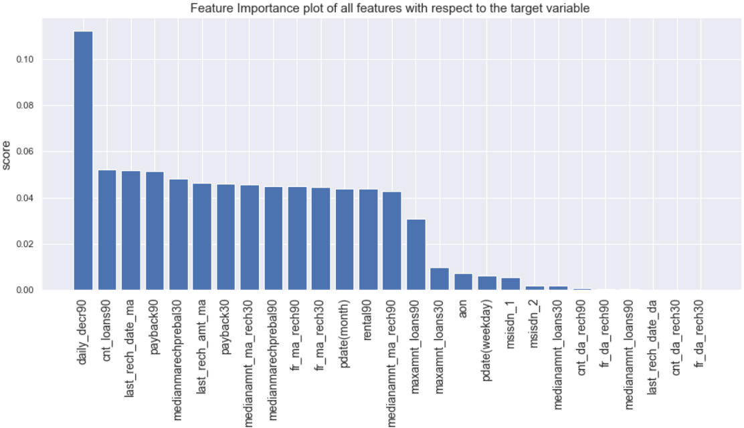
We have discarded features having relatively lower feature importance, therefore, according to the above plot, we have discarded the last 12 features.

Slide 12
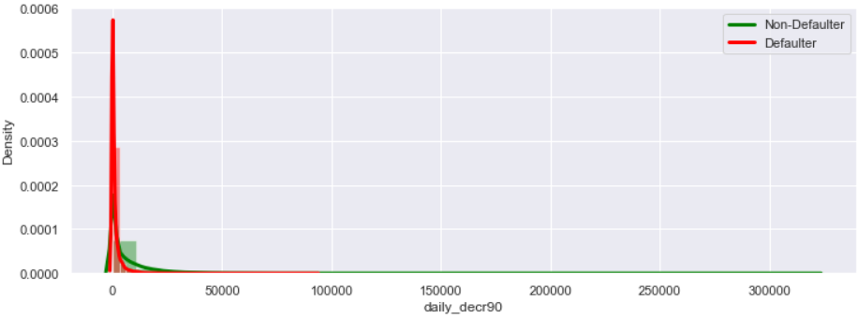
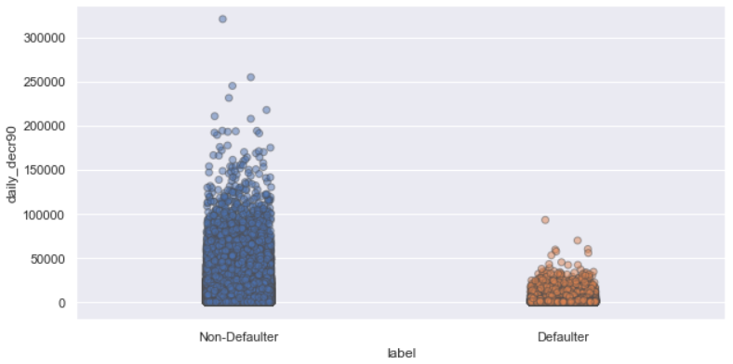
Distribution plot of daily_decr90
1-D Scatterplot of daily_decr90
According to above plots of daily_decr90(i.e., Daily amount spent from main account, averaged over last 90 days), we can conclude that, majority of customers that are defaulters are within the range of 50,000 Indonesian rupiah, in other words, defaulters usually tend to spend less from their main account.

Slide 13
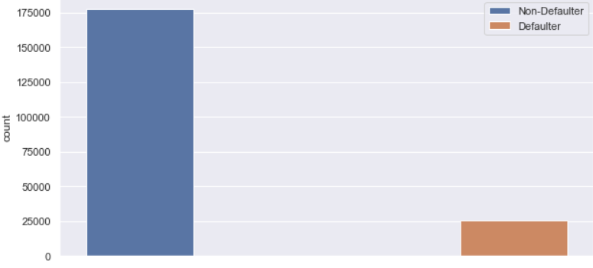
Target variable distribution
We see that our target variable is highly imbalanced, with ‘Non-Defaulter’ class being almost 7 times more than the ‘Defaulter’ class. Therefore, to treat this data imbalance problem, we have applied oversampling technique known as Synthetic Minority Oversampling Technique (SMOTE).

Slide 14
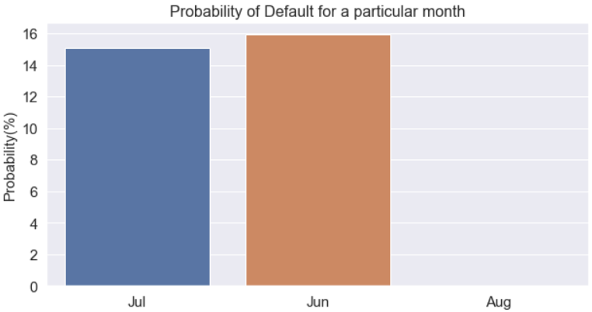
From above plot, we see that, for July and June month, the probability difference is not significant to come to a conclusion, however, during August month it is quite surprising to see no default cases reported. This could either be due to no availability of micro-credit services during this month or no record of the default case.

Slide 15
Method of Handling Outliers and Skewed Data
Even after removing the extreme values it is found that most columns were having many outliers and hence their distribution was were highly skewed with mean skewness value of 9.76 and maximum reaching up to 44.8. Moreover, data transformation techniques like logarithmic or cubic transformation did not help much in reducing the skewness of the data.
Therefore before modelling the data, we have binned the numerical variables and the binning technique that we have applied here, is supervised binning, that uses the target variable to bin the numerical/continuous variables, so that maximum information is retained in each bin about the target variable.

Slide 16
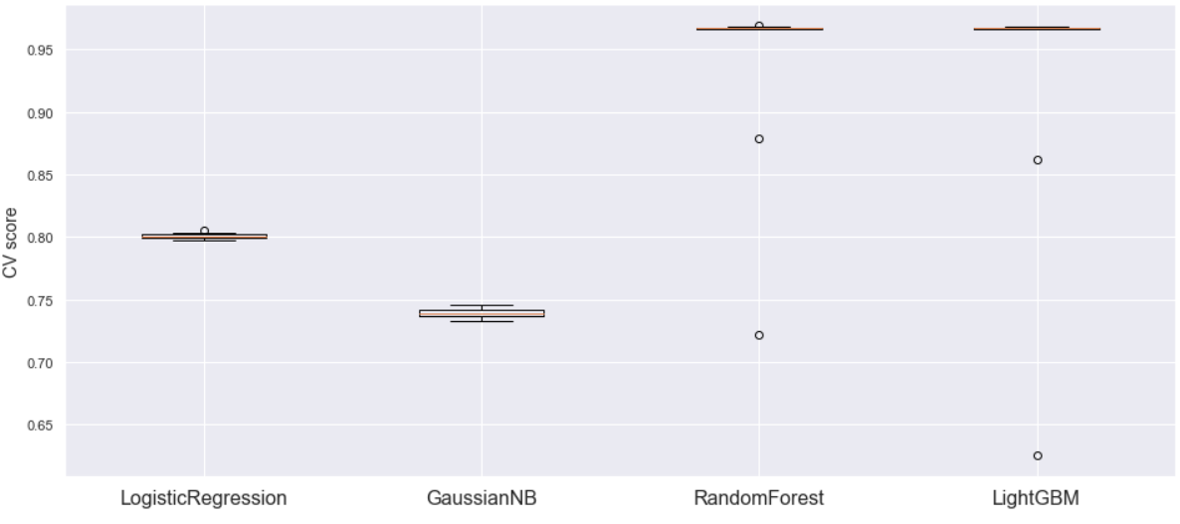
Base Model Evaluation by Cross Validation (CV) Score on Train set
From above boxplots, we see that, Random Forest and LightGBM performed better overall than the simple models like Logistic Regression and Gaussian Naive Bayes. But for two instances, we see Random Forest and LightGBM performed even poorer than the other two models, which can be noted by the outlier points.

Slide 17
Train and Test set results
Metric | Logistic Regression | Gaussian Naive Byes | Random Forest | LightGBM
Accuracy % | 79.6 | 75.2 | 98 | 93.7
F1(macro-average) % | 79.6 | 75.2 | 98 | 93.7
Recall % | 82 | 70.3 | 98.7 | 92.5
Metric | Logistic Regression | Gaussian Naive Byes | Random Forest | LightGBM
Accuracy % | 77.8 | 78.8 | 89.4 | 89.7
F1(macro-average) % | 66.9 | 66.2 | 74.4 | 75.6
Recall % | 82 | 71 | 51.5 | 54.8
ROC AUC % | 88.2 | 82.8 | 87.9 | 89.5
Train Results
Test results
By comparing train and test results, as expected, tree-based complex models like Random Forest and LightGBM overfitted more than that of other two models based on the test results. Particularly these complex models have shown low recall score which is one of the most important metric for the use case.

Slide 18
Hyper-Parameter Tuning and Threshold Adjustment
To optimize the overall performance, we have hyper-parameter tuned each model. Also, keeping in mind about data imbalance in test set, we then with the help of Receiver Operating Characteristic (ROC) curve of a model, have adjusted the probability threshold of each model to get optimal performance.
Therefore, these threshold values have been shifted to the optimal value corresponding to the highest geometric mean or G-mean between sensitivity and specificity.
The main reason for a threshold adjustment is to keep balance between sensitivity and specificity, that increases model’s ability to correctly classify the positive class (i.e., ‘Defaulter’) without much compromising about False positive (i.e., to classify ‘Non-Defaulter to Defaulter’).

Slide 19
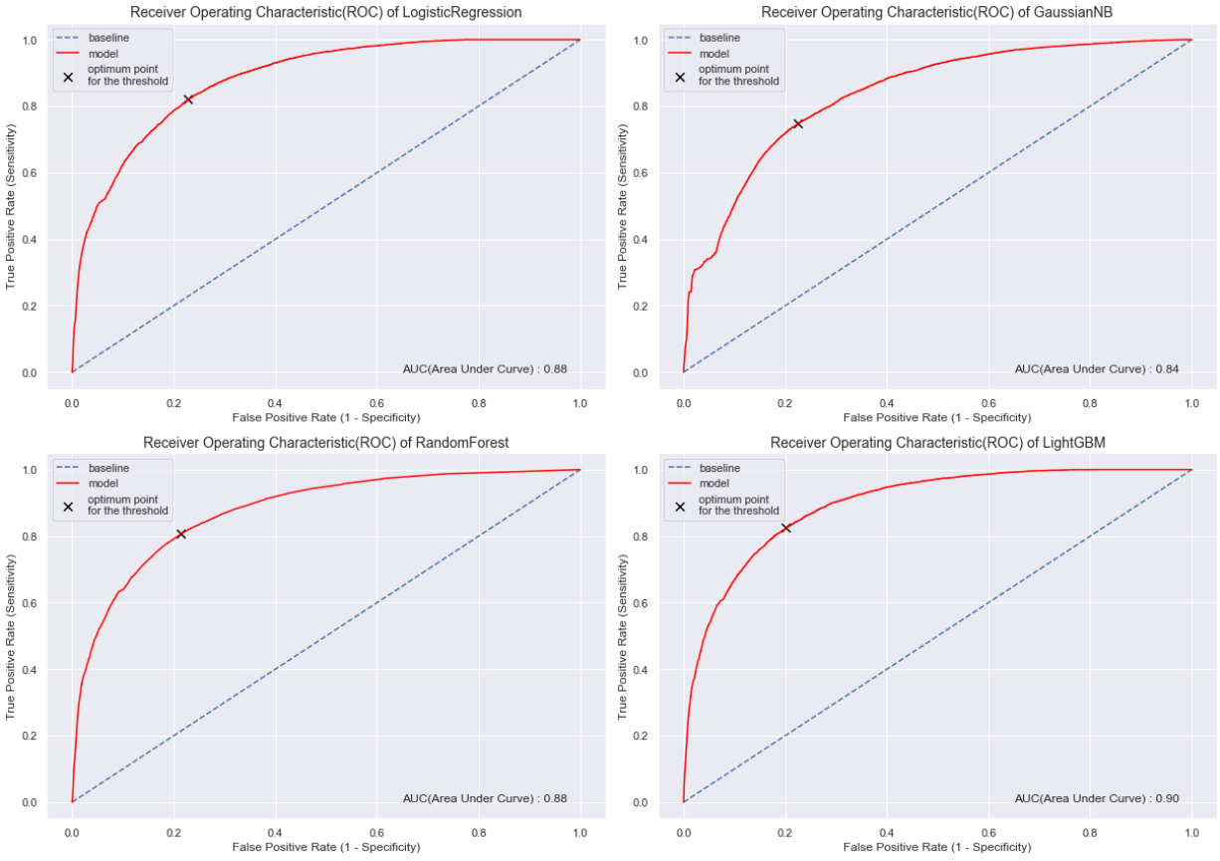
ROC curve of all models corresponding to their optimum threshold point

Slide 20
Final Test Results after hyper-parameter tuning and threshold adjustment
Metric | Logistic Regression | Gaussian Naive Byes | Random Forest | LightGBM
Accuracy % | 77.8 | 77.2 | 78.8 | 80.2
F1(macro-average) % | 66.9 | 65.3 | 67.9 | 69.2
Recall % | 82 | 74.7 | 80.7 | 82.4
ROC AUC % | 88 | 84 | 88 | 90
From the final test results we see that by tuning and adjusting the probability threshold of all models, we see overall increase in the recall score without much compromising on the F1 (macro-average) score, particularly for the tree-based algorithms like Random Forest and LightGBM.

Slide 21
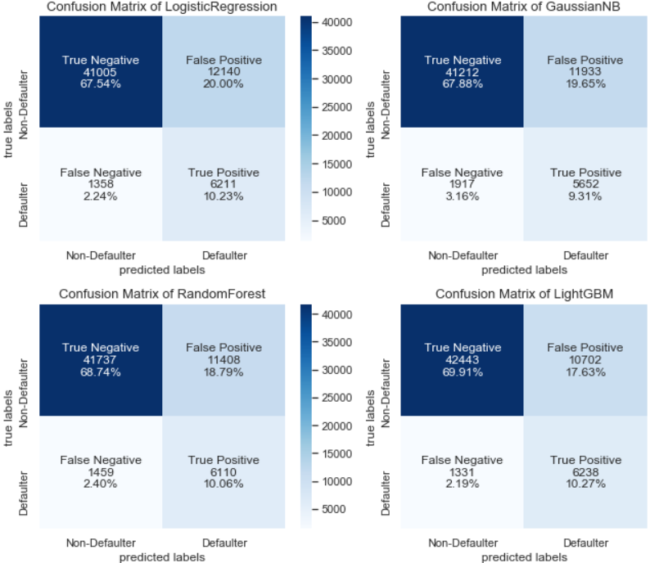
Visualizing Confusion Matrix of Final Test Results with the help of Heatmaps.

Slide 22
Understanding Key metrics for success and the interpretation of the final test results
From a business perspective, in order to prevent the further revenue loss by lending loans to defaulters, it is very important to correctly identify the customers who are ‘Defaulter’ and to reduce false negatives, therefore, our model should have high recall as possible.
Although, the accuracy of the all models decreased after hyper-parameter tuning and probability threshold adjustments, but considering heavy data imbalance, we must always decide the final model on the bases of other metrics, like in our case, high recall, f1 score and ROC AUC is much favourable.
Therefore, it can be clearly seen from above test results, that the LightGBM model performed the best out of all the models with respect to all metrics, also by analysing the heatmaps, we see that LightGBM has the lowest Type-I and Type-II errors as well. Also, LightGBM, being highly efficient for medium to large datasets, it is therefore favourable for this project.

Slide 23
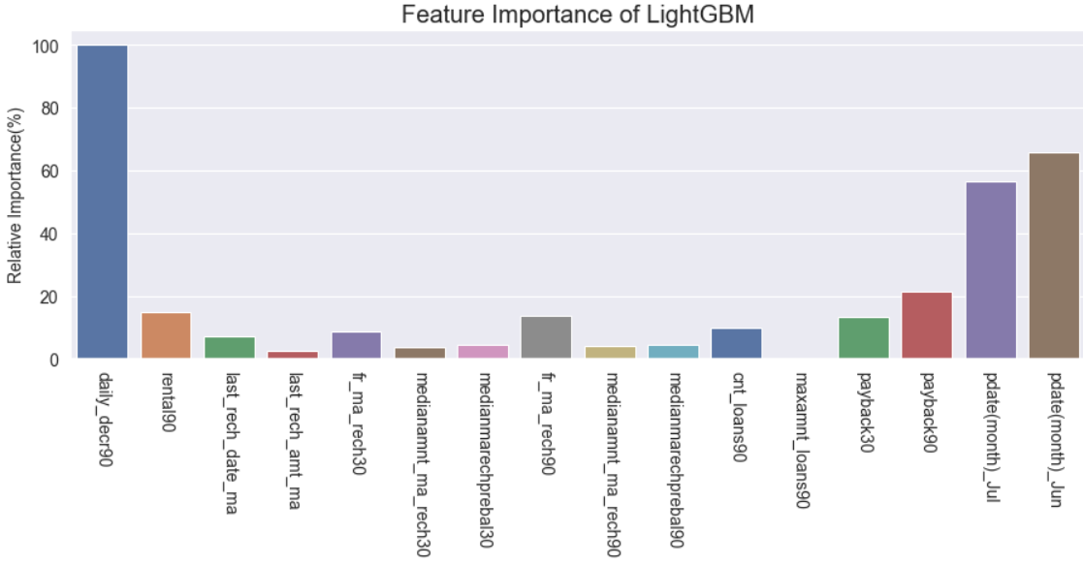
From above feature importance plot of the model LightGBM, the feature daily_decr90 is shown to have relatively high significance in comparision to other.

Slide 24
CONCLUSION
It was observed that, through statistical analysis and feature importance calculations, the feature daily_decr90 (i.e., Daily amount spent from main account, averaged over last 90 days) has shown to be the most valuable feature for prediction of the customer type (i.e., Non-Defaulter or Defaulter).
As the dataset contained irregularities that was dealt with some assumptions and also the main assumption that was the data being representative of the entire population, which may not necessarily be true. Therefore, it is recommended to use similar kinds of different datasets from other sources (possibly from other telecom service providers) and combining them to start all over again. This could therefore reduce the bias in results (if any) for a particular population/group and can possibly give much more better and concrete scenario.

Slide 25
THANK YOU

