Slide 1


NEXT GEN EMPLOYABILITY PROGRAM
CREATING A FUTURE-READY WORKFORCE
Student Name :
Vedant Sanjay Dhamale
Student ID :
STU63aa9a177a6db1672124951
Mobile No:
9356182089
Mail ID:
vedantdhamale9@gmail.com
College Name :
Vidya Pratishthan's Kamalnayan Bajaj Institute of Engineering & Technology

Slide 2
CAPSTONE PROJECT SHOWCASE
Project Title
Power BI Enabled Comprehensive Analysis on Unicorn Businesses (DA)
Abstract | Problem Statement | Project Overview | Proposed Solution | Technology Used | Modelling & Results | Conclusion | Q&A

Slide 3
Abstract
1
Strategic Decision Support: Empowering informed decisions for business growth..
2
Actionable Discoveries: Uncovering actionable insights from data trends.
3
Insightful Visualizations: Conveying complex information effectively.
4
Comprehensive Dashboard Analysis: Providing a complete view for strategic planning.

Slide 4


Problem Statement
Analyzing distribution of investments vary across different select investors within the unicorn business
Finding industry-wise distribution of unicorn companies based on the count of companies operating in each industry.
Finding Count of unicorn companies vary based on the year they jointed.
Visualizing geographical distribution of unicorn companies across different countries.
Company volume correlate with the valuation to funding ratio
Visualizing valuation to funding ratio vary across different countries

Slide 5

Project Overview
This project involves importing, preprocessing, and modeling data using Power BI, followed by creating dashboards and visualizations. The process includes:
Importing, Pre-Processing and Data Modelling
DAX and Dash Board(Visualization)
Visualization and Dashboard Preparation
Formatting and Testing the Project Functionality

Slide 6
Proposed Solution
I have analyzed the project using Power BI Dashboard. Power BI Dashboard analysis offers strategic solutions for unicorn businesses.
The stacked bar chart reveals investor preferences and funding contributions.
Another stacked bar chart highlights dominant industries among unicorn businesses.
A pie chart displays company counts based on entry years, aiding trend analysis.
The map chart shows global company distribution by country, indicating market concentrations.
A heat map correlates company volume with valuation to funding ratios, aiding investment decisions.
An area line chart tracks valuation to funding ratios by country over time, aiding financial analysis and strategic planning. These visuals offer insights for informed decision-making in the unicorn business landscape.

Slide 7
Technology used
Power BI

Slide 8
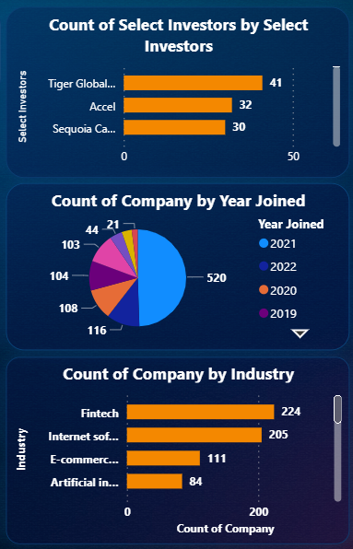
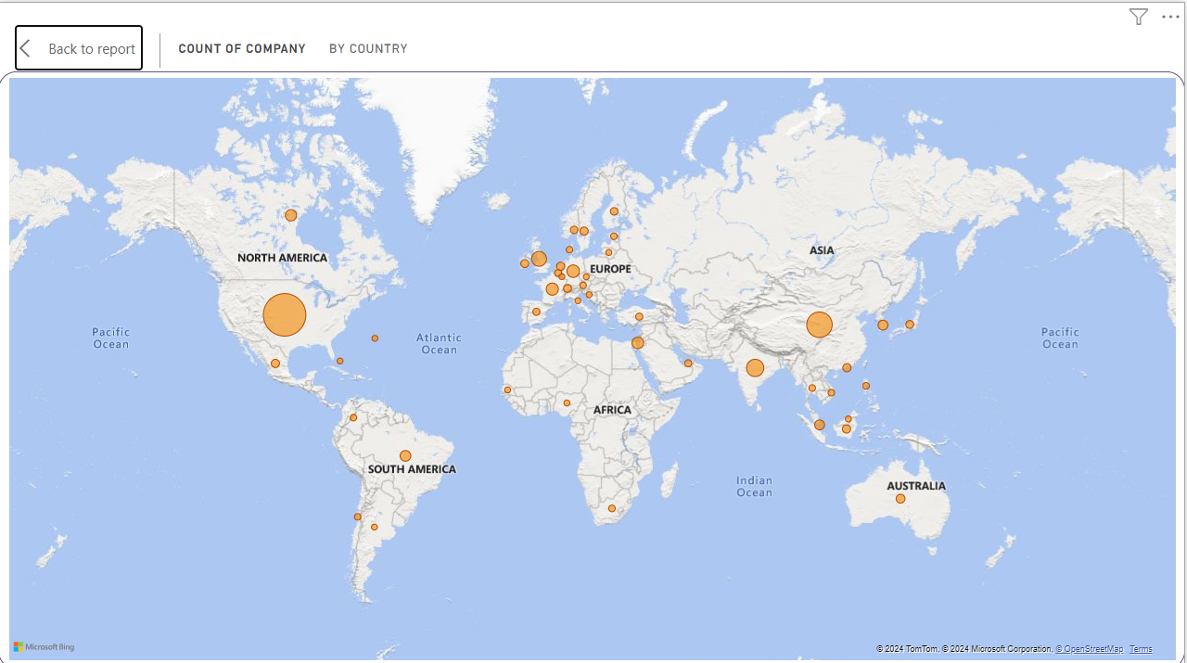
Modelling & Result

Slide 9
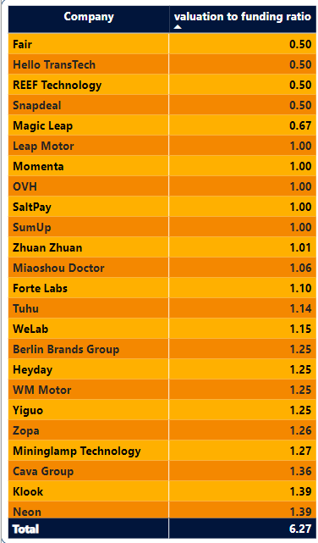
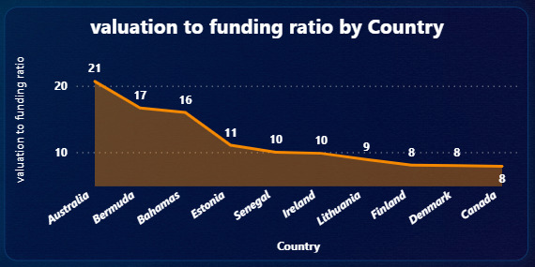
Modelling & Result

Slide 10
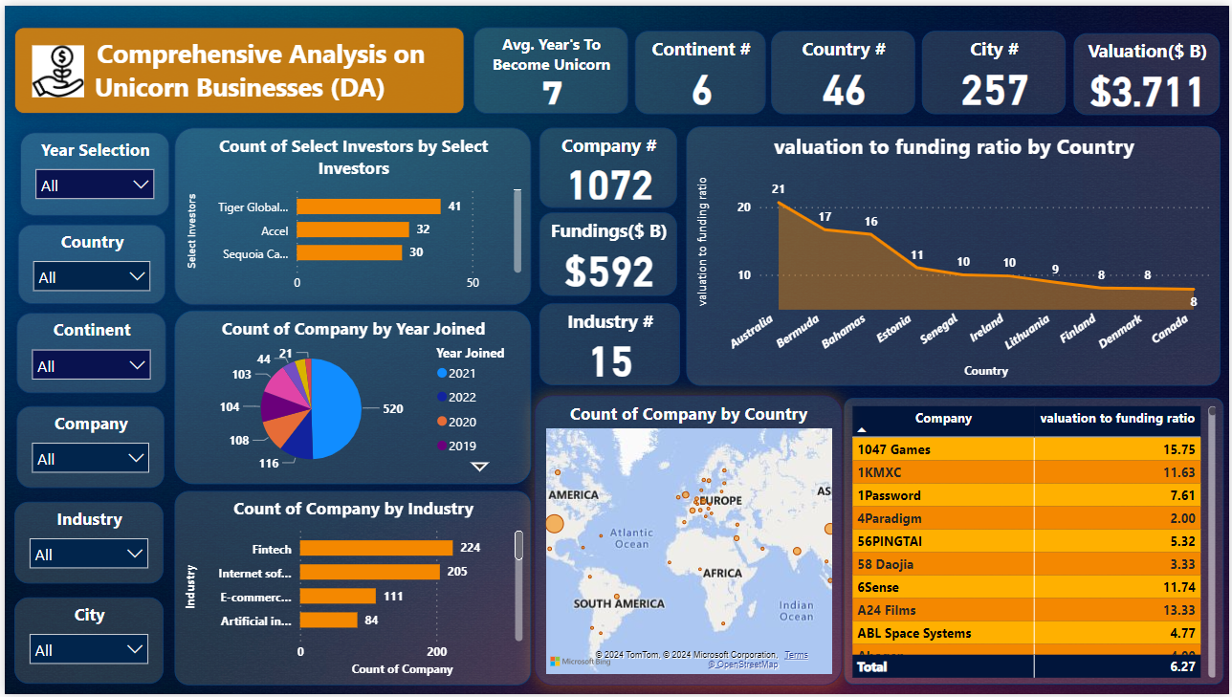
Modelling & Result

Slide 11

Conclusion
"In conclusion, Power BI dashboard provides a comprehensive analysis of the unicorn business landscape. Through visualizations we gained insights.
This dashboard equips actionable insights to make informed decisions and drive strategic initiatives within the unicorn business ecosystem."

Slide 12


Notes:
Thank You !!

