Slide 1



Crop and Fertilizer Recommendation System using Machine Learning

Slide 2

Learning Objectives
Understand the Application of Machine Learning in Agriculture Explore how ML models can assist farmers in making data-driven decisions for crop and fertilizer selection.
Data Analysis and Preprocessing Learn how to handle agricultural datasets, clean data, and extract meaningful features for model training.
Implement Classification Algorithms Build and train ML models such as Random Forest for classifying suitable crops and fertilizers based on soil and environmental parameters.
Develop a Real-Time Recommendation System Create an interactive web application using Streamlit to deliver crop and fertilizer suggestions based on user inputs.
GOAL
Source :
www.freepik.com/

Slide 3
Tools and Technology used
1. Programming Language
Python: Used as the primary language for developing machine learning models and the web application interface.
2. Machine Learning & Data Processing
Scikit-learn: For building models like Random Forest Classifier, preprocessing, and evaluation metrics.
Pandas & NumPy: Efficient data manipulation, analysis, and numerical computations.
LabelEncoder & StandardScaler: Used for encoding categorical variables and feature scaling.
3. Web Application Development
Streamlit: Used to build an interactive, user-friendly web application for real-time crop and fertilizer recommendations.
4. Data Visualization
Matplotlib: To generate basic plots like line, bar, and scatter plots.
Seaborn: Used for creating advanced and aesthetic statistical visualizations like heatmaps and correlation matrices.
5. Data Sources
CSV Files: Agricultural datasets including crop details, fertilizer usage, and production statistics were used as inputs.
Kaggle Datasets: Reliable and publicly available datasets sourced from Kaggle.

Slide 4
Methodology
Data Collection & Preprocessing
Gathered crop and fertilizer datasets from Kaggle and agriculture repositories.
Cleaned data, handled missing values, and normalized features using StandardScaler.
2. Feature Selection & Model Building
Selected essential features like N, P, K, temperature, humidity, pH, and rainfall.
Built machine learning models using Random Forest Classifier for crop and fertilizer prediction.
3. Model Evaluation
Evaluated models using metrics: accuracy, precision, recall, F1-score, and confusion matrix.
Ensured model reliability through train-test split and performance reports.
4. Web App Development & Deployment
Built an interactive app using Streamlit with separate tabs for crop and fertilizer recommendations.
Deployed on Streamlit Cloud for easy farmer access.

Slide 5
Problem Statement:
Lack of Awareness: Many farmers are unaware of which crop is best suited for their land's specific conditions.
Fertilizer Misuse: Incorrect fertilizer usage (type and quantity) often results in poor crop growth and soil degradation.
Unpredictable Income: Farmers lack accurate tools to estimate potential earnings from crop selection.
Traditional Methods: Most decisions are still made based on outdated practices and guesswork.
No Personalized Guidance: Existing systems don’t offer personalized recommendations based on current soil and weather conditions.
Data Not Utilized: Available agricultural data is not effectively leveraged to improve decision-making.
Low Efficiency: This leads to inefficient farming practices and lower agricultural productivity.
Environmental Impact: Overuse or misuse of fertilizers and poor crop planning can cause long-term environmental damage.

Slide 6
Solution:
📈 Data-Driven Recommendations
Uses real-time environmental data (NPK levels, temperature, humidity, pH, rainfall) to suggest the most suitable crop for a given region.
🌿 Fertilizer Guidance
Recommends the ideal fertilizer based on soil nutrient deficiencies using machine learning models.
🧠 ML-Powered Prediction
Utilizes Random Forest Classifiers for high-accuracy crop and fertilizer prediction.
📉 Market Insight (Agmarknet Integration)
Provides real-time market prices for selected crops via a live API scraping module.
🗺️ Region-Specific Planning
Shows crop seasons and estimated income using past production data, tailored to state and crop.

Slide 7
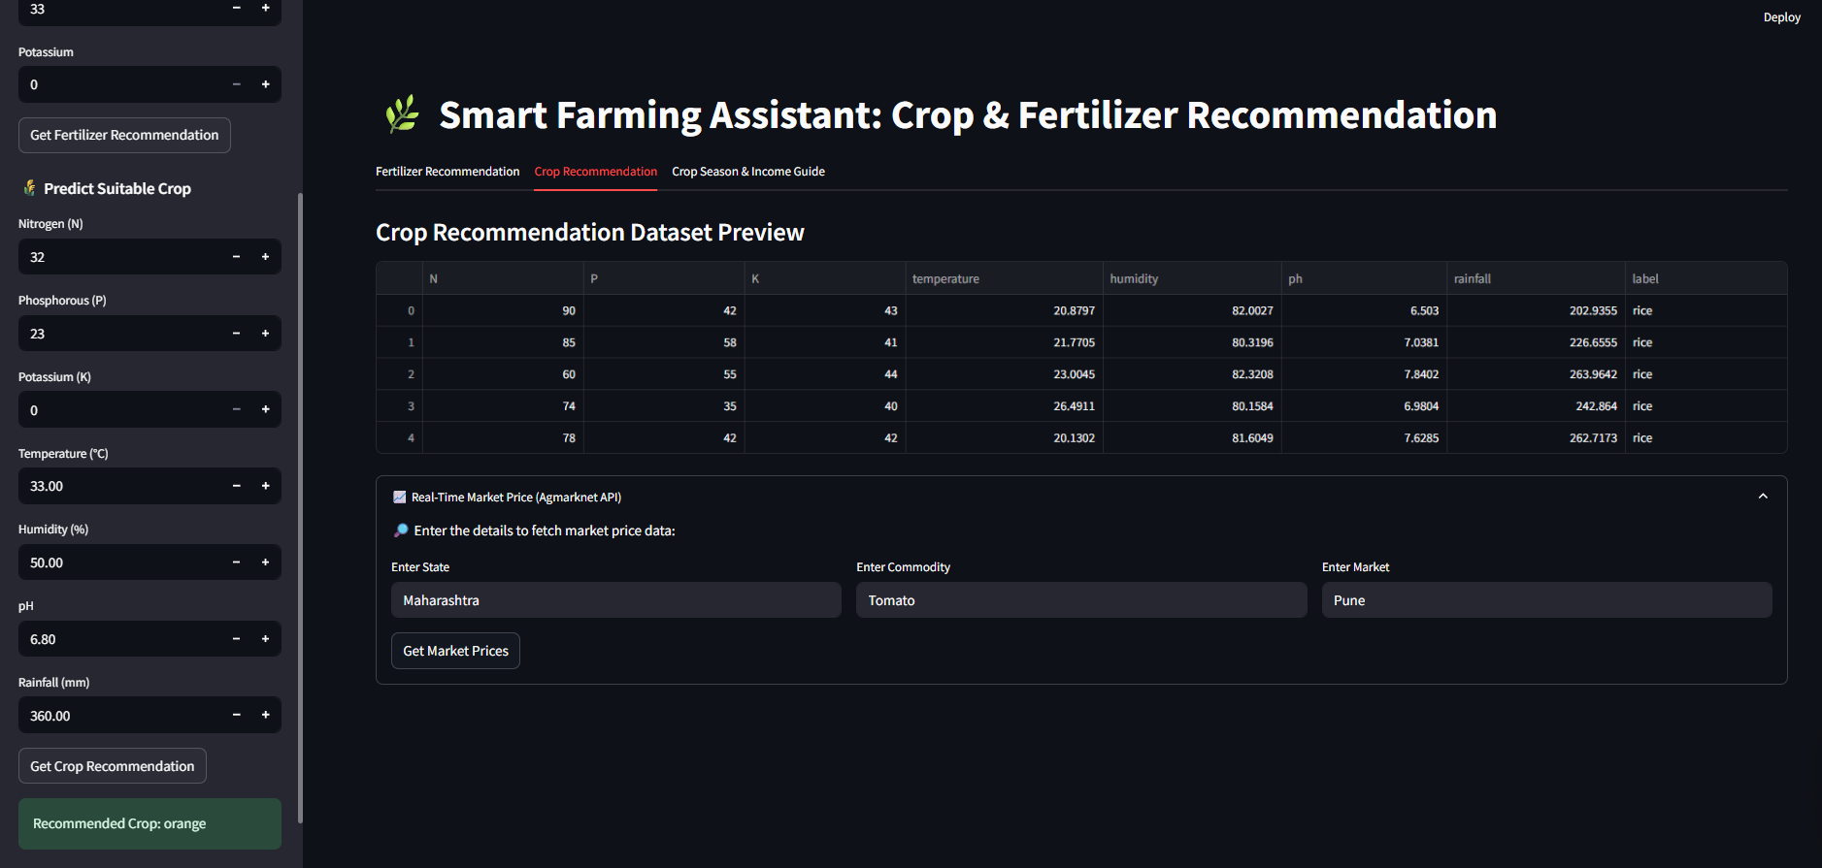
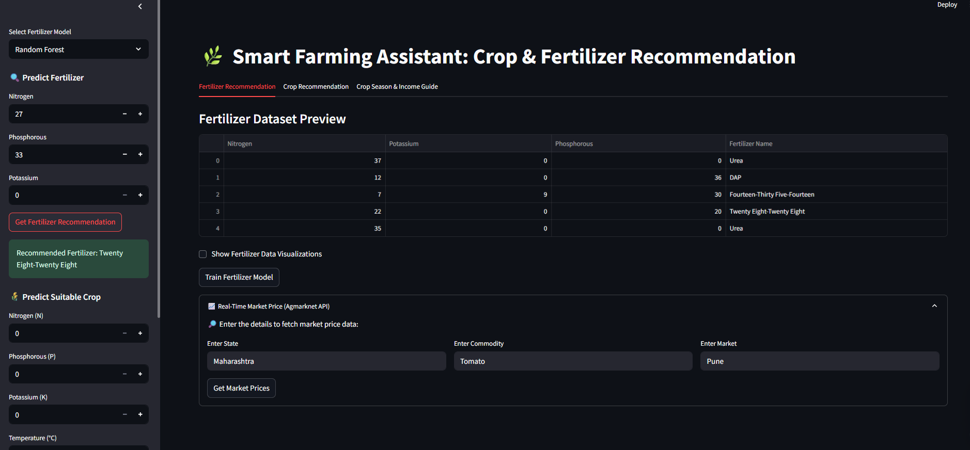
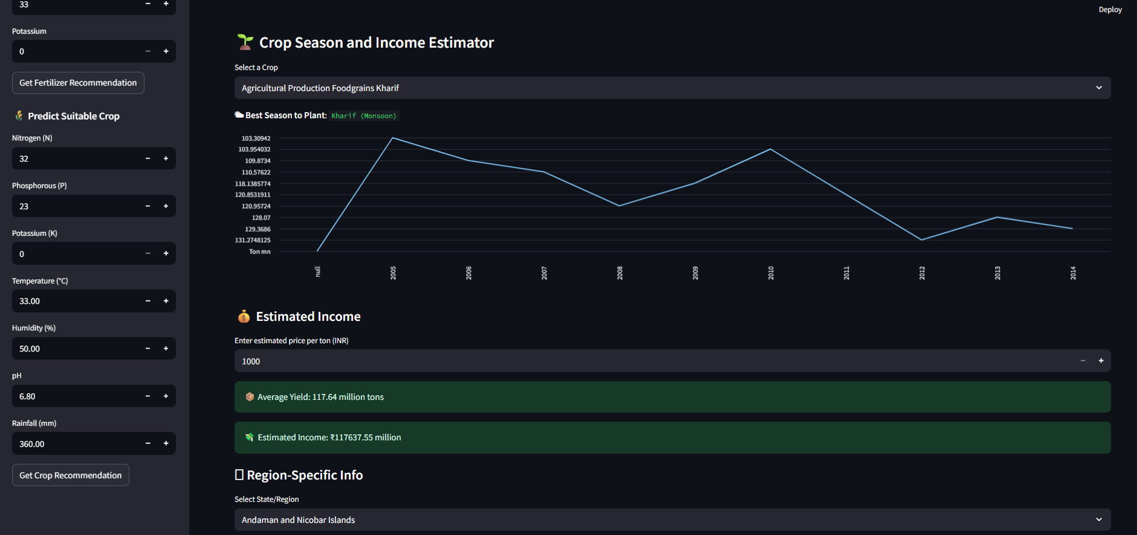
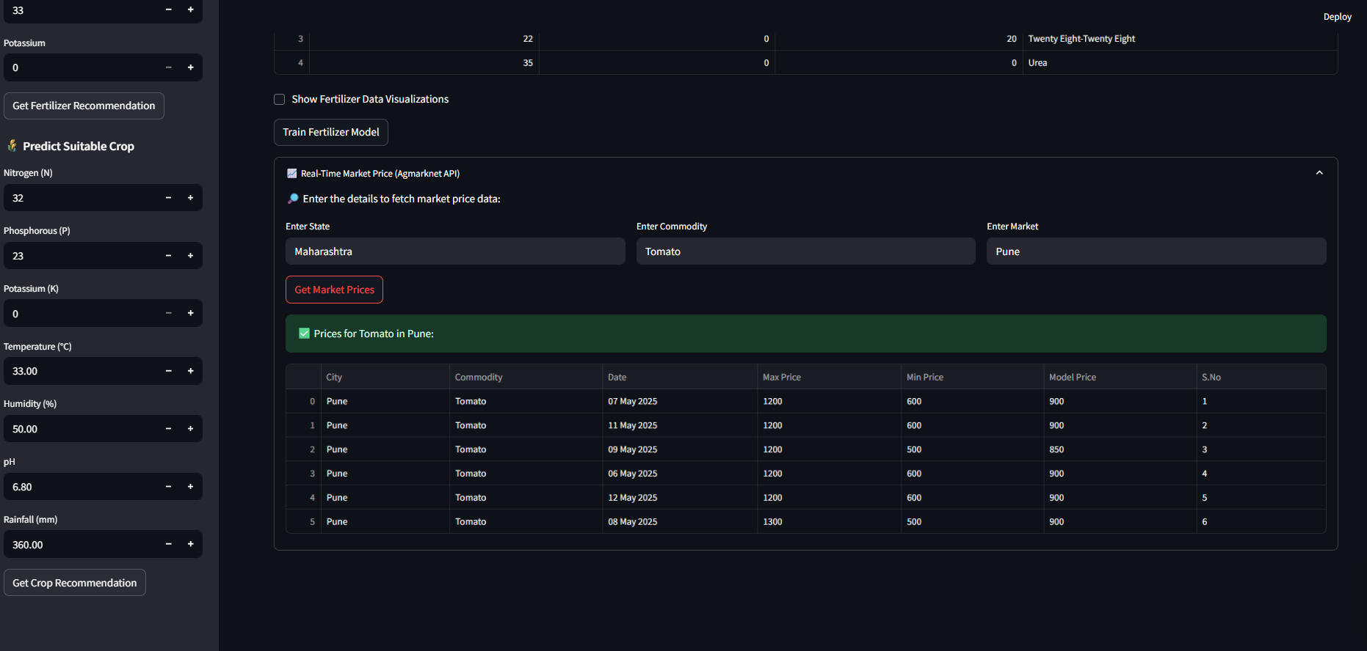
Screenshot of Output:
FERTILIZER
CROP
INCOME
MARKET

Slide 8
Conclusion:
Our system provides accurate crop and fertilizer recommendations using machine learning algorithms.
It helps farmers select the most suitable crop based on soil and environmental parameters.
The fertilizer module ensures nutrient balance by suggesting ideal NPK compositions.
Integration with real-time market price data (Agmarknet) gives farmers market awareness and helps in planning.
The region-specific module provides seasonal suitability and income estimations for crops in different states.
The system is designed to be scalable, user-friendly, and adaptable to various agricultural conditions.
This project supports the goal of smart and sustainable agriculture using data science and technology.

