Slide 1
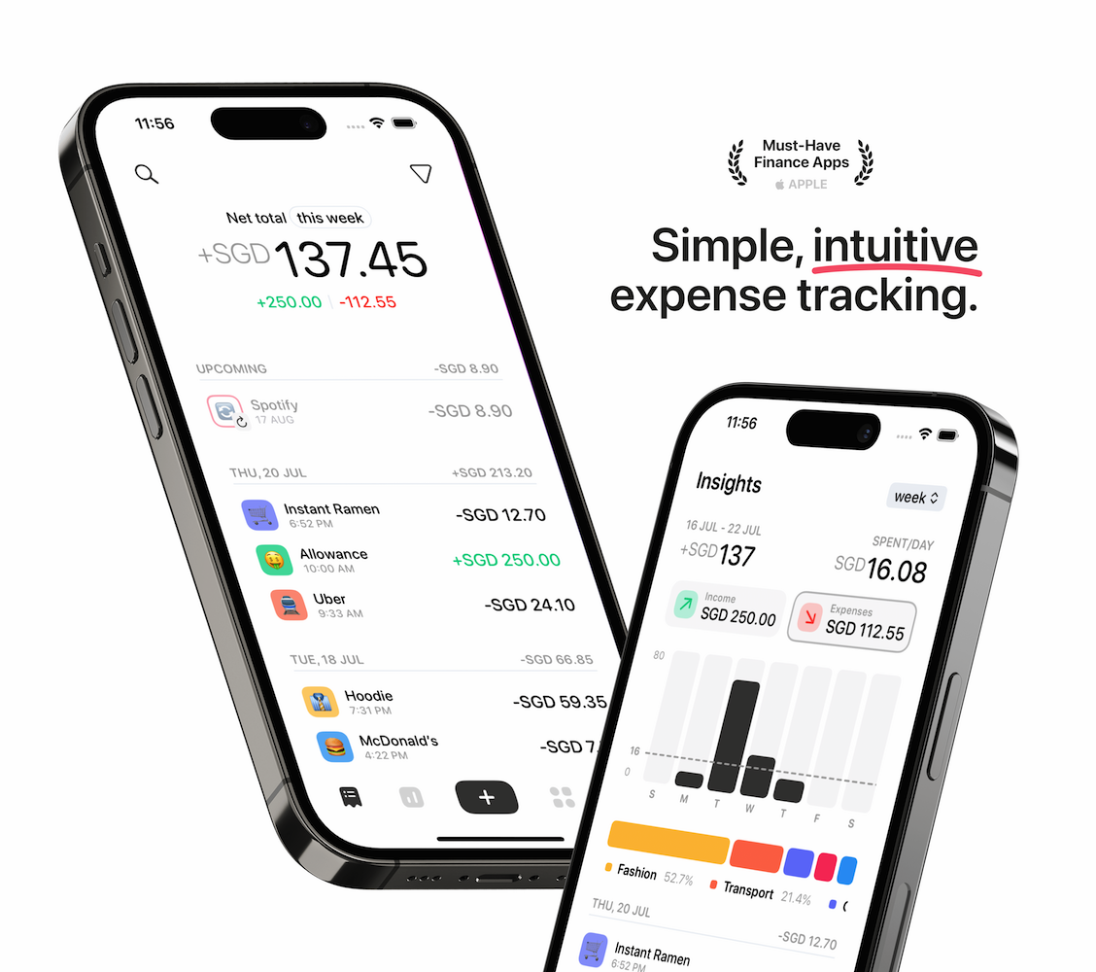
iOS · SwiftUI · Open Source
WalletWise
A simple, intuitive budget & expense tracker for iPhone
Presented by
Vedant Jagdale & Harleen Kaur
Notes:
Introduce WalletWise: a 100% free, open-source personal finance app for iOS built with SwiftUI.

Slide 2
Why WalletWise?
Most budgeting apps hide core features behind subscriptions and ads. WalletWise doesn't.
100%
0
3
GPL-3
Free forever
Trackers or ads
Languages
Open source
No paywall, no ads
Data stays on device + your iCloud
English, French, Russian
Anyone can read, fork, contribute
Built around Apple's Human Interface Guidelines — simplicity at its core.
Notes:
Motivation: expense trackers are either paid, cluttered, or ad-supported. WalletWise's goal is a beautiful, native-feeling tracker that is completely free and open source (GNU GPL v3).

Slide 3








Key Features
Blazing-fast input
Insights
Custom number pad logs an expense in seconds
Spending breakdowns by week, month and year
Budgets
Recurring expenses
Per-category and overall budgets with progress
Custom time frames, auto-logged when due
iCloud sync
Biometric lock
Transactions, categories & budgets across devices
Face ID / Touch ID protects your data
Reminders
Widgets & Siri
Daily nudges to keep your logging streak
Home/lock screen widgets and Shortcuts
Notes:
Walk through the main features. Emphasise fast entry, insights, category budgets, recurring transactions, iCloud sync, biometric authentication, reminders, quick actions and widgets.

Slide 4
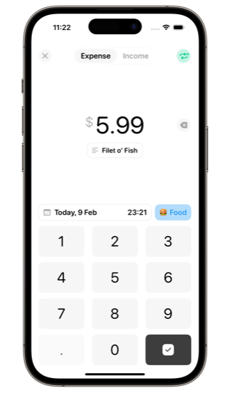
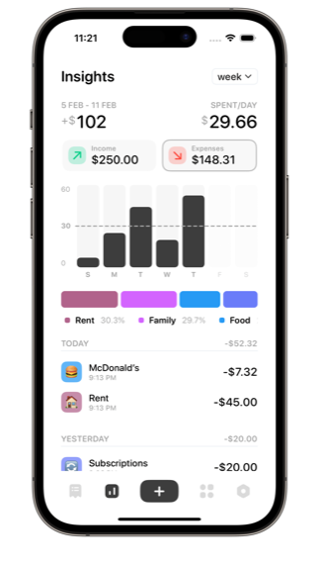
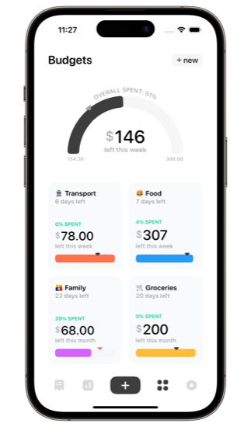
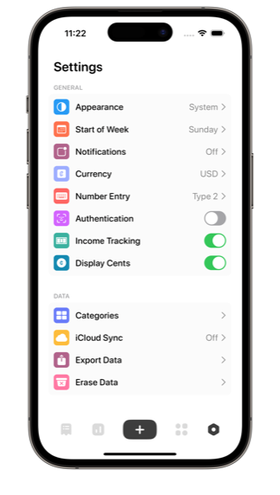
App Tour
Fast Input
Insights
Budgets
Settings
Notes:
Log screen: numeric keypad with category and date picker. Insights: bar chart plus category breakdown. Budgets: gauge showing overall spend and per-category cards. Settings: appearance, currency, authentication, iCloud, export and more.

Slide 5
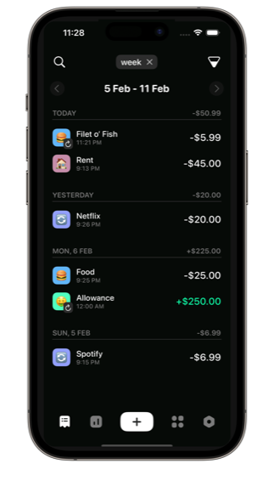
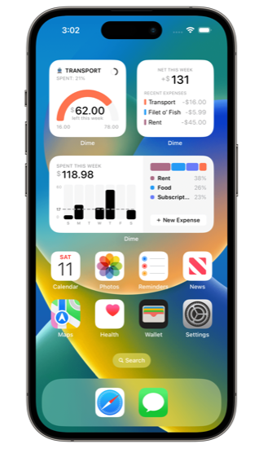
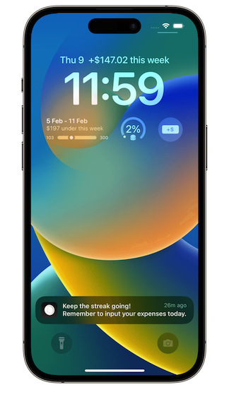


Beyond the App
WalletWise meets users wherever they are on iOS
7 widget types
Budget, insights, recent transactions, templates, new expense, lock screen
Siri & Shortcuts
App Intents: add transactions, get insights & budget status by voice
Quick actions
Long-press the icon to capture a new expense instantly
Dark mode
Home widgets
Lock screen
Notes:
WalletWise extends beyond the main app: a full dark theme, seven WidgetKit widgets for home and lock screen, Siri / Shortcuts integration via App Intents and SiriKit intents, and home-screen quick actions.

Slide 6
Tech Stack
Native Apple frameworks first, a handful of focused open-source packages
Apple frameworks
Third-party packages (SPM)
SwiftUI
Entire UI layer
Core Data
Local persistence
Alamofire
CloudKitSyncMonitor
ConfettiSwiftUI
CrookedText
SwiftUI Introspect
IsScrolling
Popovers
CloudKit
iCloud sync
WidgetKit
Home & lock widgets
App Intents / SiriKit
Siri & Shortcuts
LocalAuthentication
Face ID / Touch ID
UserNotifications
Reminders
Core Haptics
Tactile feedback
Notes:
Language: Swift. UI is 100% SwiftUI. Data is stored with Core Data and synced using NSPersistentCloudKitContainer. Extensions use WidgetKit and Intents. Dependencies are managed with Swift Package Manager.

Slide 7

Architecture
Four Xcode targets share one Core Data store through an App Group
WalletWise
Main SwiftUI app
ExpenditureWidget
WidgetKit extension
BudgetIntent
Siri intent handler
BudgetIntentUI
Siri response UI
DataController · Core Data shared SQLite store in an App Group container
iCloud · CloudKit private database
Notes:
The app, widget extension and Siri intent extensions all read and write the same Core Data store placed in a shared App Group container. NSPersistentCloudKitContainer mirrors it to the user's private iCloud database, and persistent history tracking keeps every process in sync.

Slide 8
Data Model
Core Data entities — every record belongs to a Category
Transaction
Category
Budget
amount, note
date, day, month
income: Bool
recurringType
recurringCoefficient
name, emoji, colour
income: Bool
order
amount
type (week/month…)
startDate
green
TemplateTransaction
MainBudget
amount, note
income, order
recurringType
amount, type
startDate
(overall budget)
1 Category → many Transactions · Templates and 1 Category ↔ 1 Budget
Notes:
Category is the hub: it has a one-to-many relationship with Transaction and TemplateTransaction, and a one-to-one with Budget. MainBudget stores the overall spending limit. Recurring behaviour is modelled with recurringType plus a coefficient (e.g. every 2 weeks).

Slide 9
Project by the Numbers
~28k
93
4
lines of Swift
Swift source files
Xcode targets
99
7
3
commits since Aug 2022
home & lock widgets
localisations
Notes:
Numbers measured from the repository: about 28,000 lines across 93 Swift files, 4 build targets, 99 commits since the first commit on 30 August 2022, 7 widget types and 3 languages (English, French, Russian).

Slide 10




Challenges & Learnings
Sync across processes
Capabilities & signing
App, widgets and Siri write to one store — needed App Groups, persistent history tracking and automatic merging.
iCloud and App Groups need a paid developer account; building locally meant temporarily switching to a plain NSPersistentContainer.
Number entry edge cases
Open-source collaboration
Fixed bugs like deleting after typing a decimal point (#40) — small input details matter in a finance app.
Issues, forks and pull requests from the community shape the roadmap.
Notes:
Discuss what was hard: keeping data consistent between the app and its extensions, dealing with entitlements for iCloud/App Groups when building without a paid account, polishing the number pad, and working in an open-source workflow.

Slide 11
Future Scope
01
More platforms
iPad-optimised layouts, macOS and Apple Watch companion
02
Smarter insights
Trends, forecasts and savings goals
03
More languages
Grow beyond English, French and Russian
04
Richer import / export
Bank CSV mapping and multiple currencies per account
Notes:
Possible next steps for the project. Adjust this list to match your own plans or contributions.

Slide 12
Thank you
Questions?
Vedant Jagdale & Harleen Kaur
github.com/VedantJagdale1/Dime
Notes:
Thank the audience and open for questions. Share the GitHub link: github.com/VedantJagdale1/Dime

