Slide 1
Embedded Systems Project
Link to Project: https://www.tinkercad.com/things/61KmA3HK3pR-copy-of-fabulous-tumelo/editel
PROJECT NAME : WOMEN SAFETY

Slide 2
Problem Statement
In homes, on streets, in public transports and even offices, women are in a constant state of vigilance, like a country on terrorist alert.
There have been grotesque cases of rapes of toddlers, gang rape of eight years old and women trafficking. Construct a device to tackle this situations so that these situations never arises.

Slide 3
Objective
This project is about the simple women safety device developed using Arduino Uno. Women are the backbone of any economy primarily shaping future of the country.
She who earlier stayed at home to attend her domestic duties is now maintaining work and home simultaneously, participating in the process of economic development on an equal footing with men.
In critical situations the women will not feel insecure or helpless if they have a safety device with them. Such a safety device is developed in this project

Slide 4
Working
This basically consists of two parts: 1) Women safety device 2) Parents and friends screen(Acting as mobile phones).
Women safety device is always with the user(women) and has two buttons corresponding to Red and green LEDs. Red LED is used to indicate danger and green LED is used to indicate danger. The status of women safety is conveyed to her parents and friends through SMS which in this case is shown by the LCD screen corresponding to Parents and Friends screen. When device is turned on, green LED is glowing to indicate women is safe and sound. When women feels insecure and in danger, she presses red LED button and a loud noise heard to alert the people around her and try to save that women from danger. When women feels insecure and presses red LED button and later finds that it was her misconception, she has to press the green LED button for certain number of times depending on choice to turn on green LED and turn off both red LED and the buzzer. This is make sure that she is actually safe and has enough time the press the green button for certain number of times and not one time. In nutshell, this project has a very scope in real hardware implementation and ensure safety of women.

Slide 5
Components Used
Component | Quantity
Arduino Uno R3 | 2
Red LED | 1
Green LED | 1
PushButton | 1
Piezo Buzzer | 1
1 k Ohm resistor | 3
10 k Ohm resistor | 2
LCD 16x2 | 1
250 k Ohm Potentiometer | 1
220 Ohm resistor | 1

Slide 6
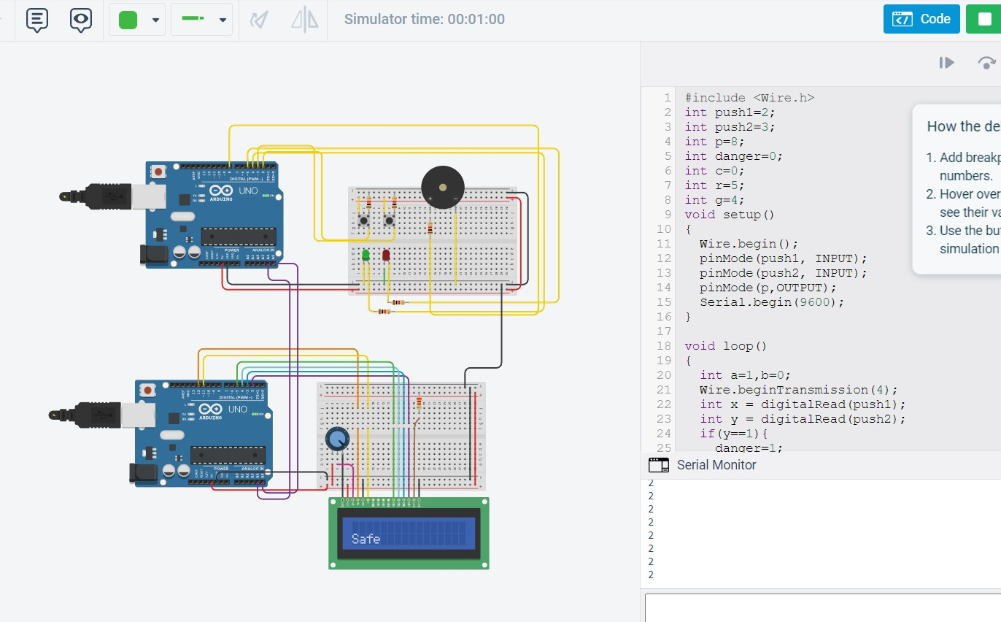
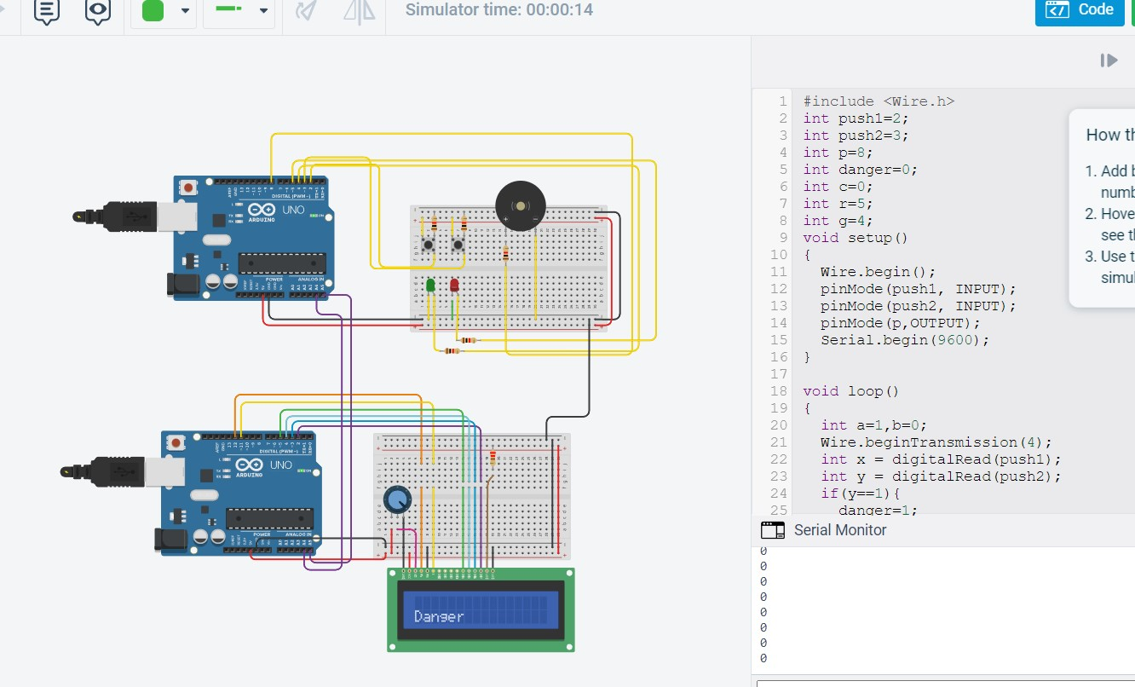
ScreenShots of the Project on TinkerCad

Slide 7
Code Master Arduino(detecting threat):
#include <Wire.h>
int push1=2;
int push2=3;
int p=8;
int danger=0;
int c=0;
int r=5;
int g=4;
void setup()
{
Wire.begin();
pinMode(push1, INPUT);
pinMode(push2, INPUT);
pinMode(p,OUTPUT);
Serial.begin(9600);
}
void loop()
{
int a=1,b=0;
Wire.beginTransmission(4);
int x = digitalRead(push1);
int y = digitalRead(push2);
if(y==1){
danger=1;
c=0;
}
if(x==1){
c++;
delay(200);
}
if(c==2){
danger=0;
c=0;
}
if(danger){
tone(p,1000,200);
digitalWrite(r,HIGH);
digitalWrite(g,LOW);
a=0;
b=1;
}
else{
//tone(p,0,0);
digitalWrite(g,HIGH);
digitalWrite(r,LOW);
a=1;
b=0;
}
Serial.println(c);
Wire.write(a);
Wire.write(b);
Wire.endTransmission();
delay(100);
}

Slide 8
Code Receiver Arduino(with Parents):
#include<Wire.h>
#include <LiquidCrystal.h>
LiquidCrystal lcd(12, 11, 5, 4, 3, 2);
void setup() {
Wire.begin(4);
Wire.onReceive(receiveEvent);
lcd.begin(16, 2);
lcd.print("Starting");
}
void loop() {
delay(100);
}
void receiveEvent(int howMany){
int x=1,y=0;
lcd.clear();
lcd.setCursor(0,1);
while(Wire.available()){
x=Wire.read();
y=Wire.read();
}
if(x==1){
lcd.print("Safe");
}
else if(y==1){
lcd.print("Danger");
}
}

Slide 9
Thank You

