Slide 1
Sentiment Analysis of Amazon Customer Reviews
Business Intelligence Project (FA-II) - Amazon Fine Food Reviews

Slide 2
122B1B122 Aaditesh Kadu 122B1B124 Vedant Kale 122B1B138 Prajwal Khobragade
Group Members
Under Guidance of
Pooja Bidwai Madam

Slide 3
Problem Statement
E-commerce platforms face issues of irrelevant search results, poor recommendations, and negative customer experiences which lead to cart abandonment and reduced sales.

Slide 4
Objective
Use text mining on customer reviews
Classify sentiment (Positive/Neutral/Negative)
Extract common issues and provide BI insights

Slide 5
Web Mining
We Scraped data from amazon website using React and Stored it in the CSV File
The data Included the product info and the reviews associated with it
The code is on github - https://github.com/Aaditesh2307/Amazon-Reviews-Scraper.git

Slide 6
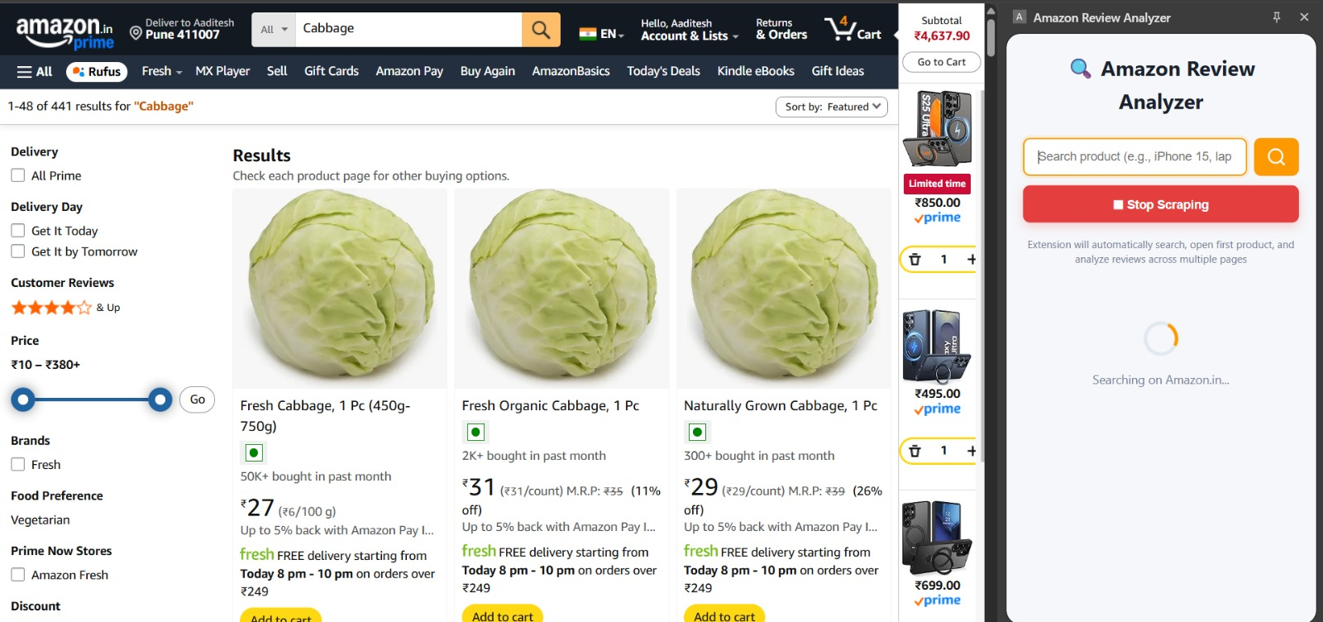
Web Mining Screenshots

Slide 7
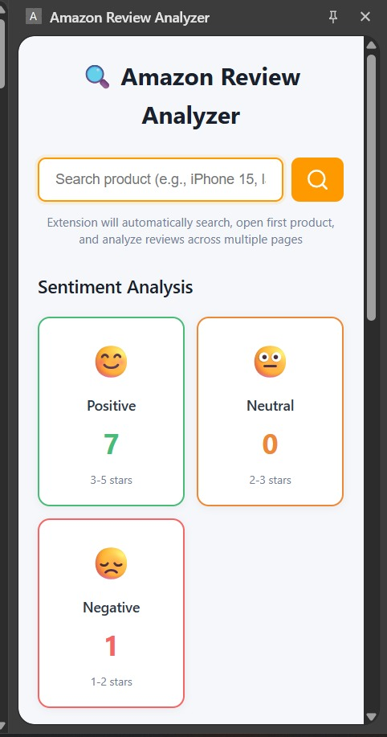
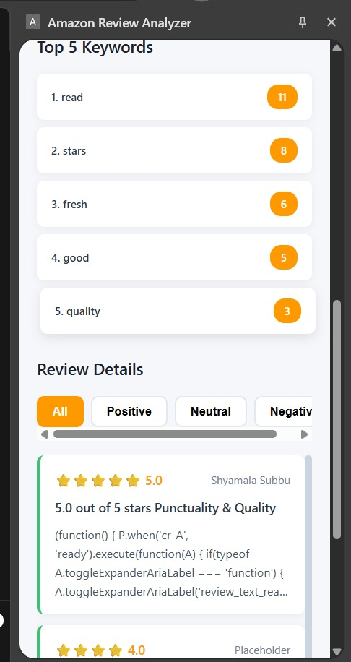
Web Mining Screenshots

Slide 8
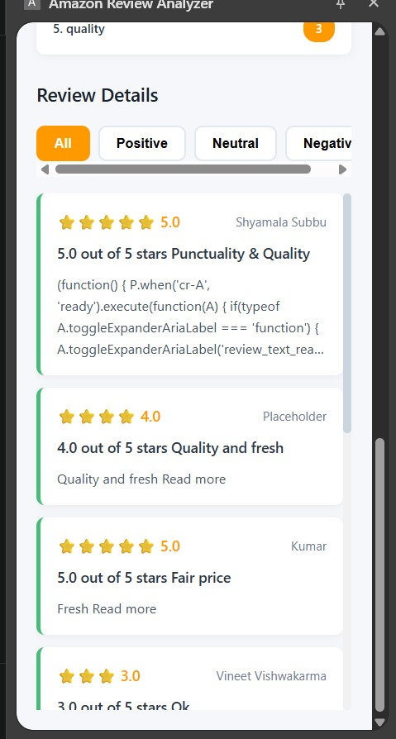
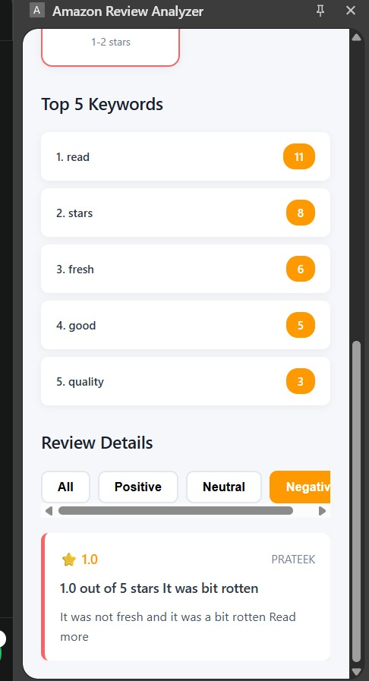
Web Mining Screenshots

Slide 9
Dataset
Amazon Fine Food Reviews (Kaggle)
Fields used: Text, Score, Summary, ProductID
Link - Amazon Fine Food Reviews

Slide 10
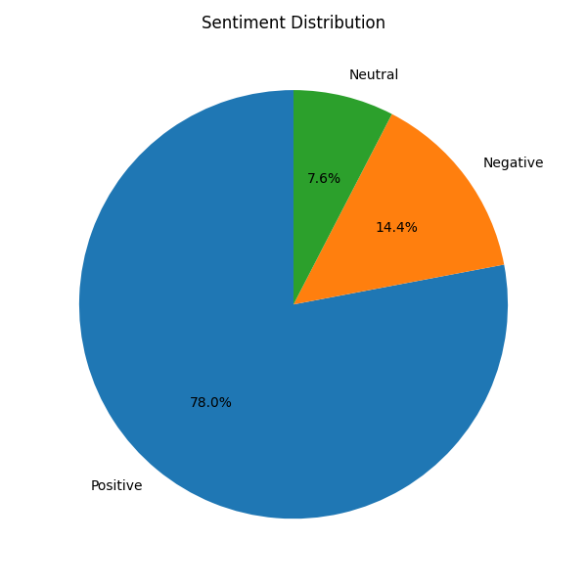
Sentiment Distribution

Slide 11
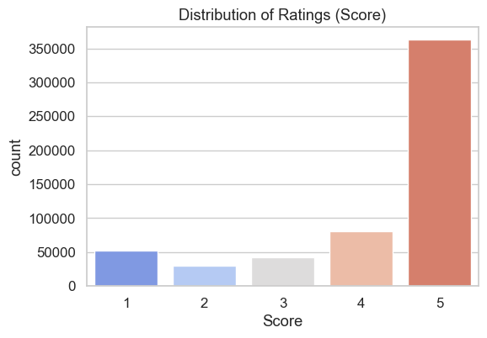
Distribution of Ratings

Slide 12
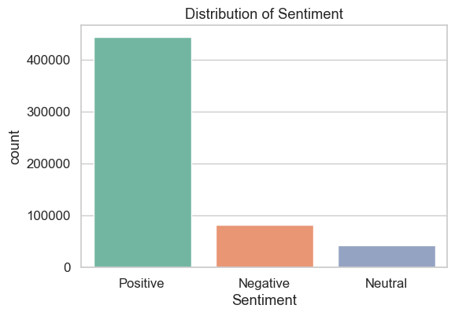
Distribution of Sentiment

Slide 13
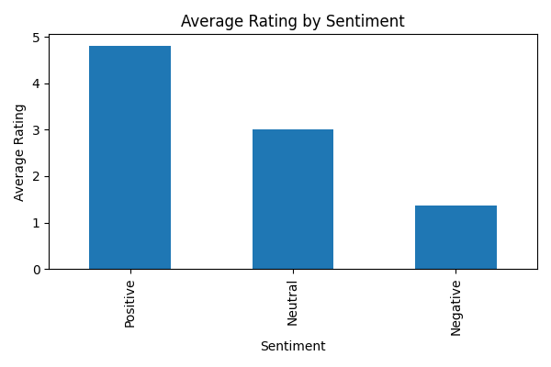
Average Rating by Sentiment

Slide 14
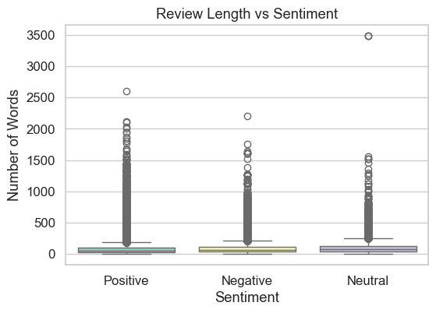
Review Length by Sentiment

Slide 15
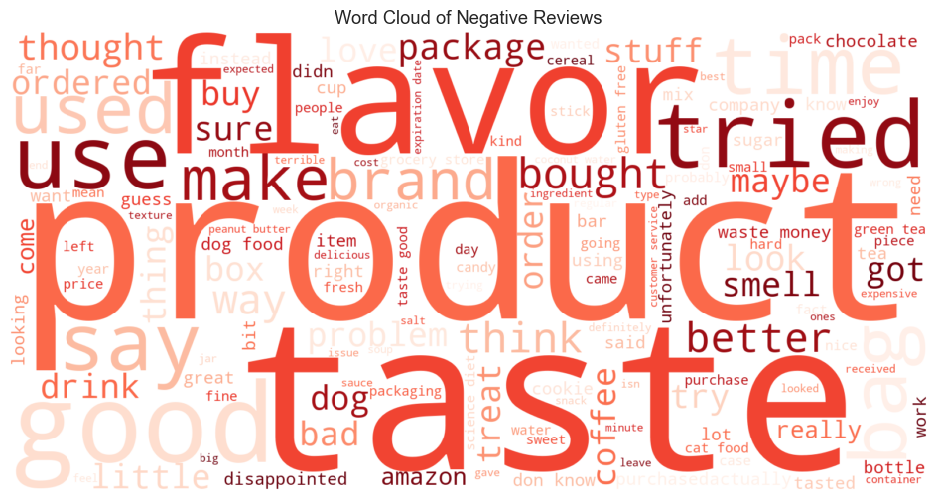
Common Issues in Negative Reviews

Slide 16
Improving Search & Recommendations
Problem: Customers face irrelevant search results and poor product recommendations, leading to a negative experience.
Insight: The vast majority of reviews are positive (78.0%), indicating a strong signal for product quality.
Solution 1: Prioritize and rank products with a higher volume of positive reviews in search results to improve relevance.
Solution 2: Enhance recommendation engines by personalizing suggestions based on a user's past behavior combined with the sentiment of reviews for potential products

Slide 17
Resolving Common Customer Issues
Problem: Negative customer experiences related to product and delivery lead to frustration and lost sales.
Insight: A word cloud analysis of negative reviews shows that common complaints are related to "flavor," "taste," "product," "package," and "box".
Solution: Proactively identify and address recurring issues with product quality (taste/flavor) and fix delivery or packaging problems that are frequently mentioned in negative feedback.

Slide 18
BI Insights
Rank products with positive reviews higher in search
Personalize recommendations using review sentiment + behavior
Fix delivery/packaging issues identified from negative reviews
Monitor sentiment trend to measure improvements

Slide 19
Conclusion & Future Work
Text mining + BI gives actionable insights to improve UX and sales.
Future: Use advanced models (BERT), multilingual analysis, integrate with dashboards.

