Slide 1
Sentiment Analysis of Amazon Customer Reviews
Business Intelligence Project (FA-II) - Amazon Fine Food Reviews

Slide 2
122B1B122 Aaditesh Kadu 122B1B124 Vedant Kale 122B1B138 Prajwal Khobragade
Group Members
Under Guidance of
Pooja Bidwai Madam

Slide 3
Problem Statement
E-commerce platforms face issues of irrelevant search results, poor recommendations, and negative customer experiences which lead to cart abandonment and reduced sales.

Slide 4
Objective
Use text mining on customer reviews
Classify sentiment (Positive/Neutral/Negative)
Extract common issues and provide BI insights

Slide 5
Dataset
Amazon Fine Food Reviews (Kaggle)
Fields used: Text, Score, Summary, ProductID
Link - Amazon Fine Food Reviews

Slide 6
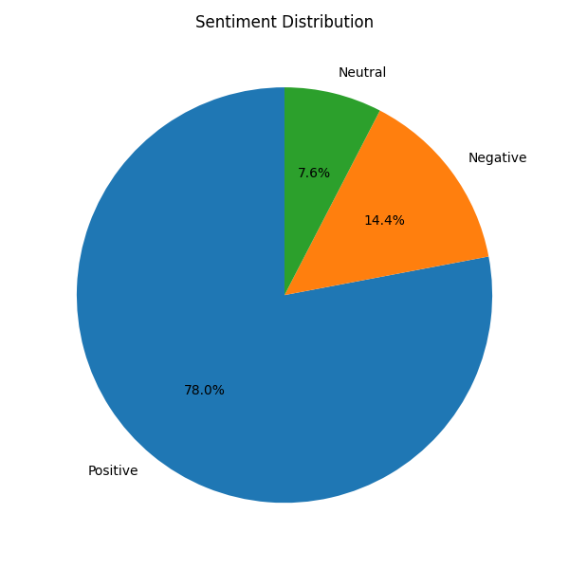
Sentiment Distribution

Slide 7
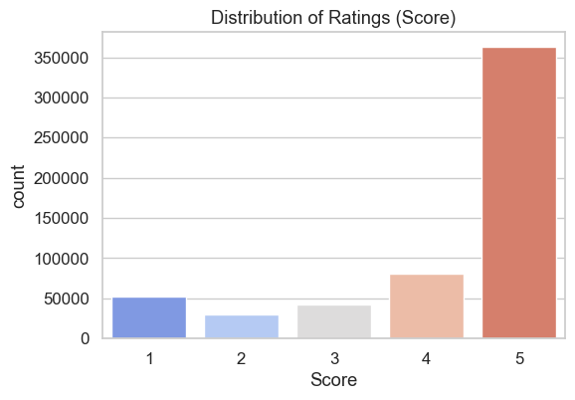
Distribution of Ratings

Slide 8
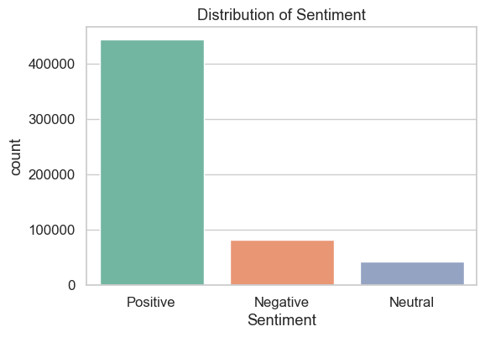
Distribution of Sentiment

Slide 9
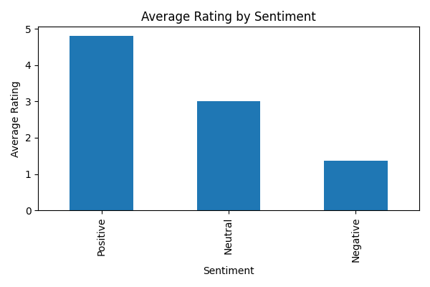
Average Rating by Sentiment

Slide 10
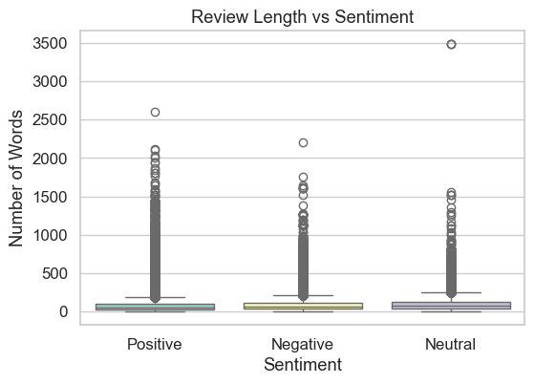
Review Length by Sentiment

Slide 11
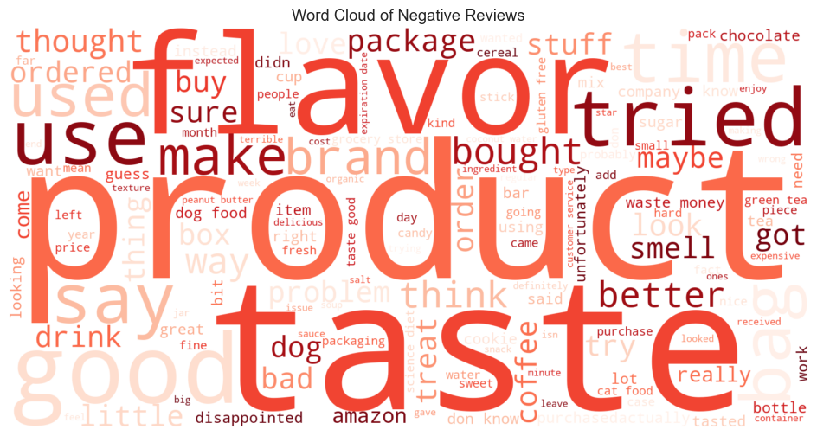
Common Issues in Negative Reviews

Slide 12
Improving Search & Recommendations
Problem: Customers face irrelevant search results and poor product recommendations, leading to a negative experience.
Insight: The vast majority of reviews are positive (78.0%), indicating a strong signal for product quality.
Solution 1: Prioritize and rank products with a higher volume of positive reviews in search results to improve relevance.
Solution 2: Enhance recommendation engines by personalizing suggestions based on a user's past behavior combined with the sentiment of reviews for potential products

Slide 13
Resolving Common Customer Issues
Problem: Negative customer experiences related to product and delivery lead to frustration and lost sales.
Insight: A word cloud analysis of negative reviews shows that common complaints are related to "flavor," "taste," "product," "package," and "box".
Solution: Proactively identify and address recurring issues with product quality (taste/flavor) and fix delivery or packaging problems that are frequently mentioned in negative feedback.

Slide 14
BI Insights
Rank products with positive reviews higher in search
Personalize recommendations using review sentiment + behavior
Fix delivery/packaging issues identified from negative reviews
Monitor sentiment trend to measure improvements

Slide 15
Conclusion & Future Work
Text mining + BI gives actionable insights to improve UX and sales.
Future: Use advanced models (BERT), multilingual analysis, integrate with dashboards.

