Slide 1

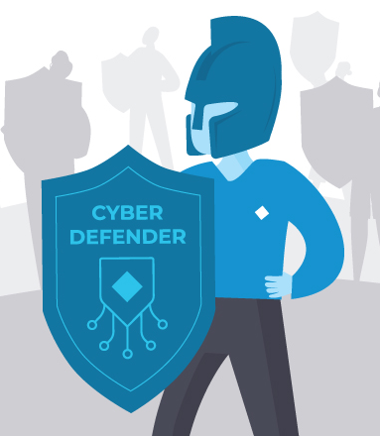
BlueWatch
-Mini SOC Lab
Presented By:
NSK Team

Slide 2
TEAM MEMBERS AND ROLES
TEAM MEMBERS | ROLES TITLE | CORE FUNCTION / FOCUS AREA
Vedant Dipak Kashid | Endpoint Configuration Engineer | Wazuh Agent (Kali Linux) and Local Host Hardening
Gandham Nihash | SIEM Platform Architect | Wazuh Manager, Docker, and Indexing Infrastructure
Meghavardhan | Threat Intelligence & Analysis Lead | Vulnerability Detection (VD) and FIM Data Correlation
Jinukala Abhiram | Network Security Monitoring Specialist | Intrusion Detection System (Suricata NIDS) Integration
Ch.Swapna | Automated Response Engineer (Active Response) | SSH Brute Force Blocking and Incident Mitigation

Slide 3
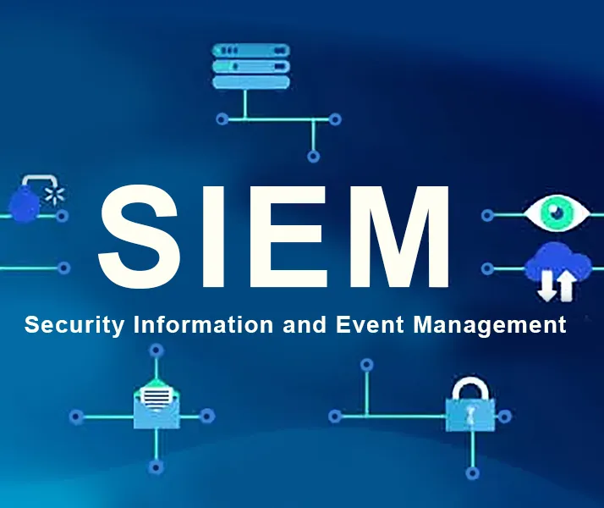
Problem Statement
Modern organizations face increasing cyber threats, but lack affordable and practical SOC environments for real-time monitoring, detection, and analysis.
Full SOC systems require costly SIEM tools, skilled experts, and dedicated infrastructure.
BlueWatch Mini SOC Lab solves this gap using an open‑source, scalable, isolated SOC environment for learning and threat simulation.

Slide 4

What This Project Does
Builds a fully functional Mini SOC environment using Wazuh + ELK.
Collects and analyzes logs from Windows & Kali Linux systems.
Detects cyber threats such as brute-force attacks, malware behavior, and unauthorized access.
Generates real-time security alerts for suspicious activities.
Visualizes events and attack patterns using Kibana dashboards.
Simulates real-world attack scenarios for practical learning.
Provides hands-on experience in SIEM, threat detection, and incident response.

Slide 5
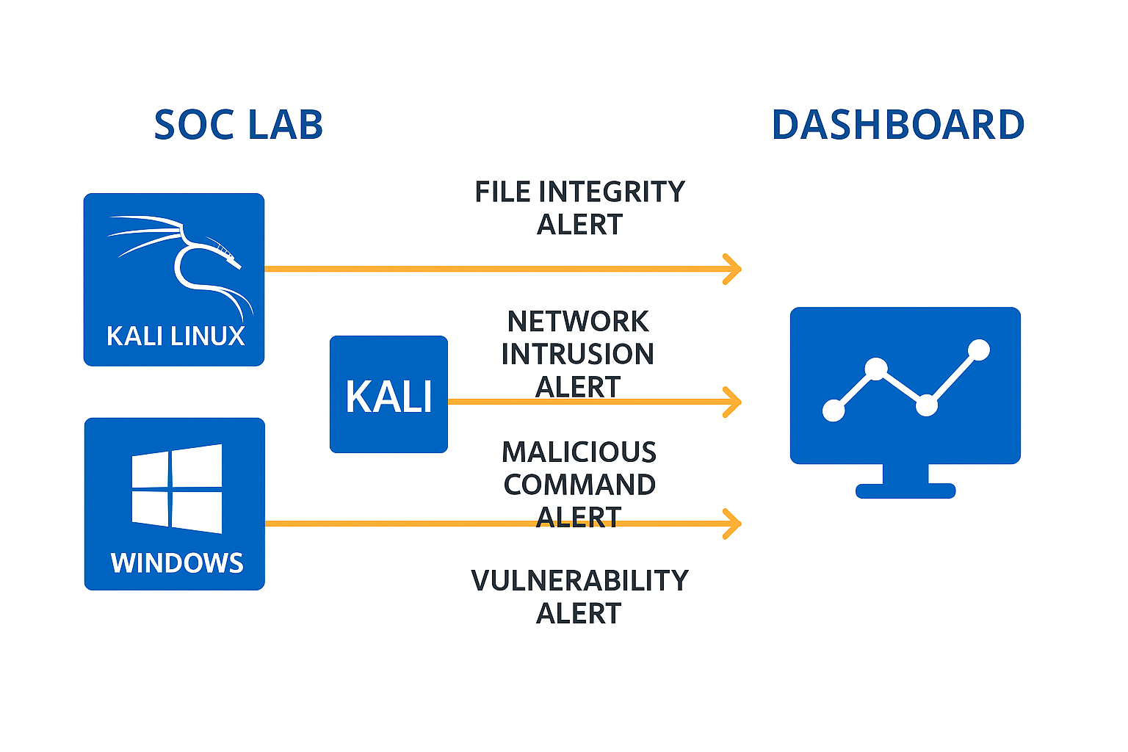
Architecture Overview
Windows + Kali Linux endpoints generate security logs.
Wazuh Agents collect logs and send them to the Wazuh Manager.
Wazuh Manager processes, analyzes, and correlates log data.
Elasticsearch indexes and stores processed events.
Kibana visualizes logs, alerts, and dashboards for SOC analysis.
End-to-end architecture simulates a real SIEM-based SOC workflow.

Slide 6
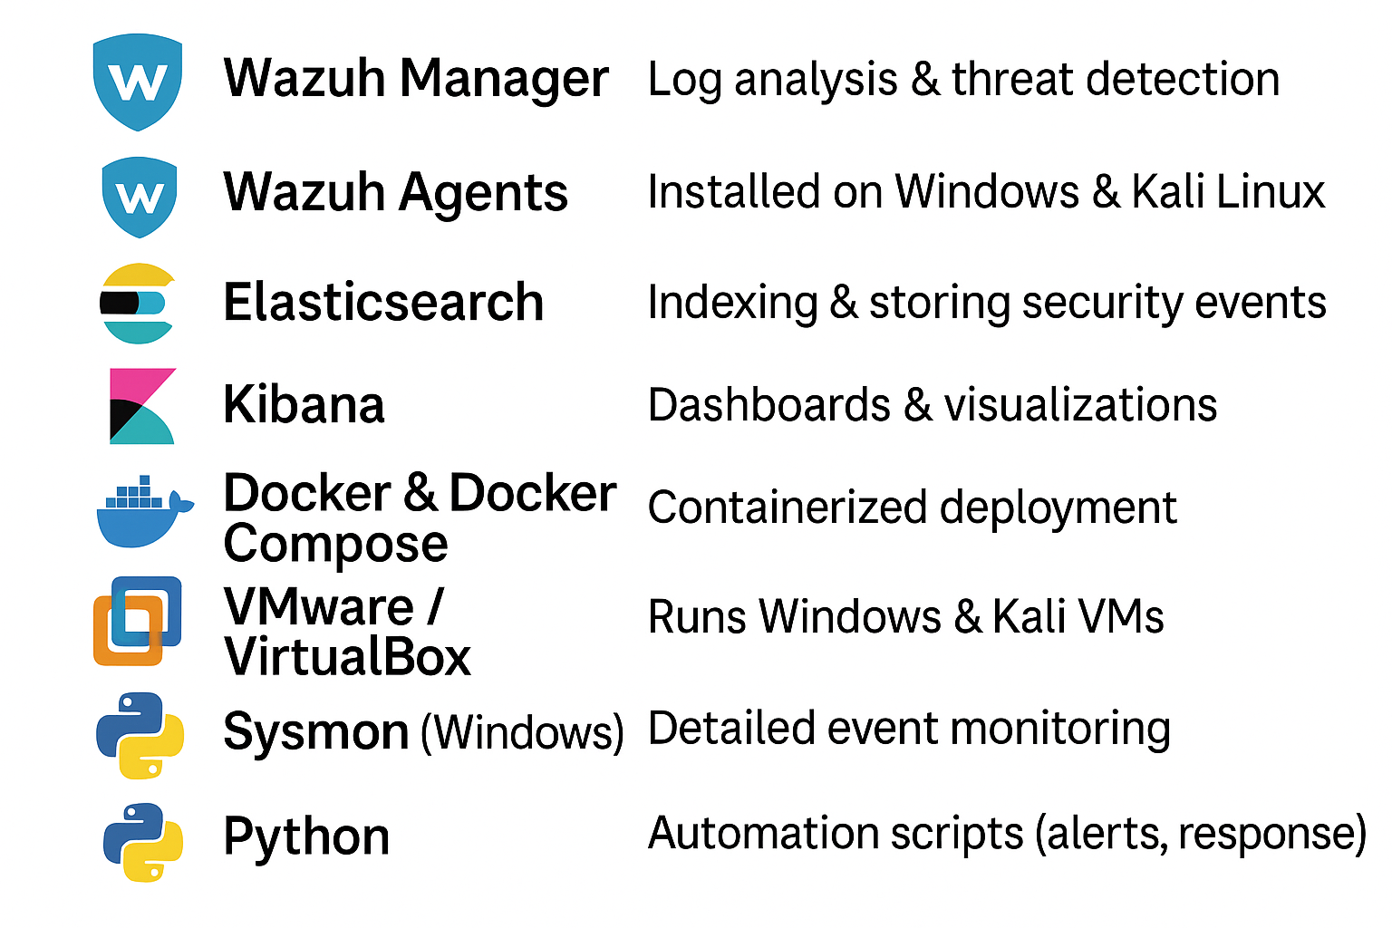
Tools Used

Slide 7
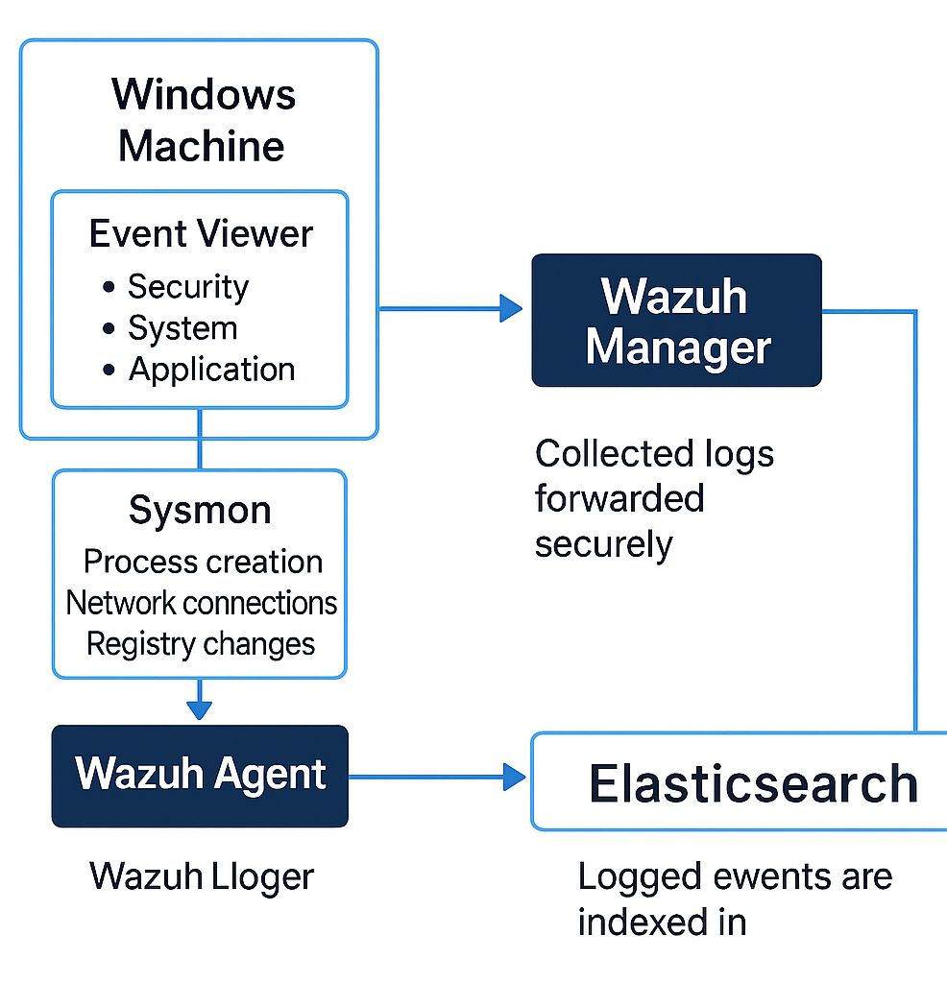
How Windows Logs Are Collected
Wazuh Agent is installed on the Windows machine.
The agent collects logs from Event Viewer (Security, System, Application).
Sysmon provides detailed logs for process creation, network connections, and registry changes.
Collected logs are forwarded securely to the Wazuh Manager.
The manager parses, analyzes, and correlates Windows events.
Logged events are indexed in Elasticsearch and visualized in Kibana.

Slide 8
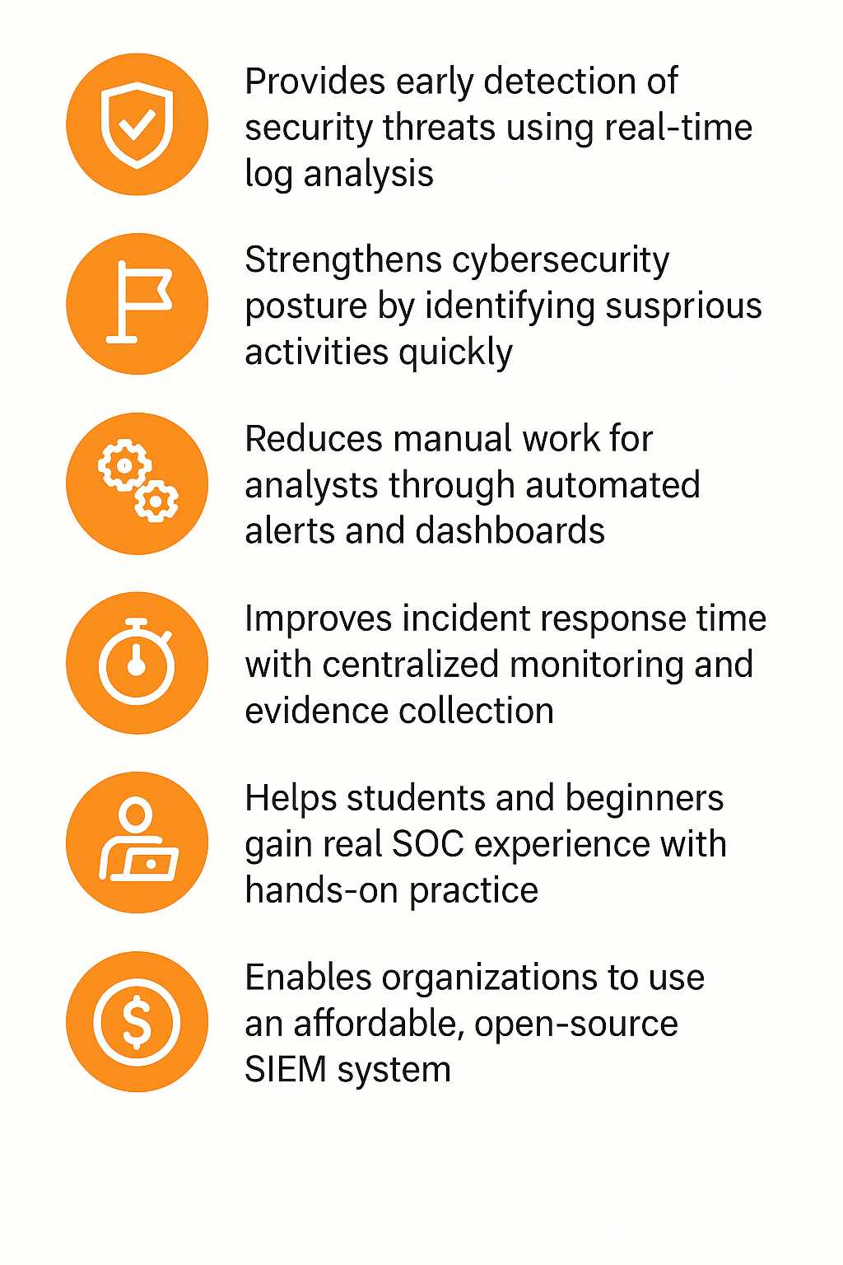
How This Helps

Slide 9

Real-World Impact
Provides early detection of cyberattacks, preventing data breaches.
Reduces financial loss by identifying threats before damage occurs.
Improves SOC team efficiency with automated alerts and log correlation.
Supports compliance with standards like ISO 27001, GDPR, and PCI-DSS.
Enhances cybersecurity training for students and beginners.
Offers a cost‑effective SOC solution for small organizations.

Slide 10
Conclusion
The BlueWatch Mini SOC Lab provides a complete, practical environment for real-time threat monitoring.
It bridges the gap between theoretical knowledge and real-world SOC operations.
Through Wazuh + ELK, users learn log analysis, threat detection, automation, and incident response.
The lab enables safe attack simulation, helping users understand adversary behavior.
This project builds strong foundational skills for SOC Analyst and cybersecurity roles.

Slide 11


THANK YOU

