Slide 1
OPERATING SYSTEMS COURSE PROJECT
SpaceRescue
Disk management that still works when the disk is full
C: 512 MB
free of 292 GB
Vedant · Shreeviraj
October 2026
Disk is full
Notes:
SpaceRescue is a Windows disk manager built for the moment the system drive is full. At that moment Windows updates fail, apps crash, and most disk tools also fail because they need disk space and memory themselves. Our tool scans fast, explains what is safe to remove, and writes nothing to the full drive. It also shows the operating-system internals behind disk space: clusters, the MFT, extents and slack.

Slide 2
Agenda
01
Introduction
07
Built for 0 bytes free
02
Problem statement
08
Algorithms
03
Gaps in Windows tools
09
Methodology and architecture
04
Use cases and objectives
10
The product
05
Related work
11
Results
06
OS concepts in our code
12
Conclusion
SpaceRescue · OS Course Project
2
Notes:
We start with the problem and why Windows' own tools do not solve it, then the users we designed for. The middle of the talk is the operating-systems content: file systems, concurrency, memory and scheduling, each tied to our code. Then algorithms, architecture, the product itself, measured results and an honest conclusion.

Slide 3
Introduction

What the OS sees

What the user sees
Clusters, extents and a free-cluster count
An MFT record for every file
Exact bytes allocated on disk
“Low disk space”
No idea which folders grew
No idea what is safe to delete
SpaceRescue connects the two: it reads what the OS knows and explains it in plain words.
SpaceRescue · OS Course Project
3
Notes:
Underneath, Windows knows exactly where every byte is: NTFS keeps a record per file in the Master File Table, and the volume tracks free clusters. The user only gets a red bar in Explorer. SpaceRescue reads the same structures the OS uses and turns them into answers a person can act on safely.

Slide 4
Problem statement
C: has 512 MB free. A Windows update fails, apps start crashing, the user opens a disk tool…


The tool needs space too

Scanning takes minutes

Nothing says what is safe
Temp files, logs and RAM. The pagefile can't grow on a full disk.
Our first prototype: 289 s for C: with a cold cache.
Users delete the wrong files or give up.
Impact: failed updates, crashing apps, lost work.
SpaceRescue · OS Course Project
4
Notes:
This is the scenario we designed around. With almost no free space, Windows itself becomes unstable. Disk tools make it worse: they write temp files, caches and settings, and they need memory exactly when the pagefile cannot grow. Our own first prototype needed 289 seconds to scan C: from a cold cache, measured on the test laptop. And no tool tells the user what is safe to remove, so people delete the wrong things.

Slide 5
Gaps in Windows’ built-in tools
Feature | Explorer Properties | Settings Storage | Disk Cleanup | Disk Mgmt | Optimize Drives | Space Rescue
Shows where space went | ~ | ~ | ✗ | ✗ | ✗ | ✓
Visual map of the disk | ✗ | ✗ | ✗ | ✗ | ✗ | ✓
Works at 0 bytes free | ✓ | ✓ | ✓ | ✓ | ~ | ✓*
Safe review + undo | ~ | ~ | ~ | ✗ | ✗ | ✓
Finds app and dev caches | ✗ | ~ | ✗ | ✗ | ✗ | ✓
Explains system files | ✗ | ~ | ~ | ✗ | ✗ | ✓
Early low-space alerts | ✗ | ~ | ✗ | ✗ | ✗ | ✓
Shows disk internals | ~ | ✗ | ✗ | ~ | ~ | ✓
✓ yes ~ partly ✗ no * zero-write design; 0-byte VHDX test pending
SpaceRescue · OS Course Project
5
Notes:
Rows are features, columns are the Windows 11 tools a user would try. Explorer's folder Properties gives one folder's size at a time. Settings > Storage shows categories and can clean temporary files; Storage Sense can run when space is low, so alerts are 'partly'. Disk Cleanup removes a fixed list of categories without undo. Disk Management shows partitions and Optimize Drives shows fragmentation percentage, which is why they get 'partly' for internals. The gap we close: none of them shows where space went at file level with a safe, undoable cleanup and warnings before the disk is full. Our 'works at 0 bytes' is a design property; the 0-byte VHDX test is still pending.

Slide 6
Use cases (1/2)

Student, 512 MB free

Developer
Rescue Mode releases the reserve file; quick wins show in 3 s.
node_modules, Gradle, pip and WSL disks grouped by project and last opened.

Gamer

“pagefile.sys is 7.8 GB?”
Steam shader cache, unfinished downloads and Epic web cache, each reviewable.
Lock badge, plain explanation, and the safe Windows setting.
SpaceRescue · OS Course Project
6
Notes:
Every scenario on this slide is supported by the current build. The student case is the core one: Rescue Mode turns on below 1 GB or 2% free, and the quick-win pre-scan answers in about three seconds. Developer caches are found by a rule table plus folder rules like node_modules next to package.json. System files such as pagefile.sys get a lock and the safe Windows tool instead of a delete button.

Slide 7
Use cases (2/2)

Disk filling for weeks

Deleted the wrong thing
Quiet alerts at 50, 20, 10, 5, 3, 2, 1 GB and 512 MB.
Undo from the toast; quarantine keeps a verified copy on another drive.

Second drive or USB stick

Right-click a folder
Work volume holds quarantine and logs; portable mode runs from USB.
“Analyze with SpaceRescue” scans just that folder (built, untested on a clean PC).
SpaceRescue · OS Course Project
7
Notes:
Every scenario on this slide is supported by the current build. Alerts run in a 1.6 MB tray process with hysteresis so they do not repeat. Quarantine copies to another drive, checks the size, then deletes, and can be undone. The Explorer right-click entry is implemented in setup.cpp but we have not yet tested it on a clean machine, so we say so.

Slide 8
Thinking from the user’s side




Notice
Understand
Act safely
Stay safe
Tray alert before the disk is full
Where space went, in seconds
Review list, quarantine, undo
Reserve file, next alert armed
Alerts only on the way down
Answers stream during the scan
Delete is never one click away
Nothing written to the full drive
Top: what the user does. Bottom: the design rule it forced.
SpaceRescue · OS Course Project
8
Notes:
We designed the flow from the user's side. First they notice, through a quiet tray alert, before the disk is full. Then they understand where space went; that is why results stream while the scan runs. Then they act, but only through a review list with confirmation and undo, never a one-click delete from the dashboard. Finally they stay safe: the reserve file can be re-created and the next alert re-arms only after space recovers.

Slide 9
Our solution
PROBLEM
SPACERESCUE

The tool needs space and RAM

Zero-write Rescue Mode + 512 MB reserve file

Scanning takes minutes

8-thread scan of C: in 8.2 s; first answer in 3 s

Nothing says what is safe

Safety badges, review list, quarantine and undo

System files look scary

Lock badge + safe Windows tool, never Delete

No warning until it’s full

Tray alerts at 50, 20, 10, 5, 3, 2, 1 GB, 512 MB
One tool, one flow: notice → understand → act safely → stay safe.
SpaceRescue · OS Course Project
9
Notes:
This is our answer to every problem we raised. Because the tool itself needs space and memory, Rescue Mode writes nothing to the full drive and can hand back a 512 MB reserve file instantly. Because scanning took minutes, the scanner now uses eight threads and finishes C: in 8.2 seconds, with a first answer after three seconds. Because users don't know what is safe, every item carries a safety badge and every action can be undone. System files get a lock and the Windows tool that shrinks them safely, and tray alerts warn long before the disk is full.

Slide 10
Objectives
01
Rescue
02
Fast scan
03
Explain
Work at 0 bytes free: zero writes to the full drive
Useful answer in seconds; full C: well under a minute
Say what each big item is and whether it is safe
04
Clean safely
05
Warn early
06
Teach internals
Review, quarantine, compress; undo every step
Alerts at fixed thresholds with hysteresis
Clusters, slack, extents and MFT on your own disk
SpaceRescue · OS Course Project
10
Notes:
Six objectives drove the work. Rescue and fast scan are the hard engineering ones. Explain and clean safely are about trust. Warn early prevents the problem, and teach internals is the operating-systems angle: the same data we use to free space also shows how the file system allocates it.

Slide 11
Related work
Tool we studied | Does well | Gap that remains
WinDirStat | Tree list + file types + treemap | No alerts, no rescue mode
WizTree | Very fast scans via the MFT | No safety guidance on what to delete
TreeSize | Detailed folder reports and exports | No early warning before disk is full
SpaceSniffer | Zoomable live treemap | Shows sizes, not what is safe
ncdu (Linux) | Tiny, fast terminal browser | Linux only; no Windows system-file awareness
Common gap: none warn before the disk fills or work around a full system drive.
SpaceRescue · OS Course Project
11
Notes:
We studied five well-known tools. WinDirStat's three linked views shaped our Explore tab, and its cushion treemap paper trail led us to the van Wijk and Bruls papers. WizTree shows how fast MFT reading can be. None of them warns before the disk is full, and none is designed to run when the system drive itself has no free space. The gap column is our reading of their feature sets, not a benchmark of them.

Slide 12
OS concepts: file systems (1/3)

MFT ≈ inode table

Directory entries

Extents vs fragments
One record per file; we read it directly
scanner_mft.cpp
Name, size, times, attributes per entry
scanner.cpp
Contiguous runs; non-contiguous = fragmented
internals.cpp

Free-space management

Internal fragmentation

Reserved blocks
Free-cluster count × cluster size
internals.cpp
Slack: unused tail of the last cluster
internals.cpp
Reserve file ≈ ext4 blocks reserved for root
rescue.cpp
SpaceRescue · OS Course Project
12
Notes:
The NTFS Master File Table is the counterpart of the Unix inode table: one record per file with its attributes and where its data lives. Directory enumeration returns entries with name, size, timestamps and attributes. File data is stored as extents, runs of consecutive clusters; a file split into many extents is fragmented, and Disk Internals draws that strip. Free space is managed in clusters, and slack is internal fragmentation. Our reserve file is the same idea as ext4 reserving blocks for root.

Slide 13
OS concepts: file systems (2/3)

Page cache

Hard links

Reparse points
Same scan: 289 s cold vs 58 s warm
PROGRESS.md baseline
MFT counts a file once; names count twice
scanner_mft.cpp
Junctions not followed: no cycles
scanner.cpp

Compression, sparse

Logical vs on disk

Journaled rename
Allocated size can be < logical size
actions.cpp Compress
Node.size vs Node.alloc (AllocationSize)
scanner.h
Recycle = same-volume rename, no new space
actions.cpp
SpaceRescue · OS Course Project
13
Notes:
The page cache is why the same scan took 289 seconds cold and 58 warm. Hard links are one file with several names: enumeration counts each name, the MFT counts the file once, which explained a 15 GB difference on C:. Junctions are not followed so we never loop or double count. Compressed and sparse files allocate less than their logical size. Recycling on the same volume is a rename, a journaled metadata operation, so it needs no new space; undo renames the file back.

Slide 14
OS concepts: file systems (3/3)

Seek time, scheduling

Unbuffered I/O
One sequential MFT read beats 400K random reads
scanner_mft.cpp
FILE_FLAG_NO_BUFFERING, cluster-aligned 4 MB
scanner_mft.cpp

Overlapped I/O

Restore points
8 reads in flight; OVERLAPPED + event
scanner_mft.cpp
Shadow copies listed with the safe tool
cleanup.cpp
SpaceRescue · OS Course Project
14
Notes:
Disk scheduling: random directory reads cause many seeks, a sequential MFT read does not; FCFS, SSTF and SCAN from the syllabus all try to reduce that seek cost. The MFT reader uses unbuffered, cluster-aligned reads and overlapped I/O with eight reads in flight. The System tab lists restore points with the Windows tool to shrink them.

Slide 15
Concurrency: the parallel scanner
Worker 1
Scan tree
• atomic fetch_add reserves node blocks
• per-worker name arenas
Folder queue (LIFO)
SRW lock + condition variable
push sub-folders, pop next
Worker 2
Worker 8
UI thread
PostMessage when done
… min(cores, 8)
No lock is held during disk I/O: workers enumerate a folder first, then lock only to push results.
SpaceRescue · OS Course Project
15
Notes:
This is scanner.cpp. Run starts min(cores, 8) worker threads. They share one LIFO queue of folders protected by a std::mutex and a condition variable; in our build these compile to a Windows SRW lock and SleepConditionVariableSRW, which we confirmed in the executable's import table. A worker pops a folder, enumerates it with no lock held, reserves a contiguous block of nodes with one atomic fetch_add, and writes names into its own arena. Then it takes the lock briefly to push the sub-folders. When the queue is empty and no worker is busy, the condition variable wakes everyone to exit, and the scanner posts a message to the UI thread.

Slide 16
Concurrency: primitives

Thread pool

Producer–consumer

Mutual exclusion
min(cores, 8) std::thread workers
scanner.cpp Run
Workers push sub-folders, pop folders
scanner.cpp m_queue
std::mutex = SRW lock (verified import)
scanner.h m_qLock

Condition variable

Atomic operations

Thread-local storage
Idle and termination: queue empty, busy == 0
scanner.cpp
fetch_add for progress and node blocks
scanner.cpp
64 KiB enumeration buffer per worker
scanner.cpp
SpaceRescue · OS Course Project
16
Notes:
The worker pool, the producer-consumer queue, mutual exclusion, the condition variable, atomics and thread-local storage are all in scanner.cpp. We checked the compiled executable: it imports AcquireSRWLockExclusive and SleepConditionVariableSRW, so the C++ mutex and condition variable are Windows slim reader-writer locks used in exclusive mode. Progress counters and node reservation use atomic fetch_add, so the hot path has no lock.

Slide 17
Concurrency: correctness

Races prevented

Deadlock avoided

Fairness, load balance
Each worker owns its folder’s child list
scanner.cpp
No nested locks; no lock during I/O
scanner.cpp
Shared LIFO queue: idle workers take next folder
scanner.cpp

Thread-safe UI

Cancellation

Amdahl, contention
Workers post messages; UI owns windows
preview.cpp
Atomic flag checked between folders
scanner.cpp m_cancel
8 threads 8.2 s; 12 threads 11.8 s
warm C:, measured
SpaceRescue · OS Course Project
17
Notes:
Races: two workers never touch the same folder's child list, because only the worker scanning a folder links its children. Deadlock: there is never more than one lock held at a time, and none is held during I/O. The shared queue balances load automatically. Workers never touch windows; they post messages. Amdahl's law shows up in our numbers: beyond 8 threads the disk and the queue lock become the serial part, and 12 threads were slower than 8. Files in use are opened with full sharing flags, and access-denied folders are counted, not fatal.

Slide 18
Memory and scheduling

I/O and CPU priority

Context switches

Virtual memory
Background mode lowers CPU and I/O priority
scanner.cpp
More threads than cores costs time: 12 > 8
measured on C:
Full disk: the pagefile can’t grow, less RAM
why we cap memory

Working set

Thrashing avoided

Arena allocation
Peak tracked; tray trims to 1.6 MB private
common.cpp, tray.cpp
Memory budget folds small files into one node
scanner.cpp
1 MB chunks, 64-byte nodes, no per-file malloc
scanner.h ScanTree
SpaceRescue · OS Course Project
18
Notes:
In Rescue Mode the scan threads enter background mode, which lowers both CPU and I/O priority so the PC stays usable. Thread count is min(cores, 8) because extra threads only add context switches; we measured 12 threads slower than 8. A full disk also means less memory, because the pagefile cannot grow, so we cap the tree with a memory budget and fold small files. Nodes and names live in 1 MB arenas instead of millions of small heap allocations, which also avoids heap fragmentation.

Slide 19
Protection and system calls

System calls

Hiberfil and swapfile

Privilege and UAC
NtQueryDirectoryFile and NTFS FSCTLs
kernel mode ↔ user mode
Shown with the safe Windows setting
cleanup.cpp
Raw volume read needs admin; else fallback
scanner.cpp

Access control

Protected files

Message loop, timers
520 folders access-denied: counted, not fatal
scanner.cpp NF_ERROR
Delete disabled for Windows-managed paths
cleanup.cpp
WM_APP messages; 30 s SetTimer poll in tray
tray.cpp
SpaceRescue · OS Course Project
19
Notes:
Every scan crosses into kernel mode through NtQueryDirectoryFile or DeviceIoControl with NTFS FSCTLs. Reading the raw volume needs administrator rights; without them we fall back to directory enumeration. Access-denied folders are counted, 520 on our C:, and the scan continues. Windows-managed paths cannot be deleted from the app. The tray watcher is a message loop with a 30-second timer and Shell_NotifyIcon notifications.

Slide 20
Built for 0 bytes free

Zero-write scan
Tree only in RAM

64-byte nodes
Arenas, no per-file malloc

Memory budget
Fold “[N small files]”

No path strings
Built only when needed

Streaming
Sizes appear during scan

Reserve file
512 MB back on demand

Work volume
Writes go to another drive

One static exe
No runtimes or DLLs
255 MB
1.6 MB
19 bytes
peak RAM, full C: scan
tray alert process
written per scan (0 in Rescue)
SpaceRescue · OS Course Project
20
Notes:
On a full disk we lose both disk space and usable memory, so every design choice here saves one or the other. The scan tree never touches disk. Nodes are 64 bytes in 1 MB chunks, ASCII names take one byte per character, and a memory budget folds small files. Measured on our laptop: 255 MB peak working set for the scanner on 1.68 million files with 8 threads, 1.6 MB for the tray process, and 19 bytes written during a whole app scan of C: - that is the last-scan-path setting, which is suppressed in Rescue Mode by design.

Slide 21
Algorithms (1/2)
01
Parallel tree traversal
02
MFT parsing
03
Size roll-up
DFS over a shared LIFO queue; O(n)
scanner.cpp
Fixups, then attributes per record; O(records)
scanner_mft.cpp
Post-order pass, children first; O(n)
scanner.cpp RollUp
04
Squarified treemap
05
Sunburst partition
06
Duplicate funnel
Rows by worst aspect ratio; cushion shading
viz.cpp Treemap
Angle ∝ size; tiny slices grouped
viz.cpp Sunburst
Size → 64 KB hash → full hash
insights.cpp
SpaceRescue · OS Course Project
21
Notes:
Six algorithms do the heavy lifting. The scan is a depth-first traversal spread over workers. The MFT reader applies the update-sequence fixups and parses each record's attributes. Sizes are rolled up in one post-order pass. The treemap uses the squarified layout of Bruls, Huizing and van Wijk with van Wijk's cushion shading; full C: renders in 76 ms. The duplicate finder only reads file contents for files that already share a size.

Slide 22
Algorithms (2/2)
07
Stale-file classifier
08
Extent merging
Last access, or last write if updates are off
insights.cpp
Join runs where next LCN = end of previous
internals.cpp
09
Top-K largest
10
Alerts with hysteresis
std::partial_sort (heap select); O(n log k)
internals.cpp
Fire on crossing down; re-arm at +10%
tray.cpp AlertLevel
SpaceRescue · OS Course Project
22
Notes:
Stale files use the last-access time only when NTFS updates it; on this PC the registry value 0x80000002 says it does, otherwise we fall back to last write. Extent merging joins physically adjacent runs; on a 6 GB ISO that turned fsutil's 86 runs into 24 fragments. Alerts fire once when crossing a threshold downward and re-arm only after free space rises 10% above it; 11 of 11 unit tests pass.

Slide 23
Deep dive: the scan pipeline
Enumerate
Reserve
Push
Roll up
64 KiB buffer per thread
one atomic node block
sub-folders to the queue
post-order, O(n)
289 s
58 s
8.2 s
first prototype, cold
first prototype, warm
now, 8 threads, warm
Cold cache with the new scanner: TBD. Elevated MFT path: 16.4 s (serial version); parallel TBD.
SpaceRescue · OS Course Project
23
Notes:
Each folder goes through four steps: enumerate with NtQueryDirectoryFile into a 64 KiB per-thread buffer, reserve a contiguous block of nodes with one atomic operation, push sub-folders, and at the end roll sizes up in post-order. The chart is measured today on the same laptop and drive: 1.68 million files, warm cache. Going from 1 to 8 threads cut 25.1 s to 8.2 s; 12 threads was slower, 11.8 s, because the disk and the queue lock became the bottleneck. The first prototype took 58 s warm and 289 s cold. We have not yet re-measured the new scanner with a cold cache, and the parallel MFT reader still needs an elevated benchmark.

Slide 24
Methodology
Scan
Parallel enumeration or MFT read
How we validated
01
Scan benchmarks: threads, cold vs warm
Extents vs fsutil queryextents
Alert thresholds: 11/11 tests
UI click tests with frame snapshots
Pending: 0-byte VHDX, install
Model
Compact tree, kinds, roll-up
02
Analyse
Categories, stale, duplicates
03
Decide
Review list with safety badges
04
Act and undo
Recycle, quarantine, compress
05
SpaceRescue · OS Course Project
24
Notes:
The pipeline has five stages, from scanning to acting with undo. For validation we benchmarked the scanner at 1 to 12 threads, compared our extent counts with Windows' fsutil file queryextents, unit-tested the alert thresholds, and drove the interface with posted clicks while it rendered frames to files. Two tests from our plan are still pending because they need administrator rights: filling a virtual disk to 0 bytes, and the install-uninstall cycle on a clean PC.

Slide 25
System architecture
User
UI layer
Engine
OS interfaces
Explorer right-click
Eight tabs (Direct2D)
Parallel scanner + MFT
NtQueryDirectoryFile
Tray alert
Review + undo toast
Insights and cleanup
NTFS FSCTLs
App window
Search, Back, Forward
Actions + undo log
Shell, DWM, Direct2D
Disk internals
NTFS + work volume
Alerts
Never on the full drive: tree, caches, logs
8 worker threads
SpaceRescue · OS Course Project
25
Notes:
Four layers. Users reach the app through the window, the Explorer right-click entry and the tray alert. The UI layer is our own Direct2D interface with eight tabs, the review list and undo. The engine has the parallel scanner with the MFT fast path, the insights and cleanup rules, the actions with an undo log, disk internals and alerts. Only the engine talks to the operating system, through directory queries, NTFS FSCTLs, the Shell and DWM. The scan tree, caches and logs never go to the full drive: quarantine and logs go to the work volume, otherwise they stay in memory.

Slide 26
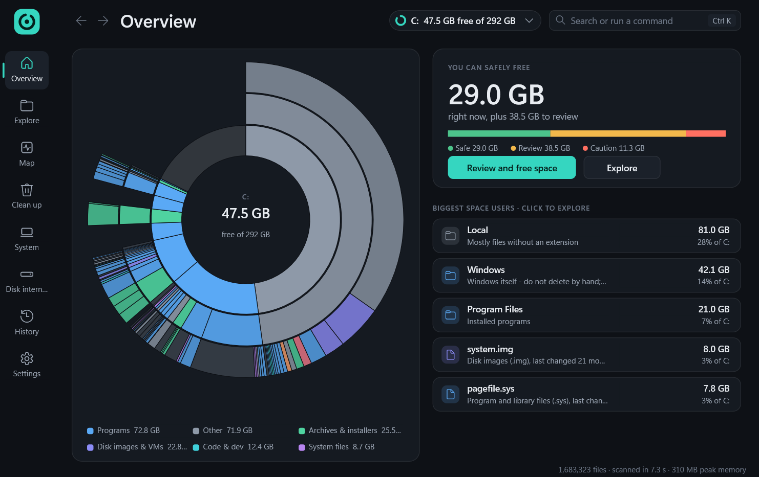
The product
Sunburst of the drive, free space in the centre
29 GB safely reclaimable on our C:
Top space users, click to explore
SpaceRescue · OS Course Project
26
Notes:
This is the first screen after a scan of our C:. The sunburst shows each folder level as a ring, coloured by the kind of files inside, with free space in grey. The meter splits what can be freed into Safe, Review and Caution: 29 GB was safe on this drive. Every card opens the item in Explore.

Slide 27
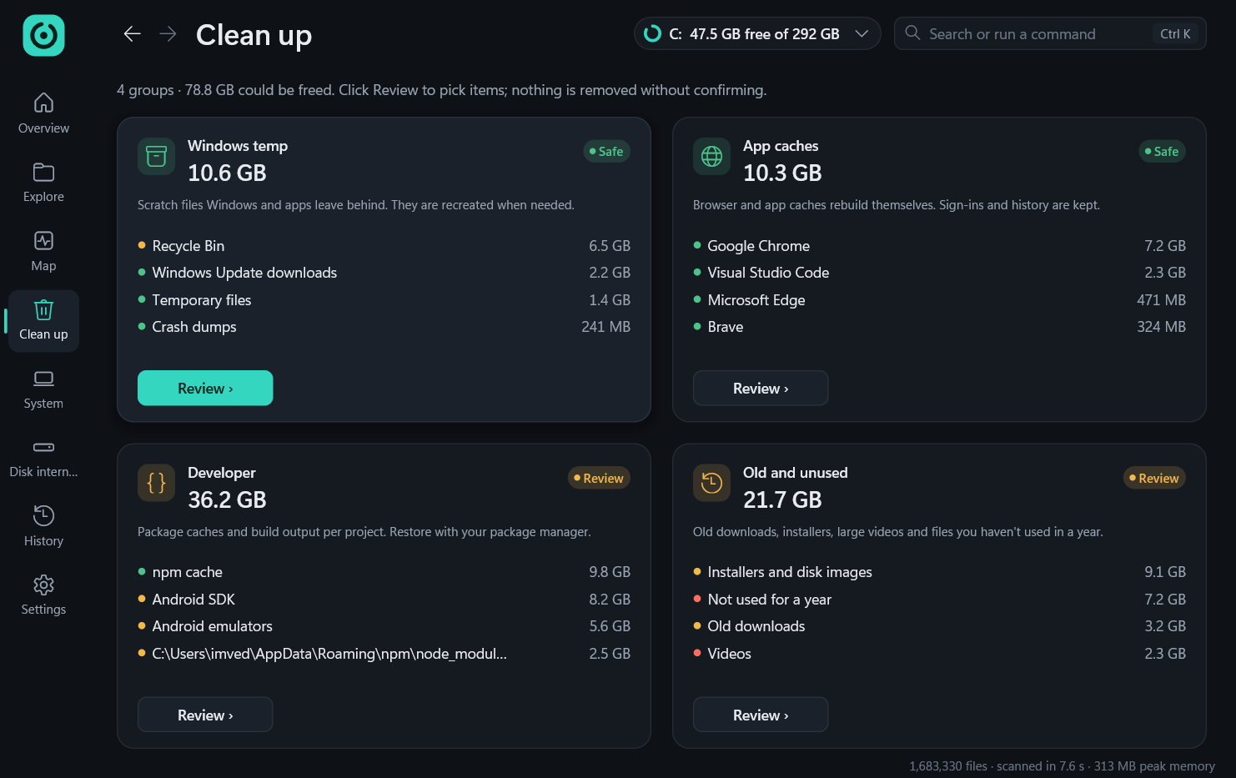
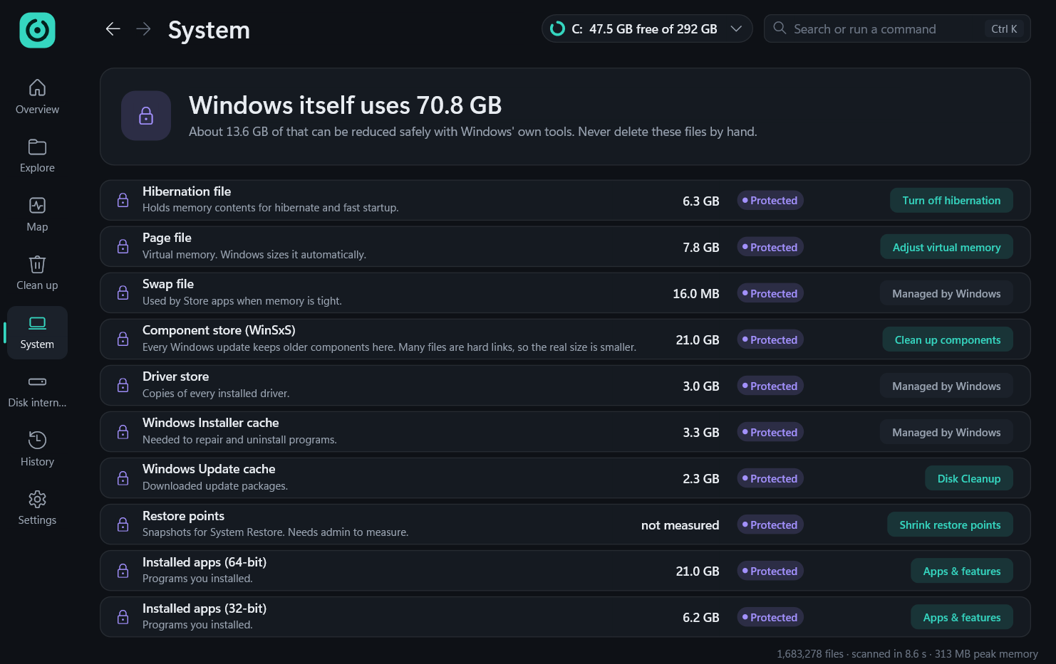
Clean up and System
Four sections with safety badges and per-project groups
Windows uses 70.8 GB; each item gets the safe Windows tool
SpaceRescue · OS Course Project
27
Notes:
Clean up groups everything removable into four sections, each with a safety badge; clicking a group opens a review list with confirmation and undo. The System tab shows what Windows itself uses, 70.8 GB here, with a lock on each item and the Windows tool that can shrink it, such as turning off hibernation.

Slide 28
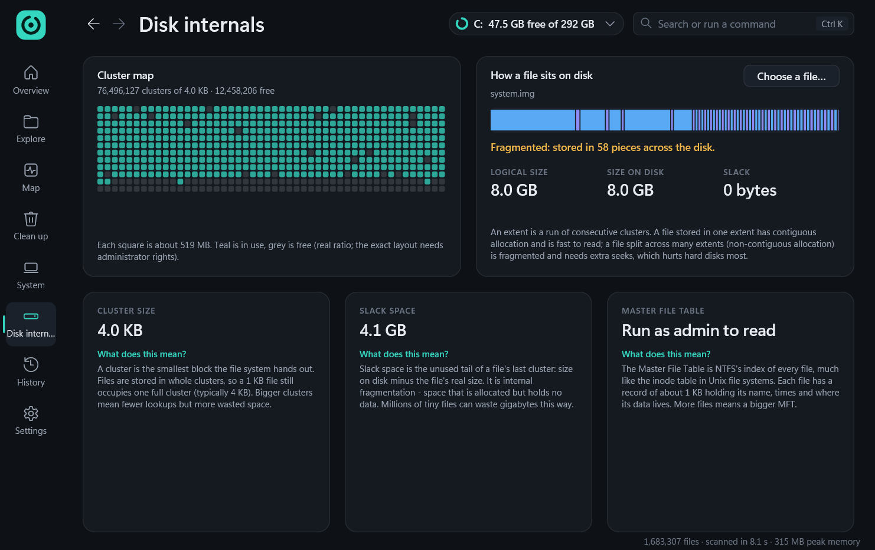
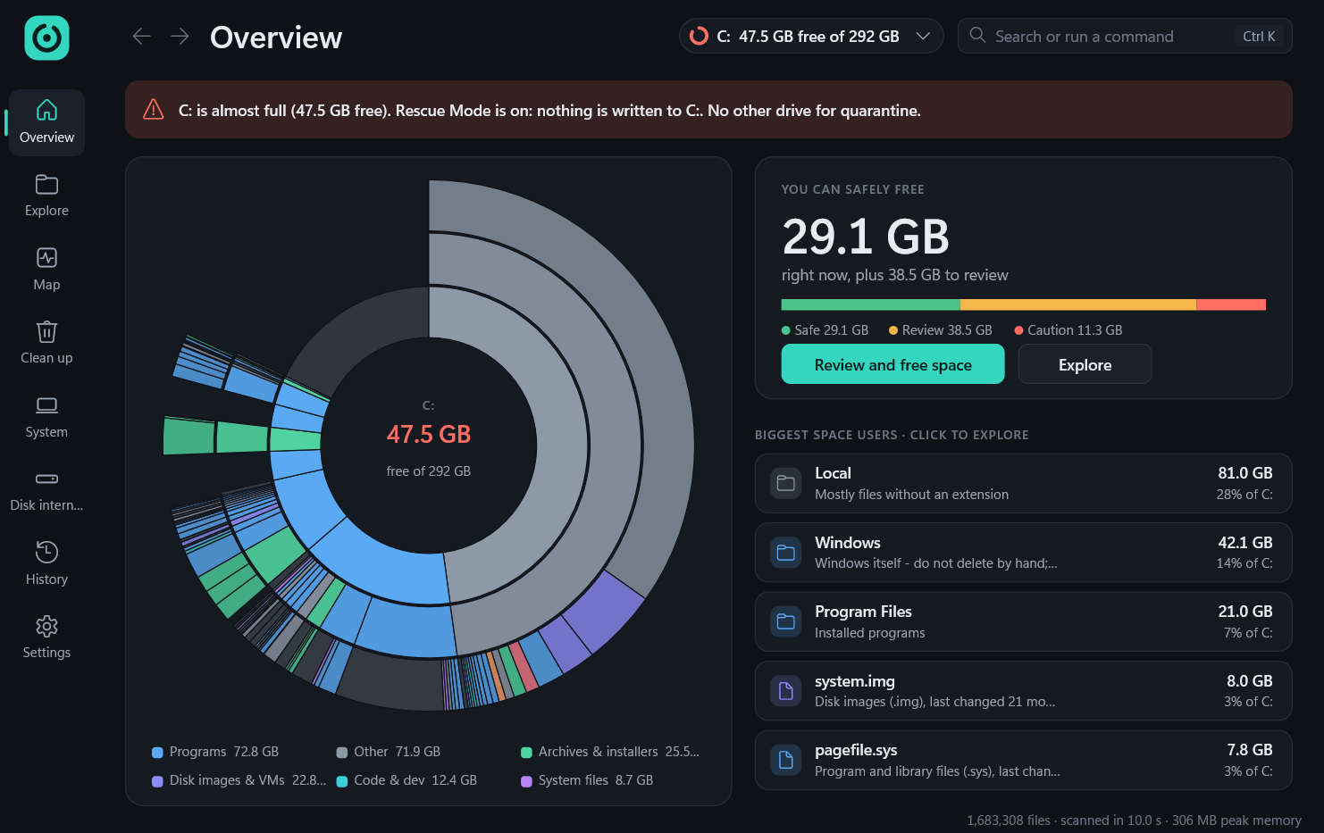
Disk internals and Rescue Mode
8 GB system image stored in 58 fragments
Rescue banner: nothing is written to C:
SpaceRescue · OS Course Project
28
Notes:
Disk Internals shows the cluster size, slack, a cluster map and the real extents of a file: this 8 GB emulator image is stored in 58 pieces. On the right is Rescue Mode, forced here with a high threshold in a test copy so we could capture it: the banner states that nothing is written to C:, and the reserve-file button appears when a reserve exists.

Slide 29
Tools and technologies

C++23

Win32 API

Direct2D

clang
Engine and UI
Files, threads, shell
With DirectWrite: GPU-drawn interface
llvm-mingw: one static x64 exe

PowerShell

Git

Claude Code

Python
Build, package, tests
GitHub, commits per module
Pair programming and code audits
Icon, strings, this deck
SpaceRescue · OS Course Project
29
Notes:
Everything is native: C++23 on the Win32 API, with Direct2D and DirectWrite for the interface. We build with clang from llvm-mingw, installed per user without admin, into one static x64 executable. PowerShell scripts build, package with Windows' own IExpress, and drive our tests. Claude Code was used as a pair programmer and for code audits.

Slide 30
Results
58 → 8.2 s
3.0 s
255 MB
full C: scan, warm cache
first “you can free” answer
peak RAM, 1.68M files
1.6 MB
76 ms
TBD
tray alert process
treemap of all of C:
space freed in 0-byte test
Test machine: Intel Core i5-1335U, 16 GB RAM, Windows 11, C: 292 GB NTFS, 1.68M files.
SpaceRescue · OS Course Project
30
Notes:
All numbers are measured on our test laptop. The full scan of C: went from 58 seconds warm with the first prototype to 8.2 seconds with eight threads. The quick-win pre-scan showed 12.5 GB safe to free three seconds after launch. The scanner peaked at 255 MB for 1.68 million files, the tray watcher uses 1.6 MB, and the cushion treemap of the whole drive renders in 76 ms. Space freed in the 0-byte virtual-disk test is still to be measured.

Slide 31
Conclusion
What we delivered
Limitations and future work
Scan of C: in 8.2 s, answer in 3 s
Zero-write Rescue Mode, reserve file
Review, quarantine and undo
Alerts at 8 thresholds
Disk internals on a real disk
0-byte VHDX test still to run
Parallel MFT path: elevated benchmark
Cold-cache timing of new scanner
Installer unsigned, per-user only
Windows 11 top-level menu entry
SpaceRescue · OS Course Project
31
Notes:
We delivered a working tool: fast scans, a zero-write rescue mode, safe cleanup with undo, early alerts and an internals view. We are also clear about what is not done yet. The 0-byte virtual-disk test and the elevated benchmark of the parallel MFT reader need administrator rights, the cold-cache time of the new scanner is not re-measured, the installer is per-user and unsigned, and the Windows 11 top-level context-menu entry needs a packaged app identity, which we left for future work.

Slide 32
References
[1] A. Silberschatz, P. B. Galvin, G. Gagne. Operating System Concepts, 10th ed. Wiley, 2018.
[2] B. Shneiderman. Tree visualization with tree-maps: 2-d space-filling approach. ACM Trans. on Graphics 11(1):92–99, 1992.
[3] J. J. van Wijk, H. van de Wetering. Cushion treemaps: visualization of hierarchical information. Proc. IEEE InfoVis, 1999.
[4] M. Bruls, K. Huizing, J. J. van Wijk. Squarified treemaps. Proc. Joint Eurographics/IEEE TCVG VisSym, 2000.
[5] J. Stasko, E. Zhang. Focus+context display and navigation techniques for radial, space-filling hierarchy visualizations. Proc. IEEE InfoVis, 2000.
[6] WinDirStat Team. WinDirStat 2.10, windirstat.net (studied as a reference).
[7] Microsoft Learn: FSCTL_GET_NTFS_VOLUME_DATA, FSCTL_GET_RETRIEVAL_POINTERS, NtQueryDirectoryFile.
[8] Microsoft Learn: Slim Reader/Writer (SRW) Locks; Condition Variables; Shell_NotifyIcon.
SpaceRescue · OS Course Project
32
Notes:
The OS concepts follow Silberschatz, Galvin and Gagne. The treemap follows Shneiderman's tree-maps, van Wijk and van de Wetering's cushion shading and the squarified layout of Bruls, Huizing and van Wijk; the sunburst follows Stasko and Zhang. The Windows APIs are documented on Microsoft Learn.

Slide 33
Thank you
29 GB
Questions are welcome
safe to free on C:
SpaceRescue · Operating Systems Course Project
Drive under control
SpaceRescue · OS Course Project
33
Notes:
Thank you. The ring is the same motif as the title slide, now showing a healthy drive: on our C:, SpaceRescue found 29 GB that is safe to free. We are happy to take questions.

