Slide 1
Machine Learning Applied to Cervical Cancer Data
RDBMS IA 1

Slide 2
Introduction
Around the globe, around a quarter of million people die owing to cervical cancer. Screening and different deterministic tests confuse the available Computer Aided Diagnosis (CAD) to treat the patient correctly for the cancer.

Slide 3
Dataset
The data has 36 columns out of which 4 columns are the target columns of the four tests conducted which determine if the patient has cancer or not.
The remaining 32 columns are the several factors that may lead to the cervical cancer.
Target column: In the given dataset, there are four target columns present, which include the results from Hinselmann test, Schiller test, Cytology test and Biopsy test.
Notes:
The target columns are test. Each test has a value 0 or 1.
We add all the values to determine the results.
The results lie in between 0 and 4.

Slide 4
Factors Considered
Factors
Age
number of sexual partners
age of first sexual intercourse
number of pregnancies
smoking habits
Hormonal
STD’s
Diseases
HPV (Human papillomavirus)
CIN (Cervical intraepithelial neoplasia)
Tests
Cytology
Schiller
Hinselmann
Standard biopsy

Slide 5
Details
Different tests are carried out to detect the presence of cervical cancer. Different models are tried on the dataset. Fine tuning of the parameters is done. The performance of Different models are compared. And finally, the best models are recommended that can be used to predict cancer.

Slide 6
Classifiers used to build model:
Decision Tree
K-nearest neighbours
Random forest

Slide 7
Procedure
Target columns have the values 0 or 1. We are combining the two possible outcomes into one column by adding the outcomes from each column for one patient.
By doing this step, if all the tests are positive for the patient, maximum value in the target column will be 4.The target column will have values 0,1,2,3,4.
We deleted the previous four target variables for deploying the machine learning algorithm on this one column with 5 possible outcomes.

Slide 8
Procedure
Prepare models:
K-nearest neighbors: 50-50 split
Decision tree and random forest: 25-75 split
Feature Extraction:
Depending upon the algorithm used use features that give maximum accuracy

Slide 9
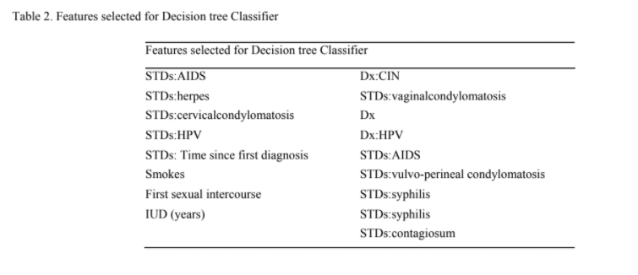
Decision Tree features

Slide 10
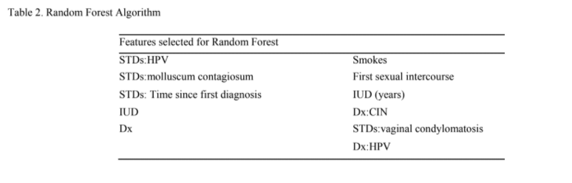
Random forest feature selection

Slide 11
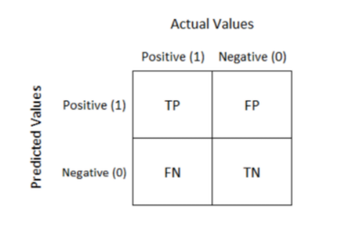
Evaluation
Using Confusion Matrix
TP - True Positive
FP - False Positive
TN - True Negative
FN - False Negative
Accuracy =(TP + TN)/ Total

Slide 12
Results
Algorithm | TP | FN | FP | TN | Accuracy
K-neighbors | 163 | 0 | 8 | 1 | 95.30%
Decision tree classifier | 183 | 24 | 8 | 2 | 85.11%
Random Forest Algorithm | 187 | 18 | 8 | 2 | 87.90%

Slide 13
Conclusion
From the initial analysis it was clear that the data is biased
In order to address the problem necessary measures were taken while modelling.
Fine tuning was done on all three models to get the best accuracy.
The best 3 models from each of them is selected and performance is compared.
It is found that all 3 models are good.
But the k-nearest-neighbour model has better accuracy.
The research also showed that herpes virus was able to fight cancer cells. This observation was made based on the available data and more scientific analysis needs to be carried out in order to verify these findings.

Slide 14
Bibliography
Paper Authors:
Dhwaani Parikh, Vineet Menon,"Machine Learning Applied to Cervical Cancer Data",International Journal of Mathematical Sciences and Computing(IJMSC), Vol.5, No.1, pp.53-64, 2019.DOI:10.5815/ijmsc.2019.01.05
K-neighbors classifier:
https://en.wikipedia.org/wiki/K-nearest_neighbors_algorithm#:~:text=In%20statistics%2C%20the%20k%2Dnearest,training%20examples%20in%20data%20set.
https://machinelearningmastery.com/k-fold-cross-validation/

Slide 15
Strategy to implement

Slide 16
Implementation
The paper talks about implementation using 3 methods:
Decision Tree
K-nearest neighbor
Random Forest

Slide 17
Implementation used:
K-neighbours:
It was noted that data was biased
Hence k-folds were used to determine the value of k
K = 5 was chosen

Slide 18
Dataset
Dataset was split in 50 - 50
Training 50% and Testing 50%

Slide 19
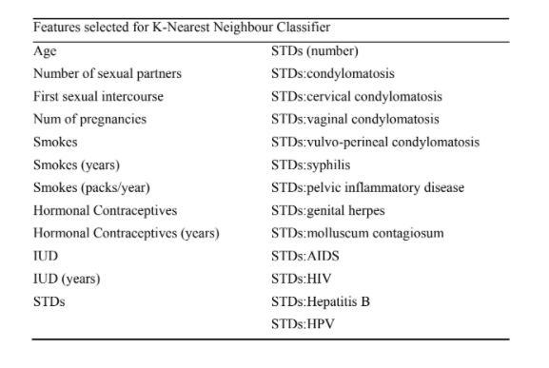
Feature Selection
25 features we selected for implementation

Slide 20
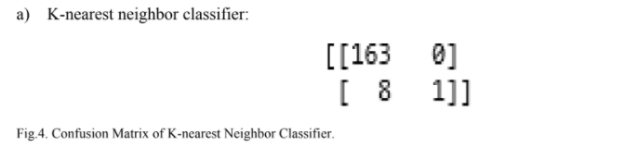
K-nearest Neighbor classifier
Results expected
Accuracy expected: 95.3%

Slide 21
Thank you

Slide 22
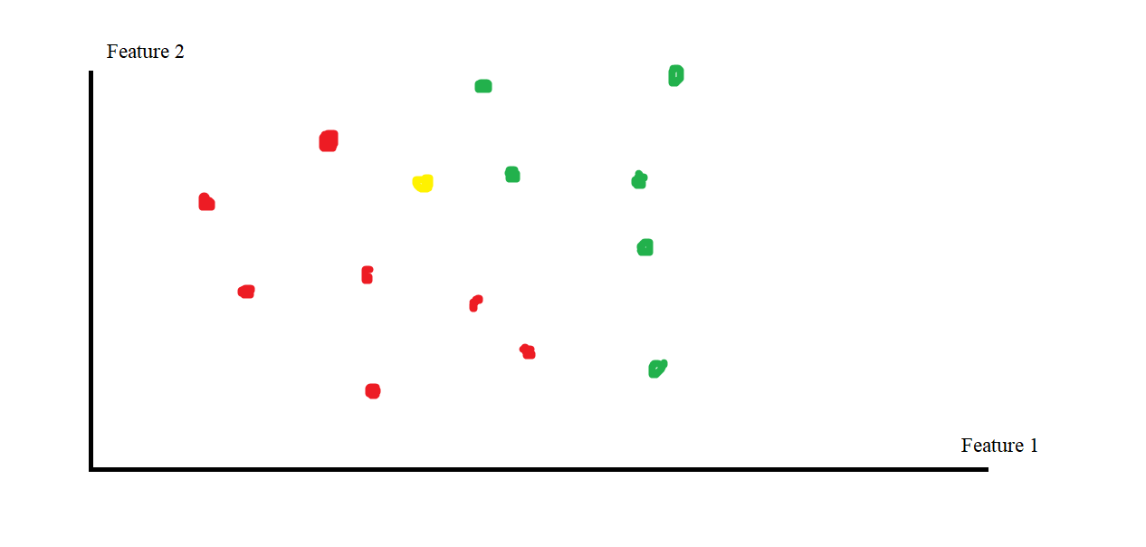
K-nearest neighbours

Slide 23
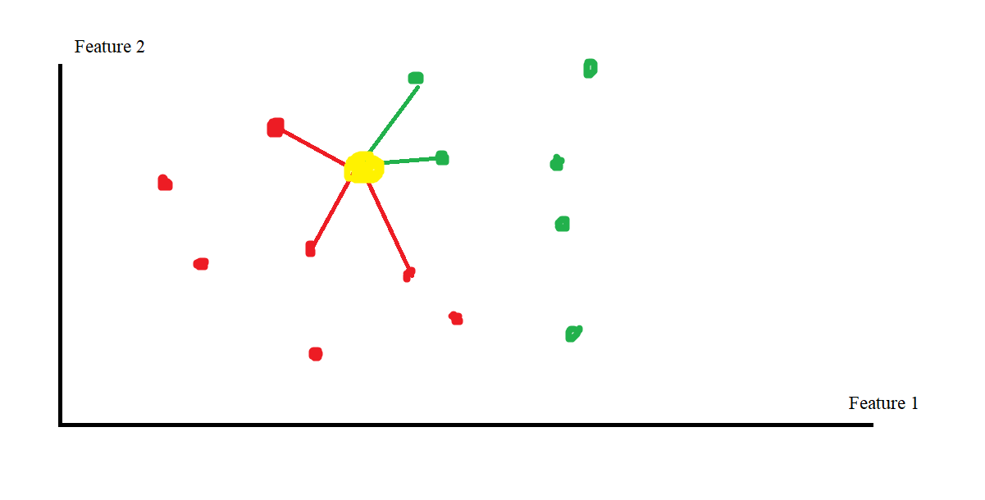
Back to slides

