Slide 1
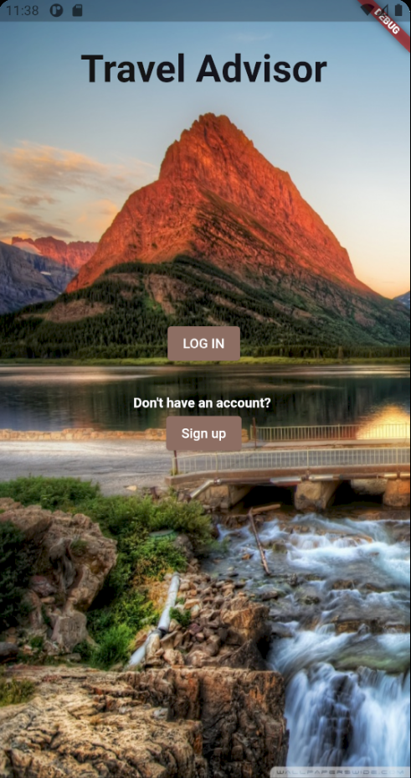
TRAVEL ADVISOR
Where adventures begin
A National Park application
Group 11:
Ali Darawsha, Meet Patel,
Vedant Majmudar, Joshua Gonzales

Slide 2

ABOUT THE APP.
Mobile application which helps users plan visits before and during their traveling within the United States’ national parks.
Serves just like a tour guide and park hub, fulfilling a wide range of usability.
This application uses Flutter as its programming language. Open-source software for cross-platform web and app development

Slide 3
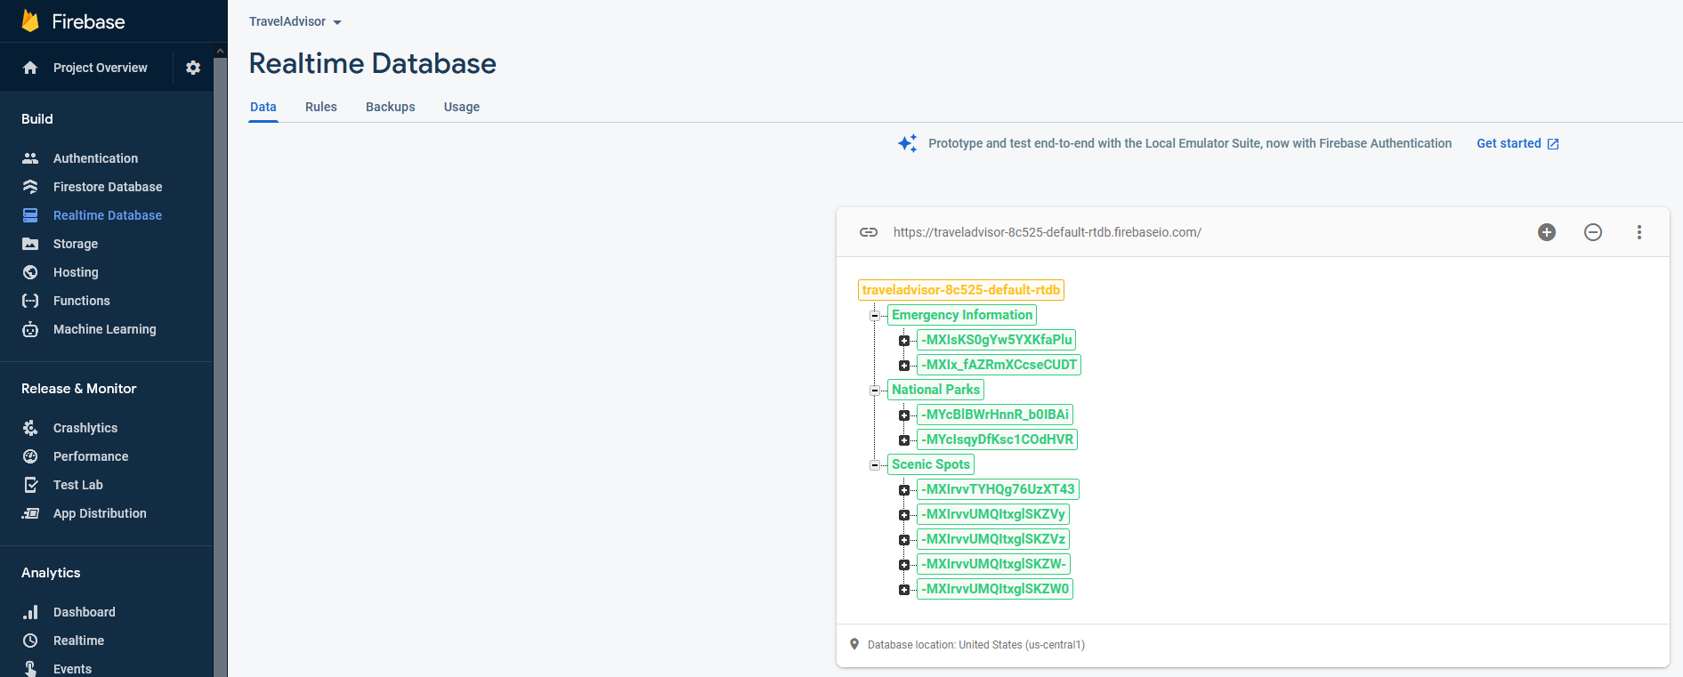
API:
Firebase
Access pictures, string data, and various information depending on the user

Slide 4
03
MAPS
2
Find out where the national park is!
FAVORITES
HOME PAGE
EXPLORE
2
Check out the national parks you have taken interest in!
Visit the national park with the information you gathered!
1
SCENIC SPOTS
2
Discover the highlights of the national parks you could visit!
SETTINGS
2
Set up your profile in case of emergencies

Slide 5
Home Page
01.
List of all the National parks
Popups on click, providing info and options
Scenic Spot button
Map button
Download Map button
launch map button
Add to favourite

Slide 6
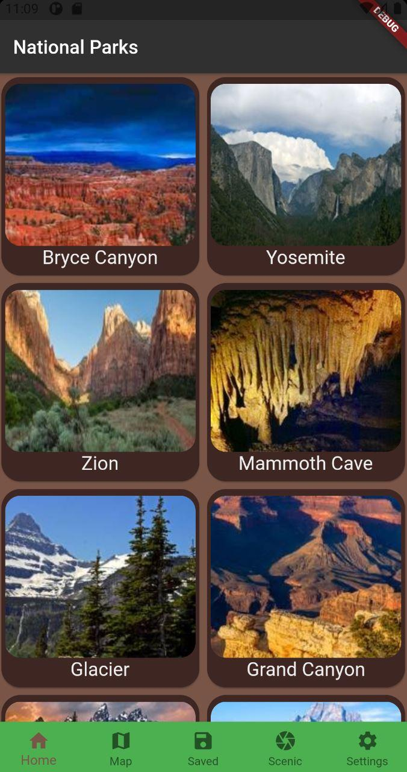
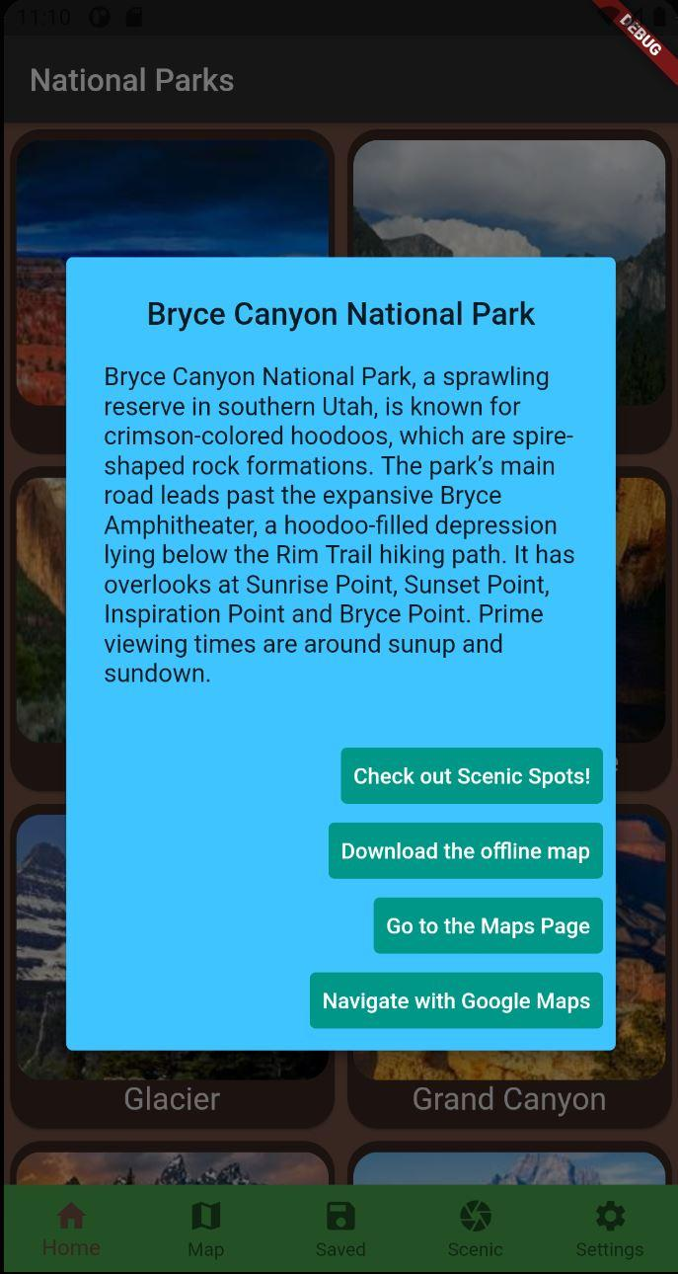
Quick Snaps
Home Page
Pop Up
List of All the National ParKs
This is the point where we can go to different part of the app.

Slide 7
02.
Map Navigation

Slide 8

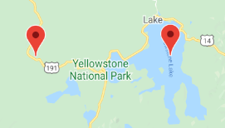
Two Sides
To The Park Within The Park
Navigation to national park via segue to Google Maps application
Google Maps application navigates to park chosen on Main Page
Map within application displaying user chosen national park, utilizing Google Maps API
Each national park filled with Scenic Spot markers

Slide 9
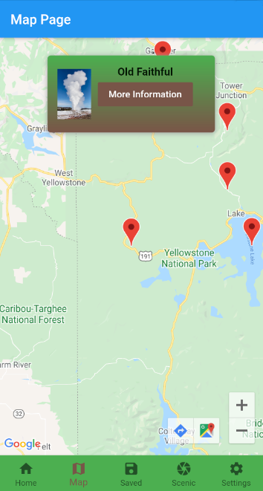
Scenic Spot Markers
Each park has a set of Scenic Spot markers
Scenic Spot information is grabbed from the Firebase database and used to populate markers
Each Scenic Spot marker has a picture of the Scenic Spot, as well as a button to the Scenic Spot Page

Slide 10
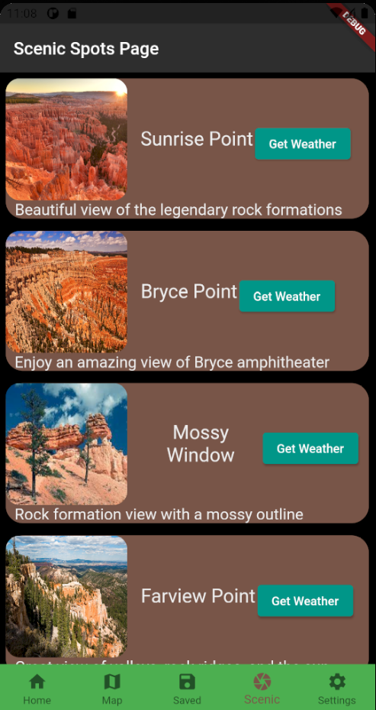
03.
Scenic Spots
List of scenic spots from selected national park
Gathered from the National Park Service (NPS) website
Highlights beautiful locations and markers to enjoy the environments and take in the scenery
Gets information through coordinates passed in from the Home Page

Slide 11
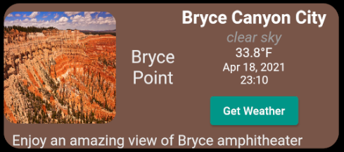

API:
OpenWeather
Allows feeding geo-coordinates into methods to get name, icon, temperature, and weather advisory
Helps users plan out their trips, even on the fly

Slide 12
04.
Favorites

Slide 13
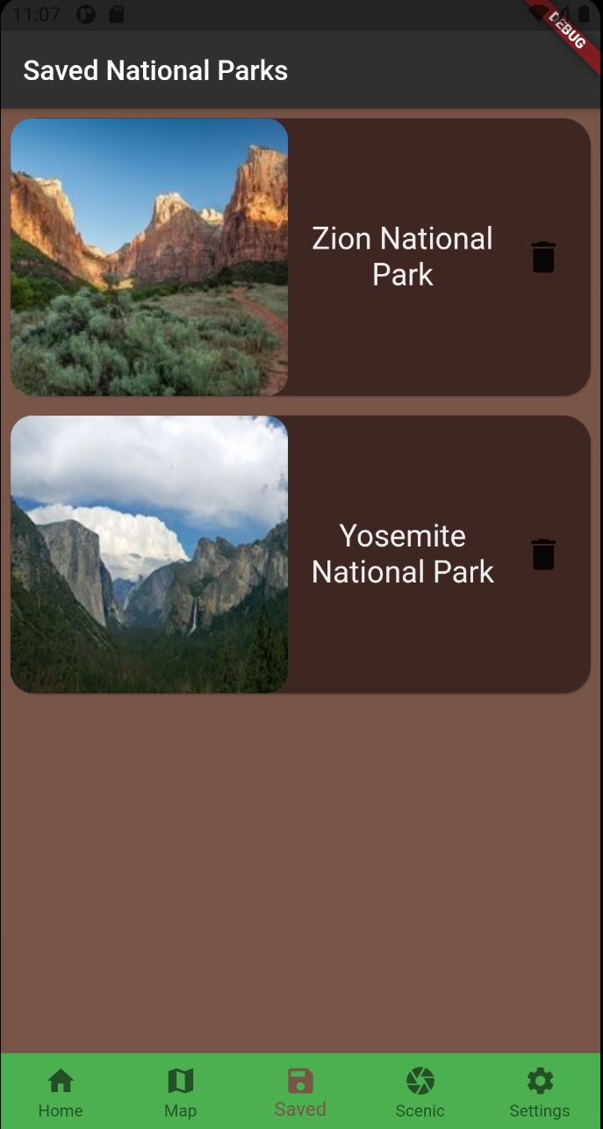
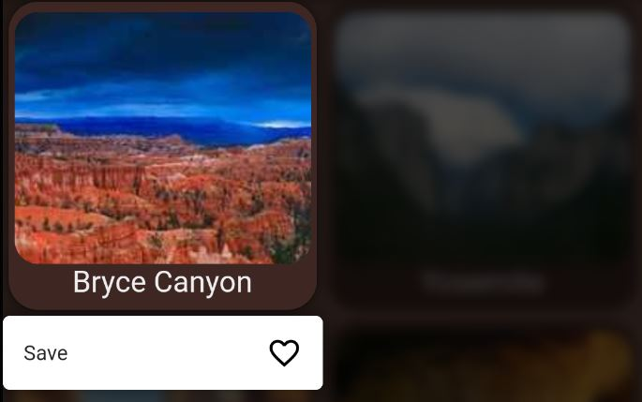
Save or Delete
Able to stay organized
Keep track which national parks visited
Delete from favourites by clicking on delete

Slide 14
05.
Emergency Reporting

Slide 15
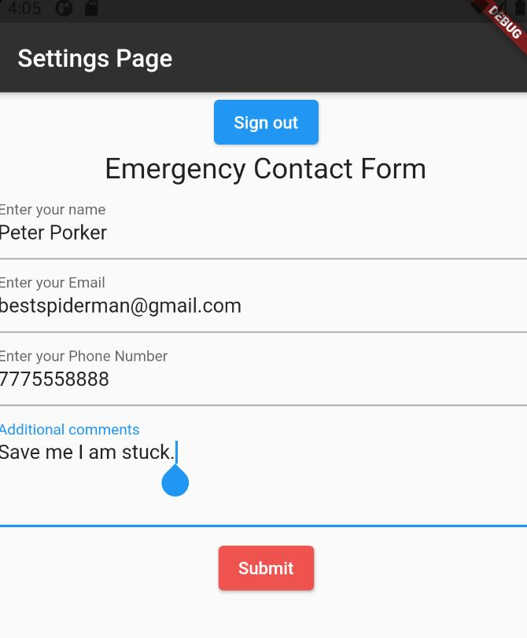
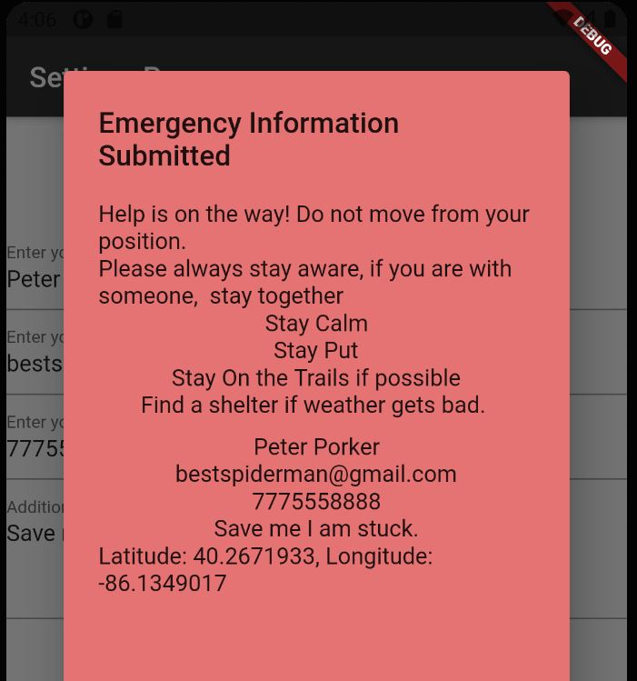
Emergency contact is used when visitors need help, whey they want to recuse.
The contact form asks every necessary information from visitors
Stores information in a realtime database with location information of the device.

Slide 16
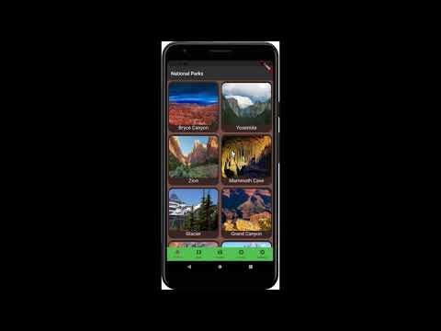
Video Demo
https://youtu.be/A2Uc8C206SI

Slide 17
THANKS
Download Templage https://slidesgo.com/theme/outdoor-activities-company-profile
Please keep this slide for attribution

