Slide 1

PsyMetric Labs PVT LTD
psymetric.online - The Future of Career Analysis for Students

Slide 2
Overview & Vision
Target Audience
The AI-Driven Mechanism
Primarily targeting 8th/9th and 11th/12th Grade Students.
Providing crucial guidance during their most pivotal educational milestones.
Assessment Model: Initial pilot phase utilizes a fixed questionnaire. Transitions into a fully dynamic, AI-driven evaluation post-pilot.
Technology Core: Questions are generated & individually tailored by our in-house trained AI model.
Evaluation: Powered by a proprietary, research-backed Machine Learning algorithm.
Ultimate Outcome: Highly accurate, data-driven career path guidance matched to the student's unique psychometric profile.

Slide 3
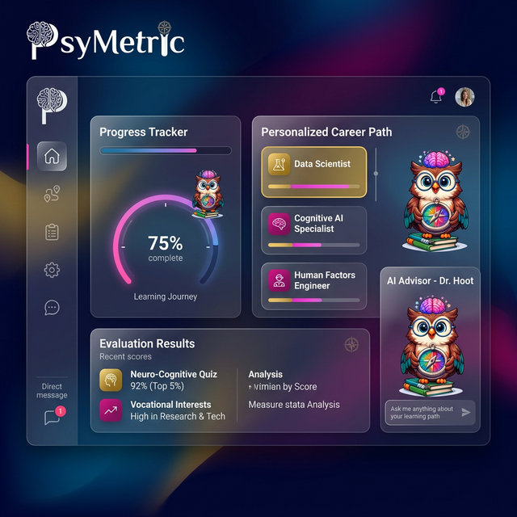
Student Dashboard (Personal Progress)

Slide 4
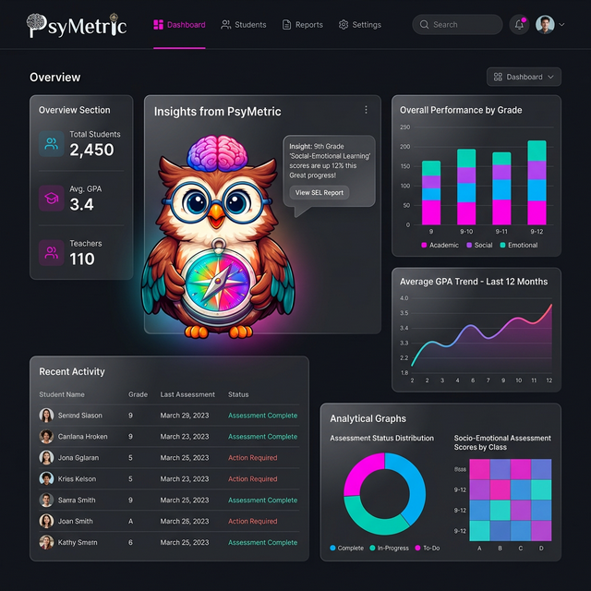
School Dashboard (Aggregated Analytics)

Slide 5
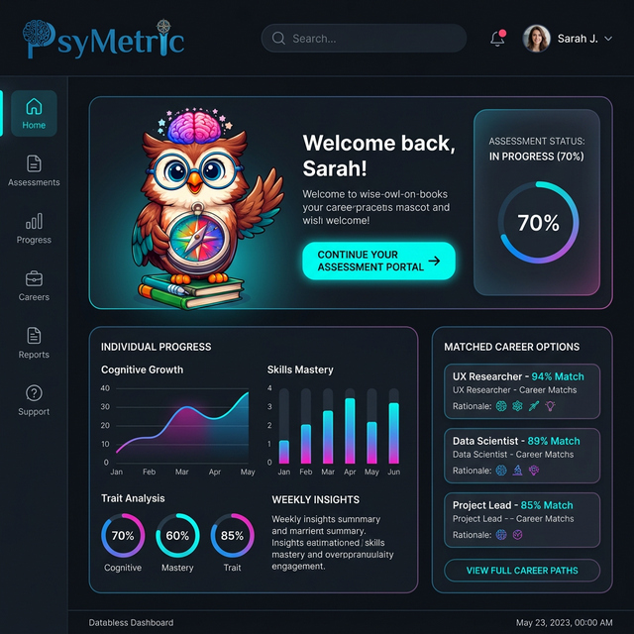
Client Dashboard (Direct Signup)

Slide 6
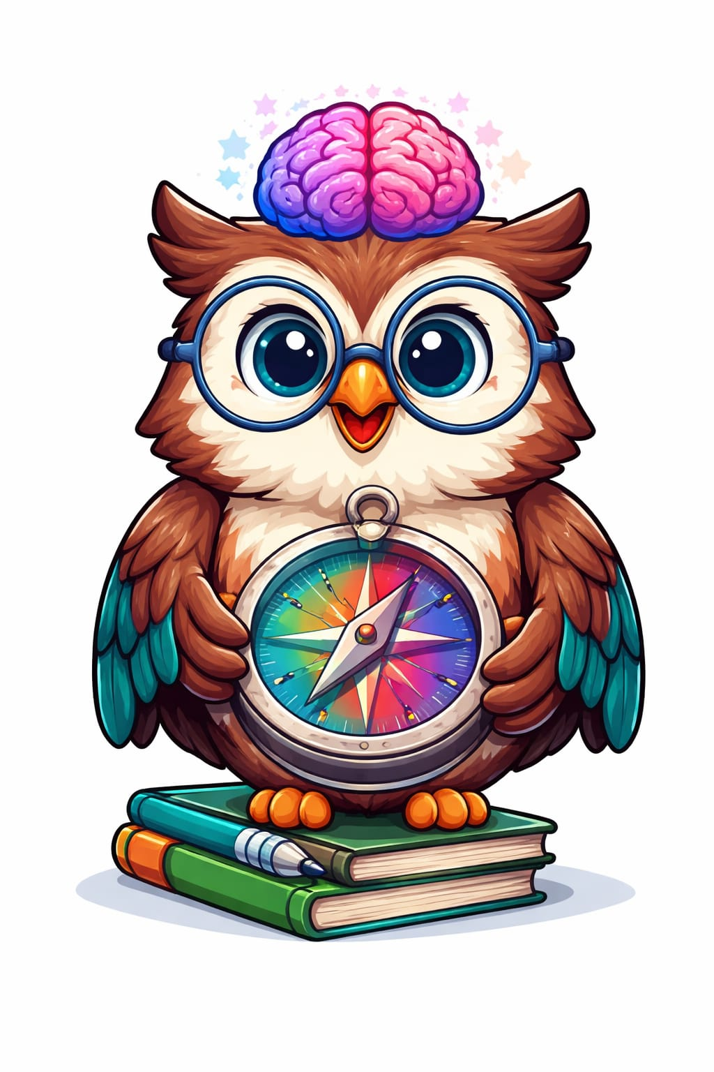
Gamification & Student Engagement
Transforming the Assessment Experience
Game-Like Format: Questionnaires are designed to feel like an interactive game. We completely eliminate the stress, pressure, and fatigue of traditional diagnostic interviews.
Reward & Progression: We implement a comprehensive Badge System. Students earn badges as part of the game to encourage completion and celebrate milestones.
Mascot Integration: 'Psy' the owl serves as a friendly, relatable companion and guide throughout the entire user journey.

Slide 7
Post-Assessment Ecosystem
Continuous Engagement
Our relationship with the user does not end after the assessment. We guide their next steps actively.
Experiential Learning
Modern Media Access
Tailored Summer Camps: Immersive, hands-on experiences customized for different student categories based on their assessment results.
Interactive Workshops & Seminars: Targeted skill-building sessions hosted by specific industry experts.
Podcasts & Audio Series: Interviews with professionals tailored to students' matched career paths.
Continuous Content Ecosystem: Keeping students deeply engaged with the PsyMetric brand.

Slide 8
Business Plan & Go-To-Market
Phase 1: Pilot (0-6 Months)
Phase 2: Validation
Strategy: Provide the platform to 10 Schools completely FREE.
Purpose: This phase uses the static questionnaire.
Goal: Critical for collecting robust, real-world baseline data from thousands of students to train and refine our dynamic AI models before charging.
Strategy: Onboard 20 Schools (average of 200 students per school).
Revenue Model: ₹100 per student.
Expected Early Revenue: ₹4,00,000.
Outcome: Prepares the business for immediate scaling and shows strong product-market fit.

Slide 9
Expansion & Phenomenal Market Potential
The Indian Landscape & The Gap
Current Value: India's career counseling market is estimated at over ₹5,000 Crore.
Growth Trajectory: Experiencing a robust 15% CAGR, poised to double to ₹10,000 Crore by the end of the decade.
The Massive Gap: There is a severe shortage of trained professionals. India currently has only ~10,000 counselors against a projected need of 14 Lakhs.
Our Advantage: This creates an astronomical vacuum for accessible, AI-driven EdTech assessments. We scale instantly where human counselors cannot.
Phase 3 Goal: Full regional dominance, starting with capturing the complete Bihar region, leading to massive 3-year profit margins.

Slide 10
Financials: Expected Expenses
Tech Infrastructure
Operations
Software development, cloud hosting, AI model training cycles, and ML algorithm maintenance.
Day-to-day business management, platform scaling maintenance, and customer success support hubs.
Sales & Collaborations
Marketing & Giftings
Strategic partnerships with educational institutions and hiring on-field B2B sales executives.
Strategic gifts for faculties and school principals.
Designed to build trust, expand network, and secure high-value B2B pilot programs and sales.

