Slide 1
TRANSITPULSE
Next-Gen Metro Routing & Commuter Flow Simulation Engine
Presented By: Vedant Patil | B.Sc. Computer Science
Tech Stack: Node.js • Express • SQLite3 • Glassmorphism UI

Slide 2
Breaking Through Static Infrastructure
🚨 THE LEGACY PROBLEM
💡 THE TRANSITPULSE SOLUTION
Modern municipal transit setups rely on rigid, static timetables. When an emergency breakdown, crowd spike, or maintenance gridlock hits a sector, the tracking frameworks fail to adapt dynamically. This leads to broken scheduling systems and high passenger congestion at platforms.
TransitPulse models the entire layout as an in-memory mathematical graph G=(V,E). Stations act as vector nodes while tracks act as directional weighted edges. The routing core runs dynamic calculations, recalculating alternative pathways instantly when modifications occur.

Slide 3
Mapping Real-World Infrastructure (Pune Metro Model)
🟣 LINE 1 (PURPLE LINE)
PCMC Hub ➔ Bhosari ➔ Khadki ➔ Shivajinagar ➔ Swargate
🩵 LINE 2 (AQUA LINE)
Vanaz Depot ➔ Nal Stop ➔ Garware College ➔ Pune Station ➔ Kalyani Nagar ➔ Ramwadi Terminal
🔄 THE HEART: DISTRICT COURT INTERCHANGE
Both lines intersect at a centralized graph hub matrix. This structure forces Dijkstra's path calculation algorithm
to automatically route commuters across line changes, dynamically computing complex physical cross-platform
journeys throughout the city map.

Slide 4
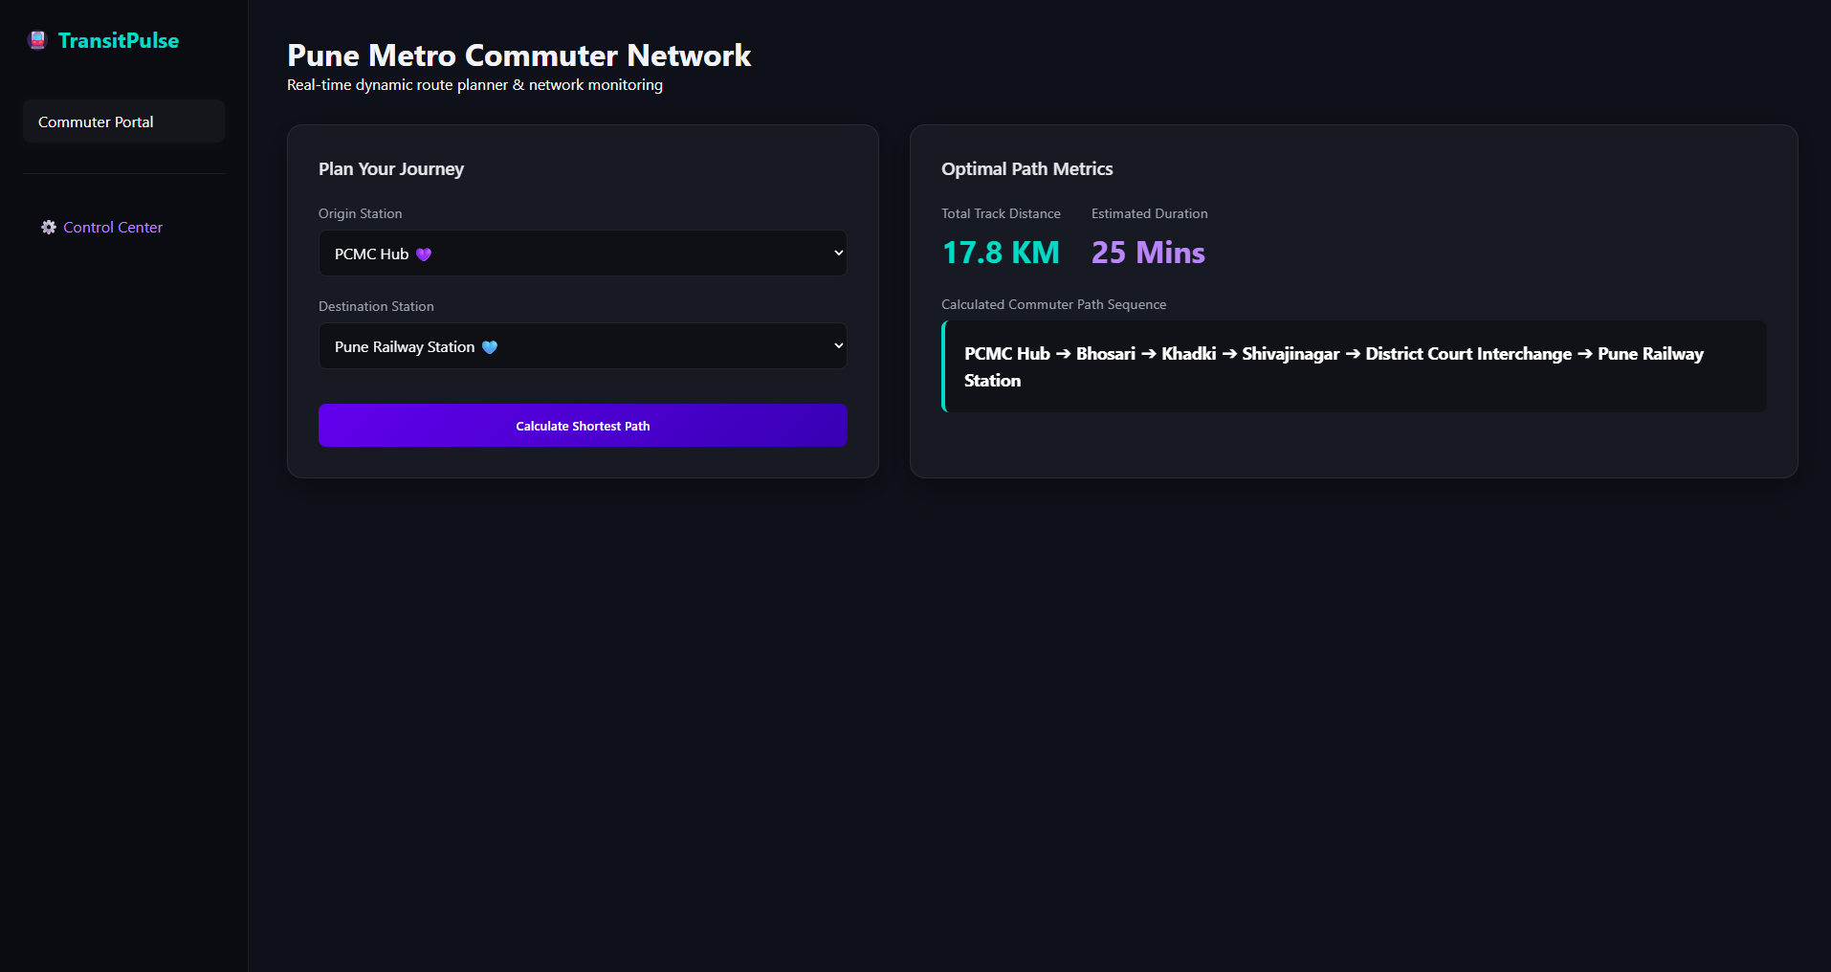
Intelligent Passenger UI Portal
• Interactive Dropdown Selections matching live database station rows.
• Automated Vector Processing running Dijkstra's engine in under 2ms.
• Delivers crystal clear output feedback highlighting track distance (KM) and precise duration weights (Mins).
[ PLACEHOLDER:
Insert Commuter Route Screenshot Here ]

Slide 5
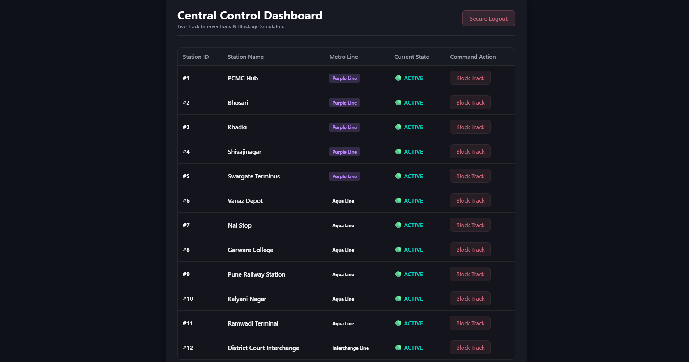
Enterprise Administrative Controls
• Isolated Architecture: Control systems reside on a distinct independent web viewport.
• Token Authentication Gate protects backend API systems from unauthorized public data requests.
• Network Kill-Switch Simulator allows control operators to flag tracks as active or blocked with a click.
[ PLACEHOLDER:
Insert Admin Control Center Screenshot Here ]

Slide 6
Real-Time Emergency Rerouting Flow
[ SCREENSHOT A: Normal Route Choice ]
[ SCREENSHOT B: Detour After Admin Track Block ]
1. Normal Flow: Engine computes shortest path straight down the main sector line.
2. Incident Trigger: Admin blocks an active track node, assigning its graph weight value to Infinity (∞).
3. Immediate Recovery: The very next path request shifts around the blocked track automatically.

Slide 7
Strategic Smart City Impact
Prevents dangerous passenger pileups on physical transit platforms by actively recalculating ticket entry paths before tokens are issued.
The modular Express API and normalized SQLite database structure allow developers to scale up to hundreds of additional stations smoothly.
⚡ Peak Optimization
Complete architectural separation between passenger layouts and operational master databases protects critical civic management data channels.
🔒 System Security
🚀 True Scalability

Slide 8
System Fully Operational.
TransitPulse Engine is compiled, connected, and running live.
Thank You! Open for Technical Evaluation & Questions.

