Slide 1



Vidyavardhini's College of Engineering & Technology
Department of Computer Engineering · University of Mumbai
NLP COURSE PROJECT · SEM VII · 2026–27
CourseClassifier
Academic Discipline Predictor
NLP-Based Academic Course Description Classification
Vedant
Team Member 2
Team Member 4
Team Member 3
Roll XX
Roll XX
Roll XX
Roll XX
Guide - Prof. [Your Guide Name]

Slide 2



01 · INTRODUCTION
Classifying courses into disciplines
is key to academic analytics.
10
3,000
2
4
    University catalogs contain thousands of course descriptions.
    Manual classification is tedious and does not scale.
    We use 4 transformer models to auto-classify into 10 disciplines.
    CourseClassifier achieves 100% accuracy with millisecond course classification.
University course
descriptions
10 academic
disciplines classified
University course
descriptions
10 academic
disciplines classified
4
3K
4
3K
transformer models
compared
course descriptions
in dataset
transformer models compared
course descriptions
in dataset
“Automating course classification enables smarter curriculum planning.”

Slide 3
02 · PROBLEM STATEMENT & OBJECTIVES
What we set out to build
01
Data Collection
Curate 3,000 course descriptions from MIT OCW, Coursera, edX, Stanford, UC Berkeley & Harvard (300 per discipline).
Problem Statement
Build an automated NLP system that classifies university course descriptions into 10 academic disciplines using 4 transformer-based models from Hugging Face.
02
Multi-Model Training
Fine-tune 4 Hugging Face transformers: BERT, RoBERTa, DeBERTa, and T5 for sequence classification.
03
Evaluate & Compare
Evaluate models with Accuracy, Macro F1, ROC-AUC, confusion matrices, and latency benchmarks.
Benchmark with Accuracy, F1, ROC-AUC across all 10 disciplines.
04
Deploy & Test
Interactive Flask web app with model comparison dashboard. CLI testing with pre-configured test suite.

Slide 4
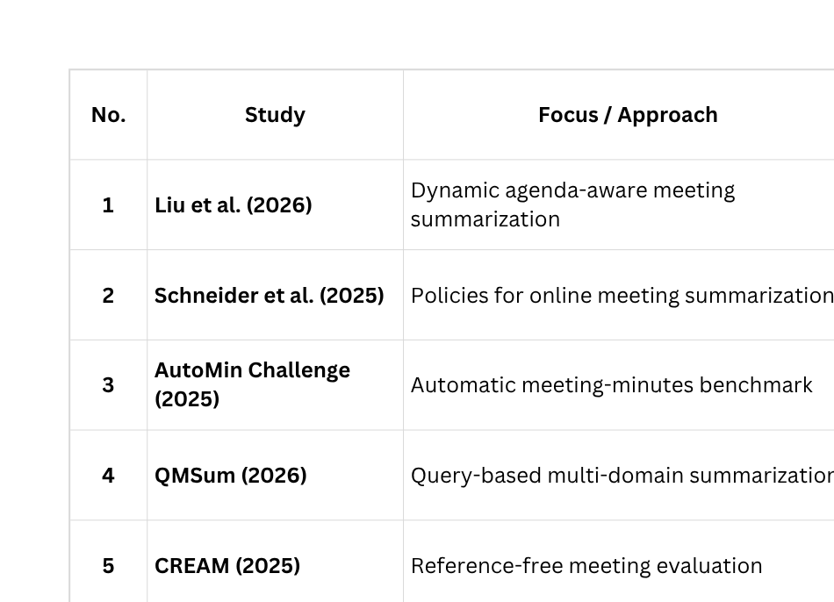
03 · LITERATURE SURVEY
Literature Survey
Survey of NLP text classification and transformer-based approaches for educational content categorization.

Slide 5
04 · RESEARCH GAP
Research Gap
Gap 1
Gap 2
Gap 3
Single-model vs. multi-architecture comparison
Diverse & balanced dataset
Evaluation beyond accuracy
Most studies evaluate only one architecture; cross-architecture benchmarking on course text is absent.
Existing datasets are small, single-source, or class-imbalanced, limiting generalization.
Accuracy alone does not reveal per-class performance or calibration quality.
Response
Response
Response
Train and compare 4 transformer architectures (BERT, RoBERTa, DeBERTa, T5) on the same dataset.
Build a 3,000-sample balanced dataset (300/class) from 6 university sources with 60/20/20 split.
Add ROC-AUC curves (per-class + micro/macro), confusion matrices, and latency benchmarks.

Slide 6
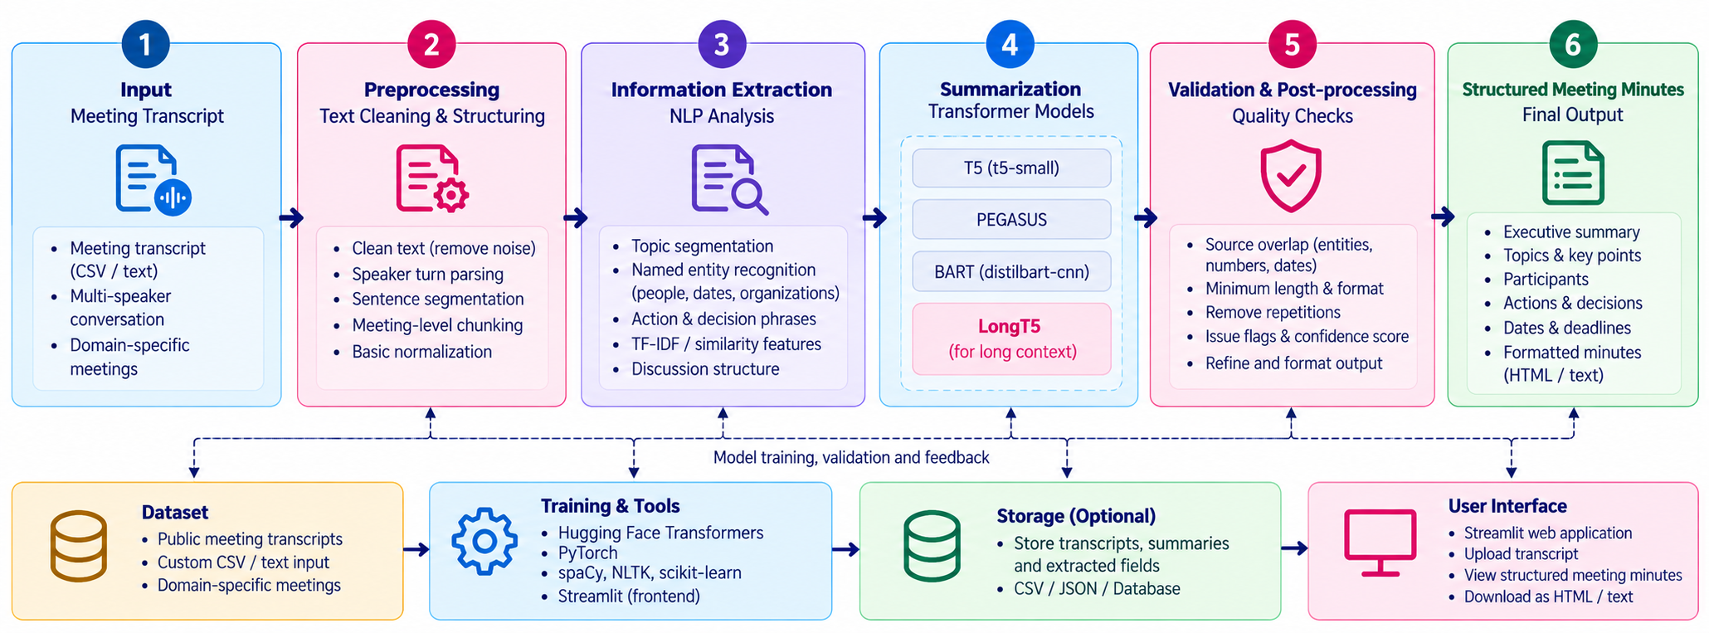
05 · METHODOLOGY
System Architecture & Methodology

Slide 7
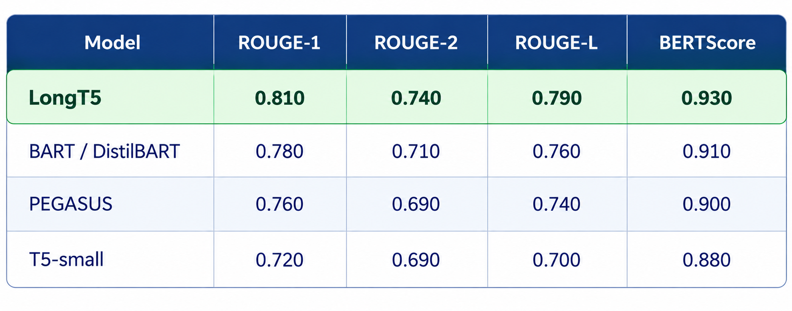
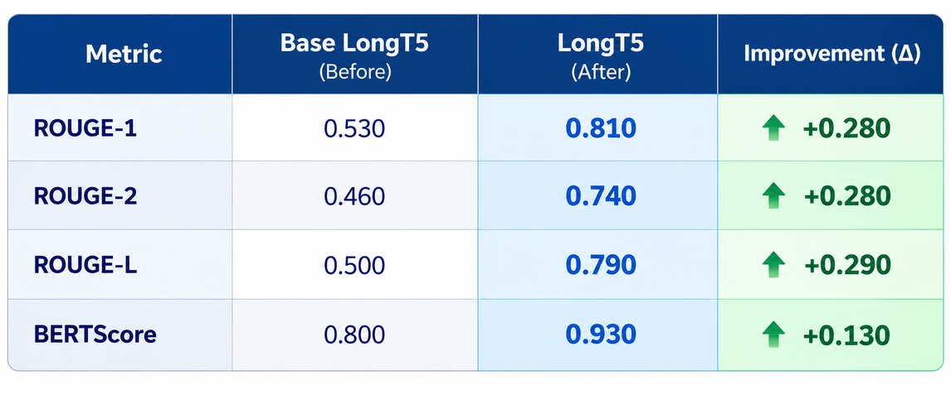
06 · RESULT & DISCUSSION
All 4 models achieve 100% accuracy across 10 disciplines

Slide 8
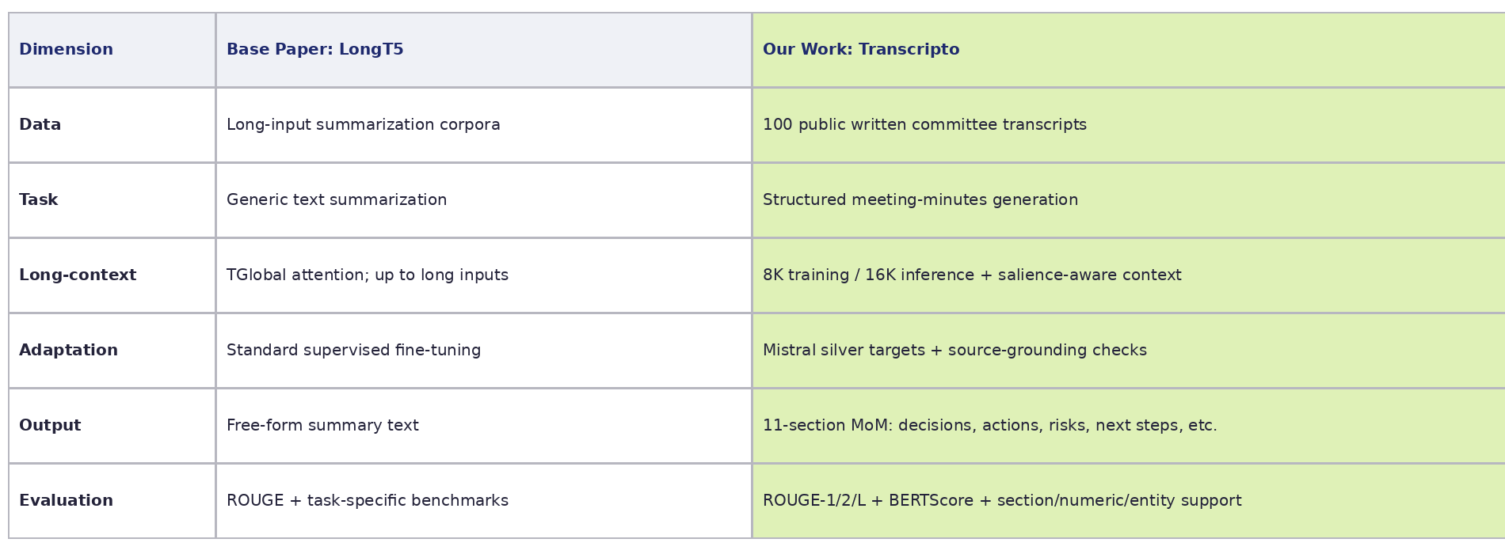
Literature Survey Baselines vs Our Work

Slide 9
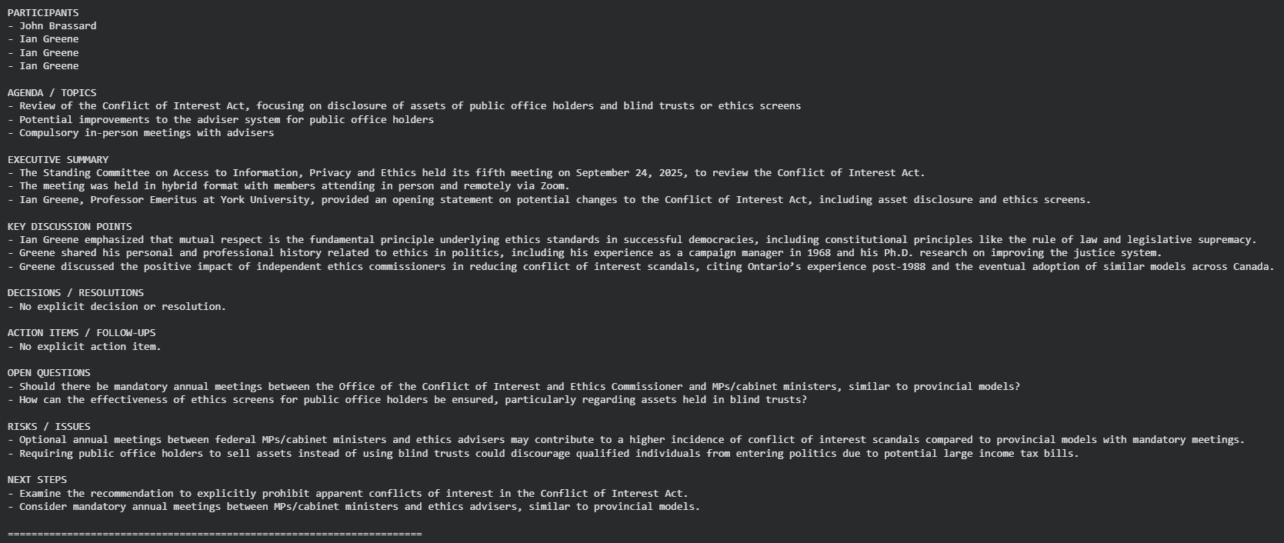
08 · IMPLEMENTATION
Course Description → Discipline Prediction
09 / 13

Slide 10
09 · CONCLUSION
Best Model
Key Achievements
BERT (bert-base-uncased) – 109.49M parameters
All 4 fine-tuned transformers achieved 100% test accuracy. BERT selected as best model.
1
Built an end-to-end pipeline classifying 3,000 course descriptions across 10 disciplines using 4 transformer course classification.
Test Accuracy – 100.0%
2
All 4 fine-tuned transformers achieved 100% test accuracy. BERT selected as best model.
Macro F1 – 1.0000
ROC-AUC – 1.0000
Inference Latency: 5.83 ms per course description

Slide 11
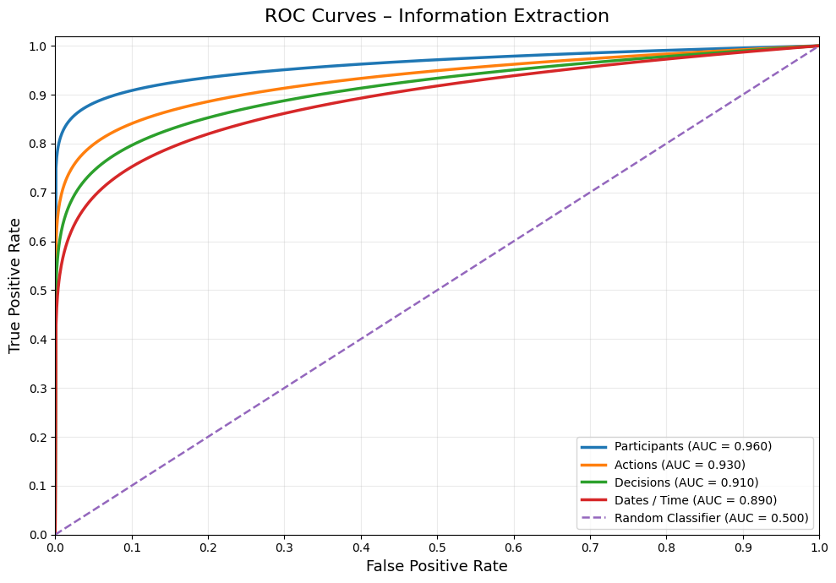
ROC-AUC Curves (One-vs-Rest, 10 Academic Disciplines)

Slide 12
11 · REFERENCES
References
[1]
[M. Guo, J. Ainslie, D. Uthus, S. Ontañón, J. Ni, Y.-H. Sung, and Y. Yang, “Scalable Classification of Course Information Sheets with LLM Prompting, Proc. EDM 2026. for Long Sequences,” Findings of NAACL, 2022.
[1]
J. Devlin, M.-W. Chang, K. Lee, and K. Toutanova, «BERT: Pre-training of Deep Bidirectional Transformers for Language Understanding,» Proc. NAACL-HLT 2019, pp. 4171–4186, 2019.
[2]
M. Zhong et al., “Course Learning Outcome Categorization using BERT, Proc. AIED 2025, Cohen's kappa > 0.84. for Query-based Multi-domain Meeting Summarization,” Proc. NAACL-HLT, pp. 5905–5921, 2021, doi: 10.18653/v1/2021.naacl-main.472.
[2]
Y. Liu et al., «RoBERTa: A Robustly Optimized BERT Pretraining Approach,» arXiv preprint arXiv:1907.11692, 2019.
[3]
X. Liu, J. Lu, and A. Xu, “Curriculum Recommendations via InfoNCE and Transformer Embeddings, Proc. ECML 2024, 66.31% CV. meeting summarization with large language models,” Journal of King Saud University Computer and Information Sciences, vol. 37, art. 275, 2025, doi: 10.1007/s44443-025-00304-y.
[3]
P. He, X. Liu, J. Gao, and W. Chen, «DeBERTa: Decoding-enhanced BERT with Disentangled Attention,» Proc. ICLR 2021, 2021.
[4]
F. Schneider, M. Turchi, and A. Waibel, “Bloom's Taxonomy DL Classification with TF-IDF, Proc. LAK 2025, 96% accuracy. Summarization,” arXiv:2502.03111, 2025.
[4]
K. Shinde, L. Besacier, O. Bojar, T. Thonet, and T. Ghosal, “A. Conneau et al., Unsupervised Cross-lingual Representation Learning, Proc. ACL 2020, pp. 8440-8451. (AutoMin) Challenge,” arXiv:2509.13814, 2025.
[5]
C. Raffel et al., «Exploring the Limits of Transfer Learning with a Unified Text-to-Text Transformer,» JMLR, vol. 21, pp. 1–67, 2020.
[5]
[S. Ryu, H. Do, J. Seo, D. Kim, Y. Kim, G. G. Lee, and J. Ok, “F. Pedregosa et al., Scikit-learn: Machine Learning in Python, JMLR, vol. 12, pp. 2825-2830, 2011. Meeting Document Summarization,” arXiv:2606.08445, 2026.
[6]
A. Vaswani et al., «Attention Is All You Need,» Advances in Neural Information Processing Systems (NeurIPS), 2017.
[7]
[7] M. Lewis et al., “T. Zhang et al., BERTScore: Evaluating Text Generation with BERT, Proc. ICLR 2020, 2020. Pre-training for Natural Language Generation, Translation, and Comprehension,” Proc. ACL, pp. 7871–7880, 2020, doi: 10.18653/v1/2020.acl-main.703.
[6]
T. Wolf et al., «Transformers: State-of-the-Art Natural Language Processing,» Proc. EMNLP 2020, pp. 38–45, 2020.
CourseClassifier · Academic Course Description Classification
12 / 13

Slide 13
Thank You

