Slide 1


Number Guessing Game
Prepared By:-
Name : Vedant Atul Simaria
Roll no : 169
Enrollment No : 21002170110185
Batch : A5 Branch : CE

Slide 2
Project Outline:-
This Project is made using python library SimpleGUICS2Pygame.
SimpleGUICS2Pygame act as a bridge between SimpleGUI library and Pygame library.
SimpleGUI provides a simple way to create graphical user interfaces (GUIs) for basic applications and games.

Slide 3
Libraries :-
import SimpleGUICS2Pygame.simpleguics2pygame as simplegui
import random
import math
Description of Libraries:-
‘simplegui’ :- This is a library for creating graphical user interfaces(GUI) in a simple way.
‘random’ :- It is used for generating random numbers.
‘math’ :- It is used for mathematical operations.

Slide 4
Global Variables :-
‘cmp_number’: The randomly chosen number.
‘choose_range’: The range of numbers for guessing.
‘max_count’: The maximum number of guesses allowed.
‘count’: The current number of guesses made.
‘message’: A message to provide feedback to the player.

Slide 5
.
Function :-
‘range10()’:- Sets the range between 0-10 and have 4 try to guess the number.
‘range100()’:- Sets the range between 0-100 and have 7 try to guess the number.
‘range1000()’:- Sets the range between 0-1000 and have 10 try to guess the number.

Slide 6
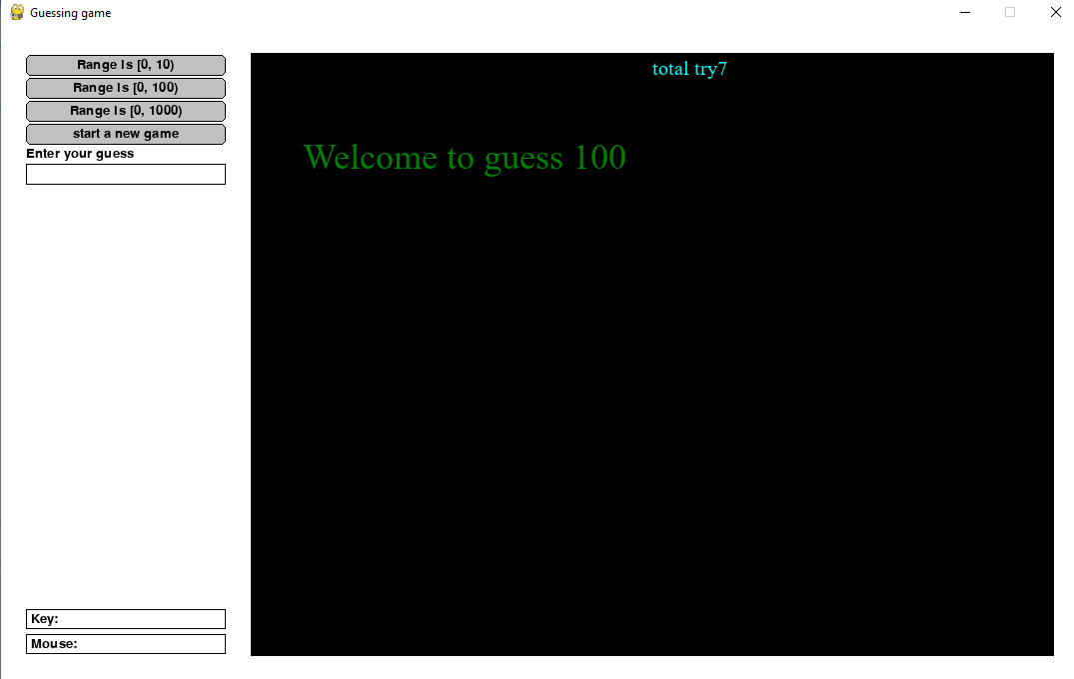
Output

Slide 7
THANK YOU….

