Slide 1

MANGAL.BHAV
Empowering religious entities through digital innovation.

Slide 2
Index
Executive Summary
Problem Statement
Problem Definition
Mangal Bhav Solutions
Market size
Pre-launch activities

Slide 3
Executive Summary
What is Mangal.Bhav App?
Mangal Bhav is a mobile app that helps people connect with Hindu spiritual services, like booking a Pandit for puja, getting daily mantras, and learning about rituals and festivals, all from your phone.
Why is it needed?
Many people today are busy, live far from temples, or don’t know how to perform rituals. Mangal Bhav helps them stay spiritually connected through their phones by making it easy to access pujas, mantras, and teachings anytime, anywhere
What is the plan?
The plan for the Mangal Bhav app is to make it easy for people to stay connected with their faith in today’s busy world. You’ll be able to book a Pandit for pujas, get daily spiritual updates, and watch videos. Best of all, you can use the app in your language, so everything feels familiar and comfortable.

Slide 4
Problem Statement
Most religions lack strong digital community engagement.

Slide 5
Problem Definition
Who’s it for ? | Challenges | Solution | Impact
Jajmaans | Hard to find trustworthy priests Busy lifestyle Difficult to make donations | Verified pandits Ritual checklists Flexible scheduling Easy digital donations | Access to authentic rituals Spiritual convenience community
Panditjis | Limited digital reach Usually not tech-savvy Lack of regular bookings | Digital visibility Direct booking system | Increased Income More Outreach

Slide 6
Problem Definition
Younger Generations | Disconnected from traditions Lack of guidance | Easy mobile access Book from anywhere | Reconnection with culture Participation made easy Meaningful spiritual engagement.

Slide 7
MANGAL.BHAV: AI-Powered Platform
Seamless Booking- Effortless scheduling of rituals enabled by our AI driven platform.
Our intuitive platform bridges devotees with religious services, enhancing spiritual connection
Easy donations- Simplified donation options for temples and religious trusts.
Curated Services- Providing verified, experienced, and trustworthy carefully curated pandits.

Slide 8
Market Size
79.8% Approximate Hindu Population out of 121.09 crores.
6-7 million Estimated number of practicing pandits/priests in India
Average 8-9 lakh Hindu temples ranging from small local shrines to major pilgrimage centers.
Sources :-
https://en.wikipedia.org/wiki/Religion_in_India?utm_source=chatgpt.com-
https://blog.dharmikvibes.com/p/648907-temples-a-state-wise-breakdown-india?utm_source=chatgpt.com

Slide 9
Marketing Strategy
Digital Outreach: Post Instagram/YouTube reels showing temple events and rituals, then partner with religious influencers to promote the app.
Offline events: Hosting free rituals in community halls with the help of pandits or Panditji's.
Engage using Popup Notifications- We can add notifications that would pop up for the devotees and other who will sign up to the app/website
Highlight Language Accessibility: Market the language support feature that is comfortable and familiar for the target audience.
Partnership with temples and ashrams: Collaborate with local temples, spiritual centers, and dharmic organizations to promote the app by providing referrals.
QR code- one-stop solution for authentic Hindu poojas, trusted pandits, and spiritual guidance and add communities.

Slide 10
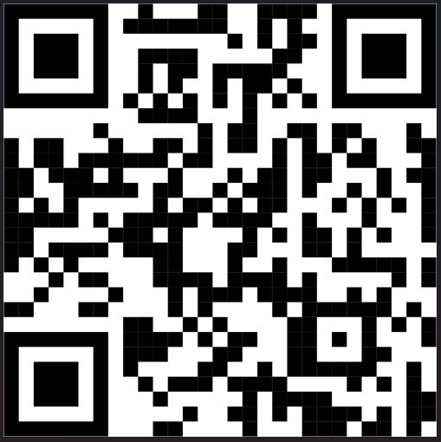

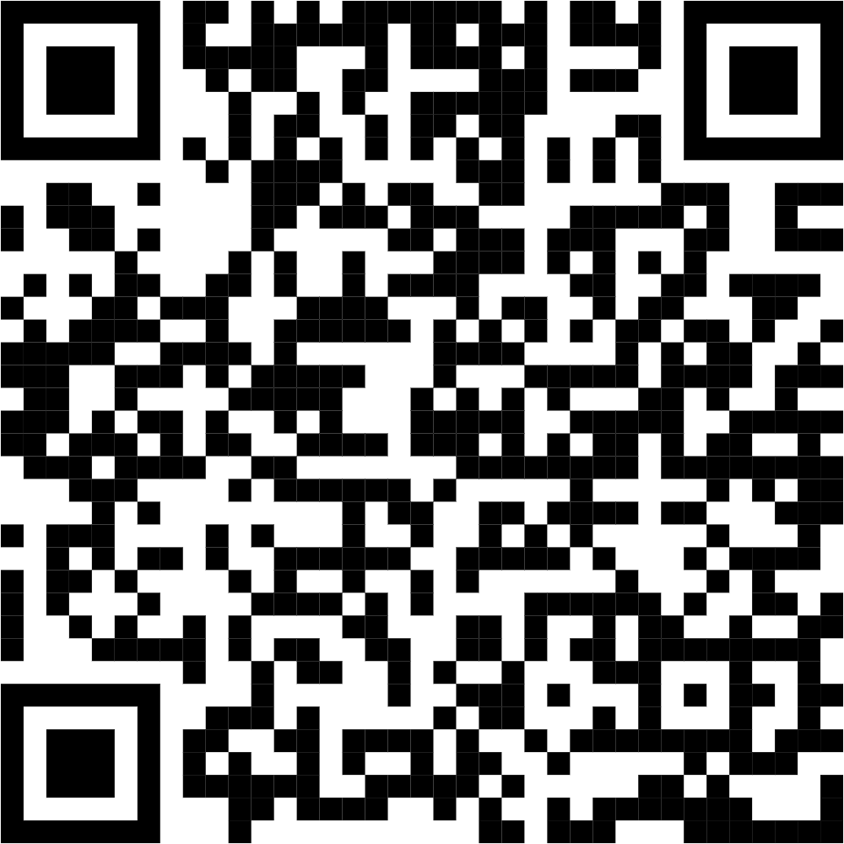

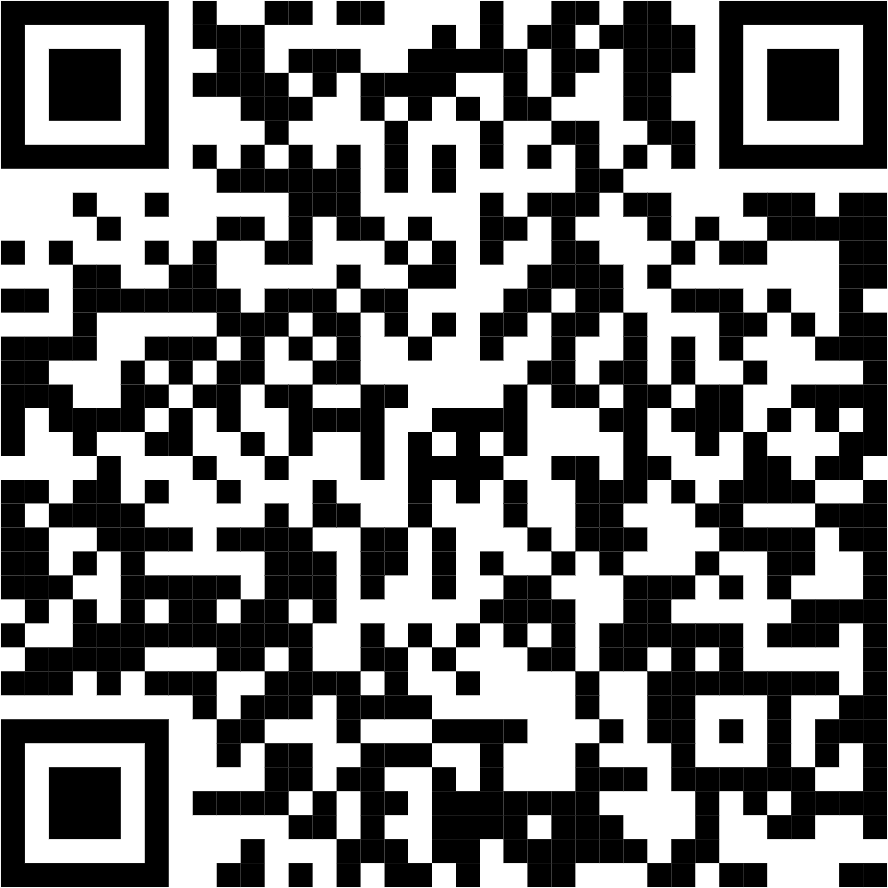

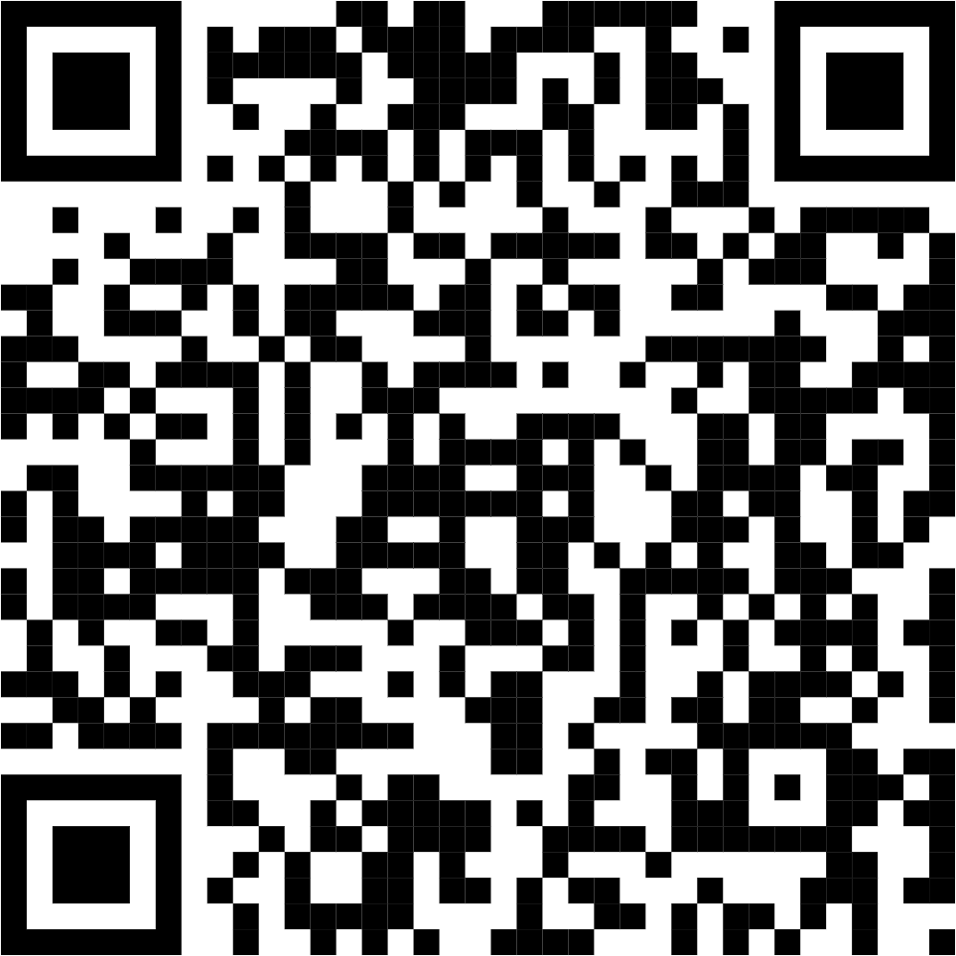
Pre-launch Activities of the Application
Generate and circulate the website QR code via print and digital media.
Website- Mangal.Bhav
Social Media Presence- Create accounts on Instagram and YouTube to share spiritual content
Mangal_bhav Mangal_Bhav Mangal Bhav
Targeted WhatsApp and SMS engagement to drive traffic to our social media pages and encourage app downloads.
Collection of Content-- Gather videos and info introducing Panditjis.
Post and share content- Edit and upload engaging spiritual videos regularly
Printed Creatives- Brochures, Visiting Cards, Posters

Slide 11
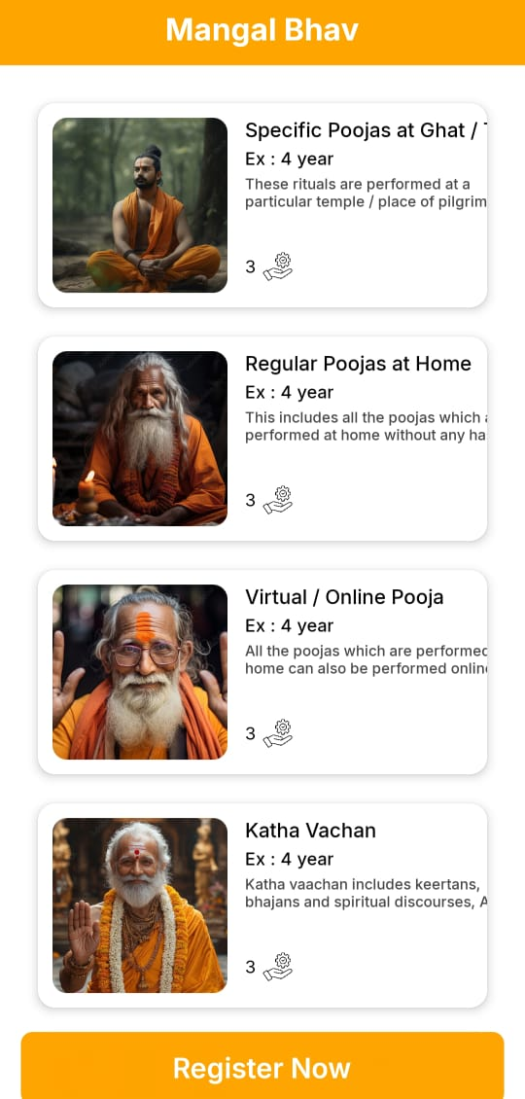
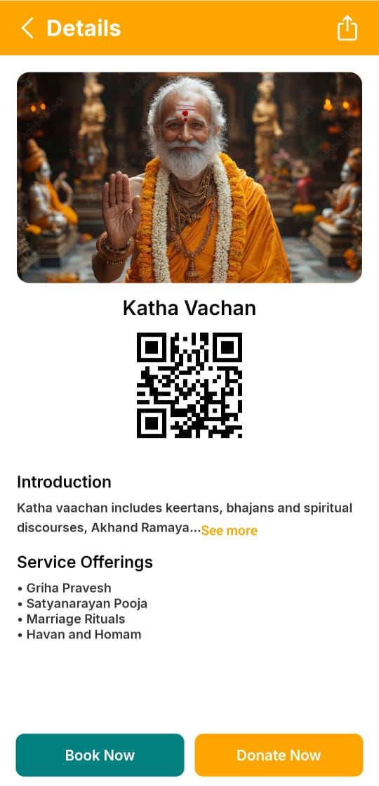
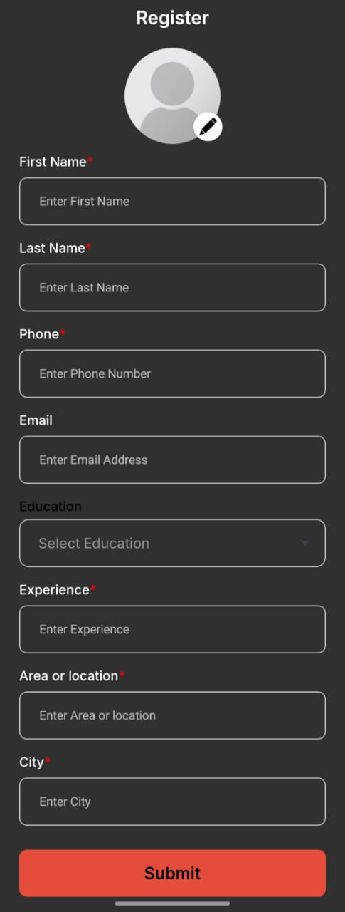
App Layout

Slide 12
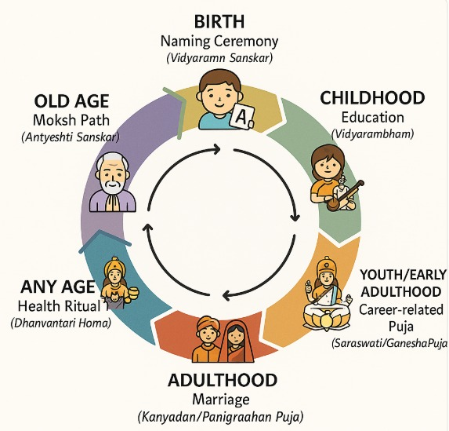
Mangal.Bhav App: Your Companion for Life’s Sanskars and Pujas
Guiding Every Stage of Life with AI
AI personalizes rituals: Suggests relevant rituals based on age and life events (e.g., birth, marriage, retirement).
Seamless planning: AI auto-schedules rituals, events, and reminders.
Content recommendations: Provides age-appropriate spiritual content, mantras, and teachings.
Upcoming event alerts: Notifies users about important dates (e.g., birthdays, anniversaries) with spiritual relevance.

Slide 13
Thank you

