Slide 1
AEP CHALLENGE / HACKOHI/O 2026
AI Outage
Concierge
Storm preparation for the Roanoke Valley
What could happen to my home, and what should I do?
01
Notes:
0:00–0:20 | 20 seconds
Imagine a winter storm is approaching Roanoke. You need to decide whether to charge backup equipment, protect food, or find somewhere warm. Our AI Outage Concierge turns the data behind your electricity supply into answers for your home, before an outage and throughout a simulated restoration journey.
Sources: aep_challenge.pdf, pp. 2–5; OHIO Judging Rubric.xlsx, Judging Rubric sheet; project documentation and current source code.

Slide 2
The data behind one home
117,642
110
15
customer premises
circuits
cleaned tables
Network relationships identify the equipment feeding each home.
Historical storm damage informs risk. AEP labor references and repair dependencies inform restoration scenarios.
02
Notes:
0:20–0:50 | 30 seconds
We connected fifteen cleaned tables covering 117,642 premises across 110 circuits. The important question was whether risk lives at the house or upstream on the line that supplies it. We used the equipment chain to connect each home to shared failure points. Trained risk models use historical damage and network features. A separate simulator combines expected damage, repair labor, crew assumptions and repair order to estimate duration. The language model explains these computed results.
Sources: aep_challenge.pdf, pp. 2–5; OHIO Judging Rubric.xlsx, Judging Rubric sheet; project documentation and current source code.
Specific evidence: docs/04-data-and-aws/cleaned-data-notes.md; docs/01-overview/scope-and-data-usage.md; backend/app/predict.py; backend/app/chat.py.

Slide 3
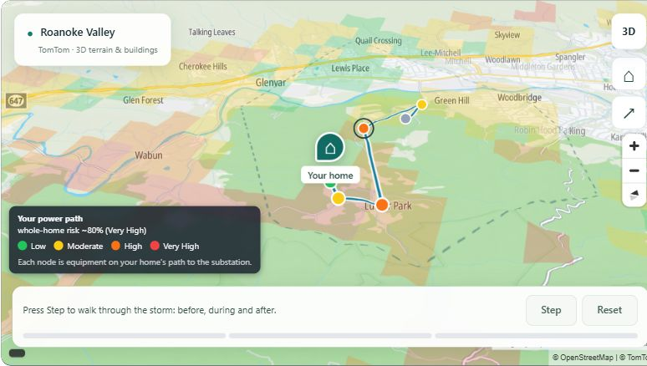
Your power path makes risk visible
One selected home
See the upstream equipment and the weakest link.
Ask why
The concierge explains the same model results in plain language.
03
Notes:
0:50–1:25 | 35 seconds
Here is the working prototype, with our new TomTom map. We select an anonymized premise and show only that home. The colored areas summarize predicted risk, while the connected points show the equipment feeding it. This makes a shared upstream failure understandable. The customer can ask why their home has this risk, and the concierge uses their profile and read-only calculation tools. Our research into outage maps and alert tools motivated this focus on personal preparation and explanation.
Sources: aep_challenge.pdf, pp. 2–5; OHIO Judging Rubric.xlsx, Judging Rubric sheet; project documentation and current source code.
Specific evidence: .pitch-build/product.png, captured from the local dashboard; web/src/tomtomMap.ts; backend/app/profile.py; docs/03-research/existing-solutions.md. Screenshot contains model estimates, not confirmed outage conditions.

Slide 4
A restoration range becomes a preparation plan
80%
10–44 hours
outage chance in this demo scenario
likely restoration range if power goes out
Change crews or access conditions to recalculate the estimate.
Compare the duration with household needs. Review preparation steps and follow the simulated alert journey.
Model estimates for one demo home in a historical storm scenario
04
Notes:
1:25–2:00 | 35 seconds
For this demo home, the February-like storm setting gives about eighty percent outage risk and a likely restoration range of ten to forty-four hours if power fails. These are model estimates, not confirmed utility information. Changing crews or access conditions recalculates the range. We then connect that duration to practical household needs through Time That Matters and preparation guidance. The replay demonstrates four messages: before the storm, outage confirmed, estimate updated, and restored. Medical needs come only from the customer declaring them.
Sources: aep_challenge.pdf, pp. 2–5; OHIO Judging Rubric.xlsx, Judging Rubric sheet; project documentation and current source code.
Specific evidence: local dashboard, default Salem premise 400797248 at severity 1.0 and two crews; backend/app/concierge.py; web/src/prepare.ts. Alerts are prototype messages, not real SMS delivery. Guidance and alert rules use the baseline outlook; do not claim all guidance changes with every restoration slider.

Slide 5
The data changed our approach
What failed
What we built
Repair dates recorded coarse closeouts. They could not support a precise restoration forecast.
An explainable scenario simulator using labor hours, dependencies and adjustable crew inputs.
Trust controls
Labeled estimates, explicit assumptions, private sessions and a fallback when information is missing
05
Notes:
2:00–2:35 | 35 seconds
One important pivot came from testing the data. Repair dates were too coarse, and some reflected administrative closeouts. We replaced a learned restoration-time forecast with an explainable simulator that responds to operational assumptions. We also tested risk on a different storm and found that storm strength and location affect transfer. We therefore disclose uncertainty and keep severity explicit. The assistant is instructed to use tool facts, acknowledge missing information and escalate emergencies. Sessions expire and can be cleared.
Sources: aep_challenge.pdf, pp. 2–5; OHIO Judging Rubric.xlsx, Judging Rubric sheet; project documentation and current source code.
Specific evidence: docs/05-judging/navigating-challenges.md, entries 4, 12, 15 and 16; backend/app/chat.py. Model scoring artifacts differ by revision, so this deck makes no quantitative model-performance claim. No live weather or outage-management feed is connected.

Slide 6
Customer value and the next step
A customer can plan before the lights go out
The prototype connects grid engineering with household decisions and plain-language explanations.
Next: connect live utility feeds, test with customers, and validate on more storms
06
Notes:
2:35–3:00 | 25 seconds
The value is a clearer household decision before the lights go out: what might happen, what could change the estimate, and how to prepare. We have a working prototype that combines grid engineering, geospatial analysis and customer communication. Our next steps are live utility integration, customer testing and validation across more storms. Today, this is a transparent scenario assistant with a complete demonstrated customer journey.
Sources: aep_challenge.pdf, pp. 2–5; OHIO Judging Rubric.xlsx, Judging Rubric sheet; project documentation and current source code.
Scope: proposed benefits are not measured deployment outcomes. Live telemetry, delivery of real alerts, automatic data refresh and broader validation remain future work.

