Slide 1
Voice-Based Email & Messaging Assistant
Hands Free Communication
Milestone 1 :Setup and Authentication
TimeLine: Weeks 1-2 January 2026
Prepared By: Vedanti Nagesh Lavekar
Guided By: Dr. Santhiya Krishnasamy

Slide 2
Presentation Outline
Introduction
Problem Statement
Aim & Objectives of the Project
Scope of the Project
Milestone 1 Overview & Deliverables
Milestone 1 Key Achievements
Technology Stack
System Architecture
Database Design
Conclusion

Slide 3
Execution Timeline - Milestone 1
Timeline: Weeks 1–2 (January 2026)
Week 1
Requirement analysis and problem understanding
Finalization of project scope and objectives
System architecture design (Three-Tier Architecture)
Database schema design (User & UserProfile tables)
Backend setup using Flask framework
Week 2
Implementation of user registration and login
Integration of speech-to-text and text-to-speech modules
Facial authentication setup
Basic voice command flow implementation
Security configuration and initial testing
Milestone 1 review and documentation

Slide 4
Introduction
A voice-based system for managing email and messaging tasks
Enables hands-free interaction using speech recognition and text-to-speech.
Reduces dependency on keyboard and mouse-based communication
Provides secure authentication using credentials and facial recognition.
Designed using a three-tier architecture for scalability and security

Slide 5
Problem Statement
Traditional email and messaging systems rely heavily on keyboard and mouse input
Such systems are difficult to use for visually impaired users and hands-free environments
Existing voice-based solutions often lack secure authentication and accuracy
Manual interaction is time-consuming and inconvenient
There is a need for a secure, voice-driven communication system for efficient email and messaging management

Slide 6
Aim of the Project
To develop a voice-based email and messaging assistant for hands-free communication
To provide an accessible and secure communication system using voice commands

Slide 7
Objectives of the Project
To design a voice-controlled interface for email and messaging
To enable hands-free interaction using speech recognition and text-to-speech
To implement secure user authentication using credentials and facial recognition
To process and execute voice commands accurately
To store and manage user data securely using a database
To follow a three-tier architecture for scalability and maintainability

Slide 8
Scope of the Project
Develop a voice-based interface for email and messaging operations
Enable hands-free interaction using speech recognition and text-to-speech
Provide secure user authentication using credentials and facial recognition
Supports basic email functionality (planned for Milestone 2)Allow voice-based messaging operations
Manage user profiles and preferences
Store and retrieve data securely using a database
Design the system using a three-tier architecture

Slide 9
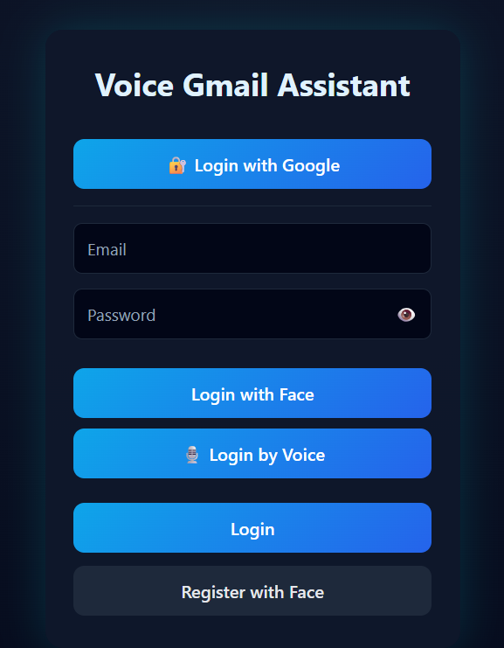
Milestone 1: Overview
Phase: System Setup & Voice Interface (Weeks 1–2)
Status: COMPLETED
System Name: Voice-Based Email & Messaging Assistant
Focus: Voice command recognition & basic communication flow
Deliverable: Functional voice interaction module for email & messaging
Ready for: Email & messaging service integration (Milestone 2)

Slide 10
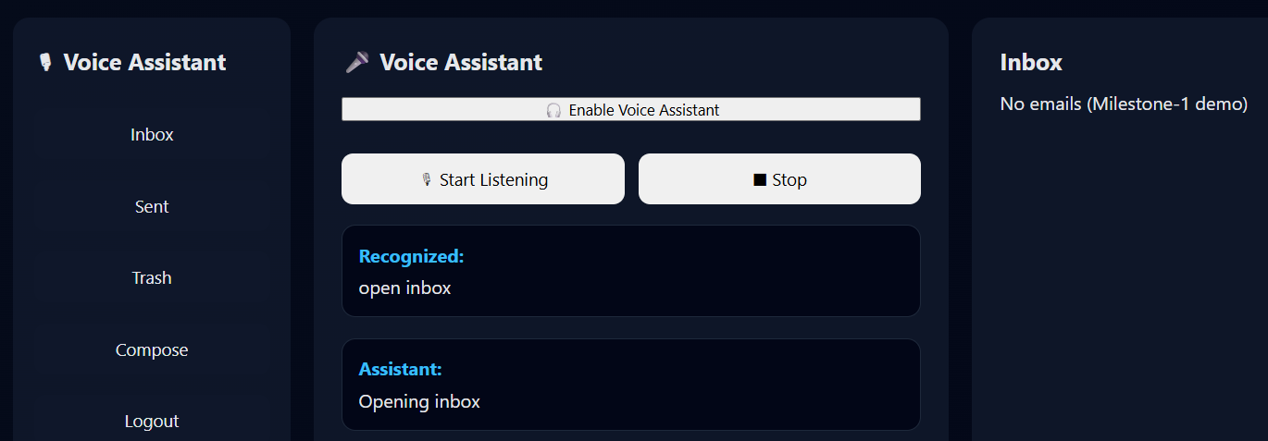
Milestone 1 Deliverables - Complete
User registration & login
Voice input (STT)
Voice output (TTS)
Facial authentication
Backend & database setup
Basic voice command flow
Security & initial testing

Slide 11
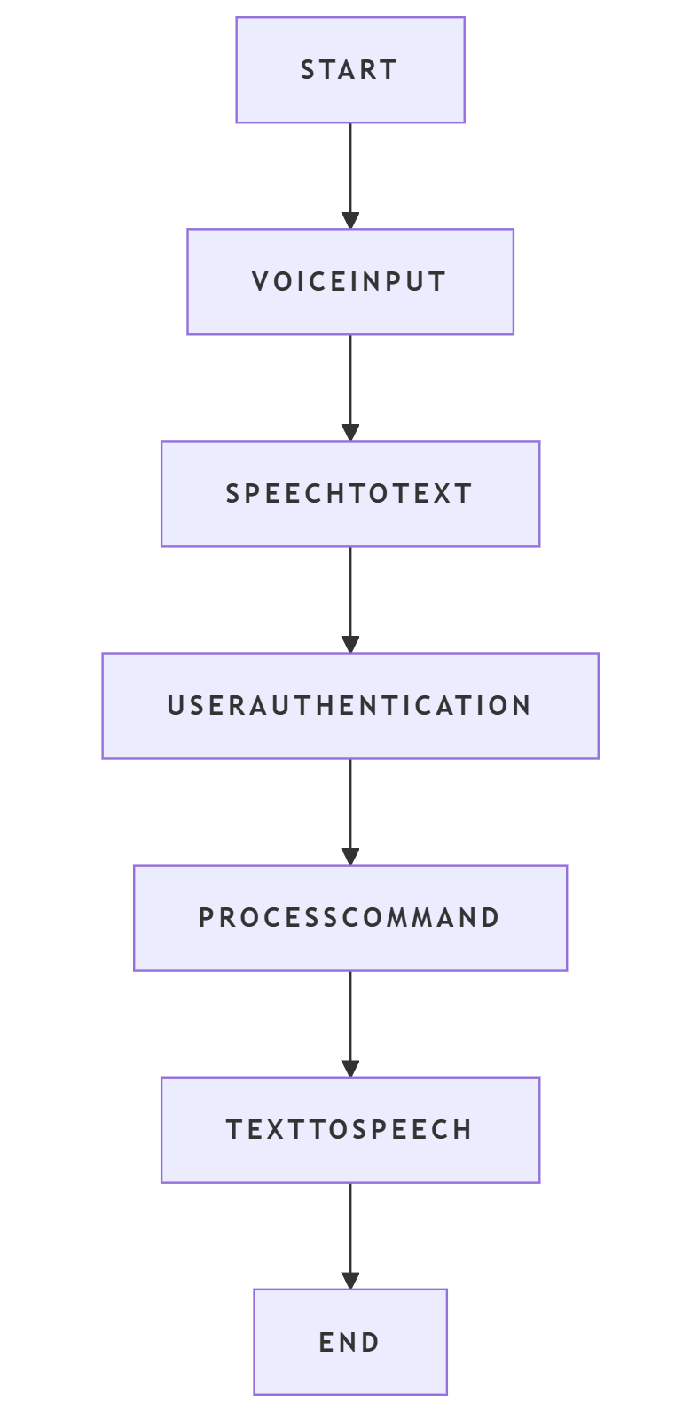
Milestone 1 – Key Achievements
Implemented voice-based user interaction
Completed secure authentication mechanism
Designed three-tier architecture
Created database schema
Established foundation for Milestone 2

Slide 12
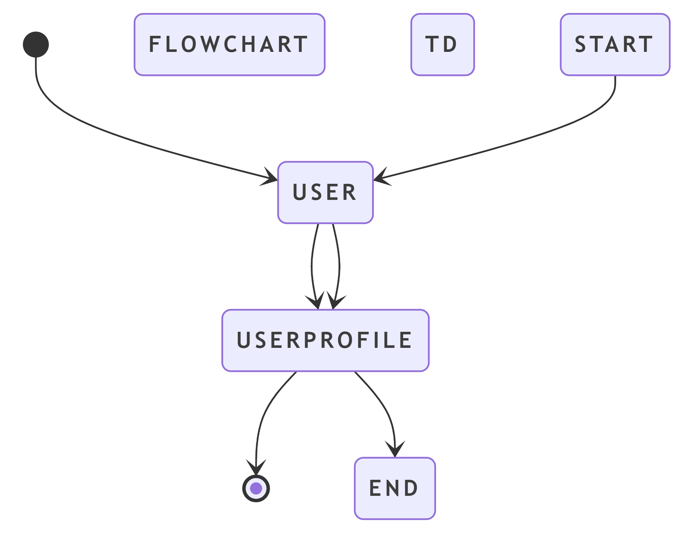
Technology Stack
Backend:
Python – Core programming language
Flask – Web framework for backend services
Flask-Login – User session management
SQLAlchemy – Database ORM
Werkzeug – Password hashing & security
Gmail API – Email sending, reading, and management
SQLite – Lightweight relational database

Slide 13
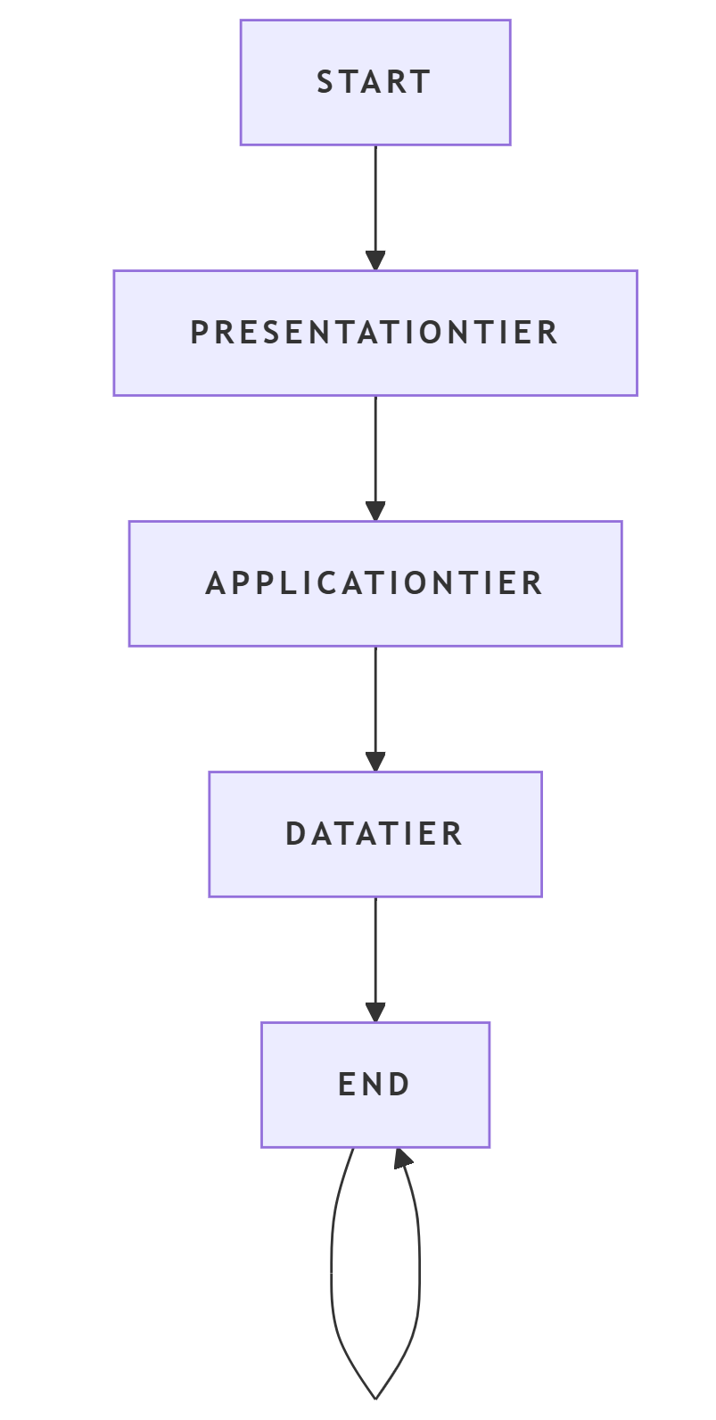
Technology Stack
Frontend:
HTML5 – User interface structure
CSS3 – Styling and layout
JavaScript (ES6) – Client-side logic
Web Speech API – Speech-to-Text (STT) & Text-to-Speech (TTS)
Face-api.js – Facial authentication (biometric verification)
Gmail API integration is planned for Milestone 2.

Slide 14
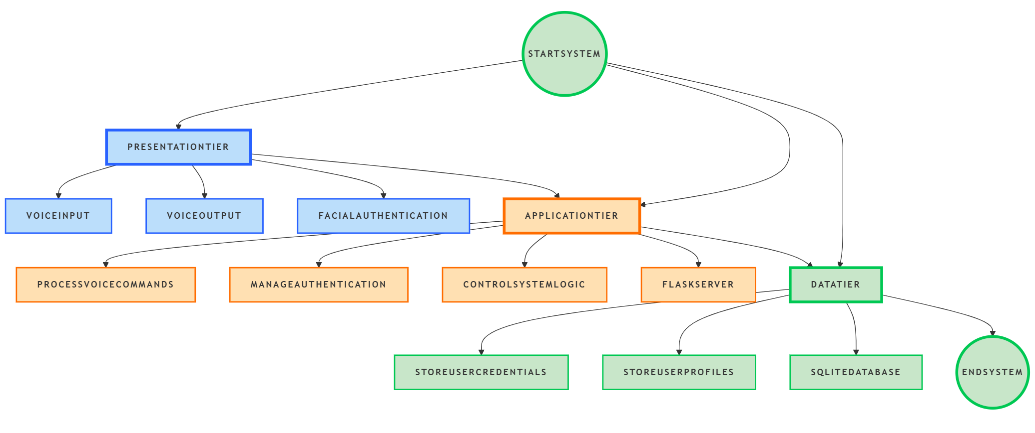
Initial System Architecture
Fig 1.1 System Architecture
This diagram represents the high-level system flow between client, server, database, and external services.

Slide 15
Database Design
User Table
Column Name | Data Type | Description
id | Integer | Unique user identifier
email | String | User email (login ID)
password_hash | String | Encrypted user password
name | String | User display name
created_at | DateTime | Account creation time

Slide 16
Database Design
User Profile Table
Column Name | Data Type | Description
id | Integer | Primary key
user_id | Integer | References User table
language | String | Preferred language
voice speed | Float | Text-to-speech speed
voice pitch | Float | Text-to-speech pitch
face_image_path | String | Facial image storage path
preferences | Text | Additional user settings

Slide 17
Conclusion
Milestone 1 focused on system setup, voice interface implementation, authentication mechanisms, and architectural design. A strong foundation has been established for email and messaging integration in Milestone 2.

