Slide 1
AI agent for chronic disease monitoring
CAPSTONE PROJECT
Presented By:
Student name :Vedant Morey
College Name & Department : G.H.Raisoni University Amravati, BCA

Slide 2
OUTLINE
Problem Statement
Technology used
Wow factor
End users
Result
Conclusion
Git-hub Link
Future scope
IBM Certifications

Slide 3
Problem Statement
Chronic diseases like diabetes and hypertension demand continuous monitoring, but traditional systems lack real-time insights and personalized support. This project aims to build an AI agent that uses wearable data, medical records, and patient inputs to provide alerts, recommendations, and medication reminders improving long-term health management through predictive analytics.

Slide 4
Technology used
IBM cloud lite services
Natural Language Processing (NLP)
Retrieval Augmented Generation (RAG)
IBM Granite model

Slide 5
IBM cloud services used
IBM Cloud Watsonx AI Studio
IBM Cloud Watsonx AI runtime
IBM Cloud Agent Lab
IBM Granite foundation model

Slide 6
Wow factors
The AI agent goes beyond standard monitoring by adapting to each patient’s needs. Its voice-enabled logging allows hands-free interaction, making it easier for elderly or visually impaired users to report symptoms or check reminders. The sentiment-aware feedback system adds emotional intelligence, analyzing text or speech input to detect stress or discomfort and adjust recommendations accordingly. Through caregiver sync mode, families can stay informed via curated updates without invading privacy. For visualization, the agent offers an insight replay dashboard, which shows health progress like a time-lapse making data intuitive and actionable. Meanwhile, its multi-disease specialization ensures tailored logic for conditions like diabetes and hypertension, each powered by micro-agents optimized for that disease. And with a privacy-first design, users control what data is shared, ensuring trust while enabling better care.

Slide 7
End users
Patients
Caregivers
Healthcare Providers
System Administrators

Slide 8
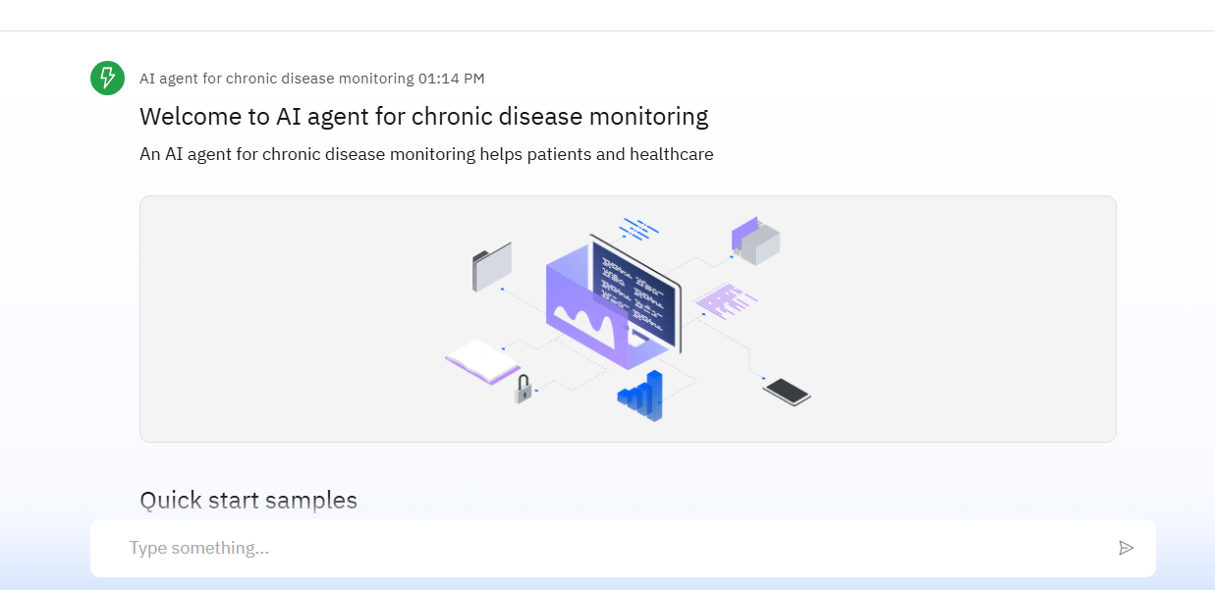
Results

Slide 9
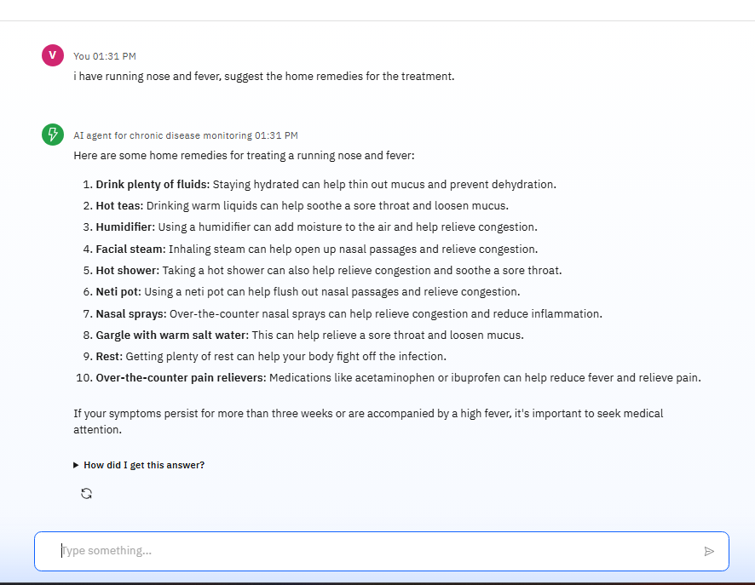
Results

Slide 10
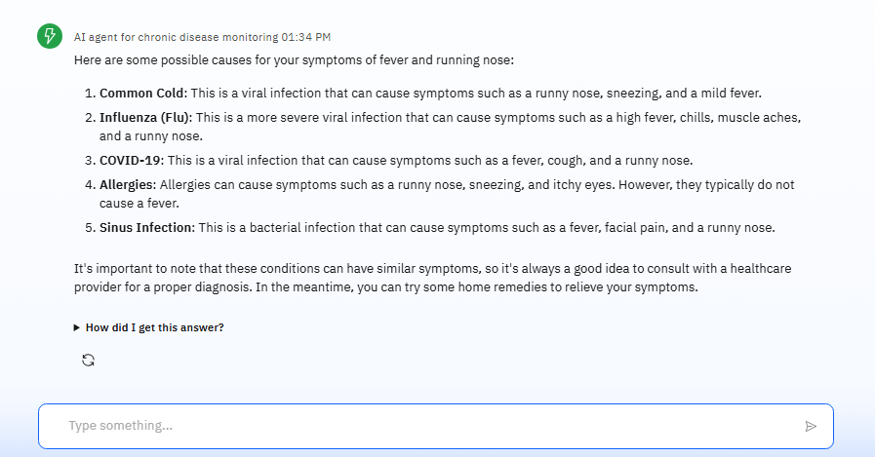
Results

Slide 11
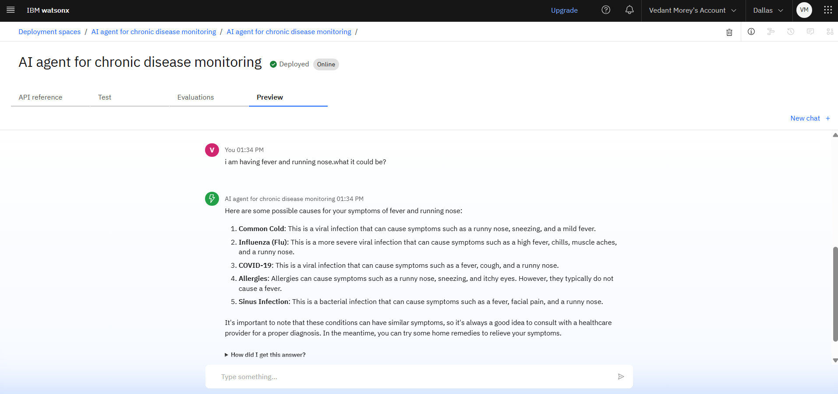
Results
Deployed AI Agent

Slide 12
Conclusion
Empowers Proactive Care – Enables real-time monitoring and personalized health insights for chronic conditions.
Enhances Accessibility – Voice interaction and caregiver sync make healthcare more inclusive and user-friendly.
Improves Outcomes – Reduces hospital visits through early detection and data-driven support.

Slide 13
GitHub Link
Github link:https://github.com/Vedantmorey/AI-agent-for-chronic-disease-monitoring

Slide 14
Future scope
Advanced Predictive Analytics – Leveraging AI models for forecasting disease progression, flare-ups, and potential complications using historical and real-time data.
Cross-Platform Integration – Expanding compatibility with smart devices, hospital systems, and telehealth platforms to ensure seamless care continuity.
Personalized Treatment Plans – Collaborating with clinical databases and genetic profiles to offer adaptive care recommendations tailored to individual needs

Slide 15
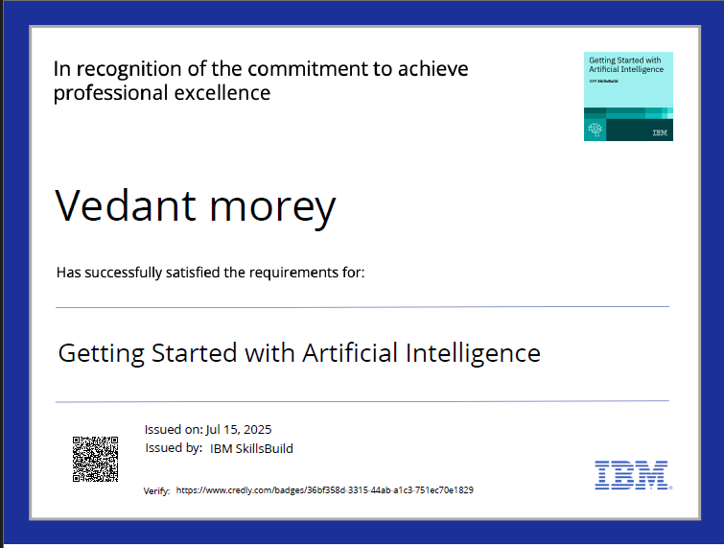
IBM Certifications

Slide 16
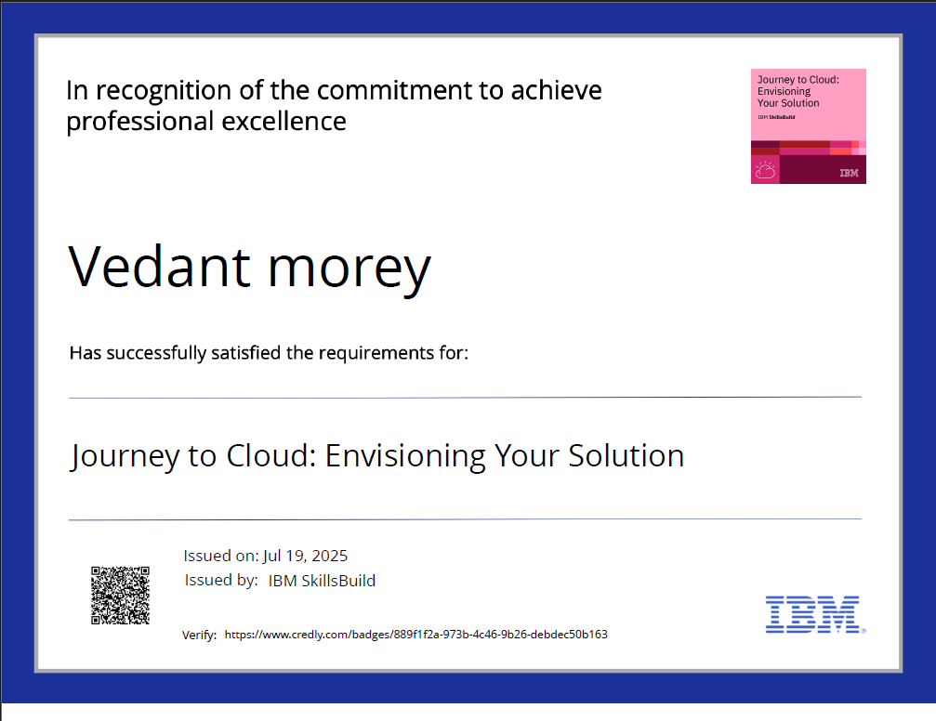

Slide 17
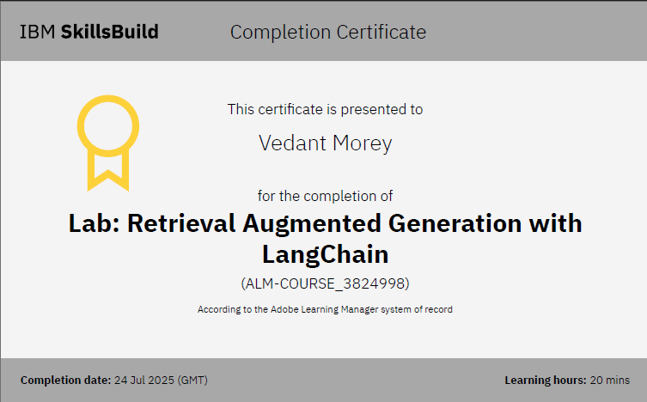

Slide 18
THANK YOU

