Slide 1
CLASSIFYING SKIN LESIONS
/SKIN DISEASES
WITH
CONVOLUTIONAL NEURAL NETWORKS

Slide 2
INTRODUCTION
With advent of Artificial Intelligence (AI) in computer field it has now become an integral part of our life. We find it used in our text recommendations, ad personalization, virtual assistants, and so much more! With AI making such huge strides in these fields, there is unlimited potential for it to have an impact on healthcare through deep learning.
Considering this advancement of AI we have made an end-to-end solution to classify skin lesions into different types using Deep Learning.
In order to get accurate and fast prediction or outcome, medical image analysis tech is constructed using Convolutional Neural Networks — a type of deep neural network which contains a filter that can understand certain types of patterns in the medical images.

Slide 3
The work is done with the vision of being the stepping stone for newer approaches that democratize and distribute access to health care. A good lesion classification model may be the motor that will accelerate the construction of tools that puts the possibility of early diagnosis and alert on patient‘s hands, even far isolated patients, where few doctors can reach. These tools may save many lives and reduce several costs with the treatment of late-stage diseases.
The related work in this field proved that there are many algorithms capable of tackling this problem, but there is an astonishing difference between shallow and deep methods in machine learning. With that in view, this work will guide its efforts in using deep neural networks to achieve its main objective.

Slide 4
LITERATURE REVIEW
After going through a lot of research articles related to usage of deep learning in the filed of medicine , we can briefly say that all the paper/articles make use of many layers of CNNs and ANNs along with millions of images as their dataset ,thereby increasing its accuracy but decreasing its speed of prediction.
Thus instead of creating many external layers we in our model make use of Transfer Learning Techniques along with MobileNet which makes the model compatible with mobile phones as well i.e. it decreases the computing power without decreasing its accuracy and at the same time increases the speed of prediction as well.

Slide 5
METHODOLOGY
For the classification purposes, we have utilized the HAM 10000 dataset which was published for Kaggle competition.
The dataset contains 10014 images along with the following metadata stores in a CSV file :
1.] The age of the patient
2.] Sex
3.] Region of Effect
4.] Detection method

Slide 6
1} Image Classification:
The dataset is divided mainly into two categories namely Training & Validation which is further divided into 7 different types of skin lesions/skin diseases which are as follow-
Actinic Keratoses
Basal Cell Carcinoma
Benign Keratosis
Dermatofibroma
Malignant Melanoma
Melanocytic Nevi
Vascular Lesions

Slide 7
The images are of the size 228x228 suitable for most state-of-the-art classification models trained on the ImageNet dataset.
Data augmentation is performed to increase the size of the dataset for more accurate results.
Augmentation methods include reversing the image, rotation, skewing, cropping, blurring, changing the contrast and brightness of the images.
20% of the data is used for testing and validation. The testing and validation data are kept the same to achieve small losses during the training.

Slide 8
NEURAL NETWORK ARCHITECTURE
The data was trained using Transfer Learning Technique.
The idea this technique is that we take a model that was trained with a huge amount of data and use that for a new task where we don’t have as much data. Usually, this helps a lot with the accuracy of the final model and reduces training time too!
MobileNet was used mainly because of its speed. Other models like Resnet50 have better accuracy but lack in speed of computation.
What makes MobileNet faster?
Convolutional layers pass a filter over an image. Passing filter over images gets hard to compute when the image has more than one color channel (RGB has 3 channels). This is where Depthwise Separable Convolution comes into play. MobileNet uses Depthwise Separable Convolution making it much faster than the normal convolution layers without compromising on the accuracy aspect.

Slide 9
What is Depthwise Separable Convolution ?
Depthwise convolution splits the process of convolution into two steps. It passes a filter to each of the individual layers in the image giving the filter a depth of 1. If there are three layers, red, green, and blue, it would pass a different filter through each of the layers. After this, it combines the layers applying a 1x1 convolution to all the layers through a process called Pointwise Convolution. The total number of computations in Depthwise Separable Convolution is 8–9 times lower than standard convolutions and results in it being able to run on mobile devices.

Slide 10
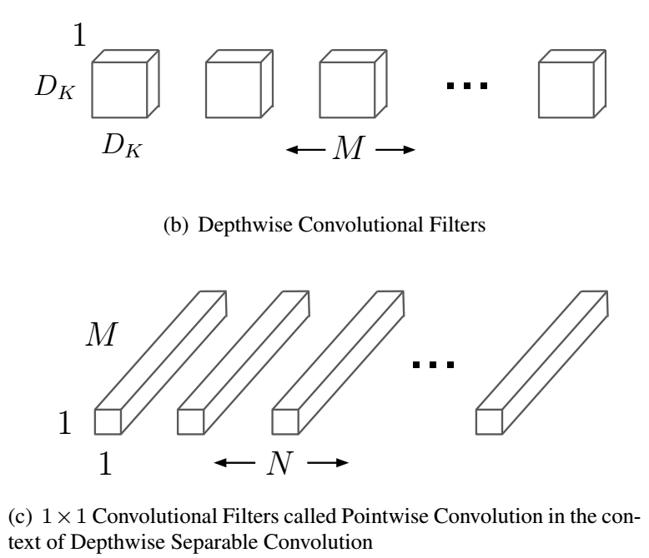

Slide 11
For the training purposes, we have used the Adam Optimizer and the Categorical Cross Entropy as the loss function.
Essentially, a Loss Function measures how wrong the model’s predictions are and the Optimizer changes the weights, accordingly , trying to make the model more accurate.
At the same time for the convolution neural network part ReLu Activation function has been used ,whereas in the output part where there are more than two classes i.e. more than two classification must be made ,we have made used of the Softmax Entropy Activation layer which is very similar to the Sigmoid Activation function.

Slide 12
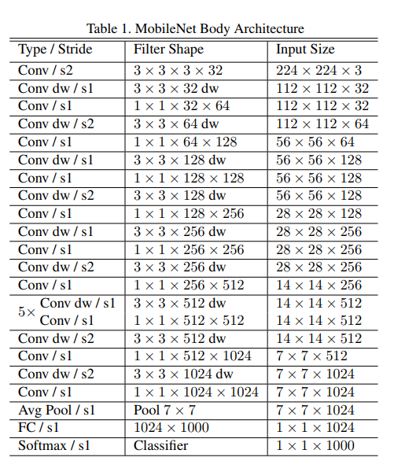

Slide 13
Neural Network Architecture
The MobileNet model is modified by removing the existing dense fully connected layers including the dropout and reshaping network layers and adding a dropout layer and a dense output layer.
We use dropout to prevent overfitting to the data. This can happen when the network gets really, good at classifying the data that you give it, but not much else. After adding this layer, we add a final, dense layer, which has an activation function attached to it. This takes all the feature maps that it has collected, and then gives us the prediction.
After we make these changes to the structure of the network, we want to freeze some of the layers to make the training time a lot faster. In this case, we freeze everything except for the last 23 layers, so our image data is trained on only the last 23 layers of MobileNet.

Slide 14
Table 2. CancerNet Body Architecture
Type/Stride | Filter Shape | Input Size
Conv/ s2 | 3 x 3 x 33 x 32 | 224 x 224 x 3
Conv dw/ s1 | 3 x 3 x 32 dw | 112 x 112 x 32
Conv/ s1 | 1 x 1 x 32 x 64 | 112 x 112 x 32
Conv dw/ s2 | 3 x 3 x 64 dw | 112 x 112 x 64
Conv/ s1 | 1 x 1 x 64 x 128 | 56 x 56 x 64
Conv dw/ s1 | 3 x 3 x 128 dw | 56 x 56 x 128
Conv/ s1 | 1 x 1 x 128 x 128 | 56 x 56 x 128
Conv dw/ s2 | 3 x 3 x 128 dw | 56 x 56 x 128
Conv/ s1 | 1 x 1 x 128 x 256 | 28 x 28 x 128
Conv dw/ s1 | 3 x 3 x 256 dw | 28 x 28 x 256
Conv/ s1 | 1 x 1 x 256 x 256 | 28 x 28 x 256
Conv dw/ s1 | 3 x 3 x 256 dw | 28 x 28 x 256
Conv/ s1 | 1 x 1 x 256 x 512 | 14 x 14 x 256
5x Conv dw/ s1 | 3 x 3 x 512 x dw | 14 x 14 x 512
Conv/ s1 | 1 x 1 x 512 x 512 | 14 x 14 x 512
Conv dw/ s2 | 3 x 3 x 512 dw | 14 x 14 x 512
Conv/ s1 | 1 x 1 x 512 x 1024 | 7 x 7 x 512
Conv dw/ s2 | 3 x 3 x 1024 dw | 7 x 7 x 1024
Conv/ s1 | 1 x 1 x 1024 x 1024 | 7 x 7 x 1024
Avg Pool / s1 | Pool 7 x 7 | 7 x 7 x 1024
FC/ s1 | 1024 x 7 | 1 x 1 x 1024
Softmax/ s1 | Classifier | 1 x 1 x 7

Slide 15
RESULTS
We have trained the model for two sets of hyperparameters and biases.
In case 2, we set the weights as below and monitor top 5 accuracy for saving the best epoch while keeping the Adam learning rate as 0.001
class_weights={
0: 2.0, # akiec
1: 2.0, # bcc
2: 2.0, # bkl
3: 2.0, # df
4: 2.0, # mel
5: 0.5, # nv
6: 2.0, # vasc
}

Slide 16
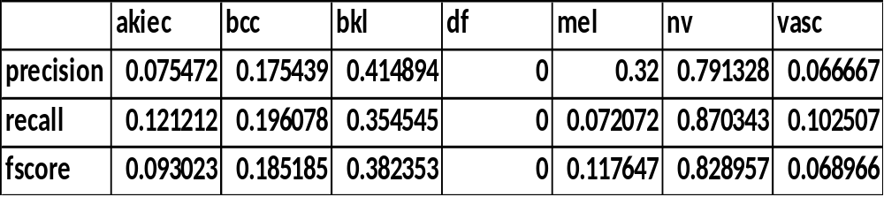
For these set of hyperparameters we have achieved the following metrics:
Micro Averaging | Macro Averaging
0.64471058 | 0.26339978
0.10250714 | 0.24081135
0.8628149 | 0.25159959

Slide 17
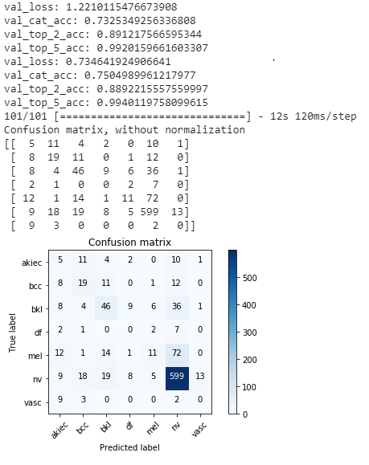
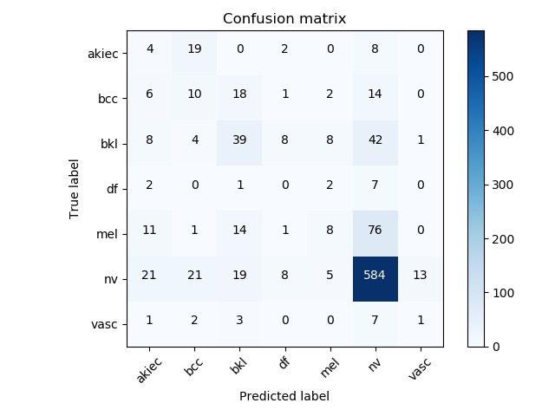
Confusion Matrix of the Model

Slide 18
OUTPUT
For the predictive analysis part ,our model can be accessed via two types of input to get the related output:
A server where the images can be provided in the form of URL or its absolute by sending a POST request to the server of an image such as -
curl -X POST -F image=@data\ISIC_0024311.jpg "http://localhost:5000/predict"
{"predictions":"You have contacted vasc","success":true}

Slide 19
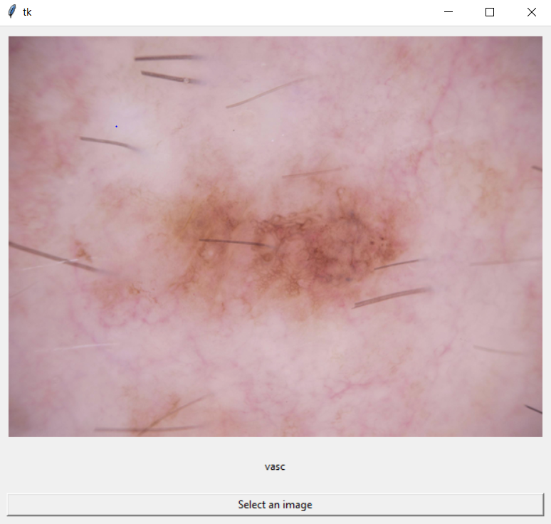
A Tkinter GUI interface-

Slide 20
DRAWBACKS
Due to small datasets and inadequate resources for training , the model is not highly inefficient and cannot be used in prediction of skin diseases in real time.
Detecting skin diseases through neural networks is not popular as there are various symptoms and causes to each type of disease and they may vary from person to person.
Training the network effectively indicates remembering a certain type of cause and effect and associating them with a certain class.
The dataset must contain more information like the results of various state of the art disease detection schemes and patient history with allergies or diseases but practical this is not possible due to confidentialities .

Slide 21
CONCLUSION
The implications of technology such as this are huge. We could potentially eradicate misdiagnosis in clinics by using AI technology, such as this.
The more data and support that we have for this, the more it can grow and become more accurate. With only 10,000 images, we achieved an accuracy of around 85%, but imagine how much better it could be if we had millions of images?
Using AI for diagnosis, we can eliminate preventable diseases, and create a future where we no longer need to worry about getting an accurate diagnosis.

Slide 22
THANK YOU

