Slide 1
Topic Cyber Security Keyloggers
Presented by : Vedant Negi
University Roll no : 2019225
Class Roll no. 75
Section : F
Mentor : Mr. Kireet Joshi

Slide 2
CONTENT
INTRODUCTION
What are Keyloggers?
Information captured by Keyloggers.
Danger from Keyloggers.
METHODOLOGY
Diagram
Python Code
Code Output
RESULT AND DISCUSSION
Protection against keyloggers.
Detecting and removing Keyloggers.
CONCLUSION & FUTURE WORK
REGARDS

Slide 3
INTRODUCTION

Slide 4
What is keylogger?
Keylogger or key stroke loggers are tools that can record every keystroke that you can type into a computer or a mobile keyboard.
As you interact with the device primarily through the keyboard, keyloggers can record lots of information about your activity.
For example : keyloggers can track credit card information that you enter, websites you visit and passwords you use.

Slide 5
Information captured by keyloggers
When the keyloggers run, they track every keystroke entered and save the data in a file.
Hackers can access this file later, or the keylogger software can automatically email the file to the hacker.
Some keyloggers, which are called screen recorders, can capture your full screen data at random intervals as well.

Slide 6
Danger of keyloggers
Hackers can steal the credit card information and make unauthorized purchase.
Malicious users can enter your email account and steal the important information or scam your contacts.
Hackers can log in your bank account or can login to your official sites and steal confidential information or transfer money out.

Slide 7
METHODOLODY

Slide 8
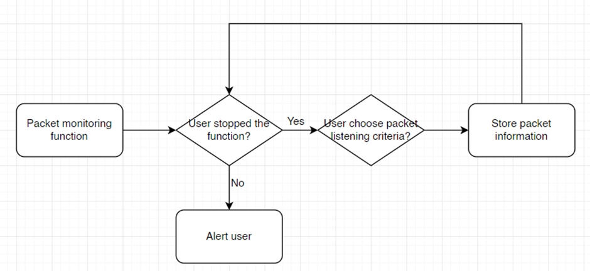
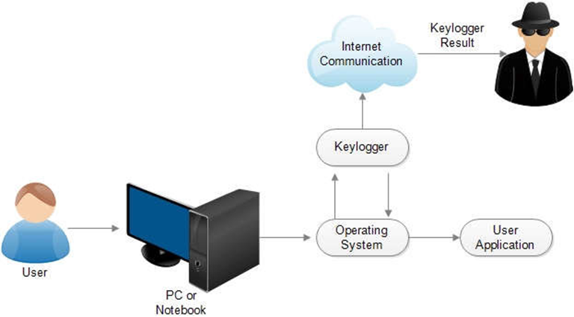
Diagrams

Slide 9
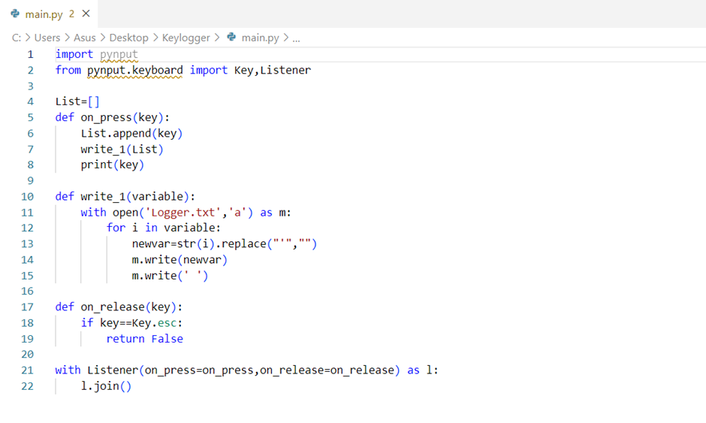
PYTHON CODE

Slide 10

Output

Slide 11
RESULT AND DISCUSSION

Slide 12
Protection against Keyloggers
Verify that the websites are legitimate :-
Cybercriminals often create convincing fake versions of popular websites.
Use a unique and strong password :-
It’s important to use unique password so that criminals can not access
to all your accounts if a password is compromised.
Verify that emails are sent from legitimate sources :-
Check for unusual email addresses and consider whether request are legitimate.

Slide 13
Detecting and Removing a Keylogger
Detecting the Keyloggers :-
A slower browser.
A lag in mouse movement and keystrokes.
A disappearing cursor.
Removing the Keyloggers :-
Uninstall the program from the device.
Clear temporary files.
Reset your device and restore it from a backup.

Slide 14
Conclusion & Future Work
In conclusion, this project highlights the serious and enduring threat of keyloggers to cybersecurity. To defend against these risks, implementing robust security measures, educating users, and embracing technical advancements are crucial. Future work should focus on behavior-based detection, encryption evasion techniques, and specialized security solutions for emerging devices. By taking a proactive and multidisciplinary approach, we can safeguard against keyloggers and enhance overall cybersecurity defenses.
Looking ahead, the future of combating keyloggers will require concerted efforts in various areas. Firstly, the development of behavior-based detection mechanisms will be crucial to identify and block new and evolving keyloggers. By utilizing machine learning and artificial intelligence, these mechanisms can recognize abnormal keyboard activity and differentiate between legitimate user input and malicious keylogging behavior. Additionally, researchers should focus on devising robust encryption schemes that can withstand keylogger attacks while maintaining usability and performance. As mobile devices and Internet of Things (IoT) become increasingly prevalent, specialized security solutions must be developed to detect and counter keylogger threats in these environments. Furthermore, cloud-based detection methods need to be explored to address the potential risks associated with keyloggers targeting cloud services. Hardware-level defenses against hardware keyloggers should also be investigated to detect and block keylogging activities at a physical level

Slide 15
THANK YOU

