Slide 1

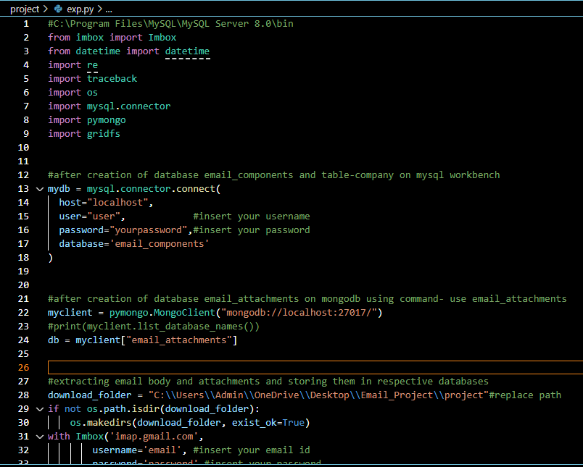
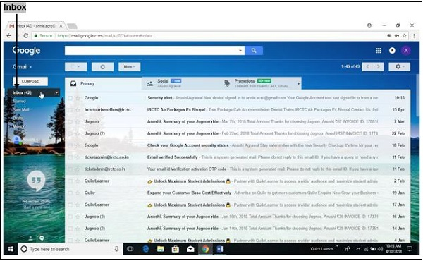
Week 2- Extracting email body and storing it in databases

Slide 2

What makes it a viable business solution?
When there is an influx of unread emails, and the company needs to maintain a record of the orders and attachments, the code efficiently stores them in respective databases.
The solution is sustainable since it automatically marks the message as read, and further the rest of the unread mails are subsequently stored in the database.
Any number of file attachments of any format (even files of size greater than 16GB) can be inserted into the database.
The records inserted can also be kept track of by the client.
The solution works perfectly well for specific mails since the client can specify/keep track of mails from specific companies or organizations.

