Slide 1

Week 3-Exploratory Data Analysis on the most trendy laptops in the market
An insightful data analysis covering the latest trend in the most prominent branded laptop models in the market, to ease up the decision making process of which laptop to buy!

Slide 2

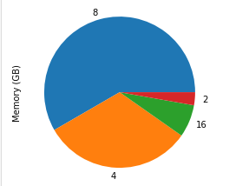
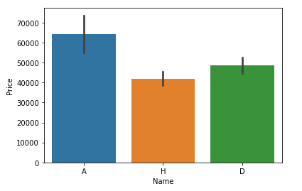
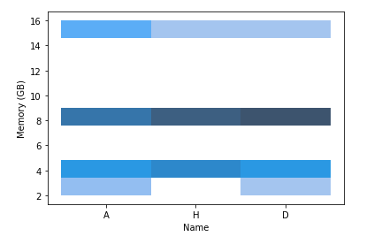
What makes the analysis useful?
The data analysis has been done on the three main laptop brands-Acer, Dell and HP.
The prices have been compared to detect the most affordable brand for the customer.
The memory and screen size are also key parameters before purchasing a laptop. The customer can decide upon the most suitable brand accordingly.
To make the interpretation easier, each parameter has been thoroughly analyzed and visualized graphically as well.
A conclusion and summary has also been done according to the analysis.

