Slide 1

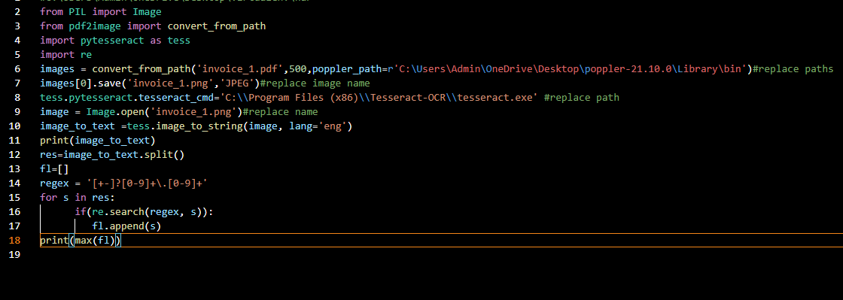
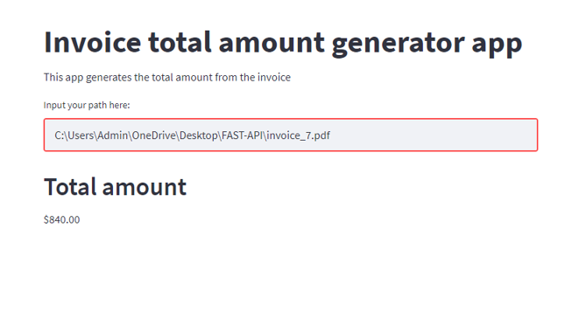

Slide 2
What makes the code efficient?
Only 4 modules were used to obtain the result, including regex and PIL (pre installed) .
Only 2 modules had to be installed,(pytesseract and pdf2image).
Thus, not many hassles regarding installation.
The desired output was produced using only 18 lines of code.
How is it user friendly?
The process is seamlessly easy as all you need is the path to your pdf file and you can get the result generated for you.
An image of the same is generated as well.

