Slide 1


Edelweiss Global Markets Hackathon
July 2023
Options Chain Tool
Let's unleash the power of Options Trading Analysis
A Presentation by TECH CAPITALISTS

Slide 2


Edelweiss Global Markets Hackathon
July 2023
Tech Capitalists
Introducing Team
Vedashree Joshi (Leader)
Mihika Dakappagari
Shruti Mungale
Hetvi Shah
Riddhi Arya

Slide 3

Edelweiss Global Markets Hackathon
July 2023
Understanding the Problem Statement
What is an Option Chain Tool?
Objectives:
1
Market Data and Dependencies
2
Implied Volatility (IV) Calculation
3
Visual Differentiation and Real-Time Functionality

Slide 4
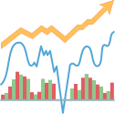

Edelweiss Global Markets Hackathon
July 2023
Need of Solution
The market data keeps changing continuously. It may change in seconds or even a fraction of seconds, based on the latest trade.
So it is imperative that there exists an application that updates users with the real time changes in the market data.
This provides valuable information about the potential risks associated with different options contracts. It will also be helpful in strategy development.

Slide 5

Edelweiss Global Markets Hackathon
July 2023
Understanding Options Stocks...
Implied Volatility
Bid Quantity
Open Interest
Strike Price
Bid/Ask
Ask Quantity
Last Traded Price
Volume
These fields provide essential information about option contracts, their trading activity, sentiment, and potential profitability.
CHANGE IN OI = Current Open Interest - Previous Open Interest
CHANGE = (Latest Trade Price - Previous Close Price)/Previous Close Price*100

Slide 6

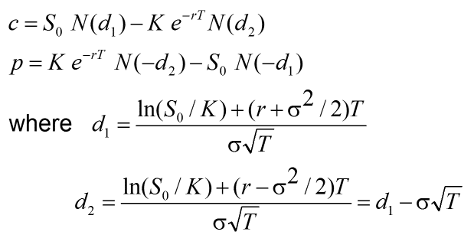

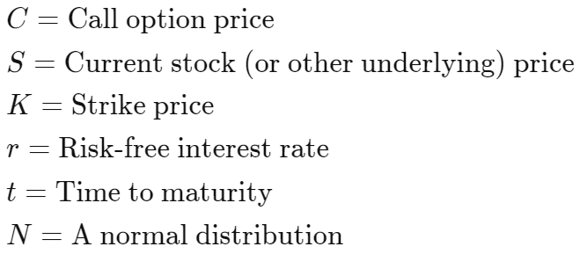

Edelweiss Global Markets Hackathon
July 2023
Understanding Options Stocks...
Implied Volatility
is derived from the
Black-Scholes formula
SciPy provides algorithms for optimization, integration, interpolation, eigenvalue problems, algebraic equations, differential equations, statistics and many other classes of problems.

Slide 7
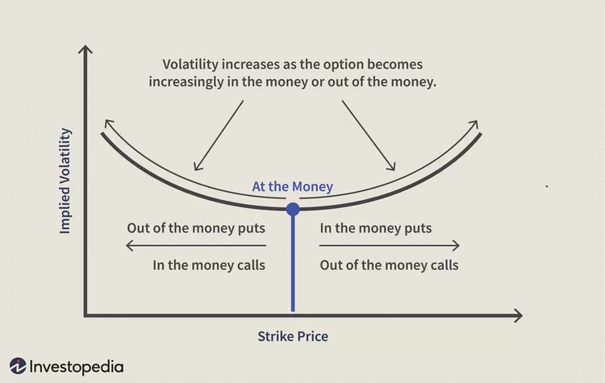
Edelweiss Global Markets Hackathon
July 2023
Understanding Options Stocks...
Volatility Smile
Volatility smiles can be seen when comparing various options with the same underlying asset and same expiration date but different strike prices.

Slide 8





Edelweiss Global Markets Hackathon
July 2023
Our Approach
Gathering &
Understanding Market
Data
Calculating Implied Volatility
(IV)
Designing
User
Interface
Integrating Frontend and Backend
Testing & Validation

Slide 9





Edelweiss Global Markets Hackathon
July 2023
Reactjs
Bootstrap
HTML
CSS
Socket Programming
Flask
Back End
Front End
Meta
Python
Javascript
Tech Stack

Slide 10
Edelweiss Global Markets Hackathon
July 2023
Why should you consider us?
As developers, we understand the importance of meeting industry needs and developing effective solutions. We have extensively researched and referred to reliable resources to align our calculations with the standard methods used in the industry and provide accuracy.
Utilizing a powerful tech stack, we have successfully implemented real-time data updates for the options chain screen based on the selected symbol and expiry date. Our frontend is developed using ReactJS, a highly capable tool for building dynamic user interfaces. On the backend, we leverage the power of Python to handle the data processing and calculations required for the options chain.
In addition to the core functionality, we have also devoted considerable effort to developing a creative and visually appealing user interface. Our UI goes beyond the scope of the problem statement by incorporating interactive dashboards and real-time market news.

Slide 11

Edelweiss Global Markets Hackathon
July 2023
The End.
References:
https://www.investopedia.com/terms/b/blackscholes.asp
https://www.investopedia.com/terms/v/volatilitysmile.asp

