Slide 1
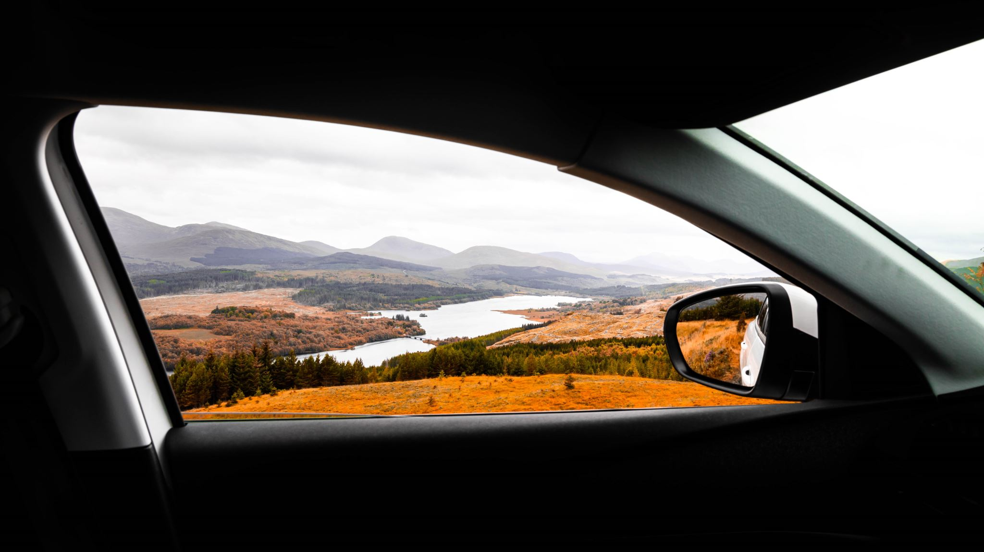
Recommendation on Taking a road trip
Students: Michele
Simon Parris
Vedasri Nakka
Professor: Edy Portmann
Supervisor: Minh Tue Nguyen
University of Fribourg
03.11.2023

Slide 2

Main idea
Develop a user-friendly technology solution that assists travellers in choosing their ideal destinations based on their personal preferences and requirements, enhancing their overall travel experience.

Slide 3
Objectives
Our platform offers users personalized travel recommendations that match their preferences.
We prioritize the most suitable destination, listing it as the top recommendation.
To make these recommendations, we will leverage accessible data on tourist trends, destination popularity, and user feedback.
Notes:
Features of Personalized Recommendations:
User Preferences: Our platform will consider user preferences, such as adventure, relaxation, culture, and more, to provide tailored recommendations.
Destination Data: We will collect and analyze data on tourist trends, seasonality, and destination popularity.
Real-time Updates: Our system will also factor in real-time information, such as travel restrictions and advisories.
Data Sources for Recommendations:
Tourist Data: We will collect data on popular destinations, traveller reviews, and activities.
Seasonal Trends: Accessible data will help us understand which destinations are popular during specific times of the year.
User Feedback: User interactions and feedback on the platform will contribute to refining our recommendations.

Slide 4
Your Feedback Matters
Age: young or old
Occupation: student, office worker, manual worker, ...
Location of departure
Maximum distance
Vacation dates
Number of people: alone, couple, group of friends, work outing, ...
Preferred language at the destination: english, french, german, ...
What type of vacation: beach, city, landscape, mountains, party
Cost: low-cost, don't care, luxurious, ...
Transportation type: car, train, bus, plane, boat
Dietary Preferences: traveler may be vegetarian, vegan etc.

Slide 5
Benefits of our system
1. Budget-Friendly Travel:
Helps travelers with limited budgets find affordable destinations.
Makes dream trips possible for those on a tight budget.
2. Exploration for Frequent Travelers:
Introduces frequent travelers to new and exciting destinations.
Encourages exploration beyond familiar places.
3. Group Travel Simplified:
Eases the process of finding destinations that everyone in a group will enjoy.
Reduces the hassle of group travel planning.
4. Enhanced Satisfaction:
Increases overall user satisfaction by offering personalized recommendations.
Creates more enjoyable travel experiences.
5. Sustainable Travel:
Promotes eco-conscious and socially responsible travel choices.
Supports responsible and sustainable tourism.
Notes:
Our system is all about making travel accessible, enjoyable, and fulfilling for everyone, from budget-conscious travellers to frequent explorers and group adventurers. We're here to help you discover your ideal destination and travel responsibly.

Slide 6

Challenges and Considerations:
Limited Data Source: Accessing accurate and up-to-date recommendations can be challenging with limited data source
Privacy: Protecting user data and privacy will be a top priority.
Real-time Information: Integrating real-time data for destination advisories is a continuous challenge.
Changing World and Travel Trend: Travel trends can shift rapidly. Trends significantly influence people's travel destination choices.
Impact of Global Events: Global events like pandemics can dramatically affect travel choices. The system must respond to sudden changes, such as travel restrictions.
User Engagement: Encouraging consistent user engagement for data collection is a challenge. Accurate recommendations depend on the quality and quantity of user data.
Staying Updated: Keeping the system updated with current travel trends is essential. Failure to adapt to evolving trends may result in less accurate recommendations.

Slide 7

Applied methods
Michine Learning Algorithms: Neural Network, Decision tre, Clustering etc.,
Collaboration filtering, Content-based filtering, Hybrid Recommender systems
Data Collection: Ssurveys, interviews, and online questionnaires etc.,
NLP: by using reviews and descriptions of travel destinations, NLP can be used to analyse text data and extract insights to improve recommendations.
Real-Time Data Integration
Feedback loop: allowing users to provide feedback on recommended destinations, which can help improve future recommendations.
Deep Learning for Image Recognition: If wes have access to destination images, deep learning models can be used to analyze and recommend destinations based on visual cues.

Slide 8
Results
Personalized Travel Recommendations
Increased Customer Satisfaction: potentially increased business
Cost Savings
Exploration of New Destinations
Simplified Group Travel
Eco-conscious Travels

Slide 9
Future Enhancements
1. Seasonal Destination Information:
Introduce a feature that allows users to input their desired destination.
Provide recommendations on the best time to visit that destination based on weather, events, and traveler reviews.
2. Traveler Reviews Integration:
Explore the possibility of integrating traveler reviews and experiences into our recommendation algorithm.
3. Eco-conscious Travel Options:
Include recommendations for eco-friendly accommodations, transportation, and activities.
4. Social Integration:
Integrate social media features that allow users to share their travel plans, recommendations, and experiences with friends and followers.
Explore the potential for social influence on travel decisions.
5. Language and Cultural Assistance:
Incorporate language translation tools and cultural guides for destinations to assist travelers in communicating and respecting local customs.
6. Voice Assistant Integration:
Incorporate voice-activated features for hands-free use, enabling users to ask questions, get recommendations, and access travel information while on the go.

Slide 10
Quesions
Would there be a way to also take that (the trends) into account?
Suggest some platform to develop our project?

Slide 11

Thank you

