Slide 1
PROBLEM STATEMENT
Most of farmers that engaging on fish farming they use local method for counting fish found in the pond by means of using assumption method and others counting by using optical sensor and proximity sensor whereby is the common method taken in the pond which lead contradiction to know the fish counted or not counted because obstacle sensor detect the object that pass Infront and proximity sensor detect object in a specific distance there fore the working principle of this system is inaccuracy as fish can be repeated counting more than one and gives wrong results as expected so in order to reduce such contradiction we decide to create automatic system for counting fish in the pond which will be accurate and more efficiency.

Slide 2
OBJECTIVE OF THE PROJECT
The objectives of the project are two parts which are
Main objective
Specific objectives

Slide 3
MAIN OBJECTIVE
To design a circuit for automatic fish counting by using image processing.

Slide 4
SPECIFIC OBJECTIVE
To study existing system for counting the number of fish in the ponds.
To design system for data collection, analysis, interpreting and give out feedback.
To build circuits and implement the prototype.

Slide 5
SIGNIFICANCE OF THE PROJECT
To count and determine the number of fish that live in the pond.
The designed system will help the farmer to provide food according to the number of fish kept.
The designed system will simplify time consuming for counting fish
The designed system will be working in more efficiency.
The designed system will be working in high accuracy.

Slide 8
EXISTING SYSTEM
The existing system operation starting when the micro controller is programmed so that it can be able to recognized the fish patterns therefore a man responsible to count the fish will put fish food in the location intended to capture fish where by obstacle sensor and proximity sensor will be positioned their for counting the fish passing Infront the sensor start as when pushing the start button the light emitting diode (LED) will turn ON to indicate the RED light to show the system is now active however when the system is activated the (LED)will indicate the YELLOW color then the optical sensor and proximity sensor will starts to count the obstacle passing Infront the positioned camera unfortunately when pushing the stop button the (LED) will indicate the GREEN light to it is stops counting hence give out the feedback by using the liquid crystal display (LCD) the total number of fish counted.

Slide 9
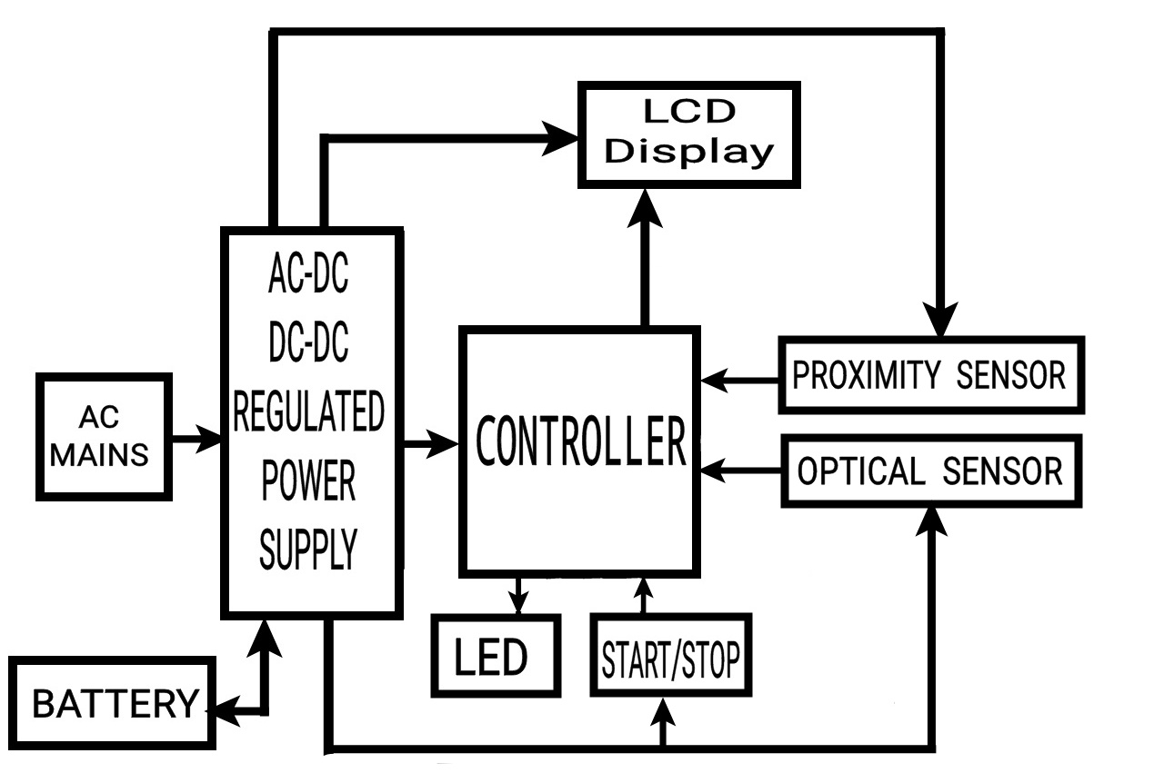
BLOCK DIAGRAM OF EXISTING SYSTEM

Slide 10
PROPOSED SYSTEM
• The proposed system operation starting when the micro controller is programmed so that it can be able to recognized the fish patterns there fore a man responsible to count the fish will put fish food in the location intended to capture fish where by 3D image (Top, Side,& Right/left camera) will be positioned to take simultaneously in order to get the exact image of fish however the 3D image obtained will be fed to the micro controller and the micro controller will prosses the images and count individual fish so the micro controller gives the output of the number of fish counted using liquid crystal display (LCD) and the green light emitting diode (LED) light will be on when switching on the circuit the red light emitting diode (LED) will be on when the start button is pushed .

Slide 11
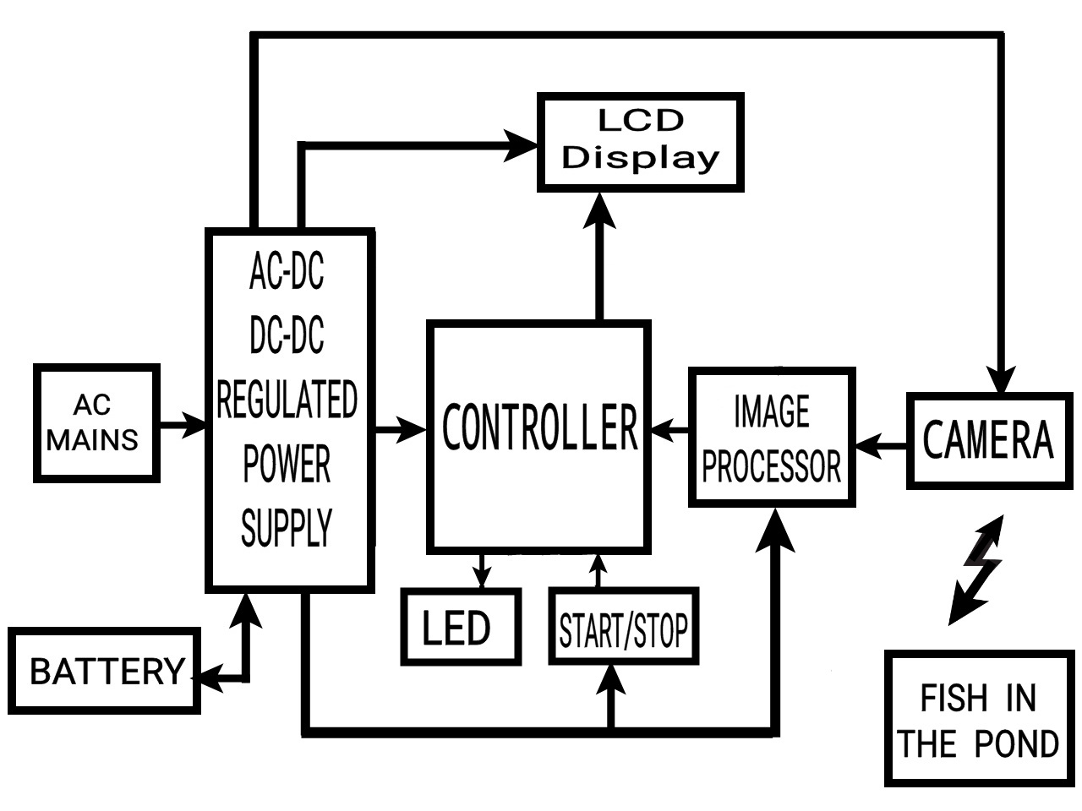
BLOCK DIAGRAM OF PROPOSED SYSTEM

Slide 12
LIST OF COMPONENTS OF THE PROPOSED SYSTEM
Power supply
Controller
LCD
Camera
Image processor
Start and stop button
LED (red, yellow, green)

