Slide 1
Fraud Risk Command Center
Stakeholder deck (Big4-style): problem → build → insights → actions
5,000
23.42%
92.78M
0.59
Transactions
Fraud rate
Fraud loss
Operating threshold
What we built
Business impact (how it’s used)
• Governed SQL warehouse (staging → curated → marts)
• QC + cleaning (production-style rules and versioning)
• Feature engineering aligned to fraud behavior
• Modeling + scoring with explainability drivers
• 4-page Power BI command center for exec + ops
• Exec: track loss, rate, and concentration
• Ops: prioritize high-risk queue with reason codes
• Analytics: understand drivers (geo/device/category/channel)
• Monitoring: threshold story + drift proxy over time

Slide 2
Problem & success criteria
Detect fraud early, reduce loss exposure, and run an efficient investigation queue
Key questions
KPIs used
• Where is fraud concentrated (region/category/channel)?
• What patterns precede fraud (velocity, anomaly, switching)?
• How well does the model separate fraud vs genuine?
• What threshold balances precision vs recall for ops capacity?
• Fraud loss and fraud rate trends
• PR-AUC (primary) and ROC-AUC (secondary)
• Precision / Recall / F1 at operating threshold
• Risk band mix and fraud capture by tier

Slide 3
Dataset snapshot
Entity coverage and label distribution
18
1,171
3,829
0
Raw columns
Fraud txns
Genuine txns
Missing (post-QC)
Dimensions used for analysis
• Customer (age, account_age_days, previous_fraud_flag)
• Geo (customer_region, is_international)
• Merchant (merchant_id, merchant_category)
• Device (device_id, device_type, ip_address)
• Channel (channel, payment_method)
• Time (transaction_datetime + derived date/hour features)

Slide 4
Data quality & cleaning
Rules applied to standardize data like a production analytics pipeline
Quality rules
Outputs
• Invalid timestamps → coerce to datetime; remove invalid rows
• Amounts ≤ 0 → remove rows
• Age outside 18–100 → set to null (or filter depending on policy)
• Duplicate transaction_id → keep latest by transaction_datetime
• clean_transactions_v1.csv (versioned export)
• QC report: counts before/after per rule
• Conformed dimensions for consistent slicing in Power BI

Slide 5
Feature engineering
Features aligned with fraud behavior: velocity, anomaly, risk context
Feature buckets
Why it matters
• Customer behavior: txn_count_1h/24h, avg_amount_7d, max_amount_24h
• Transaction context: txn_hour, day-of-week, weekend flag, channel
• Merchant risk: merchant_fraud_rate (history-based)
• Device/geo: switch flags and international indicator
• Velocity: time_since_last_txn
• Fraud often spikes with rapid bursts and abnormal amounts
• Switching device/location is a strong takeover signal
• Merchant/category concentration reveals systemic attack vectors

Slide 6
Modeling & thresholding
Evaluate correctly under imbalance; pick an operating point for ops
0.7256
0.5685
0.7002
0.5588
LR ROC-AUC (scaled)
LR PR-AUC
RF ROC-AUC
RF PR-AUC
Operating decision
• Used F1 tuning to select threshold ≈ 0.59 (balances precision/recall for review capacity).
• Output columns: fraud_probability, risk_band (Low/Medium/High), reason codes (top drivers).

Slide 7
Architecture (production-style)
Source
Excel/CSV
SQL Server
staging
SQL Server
curated dims
SQL Server
marts fact
Python
QC + Cleaning
Python
Features + Model
Power BI
Dashboards
Governance fields: ingestion_dt, source_system, load_batch_id, record_hash

Slide 8
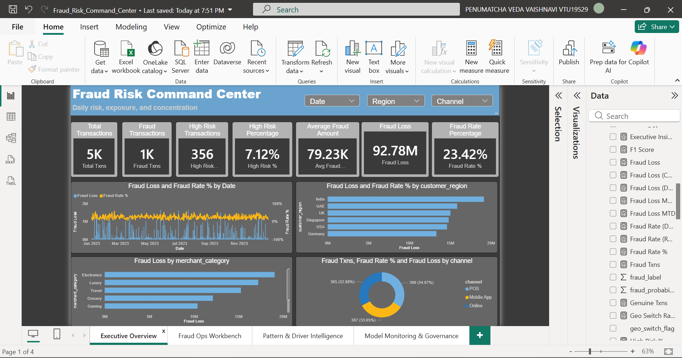
Power BI — Executive Overview
Fraud loss, fraud rate, concentration and time trends

Slide 9
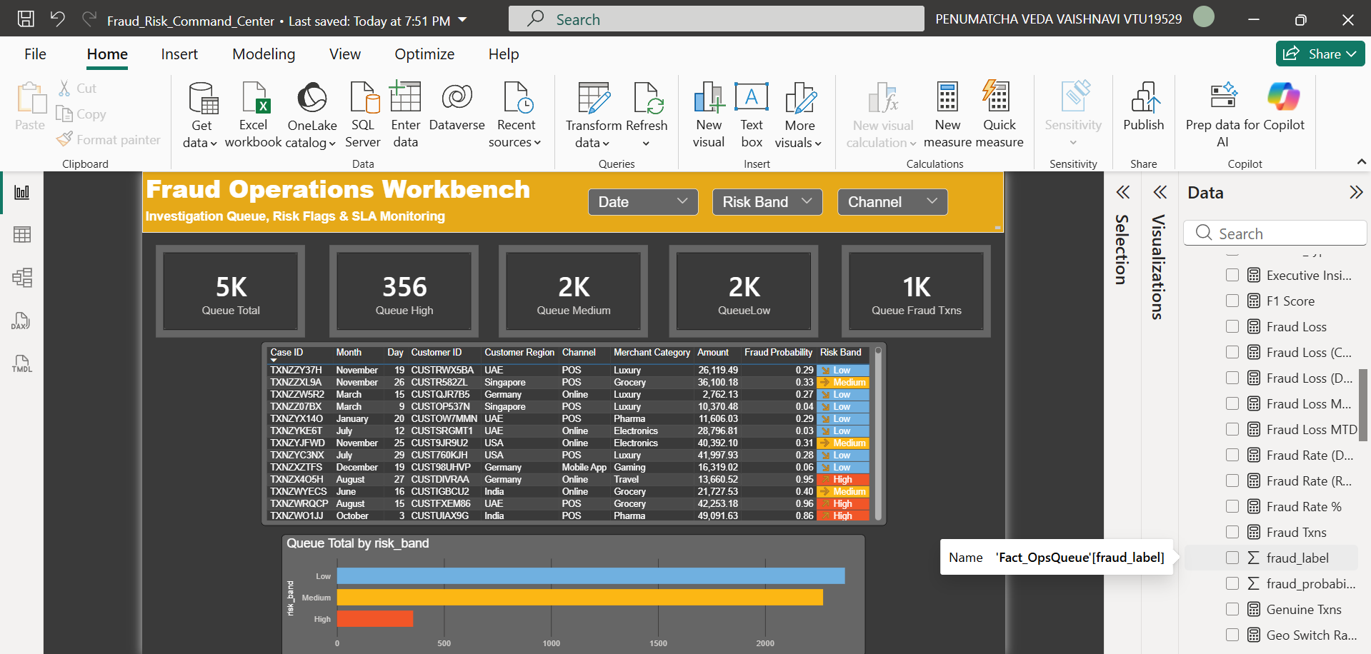
Power BI — Fraud Ops Workbench
Investigation queue with risk bands and review volumes

Slide 10
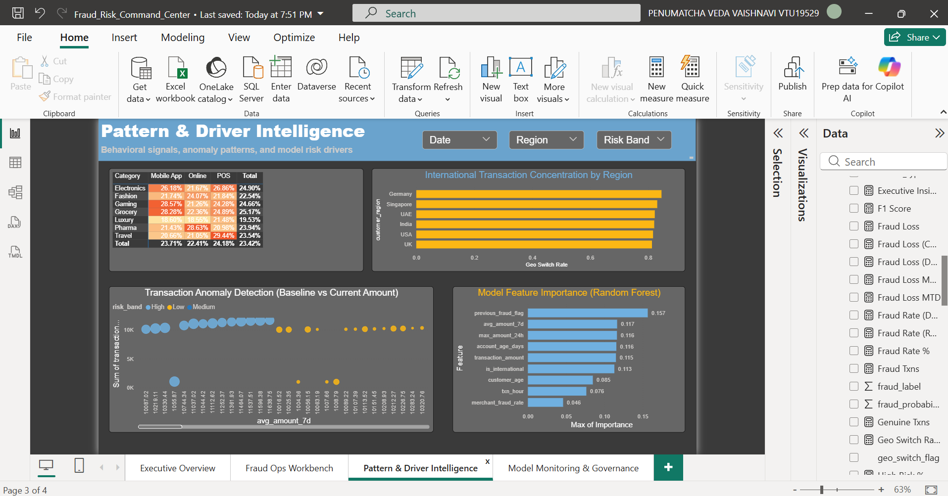
Power BI — Pattern & Driver Intelligence
Heatmap, switching patterns, anomalies, and feature importance

Slide 11
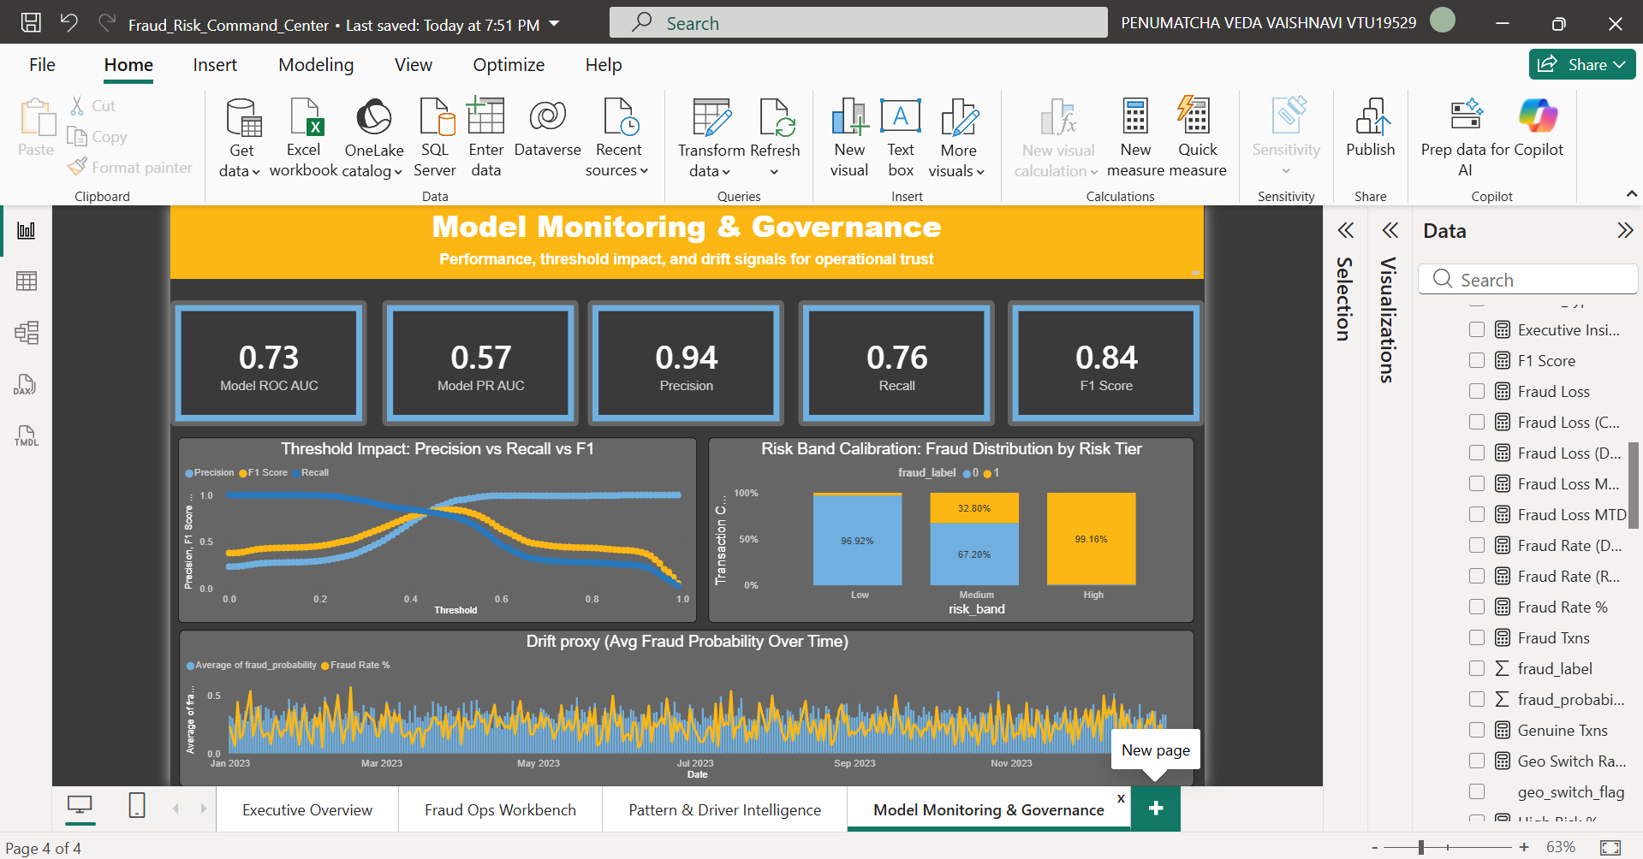
Power BI — Model Monitoring & Governance
Threshold story, calibration, and drift proxy

Slide 12
Recommendations & roadmap
What to do next to reduce loss and scale operations
Immediate actions
Next phase
• Queue strategy: review High first; sample Medium; monitor Low
• Alerts: spikes in fraud loss, geo switch rate, and international concentration
• Rules: previous_fraud_flag + international + high amount; anomaly vs avg_amount_7d; velocity bursts
• Out-of-time validation + drift metrics (PSI/KS)
• SHAP-based reason codes (XGBoost) for better explainability
• Automation: scheduled refresh + pipeline orchestration (ADF/Airflow)

