Slide 1

Handwritten Character and Numerical Recognition by using Machine Learning
Under the Guidance of
Mr.K.V.K.Sasikanth, Assistant Professor
Department of Computer Science & Engineering
Godavari Institute of Engineering and Technology, Rajahmundry.
Presented by
G.S.V.Padmavathi, 17551A0573
S.Durgasri, 17551A0548
Kouassi Alain Stéphane,17551A0532
K.Vedavyas, 17551A0587

Slide 2
Abstract
Introduction
Existing System
Proposed System
Software requirements
Architecture Model
Modules
UML Diagrams/ER Diagrams/Flow Charts
References
Abstract
Handwriting differs from person to person. Sometimes it is very difficult for a person to identify what is written from the handwritten document by other person. In this situation Handwritten Character and numerical Recognition System will brings us the reading of various combined style of writing a character.

Slide 3
Abstract
Introduction
Existing System
Proposed System
Software requirements
Architecture Model
Modules
UML Diagrams/ER Diagrams/Flow Charts
References
Abstract
Introduction
Existing System
Proposed System
Software requirements
Architecture Model
Modules
UML Diagrams/ER Diagrams/Flow Charts
References
Abstract
Introduction
Existing System
Proposed System
Software requirements
Architecture Model
Modules
UML Diagrams/ER Diagrams/Flow Charts
References
Introduction
The purpose of this project is to take handwritten English characters and numerical as input, process the character, train the K-nearest neighbour algorithm, to recognize the pattern and modify the character and numerical to a beautiful version of input.
Handwritten character and numerical recognition is an area of pattern recognition which defines an ability of a machine to analyze patterns and identify the character.

Slide 4
Introduction
Existing System
Proposed System
Software requirements
References
Abstract
Introduction
Existing System
Proposed System
Software requirements
Architecture Model
Modules
UML Diagrams/ER Diagrams/Flow Charts
References
Existing System
The existing recognition system is implemented on hand written digits taken from MNIST dataset. The system can be extended to a recognize system that can be able to recognize both digits and characters with more accuracy.

Slide 5
Introduction
Existing System
Proposed System
Software requirements
References
Abstract
Introduction
Existing System
Literature Review
Methodology
Proposed System
Software requirements
Architecture Model
Modules
UML Diagrams/ER Diagrams/Flow Charts
References
Literature Review
Research papers on handwriting character recognition systems for all types of character sets have been reviewed to see the state-of-the-art status and to identify the various approaches used for different handwritten character recognition problem. Moreover, the different handwriting analysis reported in the research papers have also been reviewed in order to get ideas on how the handwritten characters and their applications

Slide 6
Introduction
Existing System
Proposed System
Software requirements
References
Abstract
Introduction
Existing System
Literature Review
Methodology
Proposed System
Software requirements
Architecture Model
Modules
UML Diagrams/ER Diagrams/Flow Charts
References
Methodology
K-nearest Neighbour’s Algorithm:
K-Nearest Neighbour is one of the simplest Machine Learning algorithms based on Supervised Learning technique..
KNN algorithm stores all the available data and classifies a new data point based on the similarity. This means when new data appears then it can be easily classified into a well suite category by using KNN algorithm..

Slide 7
Introduction
Existing System
Proposed System
Software requirements
References
Abstract
Introduction
Existing System
Proposed System
Software requirements
Architecture Model
Modules
UML Diagrams/ER Diagrams/Flow Charts
References
Abstract
Introduction
Existing System
Literature Review
Methodology
Proposed System
Software requirements
Architecture Model
Modules
UML Diagrams/ER Diagrams/Flow Charts
References
Proposed System
Hand Written Character and Numerical Recognition works in stages as preprocessing, segmentation, feature extraction and recognition using k_neighbours. Preprocessing includes series of operations to be carried out on document image to make it ready for segmentation. During segmentation the document image is segmented into individual character or numeric image then feature extraction technique is applied on character image. Finally feature vector is presented to the selected algorithm for recognition. Here this extracted features are provided to KNN for recognition of character.

Slide 8
Introduction
Existing System
Proposed System
Software Requirements
References
Abstract
Introduction
Existing System
Proposed System
Software requirements
Architecture Model
Modules
UML Diagrams/ER Diagrams/Flow Charts
References
Abstract
Introduction
Existing System
Literature Review
Methodology
Proposed System
Software requirements
Architecture Model
Modules
UML Diagrams/ER Diagrams/Flow Charts
References
Software Requirements
Operating System : Window10
Technology : python
Tools : Anaconda jypter

Slide 9
Architecture Model
Abstract
Introduction
Existing System
Proposed System
Software requirements
Architecture Model
Modules
UML Diagrams/ER Diagrams/Flow Charts
References
Abstract
Introduction
Existing System
Literature Review
Methodology
Proposed System
Software requirements
Architecture Model
Modules
UML Diagrams/ER Diagrams/Flow Charts
References
Input Image
Preprocessing
Segmentation
Recognition
result

Slide 10
Modules
Abstract
Introduction
Existing System
Proposed System
Software requirements
Architecture Model
Modules
UML Diagrams/ER Diagrams/Flow Charts
References
Preprocessing:
The aim of preprocessing is an improvement of the image data that suppresses unwanted distortions or enhances some image features important for further processing.
Segmentation:
The goal of segmentation is to simplify and/or change the representation of an image into something that is more meaningful and easier to analyze.
Segmentation of hand written text document into individual character or digit is an important phase.

Slide 11
Modules
Abstract
Introduction
Existing System
Proposed System
Software requirements
Architecture Model
Modules
UML Diagrams/ER Diagrams/Flow Charts
References
Recognition:
In this module we will be using K-nearest Neighbour’s algortihm.
Train and test the KNN algorithm to recognize the pattern and modify the character and Numerical.

Slide 12
UML Diagrams/ER Diagrams/Flow Charts
Abstract
Introduction
Existing System
Proposed System
Software requirements
Architecture Model
Modules
UML Diagrams/ER Diagrams/Flow Charts
References
Input Image
Cancel
User
Preprocessing
Segmentation
Recognition
System
Generate Output
Use case Diagram

Slide 13
z
UML Diagrams/ER Diagrams/Flow Charts
Abstract
Introduction
Existing System
Proposed System
Software requirements
Architecture Model
Modules
UML Diagrams/ER Diagrams/Flow Charts
Output
References
System
User
1.input Image
2.Preproccessing
3.Segmentation
4.Recognition
5.Generate Output
Sequence Diagram

Slide 14

Outputs
Abstract
Introduction
Existing System
Proposed System
Software requirements
Architecture Model
Modules
UML Diagrams/ER Diagrams/Flow Charts
Outputs
References

Slide 15
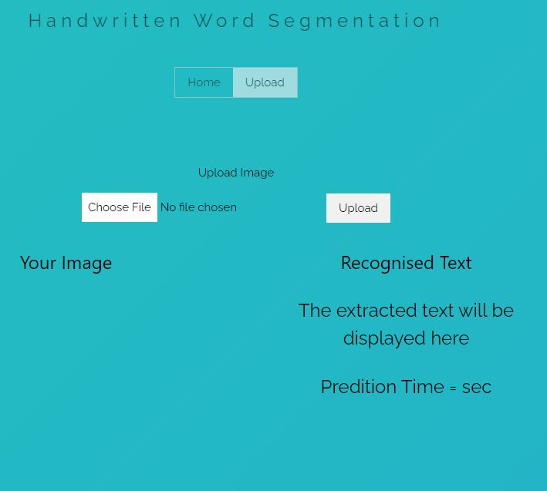
Output
Abstract
Introduction
Existing System
Proposed System
Software requirements
Architecture Model
Modules
UML Diagrams/ER Diagrams/Flow Charts
Output
Referencesc

Slide 16
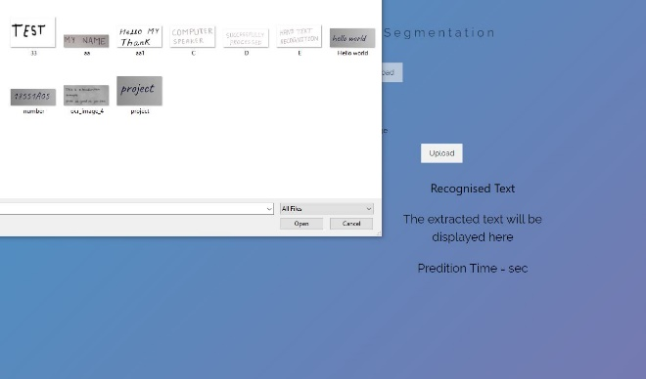
Output
Abstract
Introduction
Existing System
Proposed System
Software requirements
Architecture Model
Modules
UML Diagrams/ER Diagrams/Flow Charts
Output
References

Slide 17
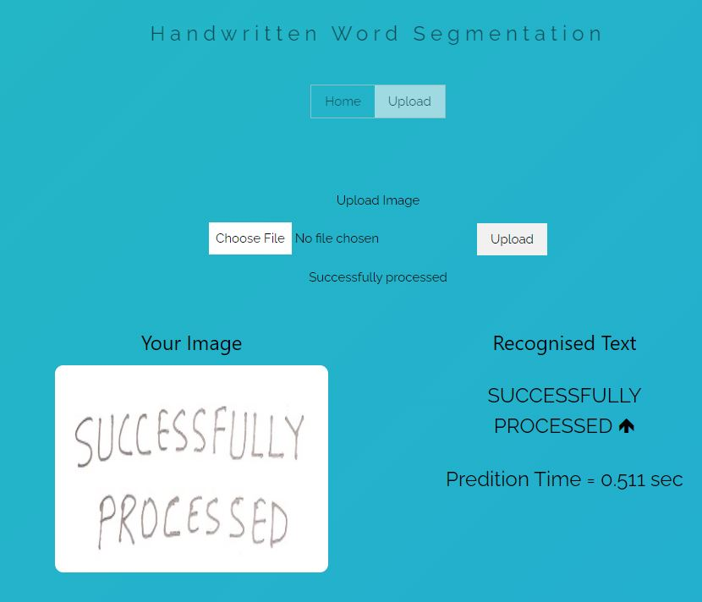
Output
Abstract
Introduction
Existing System
Proposed System
Software requirements
Architecture Model
Modules
UML Diagrams/ER Diagrams/Flow Charts
Output
References

Slide 18
Introduction
Existing System
Proposed System
Software requirements
References
Abstract
Introduction
Existing System
Proposed System
Software requirements
Architecture Model
Modules
UML Diagrams/ER Diagrams/Flow Charts
References
References
Chirag Patel, Ripal Patel: “International Journal of Scientific & Engineering Research”, “Hand Written Character Recognition using Neural Network”, pp.1-6, Volume 2, Issue 3, March-2011.
Pradeep Jayabala, E Srinivasan: “Neural network based handwritten character recognition system without feature extraction” ,”International Conference on Computer, Communication and Electrical Technology”, pp.41-45 ICCCET 2011, 18th & 19th March 2011
2/1

Slide 19
Q and A?
?

