Slide 1
Drop-D
Method pipeline

Slide 2

1.1 Background mask

Slide 3

1.2 Bakcground subtracted

Slide 4
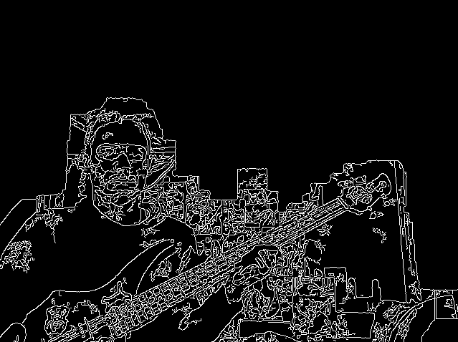
2.1 Canny edge detection with adaptive thrashold

Slide 5
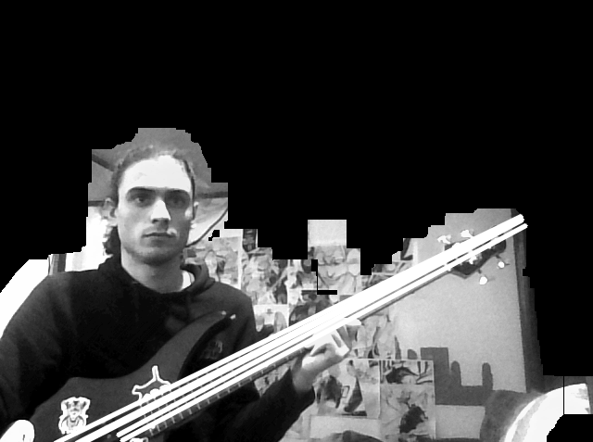
2.2 Probabilistic Hough transform

