Slide 1
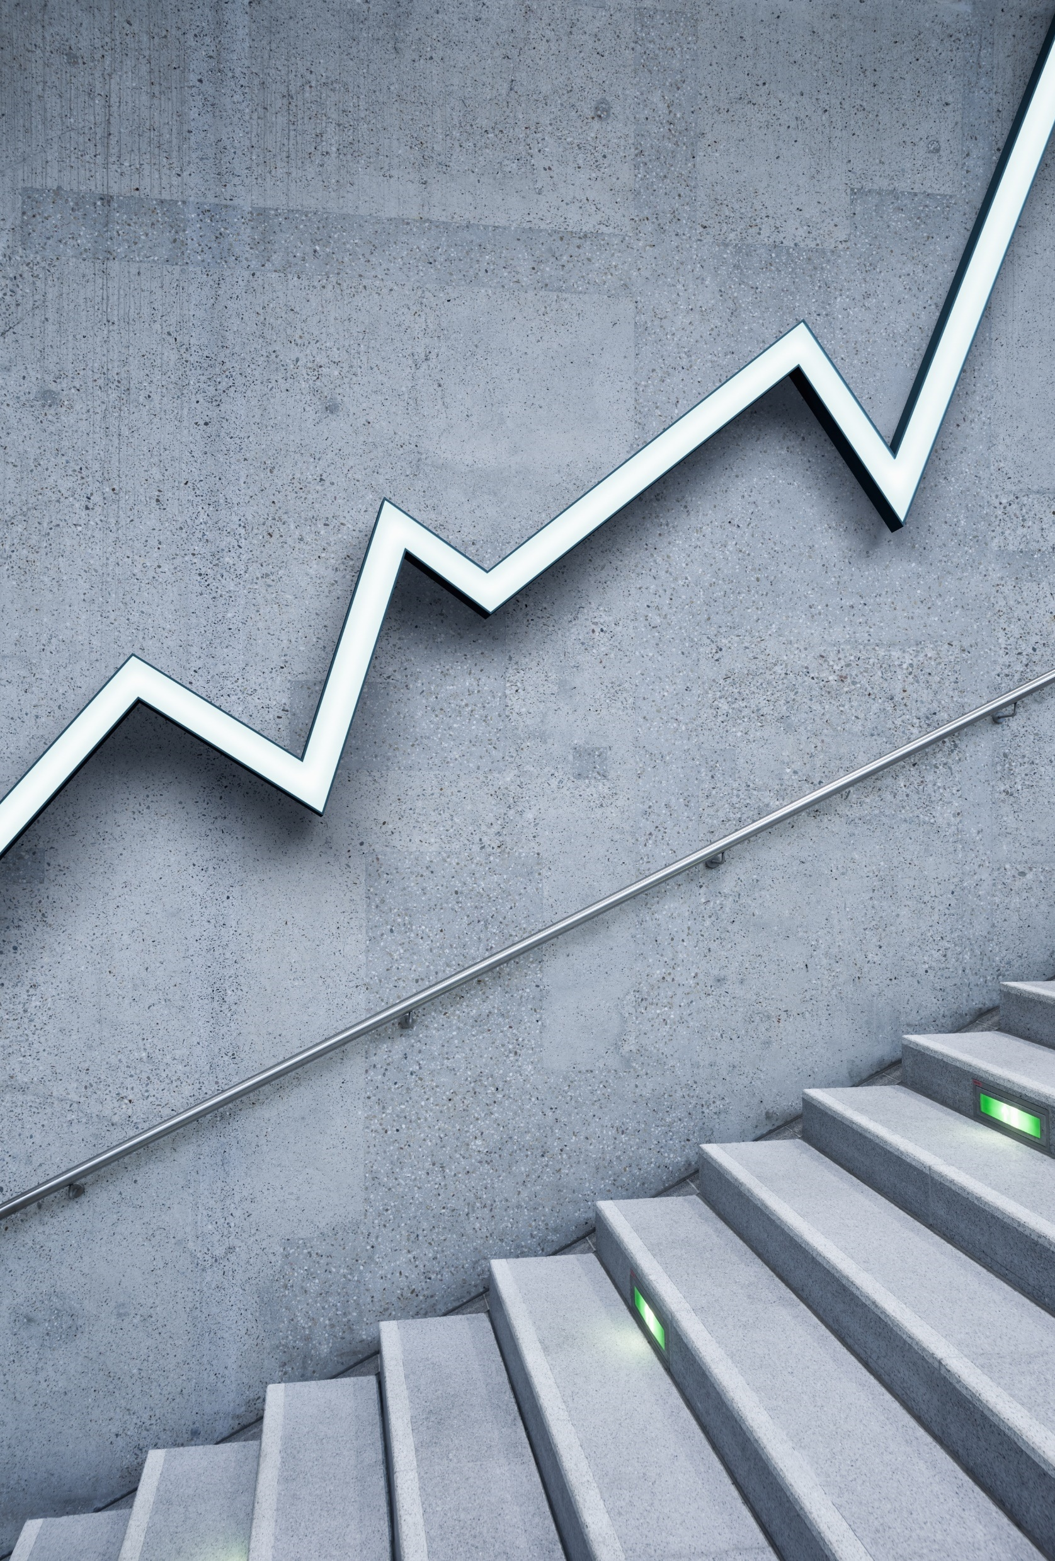
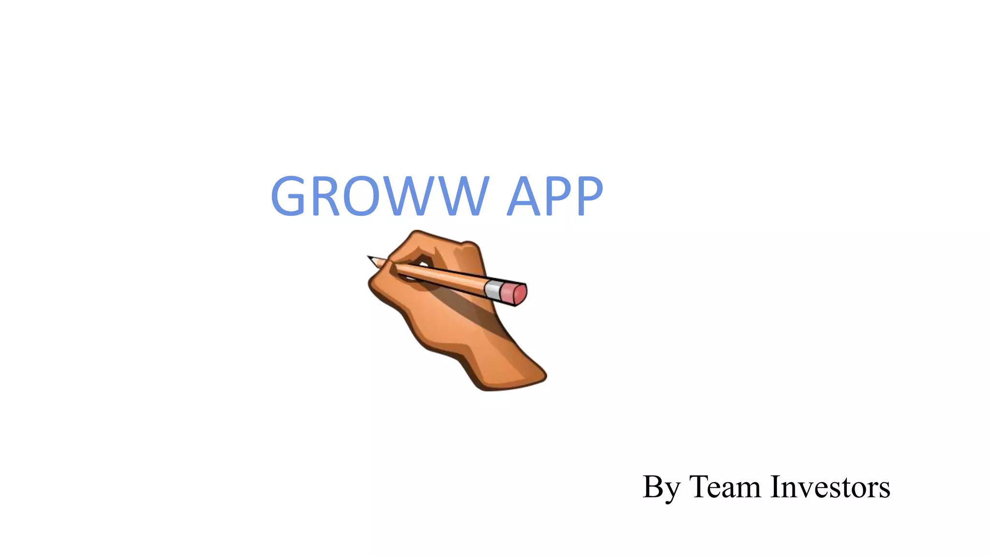
By Thallam Vedesh
I will tell you how to become rich:
Close the doors , Be fearful when others are greedy. Be greedy when others are fearful.

Slide 2
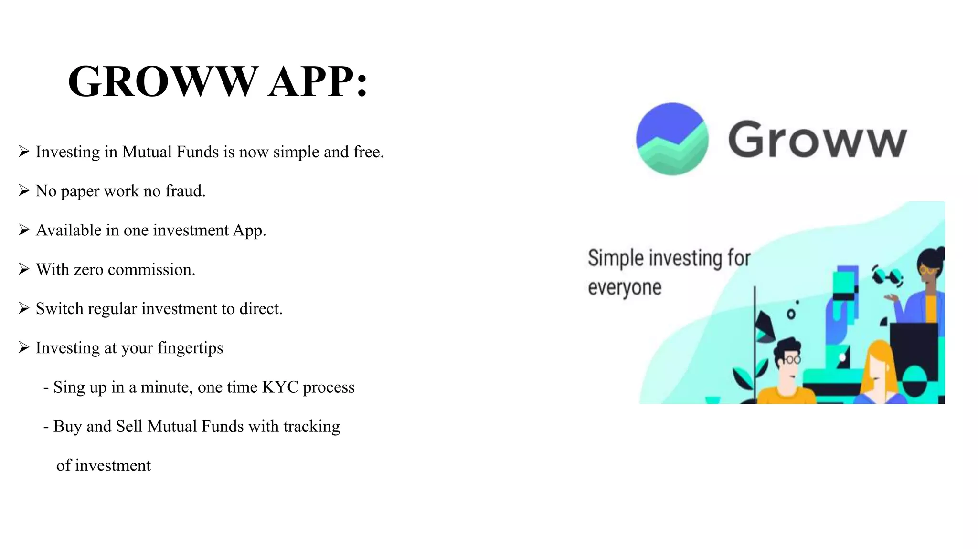

Slide 3
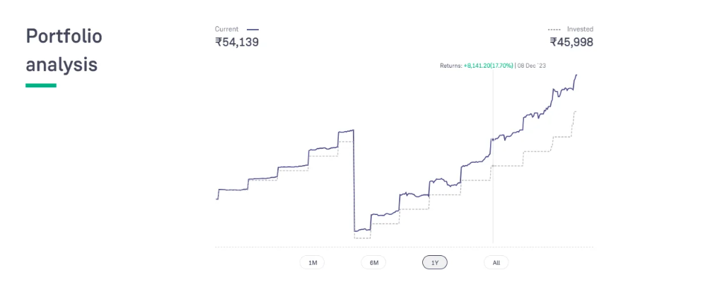
Today, Groww has become a significant company with over 1000 employees and more than 40 million users. Several large investors from around the world have invested in it.
In 2022, even Microsoft CEO Satya Nadella invested in Groww.
One of the standout features of the Groww app is its user-friendly interface.
In my opinion , you should definitely try grow once because there are no
Account opening charges and zero AMC charges , its completely free.

Slide 4
Advantages:
Easy Trading with a simple design and clean user interface.
Faster Trading on account of one-click order placement.
Secure Trading with modern encryption techniques.
Hassle-free and paperless account opening.
No separate login for Mutual Fund investments.

Slide 5
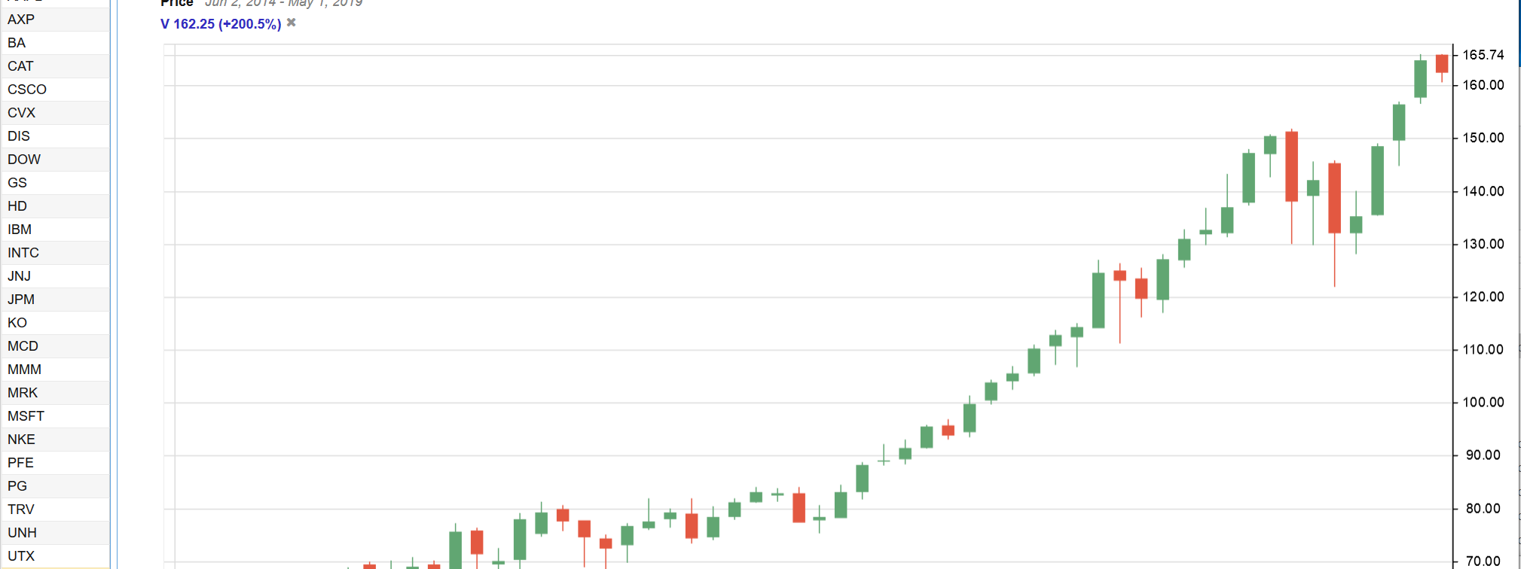
Candle Graph:

Slide 6
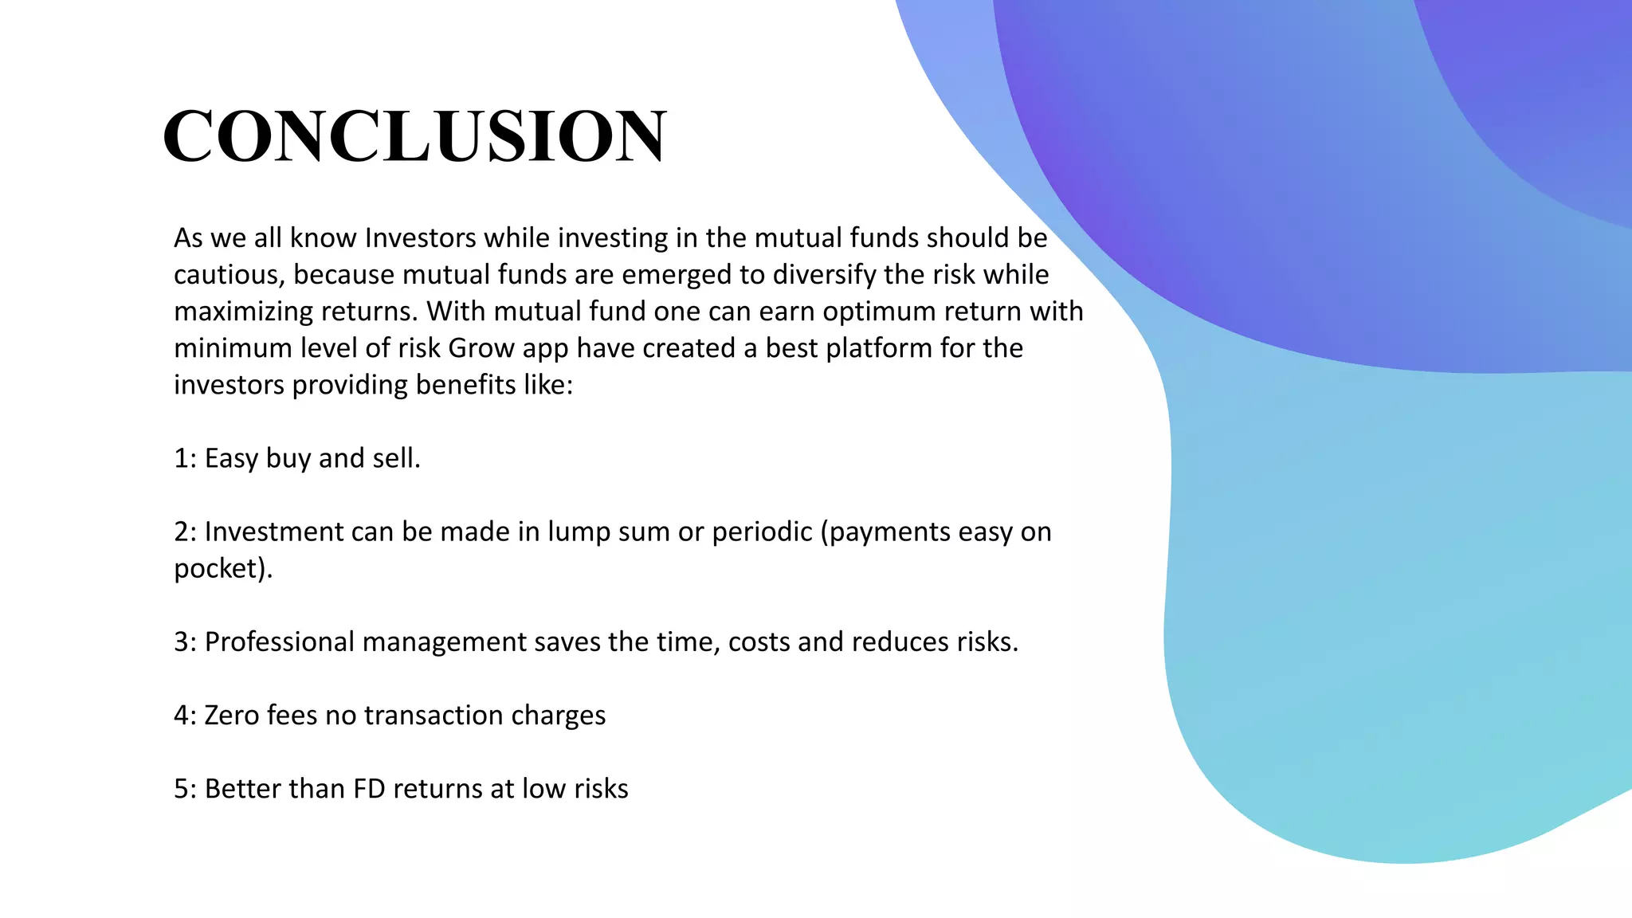

Slide 7
Thank You!

