Slide 1

WIPRO NGA Program – 25SUB4530_CP_JAVA
Capstone Project Presentation – 9th Feb & 10th Feb 2026
Project Title Here – Bank Account Management System
Presented by – Vedhanth S Shetty , Kunal Kumar Amar
Team – 9
www.rpsconsulting.in

Slide 2

About The Project:
The Banking Account Management System is a web application designed to manage customer bank accounts and basic banking operations such as account creation and transaction tracking. The system helps banks maintain accurate customer account data and provides quick access to account details and transaction history.
The Angular frontend offers an intuitive interface for managing customer accounts and viewing balances, while the Spring Boot backend processes business logic and ensures data integrity using Spring Data JPA. The application is containerized using Docker and deployed on Azure to ensure scalability, reliability, and ease of maintenance.
Key Objectives:
• Manage customer bank accounts in a centralized system
• Track account balances and transaction history efficiently Core Functionalities
• Create and manage customer bank accounts
• View account details and current balance
• Record fund transfer and received money transactions
• View transaction history for each account
• Validate transactions and handle exceptions
2024 - RPS Consulting all rights reserved

Slide 3
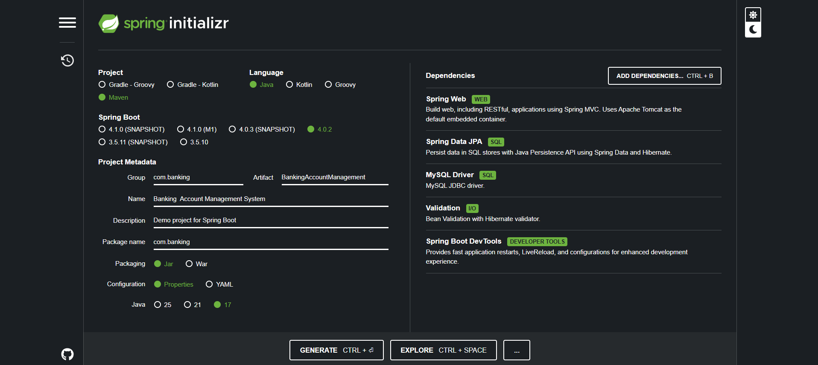
Starting With Backend
Created the Spring Boot project using Spring Initializer.
Selected the Project as Maven, language as Java – 17, then given the Group name as “com.banking”, Artifact as “BankingAccountManagement”, Name as “Banking Account Management System”, and the Package name as “com.banking”.
Selected the following Dependencies: Spring Boot DevTools, Validation, MySQL Driver, Spring Data JPA, Spring Web. After this we just click on generate.
2024 - RPS Consulting all rights reserved

Slide 4
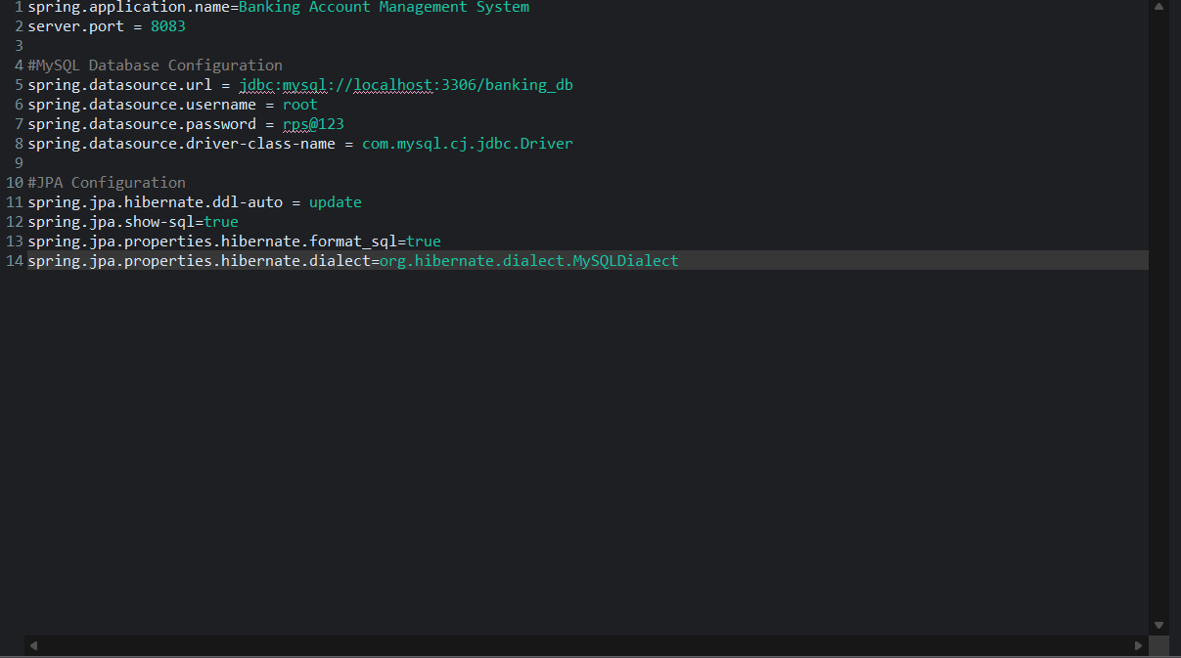
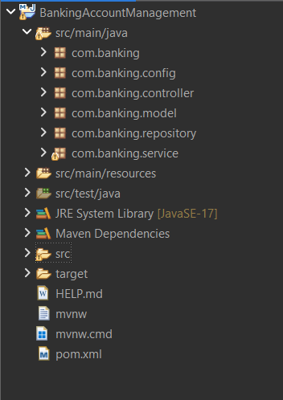
Creating the Structure And Providing Configurations
After the Successful creation of the spring boot project we open the project in the eclipse and import the project that is generated from the Spring Initializer.
Then we provide some certain configuration in the application properties like MySQL Configuration, and JPA Configuration and also provide the server port.
Then after giving all this we create the basic fundamental project structure by creating the packages as : config, controller, model, repository, and service
2024 - RPS Consulting all rights reserved

Slide 5
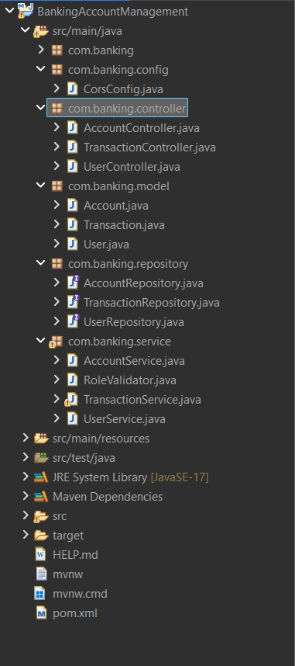
Writing the Code
Then we create the classes for each package by giving the proper names for the class according to are project requirement.
Next we write the required code for model, repository, service and controller.
2024 - RPS Consulting all rights reserved

Slide 6
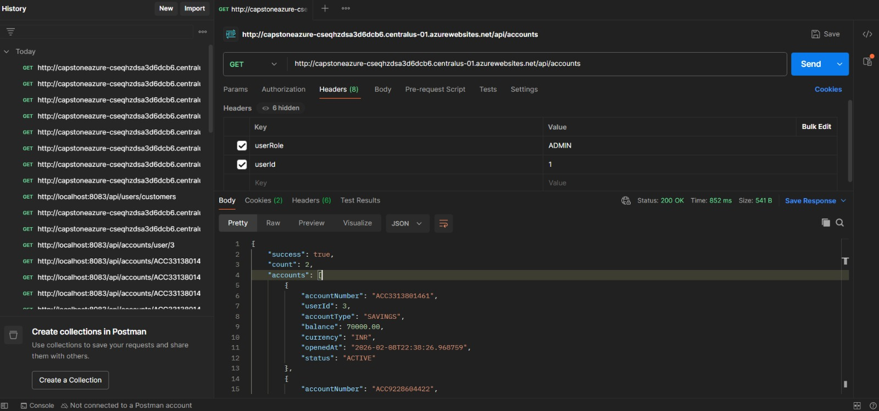
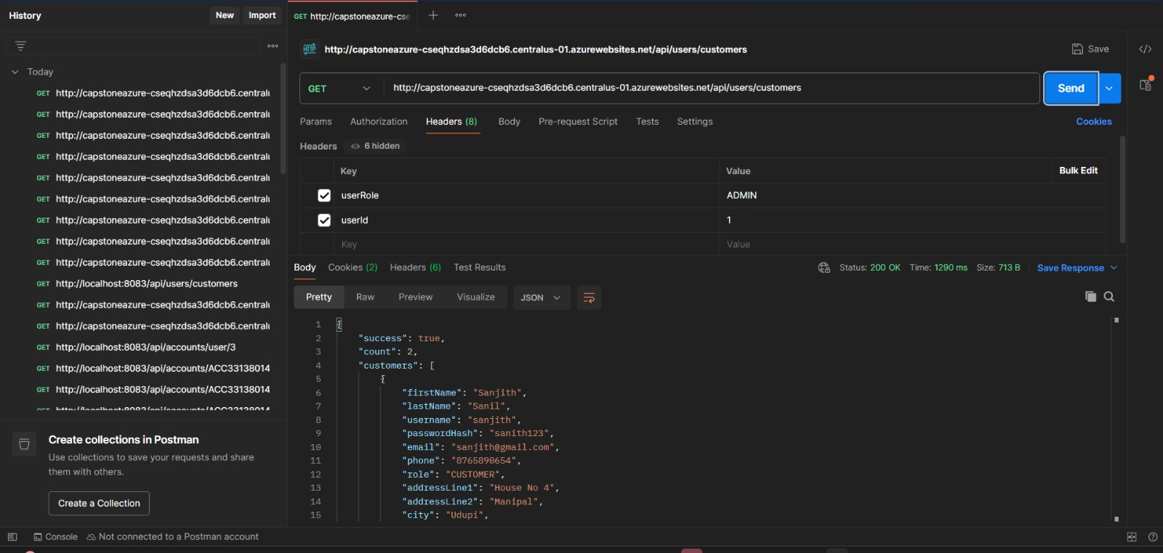
Testing Using Postman
After the successful completion of the code we first update the project, then do maven build and in that provide the goals as the clean install.
This build will help in updating the project properly by reinstalling all the dependencies. After this we just run the project as java application so due to the spring boot project the project runs on the Apache Tomcat server on the mentioned port number in the configuration file.
After the successful run we test it on the postman so that we come to know if any errors are there in the backend or not.
2024 - RPS Consulting all rights reserved

Slide 7
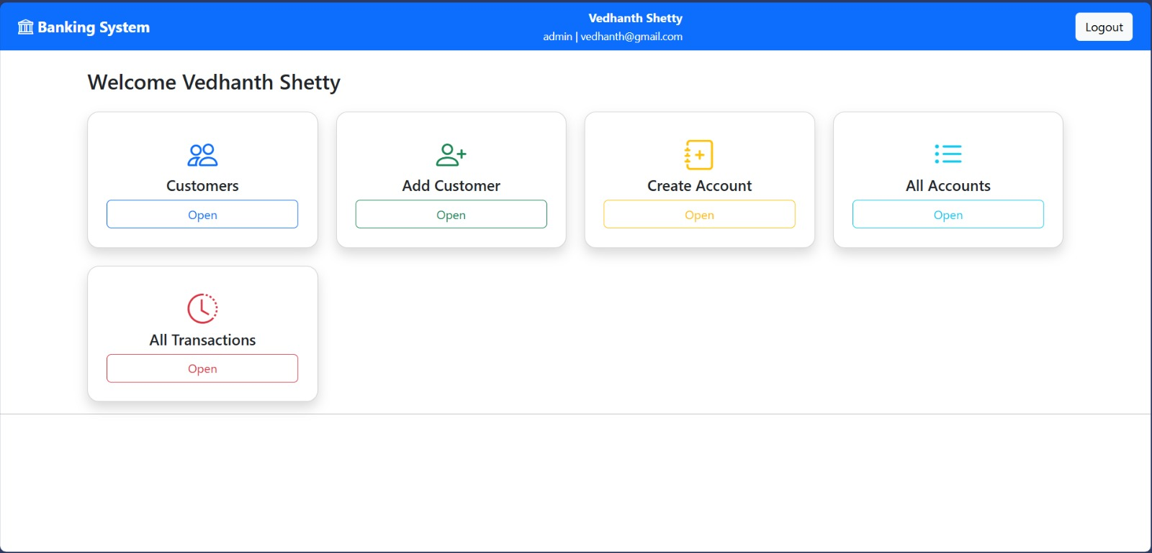
Frontend Design - Admin
So below is the Admin Page Design In this the admin can see All the customers, Add a customer, Create a Bank account, View all the Accounts, View all the transactions
And also in the Navbar the details of the admin is displayed along with a logout button

Slide 8
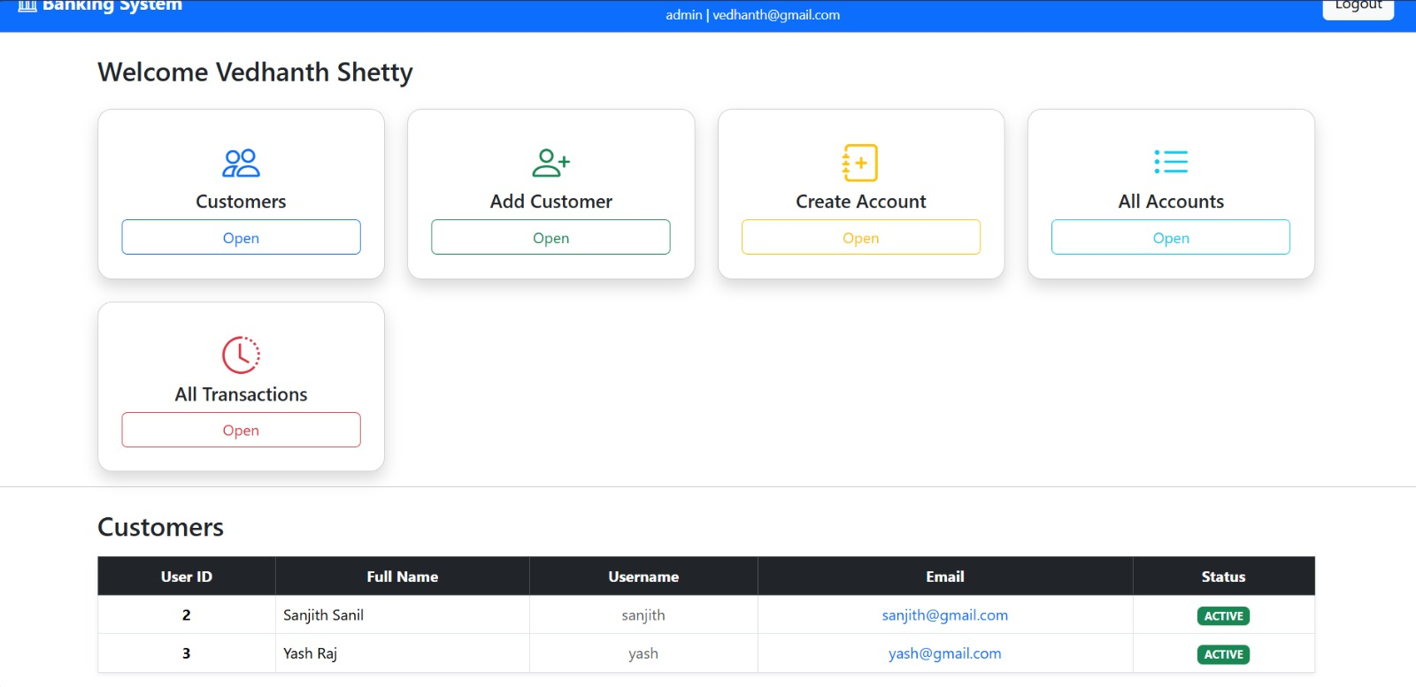
Frontend Design - Admin
So When we click on the Open button in the customers it displays all the customer in the that are already present. Displaying the details such as Used ID, Fullname, Username, Email, Status.

Slide 9
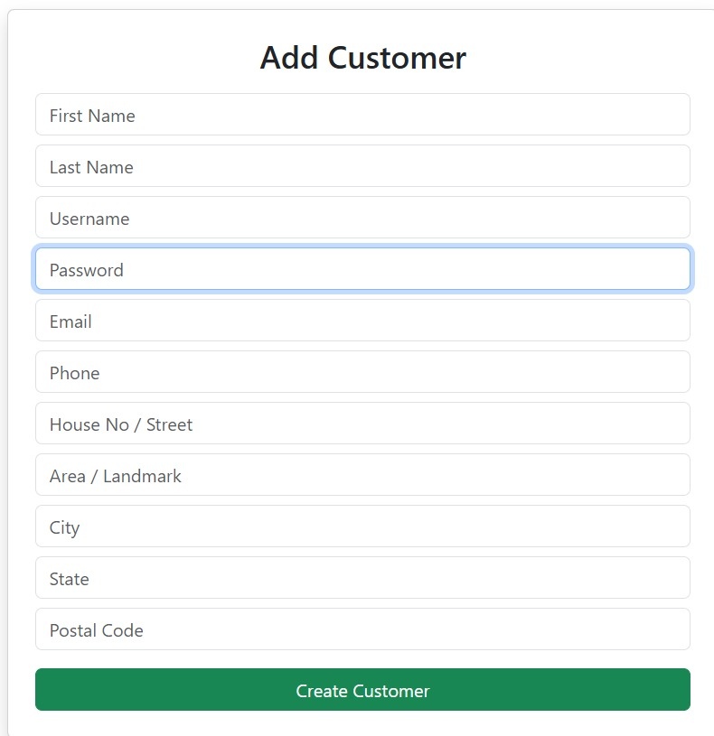
Frontend Design - Admin
Now to Add a customer through the admin the we click on the open button in the add customer section. So it asks some details to enter such as : firstname, lastname, username, password … etc. and by clicking on the create customer button it creates a new customer.

Slide 10
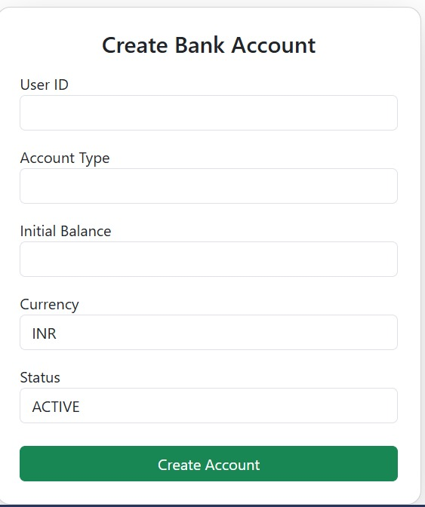
Frontend Design - Admin
Now to create a bank account we click on the open button in the Create bank Account section which opens a widget that asks the details like User ID , Account Type, Initial Balance, etc. So after entering the details of this and click on the create account button which creates a new bank account

Slide 11
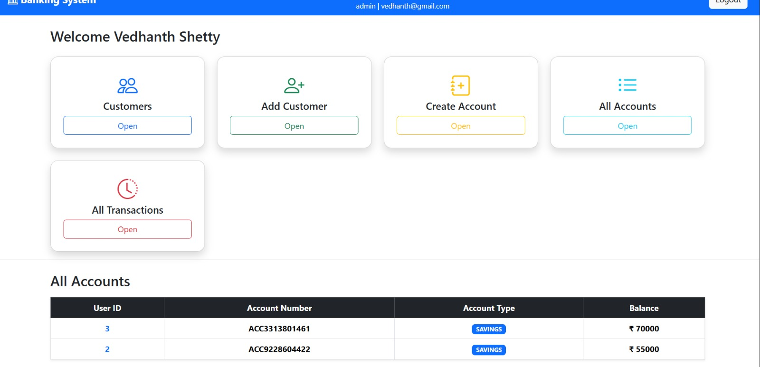
Frontend Design - Admin
Now to check all the Accounts present in the database we simply click on the open button in the all accounts section which displays all the account details present such as the user id, account number, account type, balance.

Slide 12
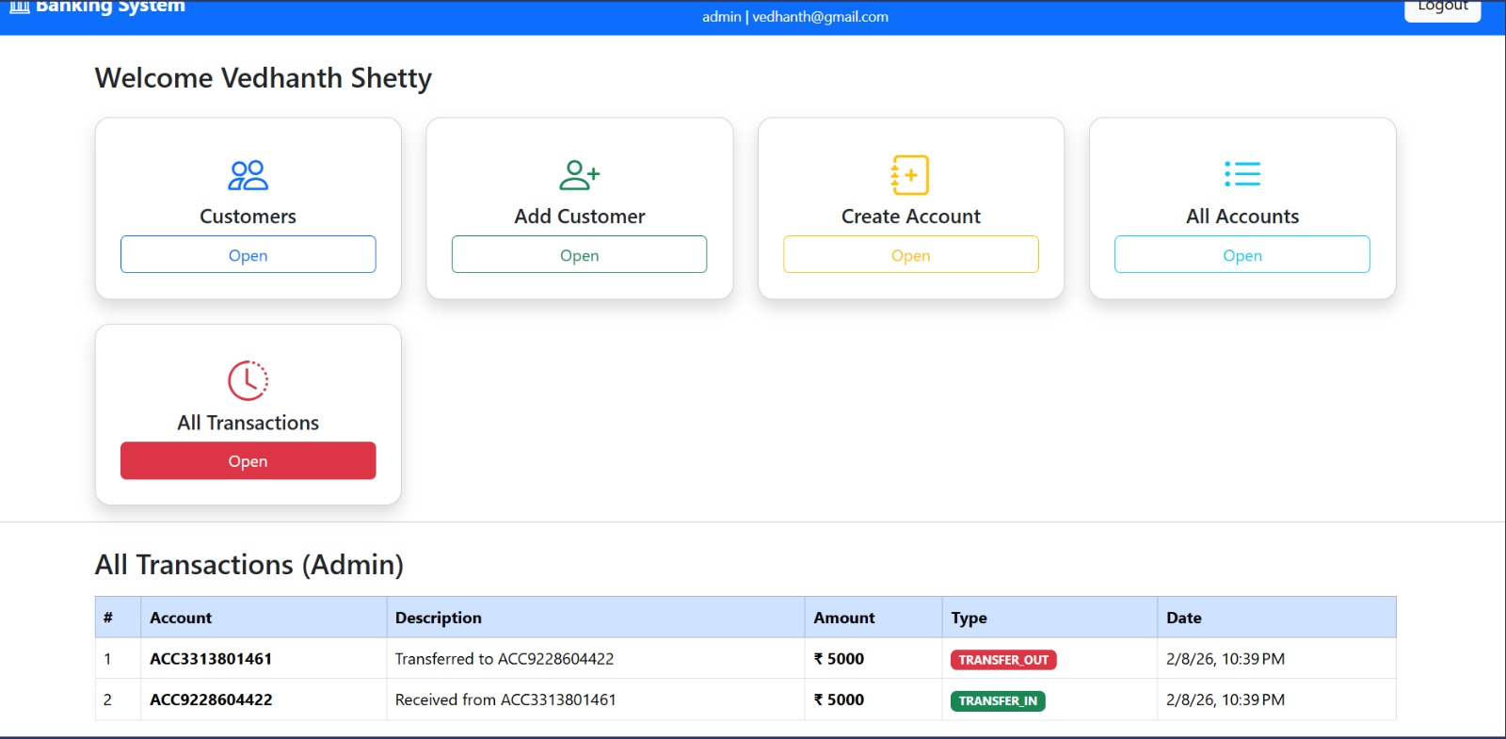
Frontend Design - Admin
Now to check all the transaction that are done in between of the customer we simply click on the open button in the All transaction section which displays account number, description, amount, type, date.

Slide 13
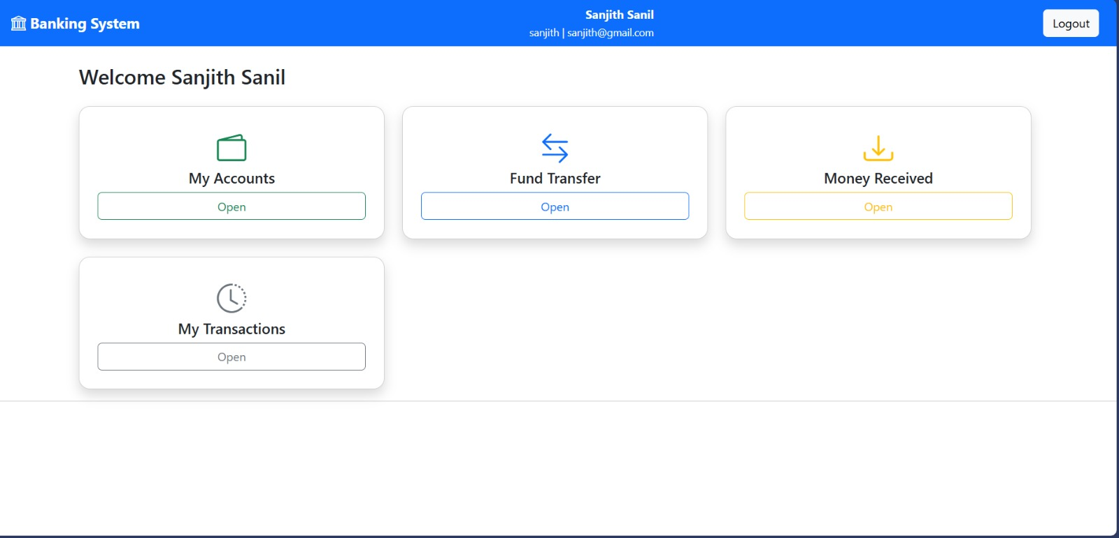
Frontend Design - User
Now we login as the user using the username and password, So the user has only some privileges such as My Accounts, Fund Transfer, Money Received, and My Transaction.

Slide 14
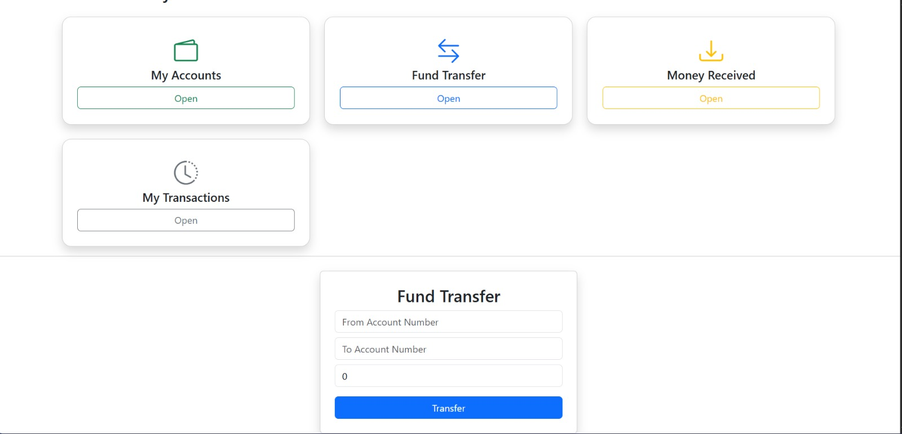
Frontend Design - User
Now to transfer the funds we click on the open button which asks for the fund transfer details such as from account number , to account number , and the amount to transfer

Slide 15
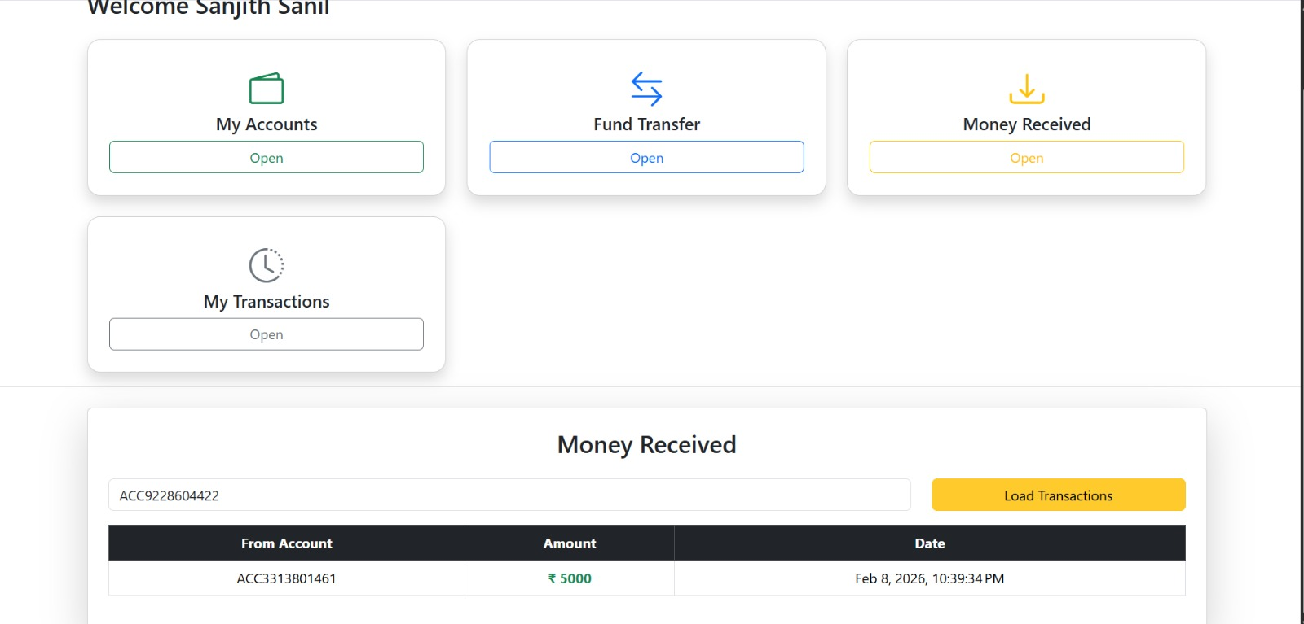
Frontend Design - User
Now to Check if the money is received simply click on the open button in the money received section so it displays the details like the from account, amount, and the Date.

Slide 16
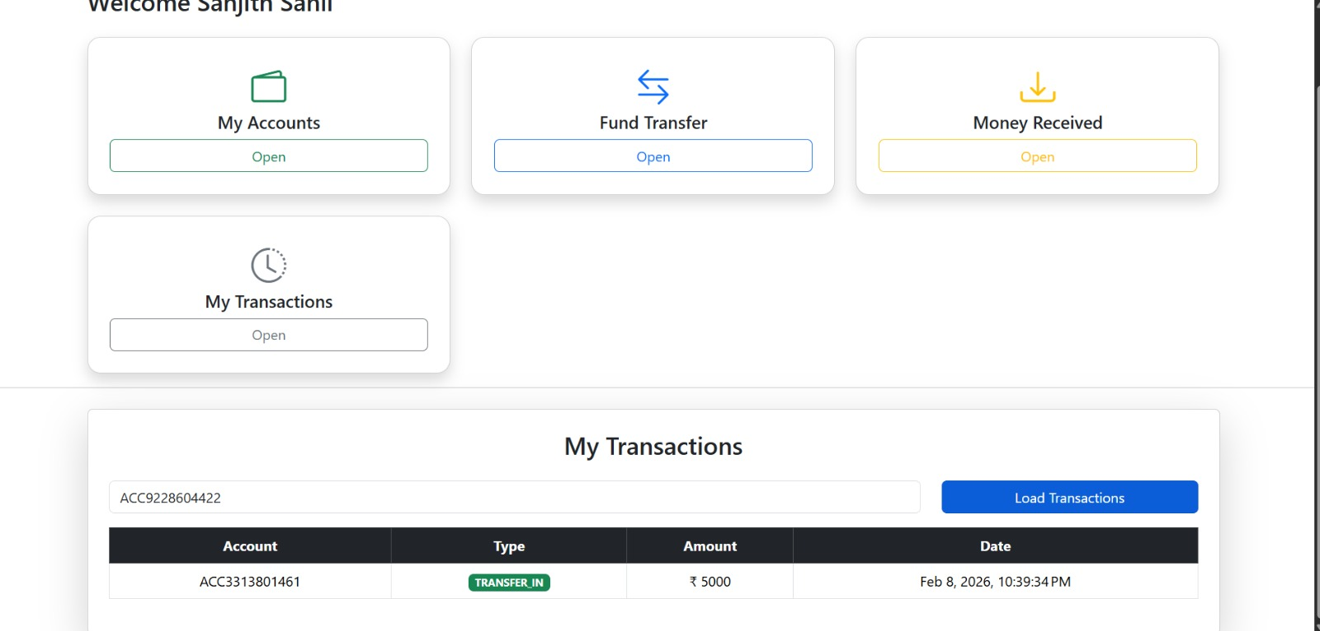
Frontend Design - User
Now to View all the transaction done by the user we simply click on the open button in my transaction section which displays all the transaction done by the user.

Slide 17
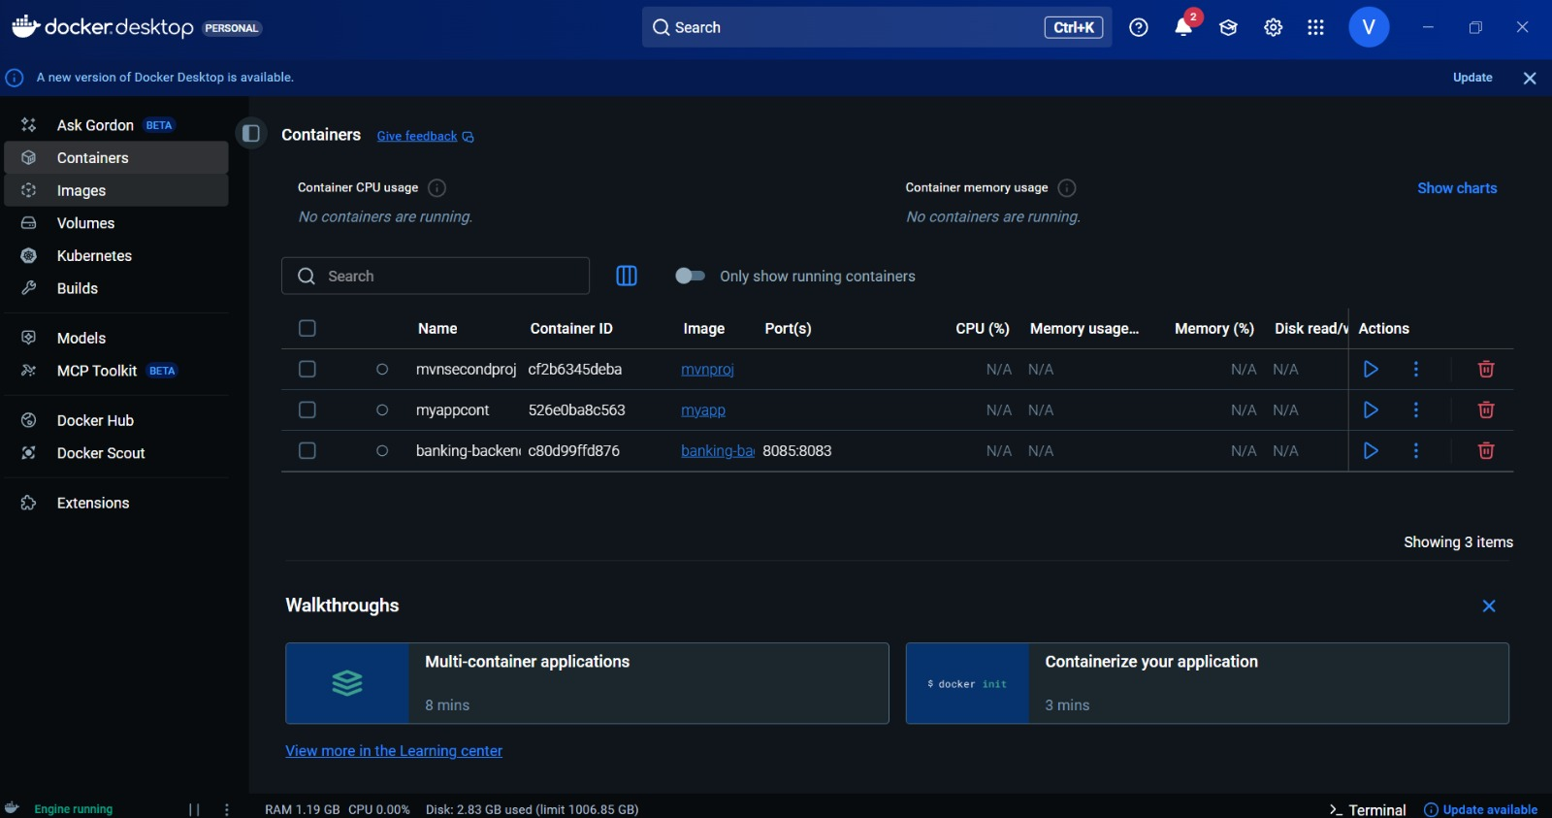
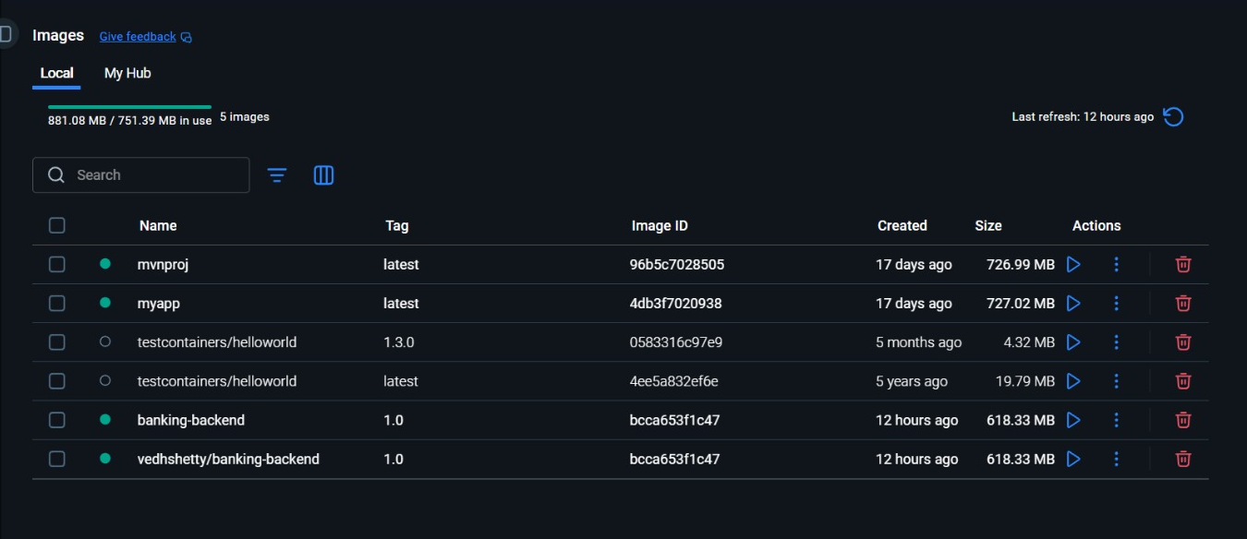
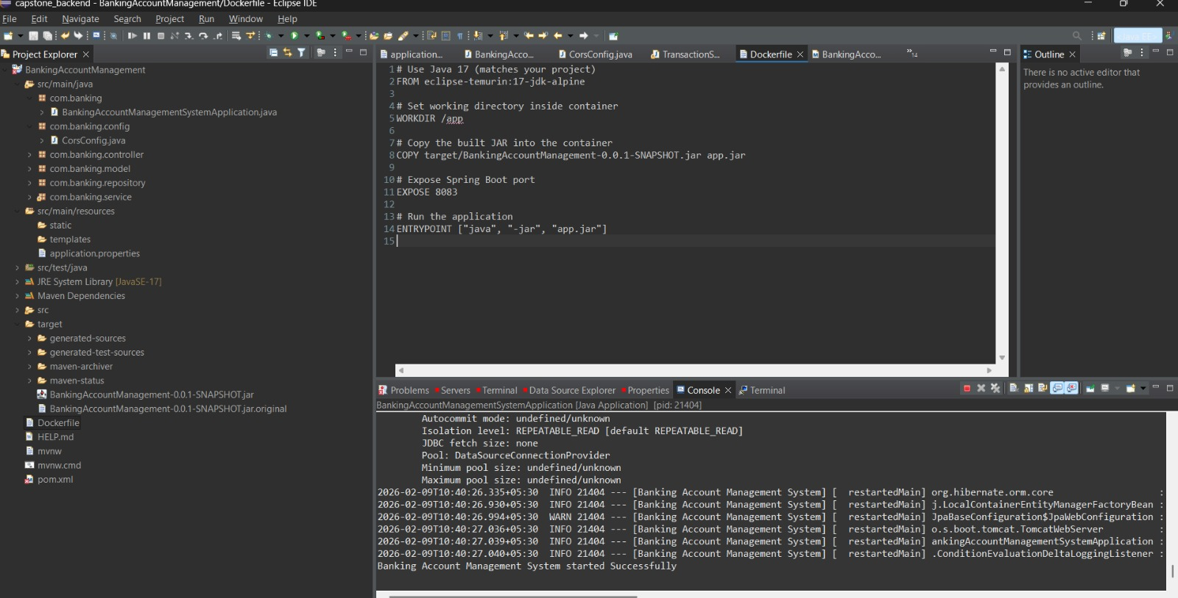
Deploying the Project on Docker
So after the complete integrations and test we deploy the backend on the Docker first by creating a file named as “Dockerfile” which consist some configurations.
Then after that we simply run the following commands in CMD: docker build –t banking-app for building the docker image and to run the container we use: docker run –p 8083:8083 banking-app

Slide 18
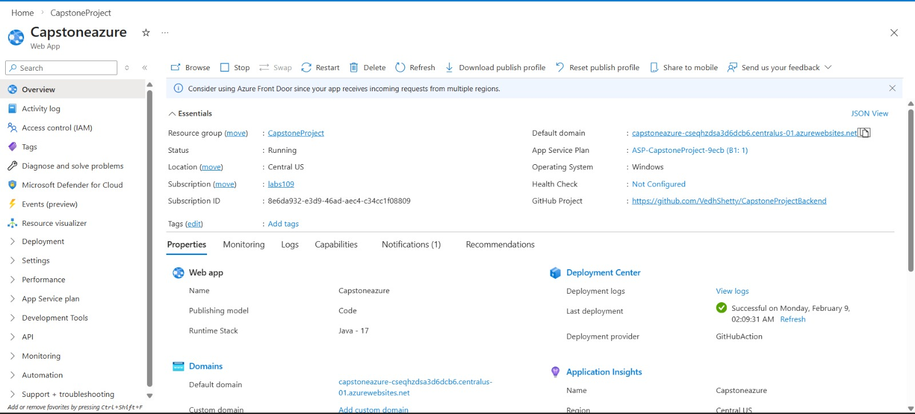
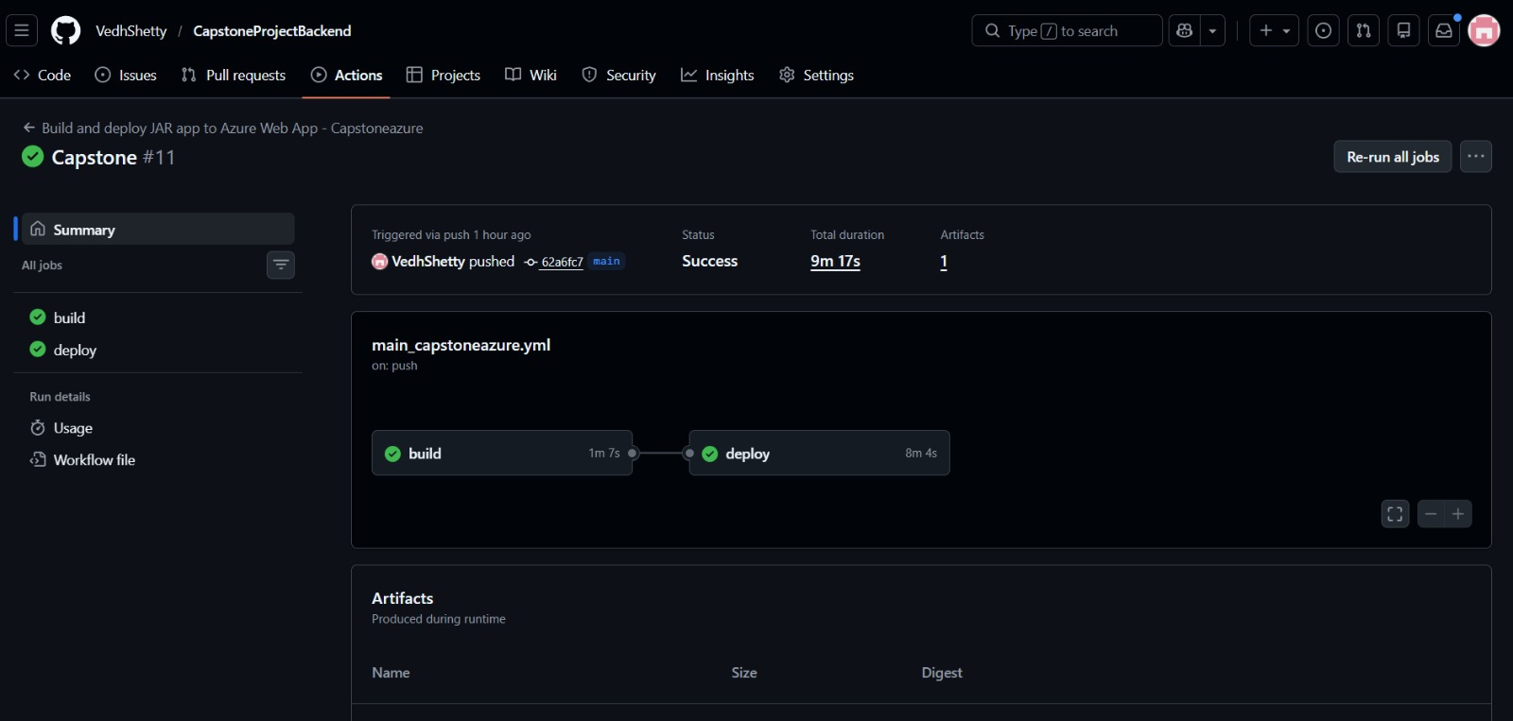
Deploying the Project on Azure
Now After deploying on the docker we deploy the backend on the azure by creating the app-service, So first we push the backend code in the github and then create a resource group in the azure.
Then Inside the resource group we create the an app service and give the name of the app service and then connect the backend repo through the github. After this an url is shown as “http://capstoneazure-cseqhzdsa3d6dcb6.centralus-01.azurewebsites.net” , and replace this url in the frontend instead of the localhost:8083.

