Slide 1
APU-GUARDIAN
AI-Driven Predictive Maintenance
End-to-end offline prototype and held-out evaluation
DATA
SCOPE
MetroPT-3 air production unit | 1,516,948 raw rows | 15 sensor signals
Historical anomaly detection, model comparison, dashboard scoring, and maintenance-ticket demonstration
Course-Based Project | Batch 11 | B. Rishika Reddy | E. Tejaswi | J. Vedha Sree
SDG 9: Industry, Innovation and Infrastructure | SDG 12: Responsible Consumption and Production
APU-GUARDIAN | PROJECT REVIEW | 1/8

Slide 2
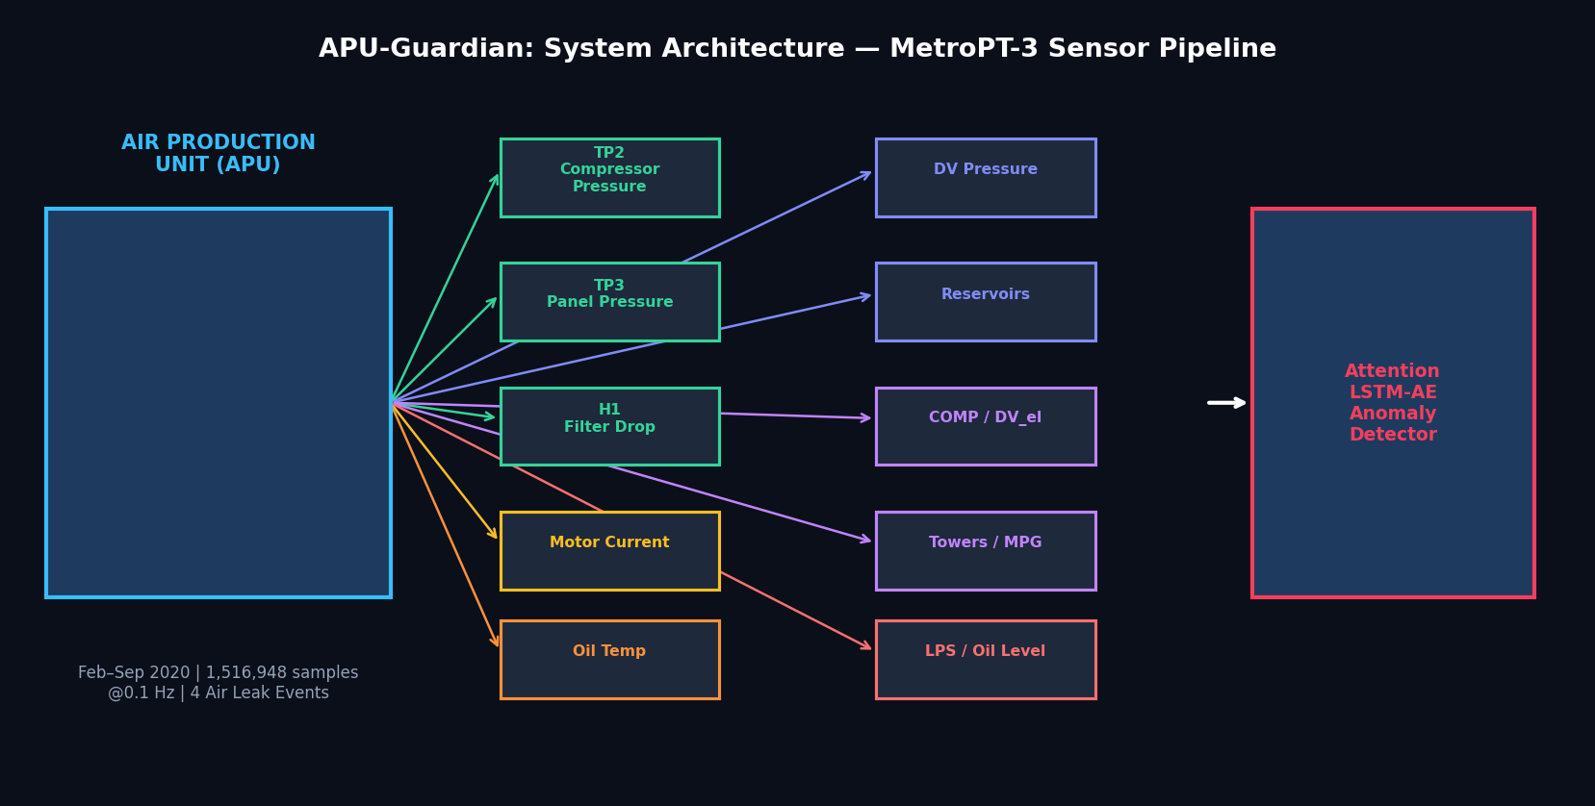
System workflow and project boundary
- Load MetroPT-3 sensor history and annotate documented Air Leak periods.
- Scale 15 channels, create sliding time windows, and train four reconstruction models.
- Calibrate an anomaly threshold on a separate normal period; score a later chronological test period.
- Display historical scores, timestep attention, a model-backed what-if perturbation, and a maintenance recommendation.
IMPORTANT SCOPE LIMIT
Offline dataset demonstration only; no live sensor, IIoT, or control-system connection.
APU-GUARDIAN | PROJECT REVIEW | 2/8

Slide 3
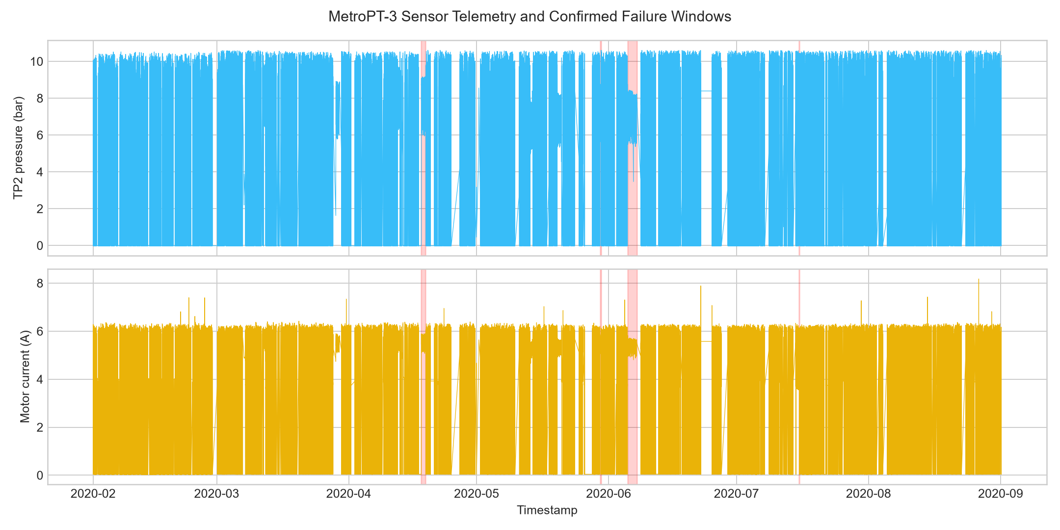
Dataset preparation and chronological evaluation
SOURCE
WINDOWS
TEST
1,516,948 raw observations
15 sensor features | Feb-Sep 2020
Every 10th row; 30-step window
~50 min window, ~8.3 min stride
13,197 windows
390 labeled anomalous
Train: before 2020-05-01 (12,696 normal windows) | Calibration: May (4,198 normal windows) | Test: from 2020-06-01
APU-GUARDIAN | PROJECT REVIEW | 3/8

Slide 4
Models and anomaly decision
Dense Autoencoder
Stacked LSTM
Per-timestep reconstruction baseline.
Temporal reconstruction baseline.
LSTM Autoencoder
Attention LSTM-AE
Encoder-decoder sequence reconstruction.
Proposed encoder attention; weights describe timestep weighting, not causal sensor explanations.
DECISION RULE
Per-window reconstruction MSE > normal-calibration 99.5th percentile. Proposed-model threshold: 9.286926.
The same fitted scaler and proposed checkpoint are loaded by the dashboard; no paper metrics or mock attention weights are substituted.
APU-GUARDIAN | PROJECT REVIEW | 4/8

Slide 5
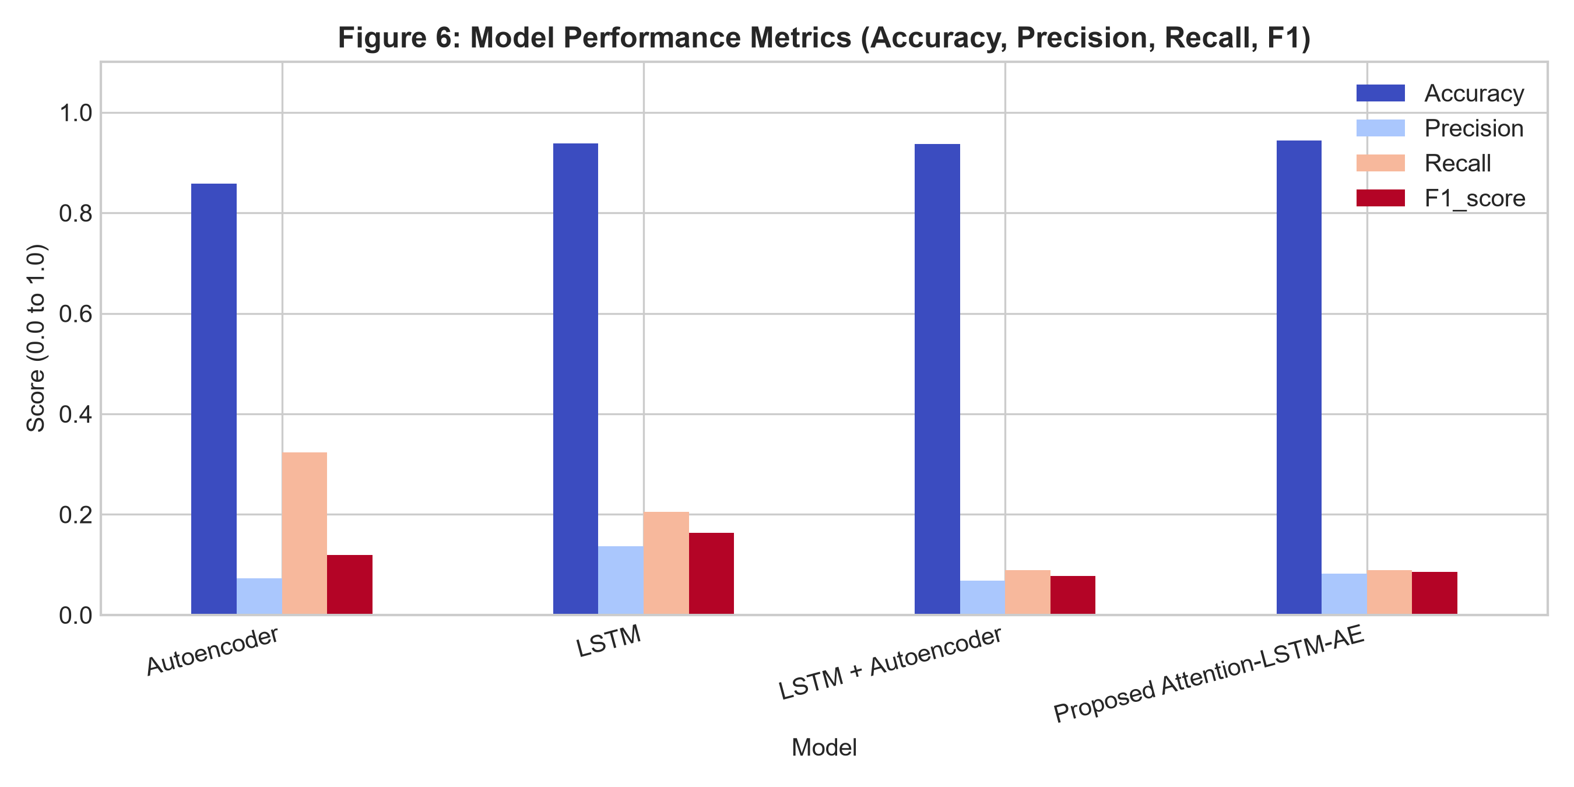
Held-out model results
Model | Accuracy | Precision | Recall | F1
Autoencoder | 0.9673 | 0.2941 | 0.0769 | 0.1220
LSTM | 0.9645 | 0.1938 | 0.0641 | 0.0963
LSTM + Autoencoder | 0.9673 | 0.3084 | 0.0846 | 0.1328
Proposed Attention-LSTM-AE | 0.9673 | 0.2981 | 0.0795 | 0.1255
Model | MAE | MSE | RMSE
Autoencoder | 0.1430 | 0.0931 | 0.3052
LSTM | 0.0759 | 0.0352 | 0.1877
LSTM + Autoencoder | 0.5862 | 1.2036 | 1.0971
Proposed Attention-LSTM-AE | 0.4765 | 0.9732 | 0.9865
All values are from this local run. Accuracy is not sufficient for this imbalanced anomaly task; inspect precision, recall, and event-level results.
APU-GUARDIAN | PROJECT REVIEW | 5/8

Slide 6
What the held-out results actually show
RECALL
FALSE ALARMS
EVENT WARNING
8.0% | 31 of 390 anomalous windows detected
73 false positives | precision 29.8%
F3 and F4 both missed within the 12-hour pre-failure window.
- 359 of 390 anomalous test windows were missed despite training on normal-only windows.
- The percentile threshold reduced false positives from 391 to 73 and improved F1 from 0.0858 to 0.1255 versus mean + 2.5 standard deviations, with slightly lower recall.
- F3 and F4 had no alert in their 12-hour pre-failure windows; F1 and F2 were outside this test period.
- The proposed model did not achieve the highest F1; LSTM-AE scored 0.1328.
APU-GUARDIAN | PROJECT REVIEW | 6/8

Slide 7
End-to-end dashboard and maintenance outputs
HISTORICAL MONITOR
MODEL INSPECTION
Sensor telemetry, model reconstruction scores, anomaly flags, and a health index derived from the calibrated threshold.
Actual checkpoint attention weights over timesteps and an interactive what-if scored by the trained model.
MAINTENANCE TICKET
NOT A LIVE DEPLOYMENT
Priority and recommended action derive from the current historical score; RUL is estimated only when a degradation trend exists.
No IIoT ingestion, persistence of work orders, operator alerts, or safety interlocks are implemented.
SDG alignment is the project intent: support resilient infrastructure (SDG 9) and more condition-based resource use (SDG 12). No quantified savings or uptime benefits have been established.
APU-GUARDIAN | PROJECT REVIEW | 7/8

Slide 8
Conclusion, next steps, and references
IMPLEMENTED
NEXT BEFORE ANY OPERATIONAL CLAIM
- Reproducible preprocessing, normal-only training, chronological calibration and test evaluation.
- Four trained checkpoints, persisted inference scaler/settings, regenerated metrics and figures.
- Model-backed offline dashboard, tests, and an updated presentation.
- Improve detection and verify event-level early warning on additional labeled failures.
- Validate threshold selection without test leakage and report confidence/false-alarm burden.
- Only then consider live data integration and operator review.
REFERENCES
1. Davari, N., Veloso, B., Ribeiro, R.P., Pereira, P.M., & Gama, J. (2021). Predictive maintenance based on anomaly detection using deep learning for air production unit in the railway industry. IEEE DSAA.
2. Veloso, B., Gama, J., Ribeiro, R.P., & Pereira, P.M. (2022). MetroPT: A benchmark dataset for predictive maintenance. Scientific Data.
3. UCI Machine Learning Repository. MetroPT-3 dataset, ID 791.
4. Akshitha Mary, A., & Chandra Sekar, P. (2025). AI-Driven Predictive Maintenance for Metro Operations Using LSTM Autoencoder. IJACSA, 16(4).
APU-GUARDIAN | PROJECT REVIEW | 8/8

