Slide 1
News articles classifier
P Manish
Vedha Krishna Velthapu

Slide 2
Contents
Planning Document
Milestone 1 Report
Milestone 2 Report
Milestone 3 Report
Milestone 4 Report
Jmeter stress test screenshots
Setup steps

Slide 3
Planning Document
https://docs.google.com/document/d/12yBr9iS_2Y7TUdLg-8Pu-fC3epiNBLcLnXRKi2ezRB4/edit?usp=sharing

Slide 4
MILESTONE 1
Architectural Design
Environment details
Input and Output
Challenges

Slide 5
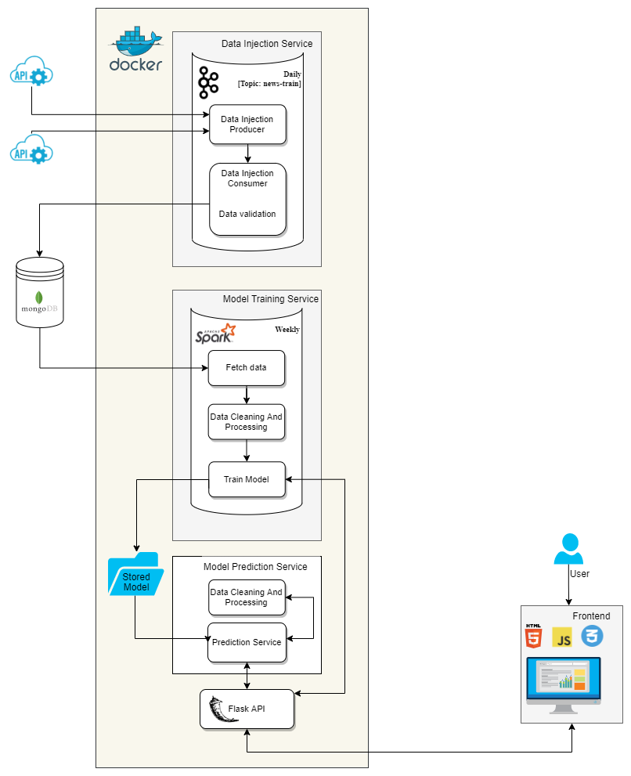

Slide 6
Environment details
Database: Free MongoDB database on cloud
Streaming: Apache Kafka

Slide 7
Input
Input
Input Processed
We get our data from 2 APIs
Free news API
Newscatcher API
We validate that all the fields we needs is in returned by the API (published-date, topic/category, title, summary, and source).
Both the APIs we used had a news category which we changed to general news before the article is stored in the database to reduce some ambiguity.
The topic we used in Kafka is news-train

Slide 8
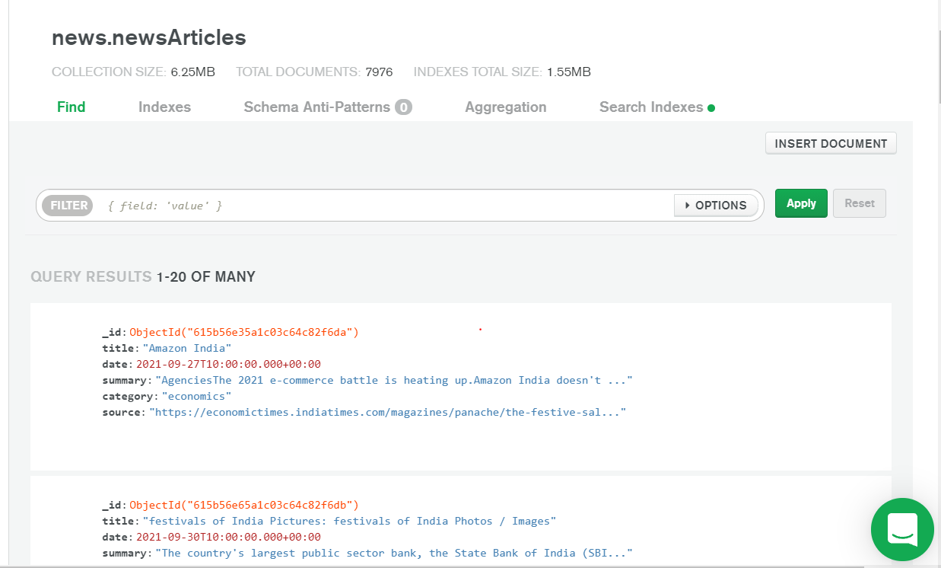


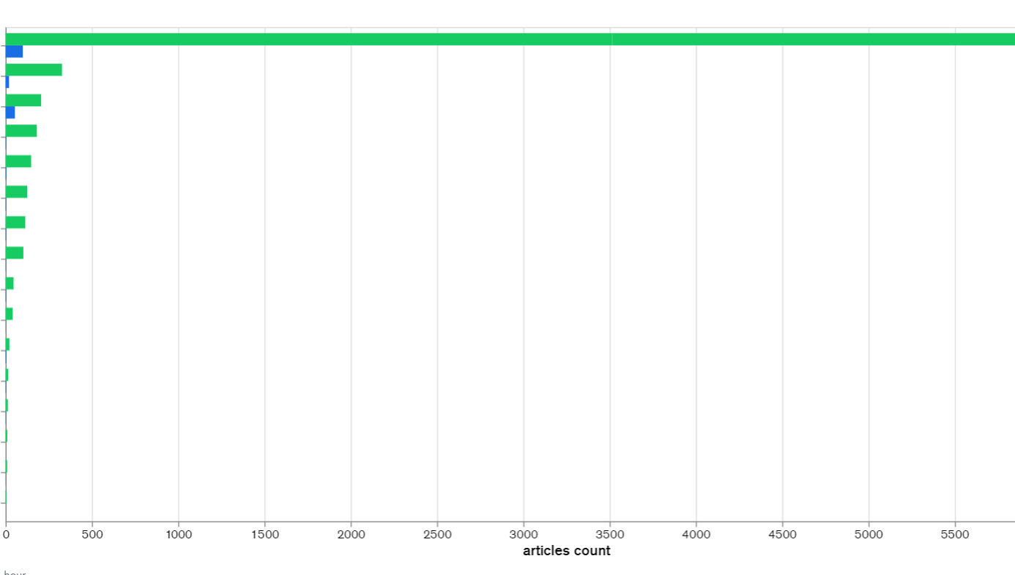

Output
Structured data stored in our database with the following columns:
Title: News article’s title
Summary: News article’s summary
Category: News article’s category, i.e sports, health
Source: News article’s URL link
Date: News article’s published date

Slide 9
Challenges
Lack of understanding on Kafka and Kafka queues
Not saving duplicates on MongoDB and both the team members are not very experienced with MongoDB
Solution: Splitting the task so 1 person focus solely on Kafka until it is set up, instead of 2 people working on it together helped us. We managed to finish the other tasks along with Kafka in time.
Solution: We managed to created a unique index on the title, so any article with repeating titles will fail to save.

Slide 10
Challenges
Finding a good source to get news articles from as most of the sources/APIs were paid
Coordinating and working together between different time zones
Solution: After a lot of research, we found 1 API we can use and the free news API provided, worked for us.
Solution: Communicating regularly and meeting every 2-3 days to have alignment on our tasks.

Slide 11
Challenges
Saving large amounts of documents to the database was taking long and with bulk insert, if a document fails all documents after that won't save. With the unique title constraint if a document failed all the documents after that won't save
Solution: We decided to insert all the documents individually in a try-catch block. If there are any exceptions while saving the documents, it will not stop the application from running. Even though this is a bit slower, we would rather have a slow write than a lot of documents failing to save to the database.

Slide 12
MILESTONE 2
Environment details
Input and Output
Challenges

Slide 13
Environment details
Database: Free MongoDB database on cloud
Data processing: PySpark
Data cleaning (to remove non-English words): nltk

Slide 14
Input
Input:
The data from our database what we collected from milestone 1.
Input Processed:
Fetched data from database
Created a spark data frame
Concatenated the title and summary
Removed all the non-English words, spaces and special characters from the text. We used nltk and stop words for this
Pipeline with the following steps:
Tokenize the title and summary
Applied a CountVectorizer to convert the list of tokens above to vectors of token counts
Applied term frequency–inverse document frequency (TF-IDF) to evaluate how relevant a words are in a set of documents.
NOTE: The categories we already cleaned and validated before inserting into the database as we knew this was an important value.

Slide 15
Output
Independent values (features): The output is a matrix of token counts
Dependent values (target): A list of integers that maps to categories

Slide 16
Challenges
Getting data from our mongo dB database using pyspark
Find an appropriate model for our problem, as we wanted to process our data to work for that specific model
Solution: Our mentor showed us a few examples which helped us get around the issue. Instead of fetching data using pyspark, we got data using pymongo and created a spark data frame with that data to process it.
Solution: We could not find an example of a text classifier model that accepts title, summary and date of the news article as an input, all the models just took in 1 string as input. Based on this we also decided to not pass in date as an input to train the model, and we concatenated the title and summary to form 1 string.

Slide 17
MILESTONE 3
Environment details
Input and Output
Challenges

Slide 18
Environment details
Database: Free MongoDB database on cloud
Data processing: PySpark
Data cleaning (to remove non-English words): nltk

Slide 19
Input and output
Input:
Cleaned set of count vector of articles and integer as a category that maps to a string category from milestone 2.
Input Processed:
Split the data into train and test using a build in spark dataframe function, randomSplit().
We used 3 models, NaiveBayes, RandomForestClassifier and LogisticRegression(1-to-rest) and picked the best model based on it’s accuracy.
We also used pySpark’s CrossValidator and passed in different parameters to train the model and picked the best one for each.
We finally saved the model using pickle.
Output:
A pickle file that stored the model. This model can now be used by the training service.

Slide 20
Challenges
Setting up pysprak
Find an appropriate model for our problem, as we wanted to process our data to work for that specific model
Solution: Only 1 person could set up a vm on their laptop and the other team member had issues with his laptop.
Solution: We could not find an example of a text classifier model that accepts title, summary and date of the news article as an input, all the models just took in 1 string as input. Based on this we also decided to not pass in date as an input to train the model, and we concatenated the title and summary to form 1 string.

Slide 21
Challenges
Miss balance of amount of data in the dataset for each category
Solution: We found out that our data set have more number of a category News which resulted in miss predicting the classification. To solve this we gathered few more data to our dataset to make the categories balanced.

Slide 22
MILESTONE 4
Environment details
Input and Output
Challenges

Slide 23
Environment details
Database: Free MongoDB database on cloud
Data processing: PySpark
Data cleaning (to remove non-English words): nltk
API: (Flask api and uvicorn)
Frontend: (HTM, css, javascript)

Slide 24
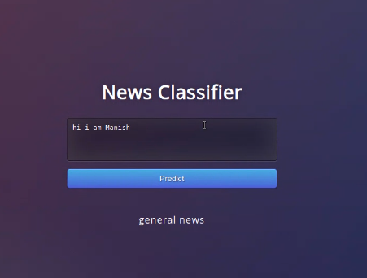
Input and output
Input:
Model saved in a pickle file
News article from frontend
Input Processed:
Loaded the model from the pickle file and called the predict function of that model to get the category of the news
Output:
Category of news

Slide 25
Challenges
Not enough time and resources to setup docker
Find an appropriate model for our problem, as we wanted to process our data to work for that specific model
Solution: Only 1 person could set up a vm on their laptop and the other team member had issues with his laptop.
Solution: We could not find an example of a text classifier model that accepts title, summary and date of the news article as an input, all the models just took in 1 string as input. Based on this we also decided to not pass in date as an input to train the model, and we concatenated the title and summary to form 1 string.

Slide 26
Set up (without docker)
Both the team members had issues with our laptops and could not test docker so have a docker setup in the ‘docker-final’ folder and the ‘normal-setup’ folder has code without using docker please follow instruction on the next slide for the setup.

Slide 27
KAFKA
In terminal 1 (in the root folder):
wget https://downloads.apache.org/kafka/3.0.0/kafka_2.12-3.0.0.tgz
tar -xvf kafka_2.12-3.0.0.tgz
sudo apt install openjdk-8-jdk -y
java –version
cd NewsArticlesClassifier
pip3 install -r requirements.txt
cd dataIngestionService
./kafka_2.12-3.0.0/bin/zookeeper-server-start.sh ./kafka_2.12-3.0.0/config/zookeeper.properties
In terminal 2 (in the root folder):
./kafka_2.12-3.0.0/bin/kafka-server-start.sh ./kafka_2.12-3.0.0/config/server.properties
In terminal 3 (run all the steps below on terminal 3 – in dataIngestionService folder):
./kafka_2.12-3.0.0/bin/kafka-topics.sh --list --bootstrap-server localhost:9092
./kafka_2.12-3.0.0/bin/zookeeper-server-start.sh -daemon ./kafka_2.12-3.0.0/config/zookeeper.properties
./kafka_2.12-3.0.0/bin/kafka-server-start.sh -daemon ./kafka_2.12-3.0.0/config/server.properties
ps -ef | grep kafka
./kafka_2.12-3.0.0/bin/kafka-topics.sh --create --bootstrap-server 127.0.0.1:9092 --replication-factor 1 --partitions 1 --topic news-train
./kafka_2.12-3.0.0/bin/kafka-topics.sh --describe --bootstrap-server 127.0.0.1:9092 --topic news-train
python3 consumer.py
In terminal 4 (In dataIngestionService folder):
python3 producer.py

Slide 28
PySpark
Run the following:
python3 -m nltk.downloader stopwords
python3 -m nltk.downloader punkt
wget https://dlcdn.apache.org/spark/spark-3.1.2/spark-3.1.2-bin-hadoop3.2.tgz
tar -xvf spark-3.1.2-bin-hadoop3.2.tgz
sudo apt install scala -y
scala –version
nano .bashrc
Add the following to the bash file
export PATH=$PATH:/home/<USER>/spark-3.1.2-bin-hadoop3.2/bin
export PYSPARK_PYTHON=python3
Save and close the bash file
Source .bashrc
cd NewsArticlesClassifier/ModelPredictionService
Spark-submit modelPrediction.py
NOTE: Make sure using java 8 not other versions

Slide 29
Front end
On terminal 1:
cd NewsArticlesClassifier/ModelPredictionService
Python3 app.py
On terminal 2:
cd NewsArticlesClassifier/ModelTrainingService
Python3 app.py

Slide 30
Set up (with docker)
Both the team members had issues with our laptops and could not test docker so have a docker setup in the ‘docker-final’ folder and the ‘normal-setup’ folder has code without using docker please follow instruction on the next slide for the setup.

Slide 31
Docker
In terminal 1:
docker-compose up --build
In terminal 2:
docker cp Newsarticlesclassifier_trainer_1:/app/modelTrainingService ./models/.

