Slide 1
ARTIFICIAL INTELLIGENCE
PHASE 4 PROJECT

Slide 2
CREATE A CHATBOT IN PYTHON:
Chatbot:
A chatbot is a computer program that simulates human conversation with an end user. Though not all chatbots are equipped with artificial intelligence (AI), modern chatbots increasingly use conversation ai techniques like natural language processing (NLP) to understand the user’s questions and automate responses to them.

Slide 3
Phase4 :
In this part you will continue building your project. Continue building the chatbot by integrating it into a web app using Flask.

Slide 4
Create a Flask Project
Create a new directory for your Flask project.
2. Inside this directory, create a virtual environment
Python code:
python -m venv venv
source venv/bin/activate # On Windows, use 'venv\Scripts\activate'
3. Install Flask
Python code:
pip install Flask

Slide 5
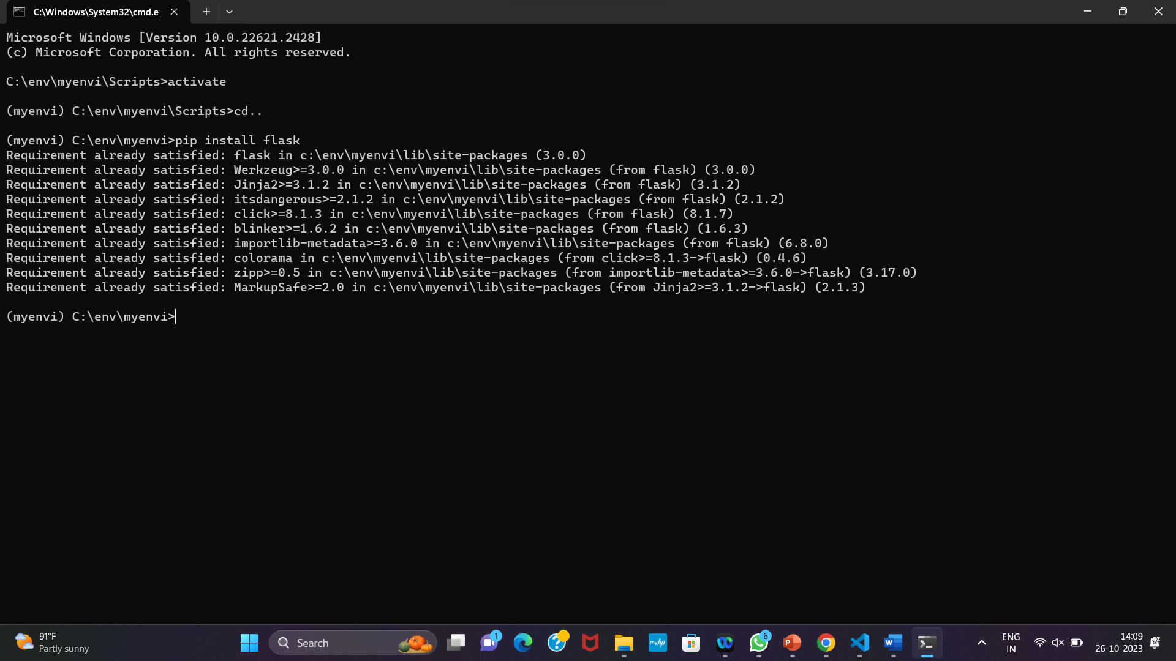
Step 2:
Create a Basic Flask Web App
1. Create a file named app.py in your project directory.
2. In app.py, import Flask and create a basic Flask app:

Slide 6
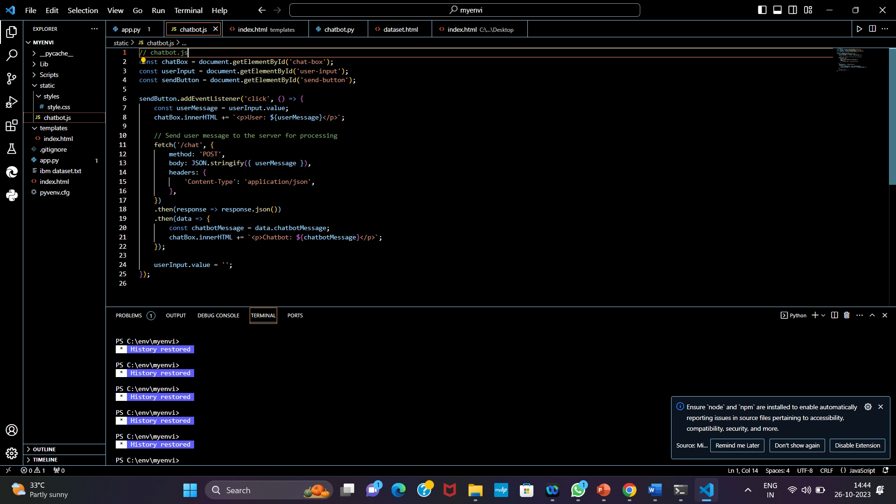
Python code:

Slide 7
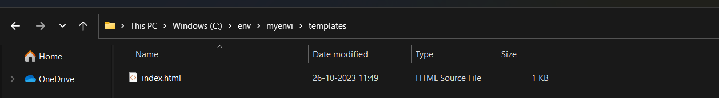
Step 3:
Create HTML Templates
1. Create a folder named templates in your project directory.
2. Inside the templates folder, create an HTML file named index.html:

Slide 8
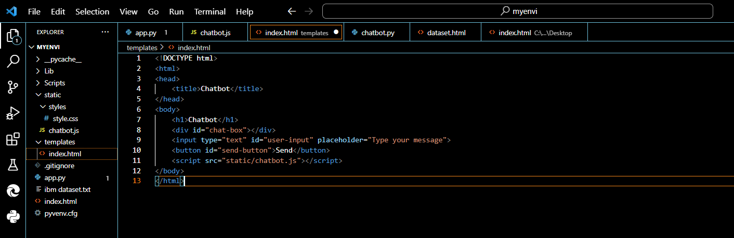
HTML code:

Slide 9
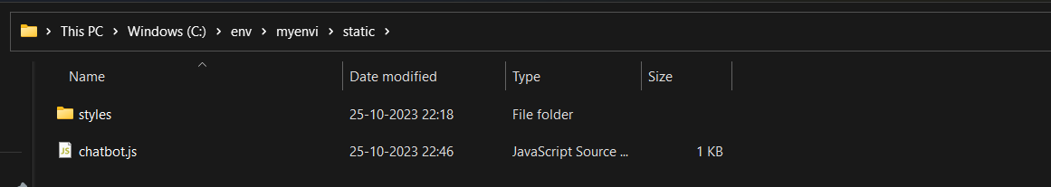
Step 4:
Create JavaScript for Chatbot
1. Create a folder named static in your project directory.
2. Inside the static folder, create a JavaScript file named chatbot.js. This file will handle user input and responses from the chatbot.

Slide 10
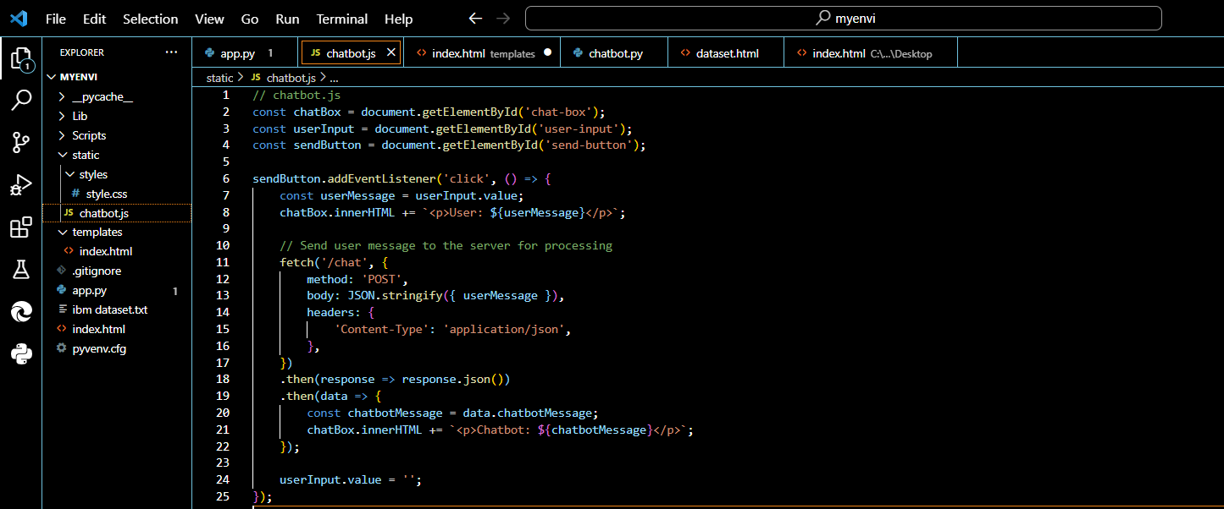
JavaScript code

Slide 11
Step 5:
Implement Chatbot Logic in Flask
In app.py, add a new route to handle user messages and return chatbot responses.
2. Implement the get_chatbot_response function using your existing chatbot logic. This function should take a user message as input and return the chatbot's response.

Slide 12
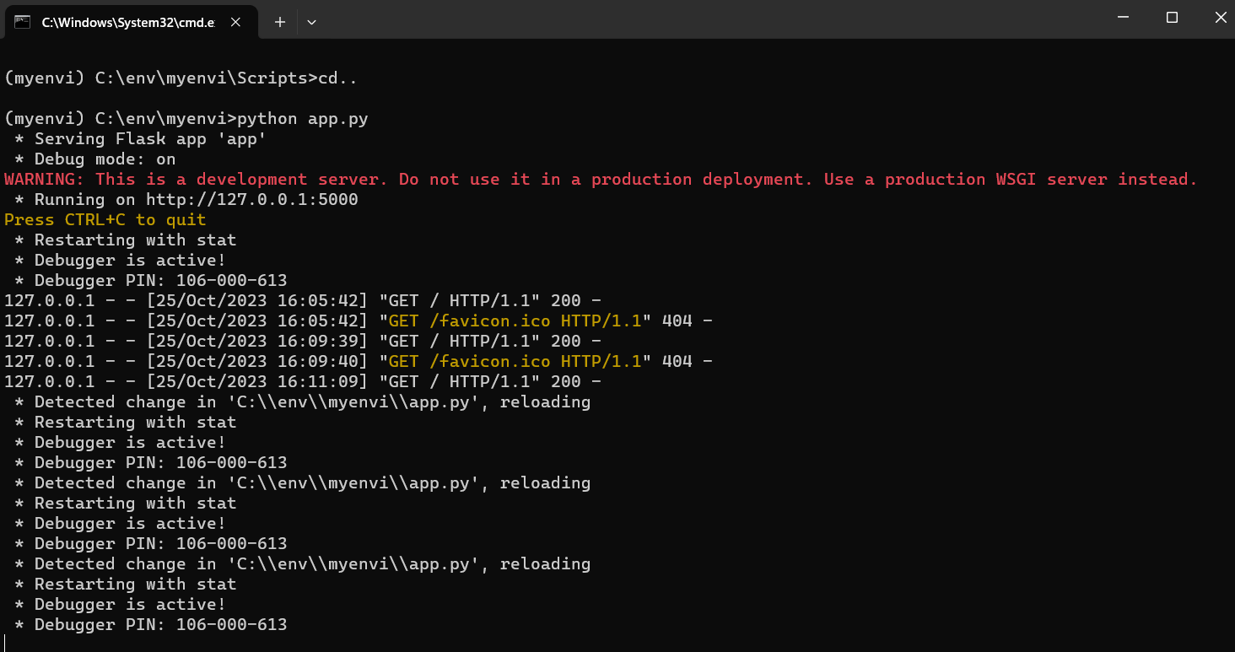
Step 6:
Run Your Flask App
1.Run your Flask app using the following command:

Slide 13
Python Code:
python app.py
2. Access your chatbot web app by opening a web browser and navigating to http://127.0.0.1:5000 Our chatbot is now integrated into a Flask web app. Users can interact with it through the web interface. Make sure you adapt the chatbot logic and responses to suit your specific use case and chatbot implementation. You can also enhance the web interface to make it more interactive and visually appealing

Slide 14
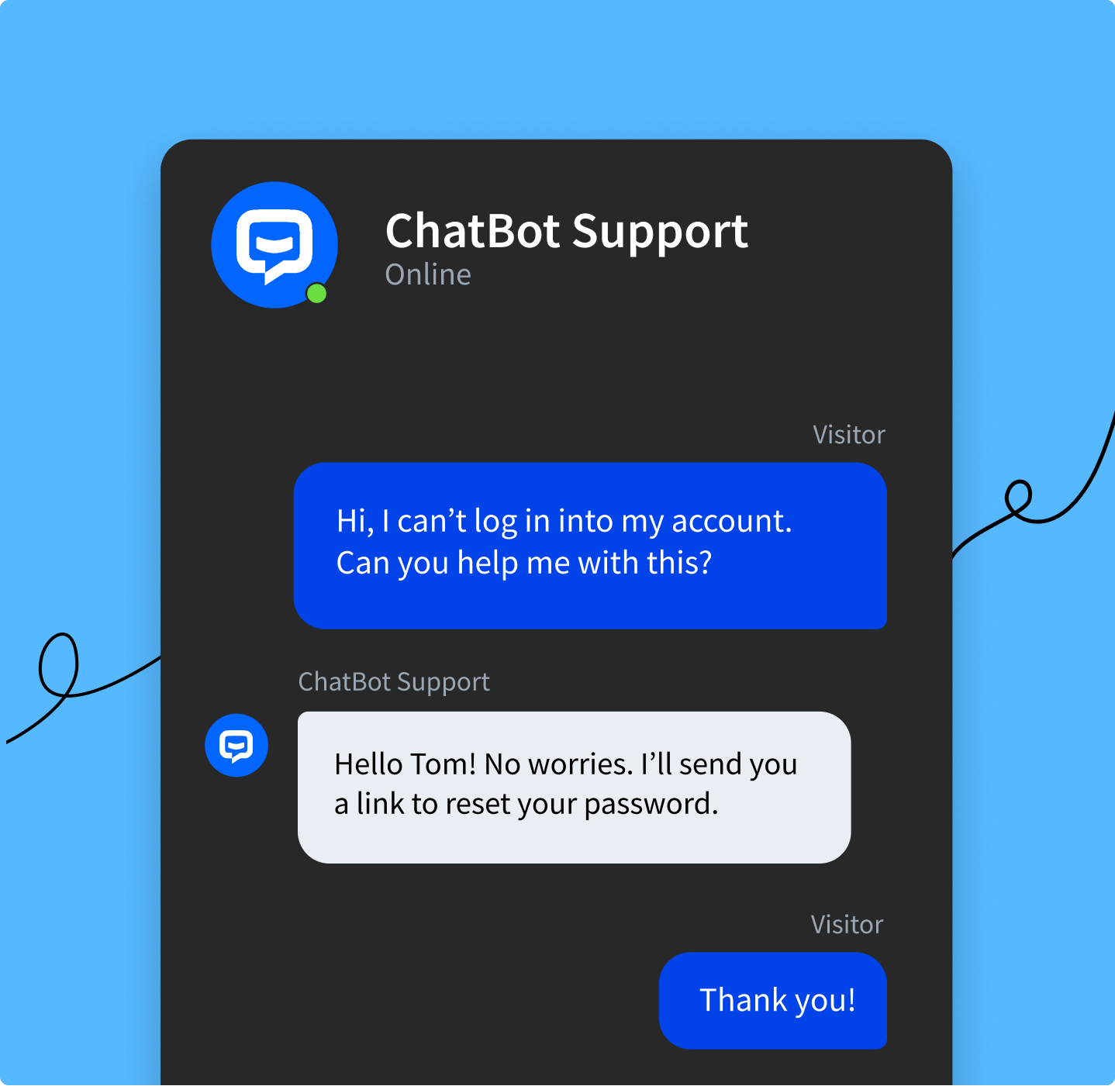

Slide 15
Conclusion:
- "Thank you for chatting with Your Chatbot Name! I hope I was able to assist you effectively."
- "If you have any more questions or need further assistance, feel free to reach out."
- "Your feedback is valuable. Type 'feedback' to share your thoughts on this interaction."
- "Have a great day! Goodbye!“
hereby,I conclude that those content are not copied and done on my own

