Slide 1
Smart water fountain
Phase 5
Project by:-
M.VEDHALAKSHMI
S.SOWMYA
R.MONISHA
J.REKHA
A.SARANYA
SNEHA.S.G

Slide 2
Introduction
The designed smart water system took into account the large amount of various sensors data (cameras and water sensor nodes) to provide an optimized water fountain monitoring allowing a convenient supervision and to inform instantly the administrator and the end-users about any abnormal state of the machine. …In this document we will see a complete steps we have taken to build a smart water fountain

Slide 3
Objective
The project aims to enhance public water fountains by implementing IOT sensors to control water flow and detect malfunctions. The primary objective is to provide real-time information about water fountain status to residents through a public platform. This project includes defining objectives, designing the IOT sensor system, developing the water fountain status platform, and integrating them using IOT technology and Python.

Slide 4
IOT SENSORS
Sensors: IOT sensors are used to measure various parameters of water quality, such as pH, temperature, dissolved oxygen, and the presence of chemicals and microorganisms. These sensors can be placed in rivers, lakes, and other bodies of water, and they can transmit data In real-time to a central monitoring system.
Smart meters: IOT smart meters are used to monitor water usage in homes and businesses, and they can detect leaks and other potential issues. By providing real-time data on water usage, these devices can help water utilities to better manage their systems and respond to potential problems.

Slide 5
IOT SENSORS
Actuators: IOT actuators are devices that can control or manipulate the environment based on data from sensors. In the context of water quality, actuators can be used to automatically adjust the flow of water, or to dispense chemicals or other substances to improve the quality of the water.
Gateways: IOT gateways are devices that can connect multiple sensors and other devices to the internet, and they can act as intermediaries between the devices and a central monitoring system. In the context of water quality, gateways can be used to collect data from multiple sensors and transmit it to a central server for analysis and processing.

Slide 6
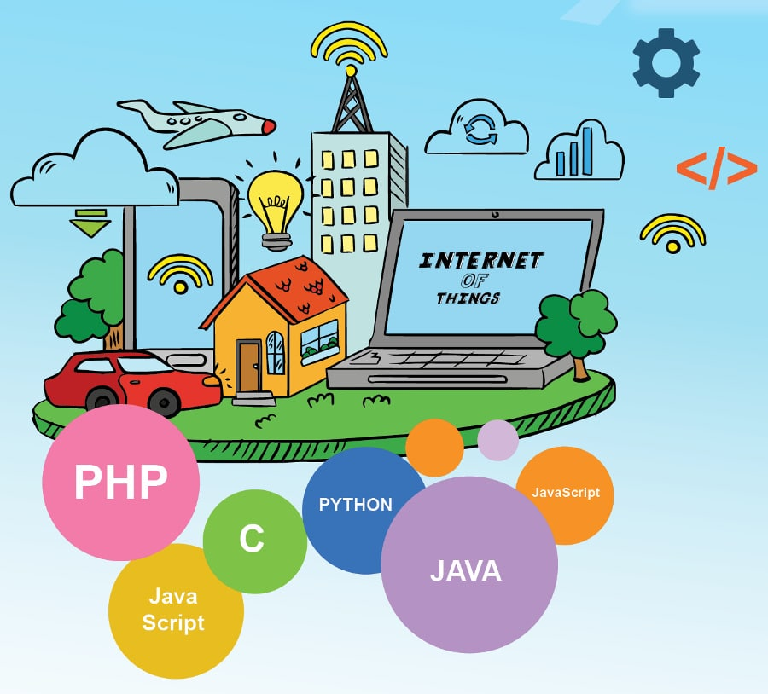
languages used

Slide 7
Coding
Import time import os From OmegaExpansion import AdcExp adc = AdcExp.AdcExp( while 1: a0 = adc.read_voltage(0) a1 = adc.read_voltage(1) # a2 = adc.read_voltage(2) a3 = adc.read_voltage(3) temp = (a0 – 0.5) * 100 soil = (a1 / 5) * 100 rPhoto = 5.0 / a3 * 1000 – 1000 lux = 500/(rPhoto/1000)

Slide 8
Const char* ssid = “Your_Router_Name”; const char* password = “Your_WiFi_Password”; void setup(){ Serial.begin(115200); Serial.println(“\nWiFi station setting”); WiFi.mode(WIFI_STA); WiFi.begin(ssid, password); Serial.print(“Connecting”); while (WiFi.status() != WL_CONNECTED){ delay(500); Serial.print(“.”); } Serial.println(“\nWiFi connection established”); Serial.print(“Device ip address: “); Serial.println(WiFi.localIP()); }

Slide 9
Steps
To keep your fountain working at its best, there are a few things you can do. Remove all debris from fountain once a week ( more during bad weather) Prevent algae growth by placing your outdoor fountain in the shade Use distilled water in your fountain to further prevent algae growth Deep clean your fountain with a stiff brush once every few months, including pump and tubing Repair any leaks as soon as possible If the reservoir does not have enough water in it, this can damage the pump. In the summer, its especially important to check the reservoir level frequently, due to evaporation.

Slide 10
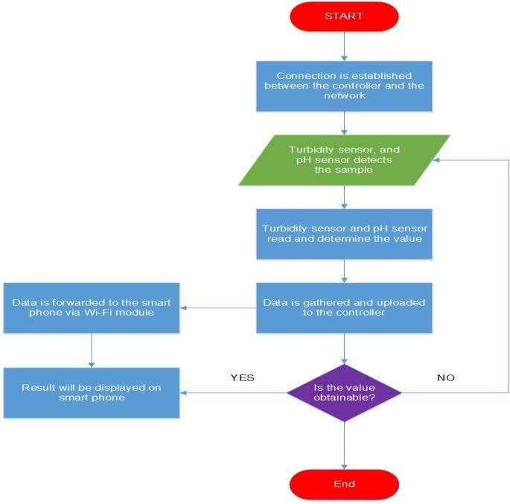
Flowchart for water management In fountain

Slide 11
Thank you

