Slide 1


WISH · IIT BOMBAY · 2026
Rural Bus Tracking &
Passenger Information System
Low-bandwidth GPS tracking, ETA prediction, multilingual alerts
WISH Project · IIT Bombay · Summer 2026

Slide 2
01
SECTION
Problem & Motivation
02 / 23

Slide 3

RURALSYNC
The Problem
Rural passengers have no reliable way to know when a bus will arrive — and existing trackers assume continuous 4G and a smartphone.
— Patchy or absent mobile data along rural routes
— Feature phones dominate; smartphone apps don't reach the audience
— Multiple regional languages required, not just English / Hindi
— Operators have no live view of route adherence or delays
03 / 23

Slide 4
RURALSYNC
Project Goals
Build a system that meets passengers where they are — feature phone, SMS, IVR — and gives operators real visibility.
— Track buses with low-cost hardware over intermittent networks
— Predict accurate ETAs even during signal blackouts
— Reach every passenger via SMS / IVR — no smartphone required
— Alert passengers automatically when a bus diverts from its route
04 / 23

Slide 5
02
SECTION
System Architecture
05 / 23

Slide 6
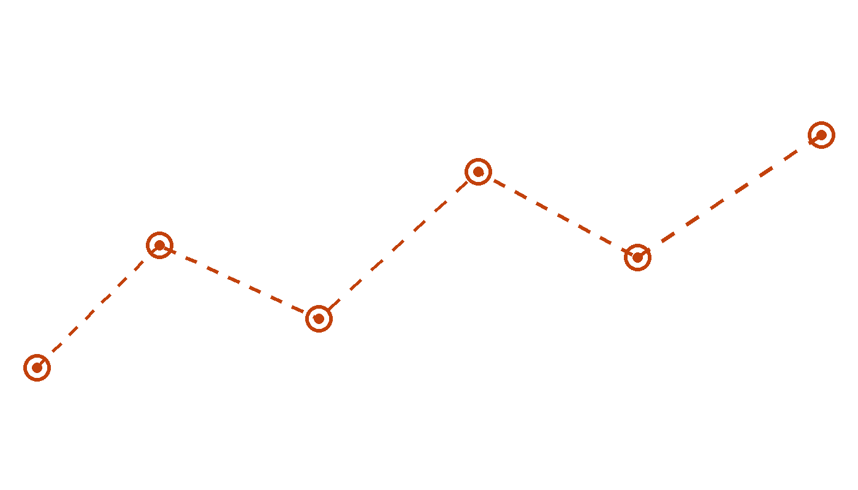
ARCHITECTURE
End-to-End Data Flow
Bus
Person 1
Person 2
Database
Person 3
GPS Hardware
Ingestion + DB
ETA Engine
Positions / ETAs
SMS · IVR · Dash
Each layer owns a clear responsibility; the database is the contract between them.
06 / 23

Slide 7

RURALSYNC
Three-Layer Architecture
Responsibilities split across three contributors, glued together by a shared PostgreSQL + PostGIS database.
— Bus hardware emits a GPS ping every 2 – 3 minutes
— Person 1 — ingests, validates, deduplicates packets
— Person 2 — derives position, ETA, status, divert alerts
— Person 3 — delivers SMS, IVR, dashboard, stop-side display
07 / 23

Slide 8
03
SECTION
Person 1 — Ingestion & Database
08 / 23

Slide 9
RURALSYNC
Responsibilities (P1)
The data plumbing layer — converts raw bus pings into a clean stream the engine can trust.
— Receive GPS packets via HTTP, fall back to SMS gateway when offline
— Validate, deduplicate, and clean incoming pings
— Maintain canonical route data: stops + road polyline
— Expose a clean stream of positions to the ETA engine
09 / 23

Slide 10
RURALSYNC
Route Data — Where the Polyline Comes From
A practical fallback chain so every route has geometry, even when authoritative data is missing.
— OpenStreetMap + OSRM — automated polyline fetch (default)
— Manual digitisation in QGIS / Google My Maps for missing roads
— One test drive per route — most accurate, also seeds travel times
— GTFS shapes.txt where available; Google Directions as paid fallback
10 / 23

Slide 11
04
SECTION
Person 2 — ETA & Prediction Engine
11 / 23

Slide 12
RURALSYNC
The Four Jobs of the Engine
Turns raw lat/lon into something a passenger can actually act on.
— ETA calculation — distance ÷ speed, refined by learned segment times
— Network-loss prediction — dead-reckoning when pings stop
— Historical learning — per-segment, per-time-of-day averages
— Route adherence — 50 m geofence corridor with auto-alert on divert
12 / 23

Slide 13
ENGINE
Prediction State Machine
The status flag drives wording on every passenger-facing surface.
LIVE
ESTIMATED
LAST_KNOWN
OFF_ROUTE
01
02
03
04
Fresh GPS ping in the last few minutes
Projected from last known speed during short blackout
Blackout too long — freeze position, mark uncertain
Three consecutive packets outside the corridor
13 / 23

Slide 14

RURALSYNC
Cold-Start Strategy
On day one the historical table is empty. A four-step fallback chain means the engine never fails to produce an ETA.
— Hardcoded defaults — ~30 km/h highway, ~25 mixed, ~15 town
— Seed from the published bus schedule (stop-to-stop times)
— Seed from OSRM driving-time estimates per segment
— Optional test drive per route for the highest-fidelity seed
— Fallback chain: bucket → segment → route → default
14 / 23

Slide 15
RURALSYNC
What the Engine Writes to the DB
A single contract: Person 3 reads these rows, the engine guarantees them.
— Bus position (lat, lon, timestamp)
— Next stop and ETAs for all upcoming stops
— Status flag — LIVE / ESTIMATED / LAST_KNOWN / OFF_ROUTE
— Confidence score 0–1 — drives wording ("12 min" vs "~12 min")
15 / 23

Slide 16
05
SECTION
Person 3 — Passenger Interface
16 / 23

Slide 17
RURALSYNC
Reaching Every Passenger
Smartphone-free by design. SMS and IVR work on any handset; the dashboard and display board cover operators and waiting passengers.
— SMS query handler: text a bus number, get an ETA back
— IVR call flow: speaks the ETA in the chosen regional language
— Authority dashboard: live map, alerts, adherence view
— Stop-side display board: next bus + ETA in local language
— Maintains the query log that drives divert auto-alerts
17 / 23

Slide 18
06
SECTION
Divert Alert Pipeline
18 / 23

Slide 19
RURALSYNC
End-to-End Divert Flow
Fully automated — no operator action required to notify affected passengers.
— Engine detects 3 consecutive off-corridor packets → OFF_ROUTE
— Writes alert row to DB, flashes banner on authority dashboard
— Looks up recent query log for that bus (last N hours)
— Auto-sends SMS / IVR to every recent querier in their language
— Operator notified simultaneously — no manual step
19 / 23

Slide 20
07
SECTION
Tech Stack & Roadmap
20 / 23

Slide 21
RURALSYNC
Tech Stack
Open-source where possible, paid services only where they earn it.
— Backend — Python (FastAPI / Flask)
— Database — PostgreSQL + PostGIS for geospatial queries
— Routing — self-hosted OSRM over OpenStreetMap data
— Telephony — SMS gateway + IVR provider (Exotel / Twilio)
— Hardware — low-cost GPS module + 2G modem on each bus
21 / 23

Slide 22
RURALSYNC
Status & Pilot Plan
Prototype works end-to-end on simulated data; next step is hardware-in-the-loop.
— Phase 1 — bench test with simulator (done)
— Phase 2 — single bus, single route, schedule-seeded ETAs
— Phase 3 — 5 routes, dashboard + SMS live, ground-truth collection
— Phase 4 — historical learning active, accuracy review at 4 weeks
22 / 23

Slide 23
WISH · IIT BOMBAY · 2026
Thank You
Questions & Discussion
WISH Project · IIT Bombay

