Slide 1

CUSTOM AIO FLIGHT CONTROLLER DESIGN

Slide 2
GOAL
Design an ultra-lightweight All-In-One Flight Controller capable of controlling an autonomous drone.
Specifications
Small size (25×25 mm)
Lightweight (Target ≈3.14 g PCB)
Long range communication
IMU based stabilization
ArduPilot compatibility
Battery powered
USB programming
External Flash storage

Slide 3
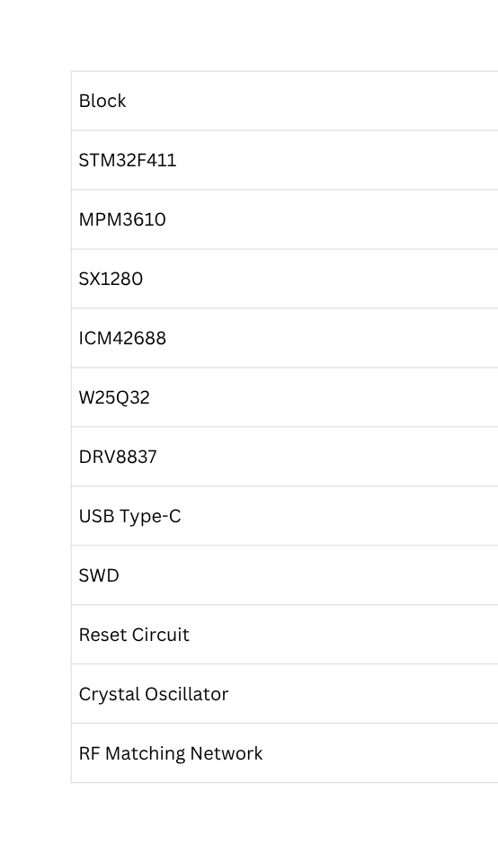
COMPLETE HARDWARE ARCHITECTURE

Slide 4
POWER SUPPLY SECTION
Component: MPM3610 Buck Converter
Specifications
Input Voltage
4.5V – 21V
Output Voltage
Adjustable
3.3V
Maximum Output Current
1.2A
Efficiency
Approximately 90–95%
Switching Frequency
About 2 MHz
FUNCTION
CONVERTS VBAT (3.0–4.2 V) TO 3.3 V
POWERS ALL DIGITAL COMPONENTS
HIGH EFFICIENCY (~90–95%)
MAXIMUM OUTPUT CURRENT: 1.2 A
SUPPORTING COMPONENTS
C7 – 10 ΜF (INPUT FILTER)
C8 – 100 NF (NOISE FILTER)
C9, C10 – 22 ΜF (OUTPUT STABILIZATION)
C11, C12 – 100 NF (HIGH-FREQUENCY BYPASS)

Slide 5
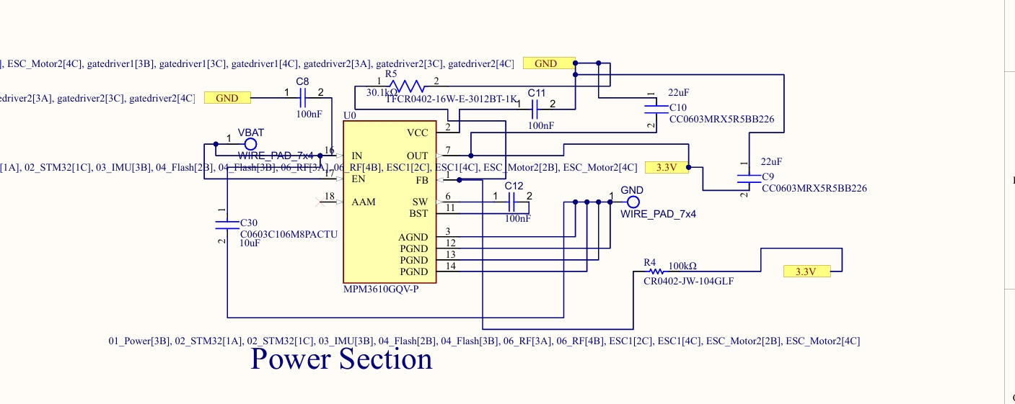

Slide 6
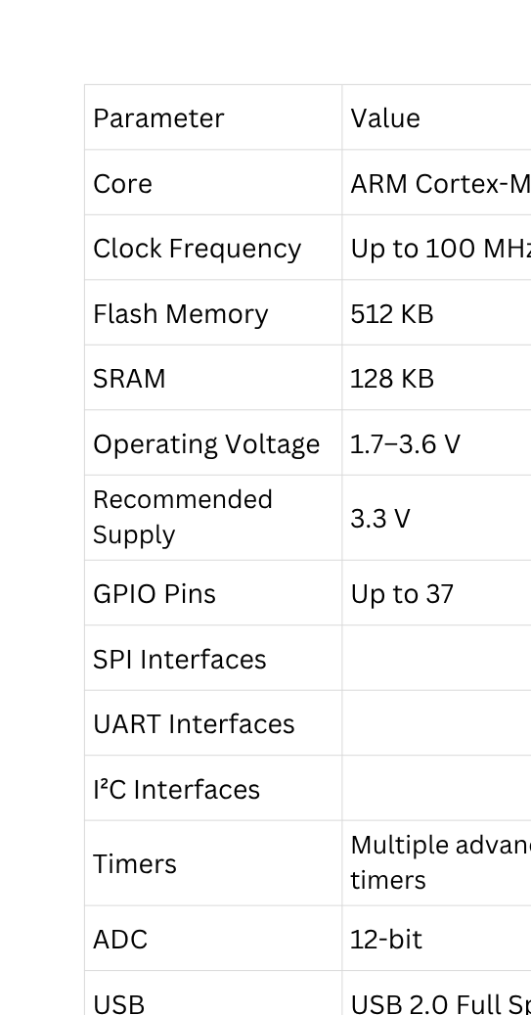
STM32F411CEU6 – FLIGHT CONTROLLER (MAIN PROCESSING UNIT)
ROLE IN THE SYSTEM
CENTRAL PROCESSING UNIT (BRAIN OF THE AIO BOARD)
EXECUTES FLIGHT CONTROL FIRMWARE
COMMUNICATES WITH ALL ONBOARD PERIPHERALS
GENERATES MOTOR CONTROL SIGNALS
MANAGES WIRELESS COMMUNICATION AND SENSOR PROCESSING
MAJOR FUNCTIONS
READS IMU SENSOR DATA
PROCESSES FLIGHT CONTROL ALGORITHM
CONTROLS BRUSHED MOTORS
STORES CONFIGURATION IN FLASH MEMORY
COMMUNICATES WITH RF MODULE
SUPPORTS USB PROGRAMMING AND SWD DEBUGGING

Slide 7
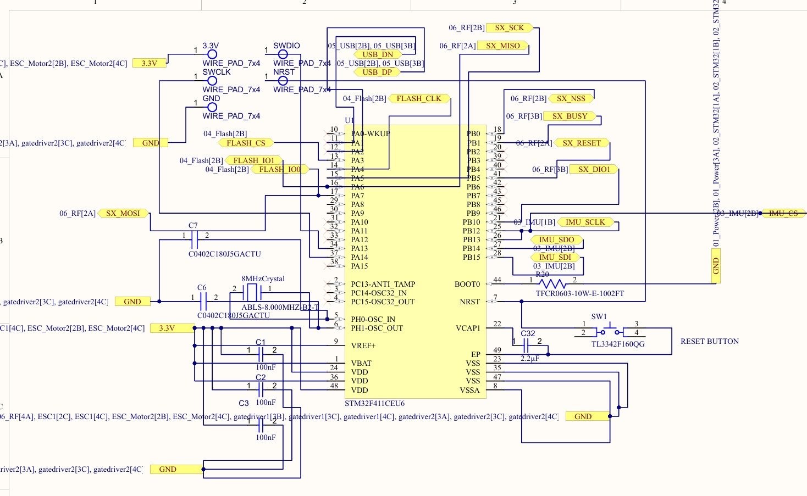

Slide 8
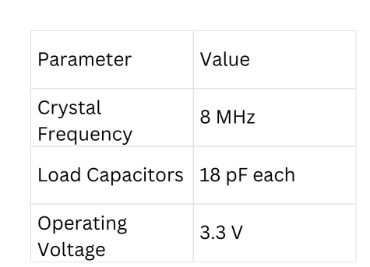
CLOCK CIRCUIT (SYSTEM CLOCK GENERATION)
COMPONENTS USED
8 MHZ CRYSTAL OSCILLATOR (X2)
2 × 18 PF LOAD CAPACITORS (C5, C6)
SPECIFICATIONS
PURPOSE
PROVIDES A STABLE CLOCK SOURCE FOR STM32
ENSURES ACCURATE TIMING FOR ALL PERIPHERALS
IMPROVES USB COMMUNICATION ACCURACY
ENABLES RELIABLE SPI COMMUNICATION
CONNECTIONS
PH0 (OSC_IN) → CRYSTAL
PH1 (OSC_OUT) → CRYSTAL
C5 → CRYSTAL TO GND
C6 → CRYSTAL TO GND

Slide 9
RESET & BOOT CIRCUIT
RESET CIRCUIT
COMPONENTS USED
RESET PUSH BUTTON (SW2)
10 KΩ PULL-UP RESISTOR (R1)
BOOT CIRCUIT
COMPONENTS USED
10 KΩ PULL-DOWN RESISTOR (BOOT0)
PURPOSE
SELECTS THE BOOT MODE
ENSURES BOOT FROM INTERNAL FLASH MEMORY
PURPOSE
MANUALLY RESETS THE STM32
RESTARTS FIRMWARE EXECUTION
USED DURING DEBUGGING AND
FIRMWARE DEVELOPMENT
CONNECTIONS
NRST PIN → RESET BUTTON
R1 (10 KΩ) → NRST TO 3.3 V
RESET BUTTON → GND

Slide 10
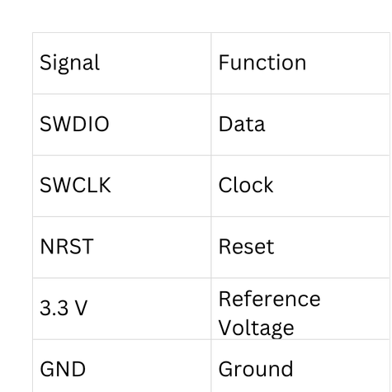
SWD PROGRAMMING INTERFACE
PURPOSE
PROGRAM STM32
DEBUG FIRMWARE
FLASH BOOTLOADER
REAL-TIME DEBUGGING
PROGRAMMER
ST-LINK V2
STM32CUBEPROGRAMMER
ADVANTAGES
FAST PROGRAMMING
REAL-TIME DEBUGGING
BREAKPOINTS
REGISTER MONITORING
SIGNALS

Slide 11
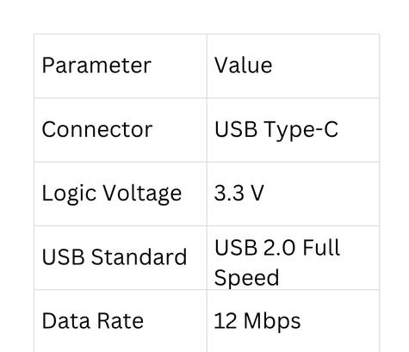
USB TYPE-C INTERFACE
PURPOSE
FIRMWARE UPLOAD
SERIAL COMMUNICATION
BOARD POWER DURING PROGRAMMING
MAIN COMPONENTS
USB TYPE-C CONNECTOR
CC1 & CC2 RESISTORS (5.1 KΩ)
USB_DP
USB_DM
FIRMWARE UPLOAD
USB COMMUNICATION
FUTURE CONFIGURATION
DEBUG LOGGING
FUNCTIONS
SPECIFICATIONS

Slide 12
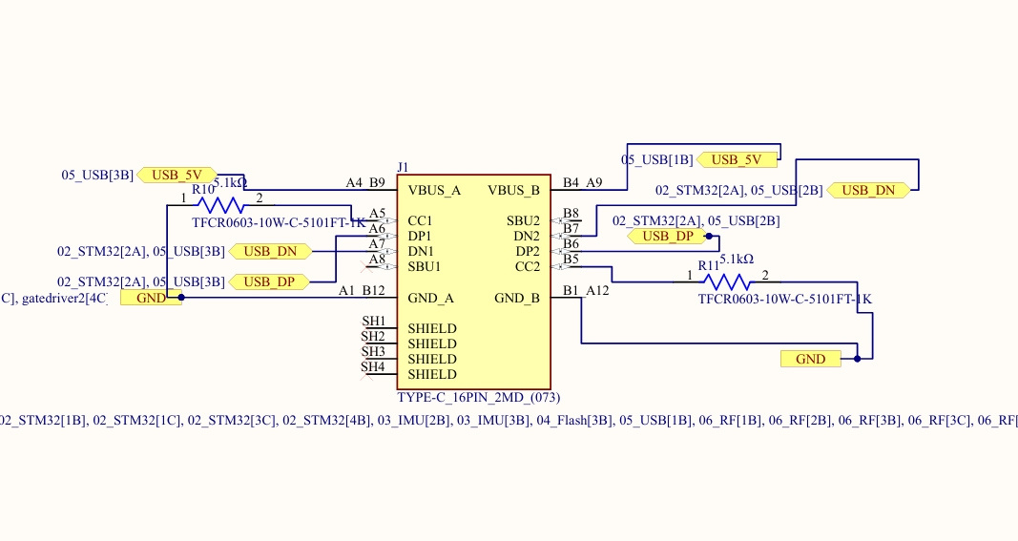

Slide 13
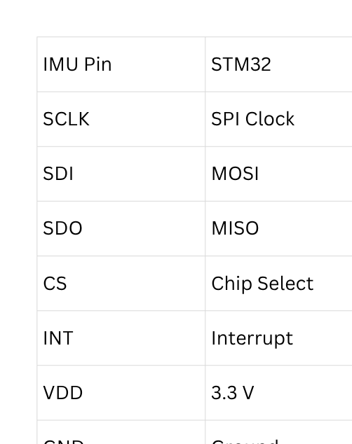
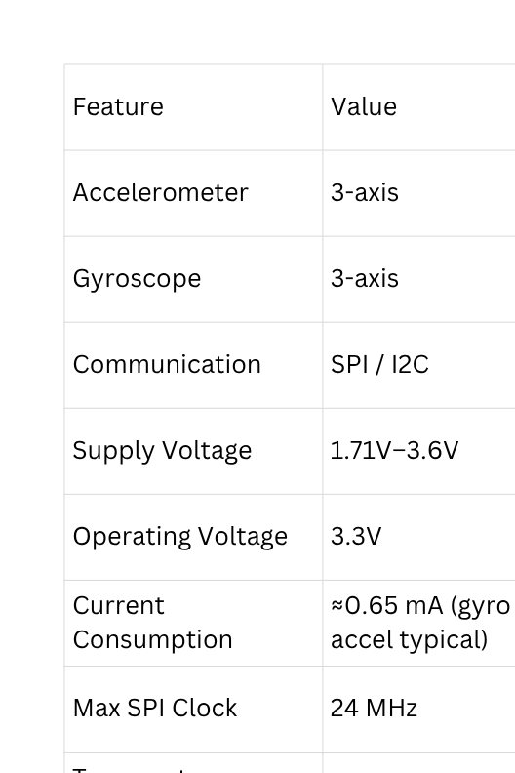
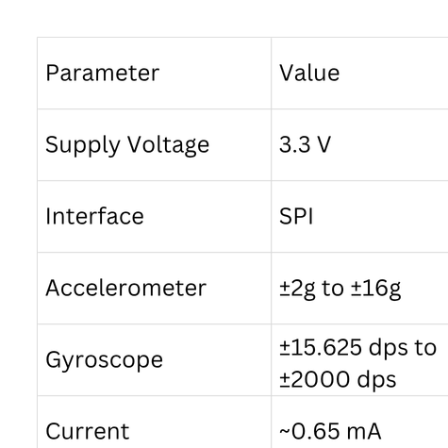
ICM42688-P INERTIAL MEASUREMENT UNIT
PURPOSE
MEASURES MOTION
MEASURES ROTATION
DRONE STABILIZATION
FLIGHT NAVIGATION
SENSOR TYPE
3-AXIS ACCELEROMETER
3-AXIS GYROSCOPE
CONNECTIONS
FEATURES FROM DATASHEET
SPECIFICATIONS
SUPPORTING COMPONENTS
100 NF CAPACITOR
2.2 ΜF CAPACITOR

Slide 14
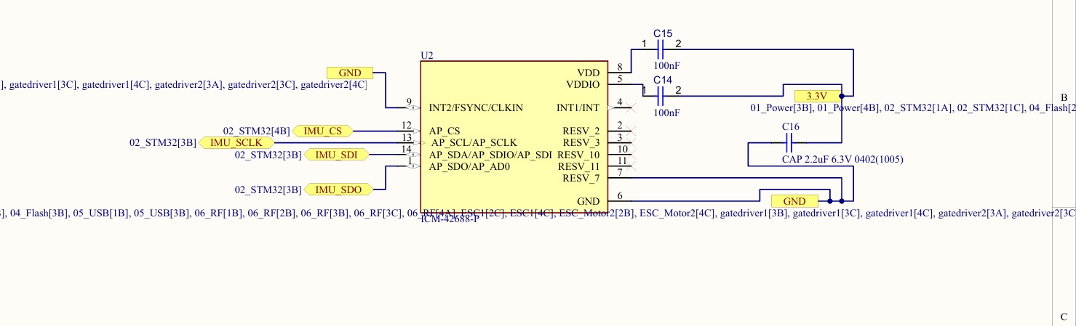

Slide 15
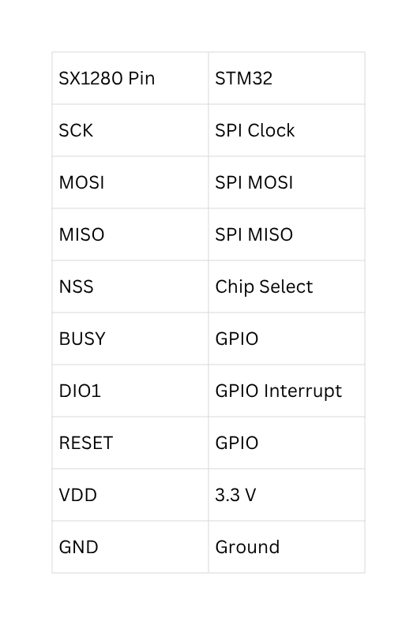
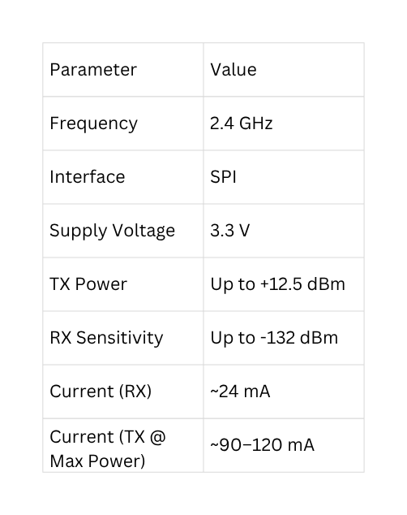
SX1280 RF TRANSCEIVER (EXPRESSLRS 2.4 GHZ)
PURPOSE
WIRELESS COMMUNICATION BETWEEN DRONE AND TRANSMITTER
RECEIVES CONTROL COMMANDS
SENDS TELEMETRY DATA
SUPPORTS EXPRESSLRS PROTOCOL
COMPONENT
SX1280IMLTRT
STM32 CONNECTIONS
KEY SPECIFICATIONS
FUNCTIONS
RECEIVES RC COMMANDS
SENDS TELEMETRY
SPI COMMUNICATION
LONG RANGE COMMUNICATION

Slide 16
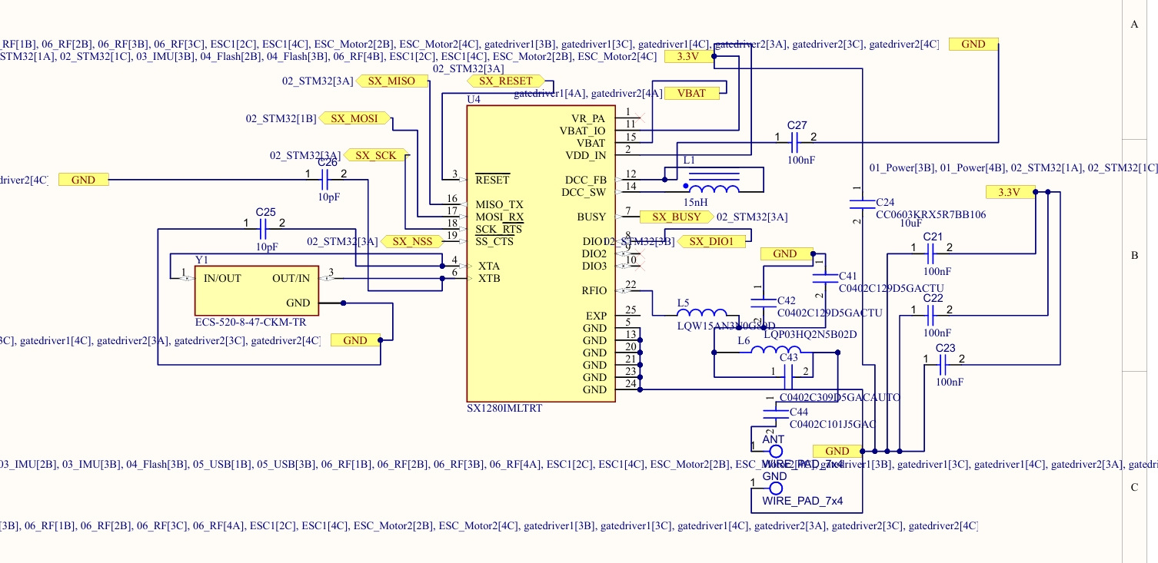

Slide 17
RF MATCHING NETWORK & ANTENNA
PURPOSE
MATCHES ANTENNA IMPEDANCE
MAXIMIZES RF POWER TRANSFER
REDUCES REFLECTED POWER
IMPROVES COMMUNICATION RANGE
COMPONENTS
INDUCTOR
MATCHING CAPACITORS
2.4 GHZ ANTENNA
IMPEDANCE
RF OUTPUT = 50 Ω
ANTENNA = 50 Ω
BENEFITS
MAXIMUM TRANSMISSION EFFICIENCY
BETTER RECEIVER SENSITIVITY
LOWER SIGNAL LOSS
STABLE RF PERFORMANCE

Slide 18
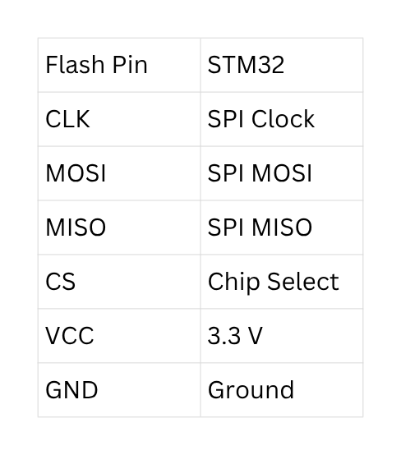
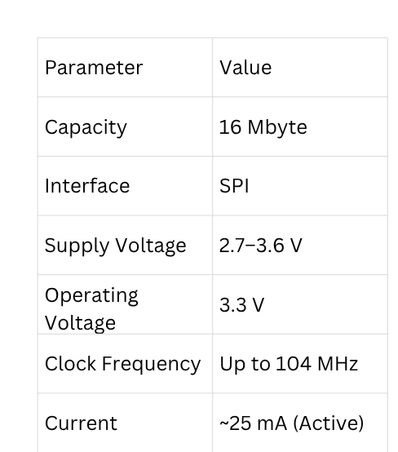
W25Q32JV EXTERNAL FLASH MEMORY
PURPOSE
STORES CONFIGURATION DATA
STORES CALIBRATION VALUES
STORES LOGS
SUPPORTS FUTURE
FIRMWARE EXPANSION
COMPONENT
W25Q32JV
STM32 CONNECTIONS
FUNCTIONS
PARAMETER STORAGE
CALIBRATION STORAGE
FLIGHT LOGS
FIRMWARE SUPPORT
KEY SPECIFICATIONS

Slide 19
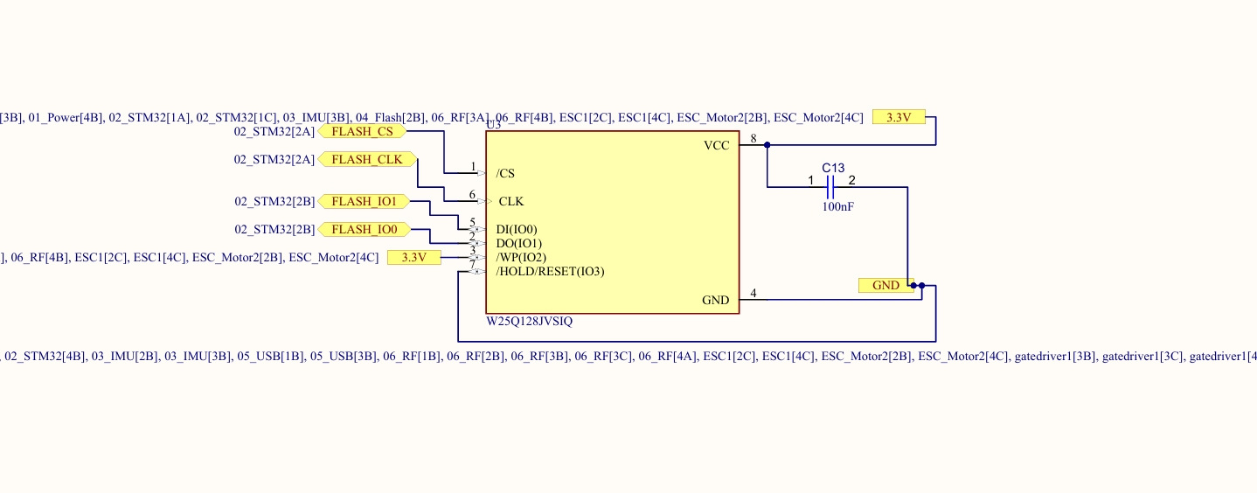

Slide 20
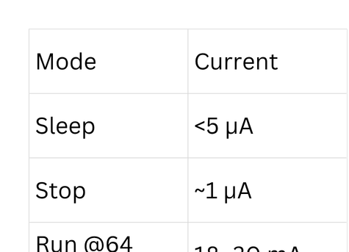
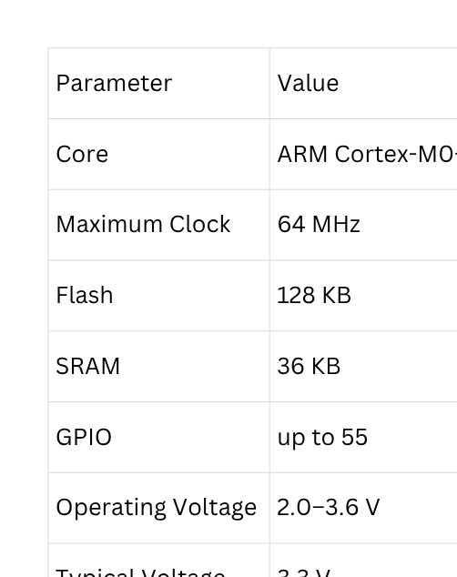
STM32G071GBU6 – MOTOR CONTROLLER
DEDICATED MCU FOR MOTOR 2 ESC
GENERATES SIX PWM GATE SIGNALS
ARM CORTEX-M0+ (64 MHZ)
SWD PROGRAMMING INTERFACE
RESET CIRCUIT WITH PULL-UP RESISTOR
LOCAL POWER DECOUPLING CAPACITOR
CURRENT CONSUMPTION
SPECIFICATIONS
SUPPLY VOLTAGE
OPERATING VOLTAGE
2.0–3.6 V
USED VOLTAGE
3.3 V
ACTUAL CURRENT DEPENDS ON
PWM FREQUENCY
CPU LOAD
PERIPHERAL USAGE

Slide 21
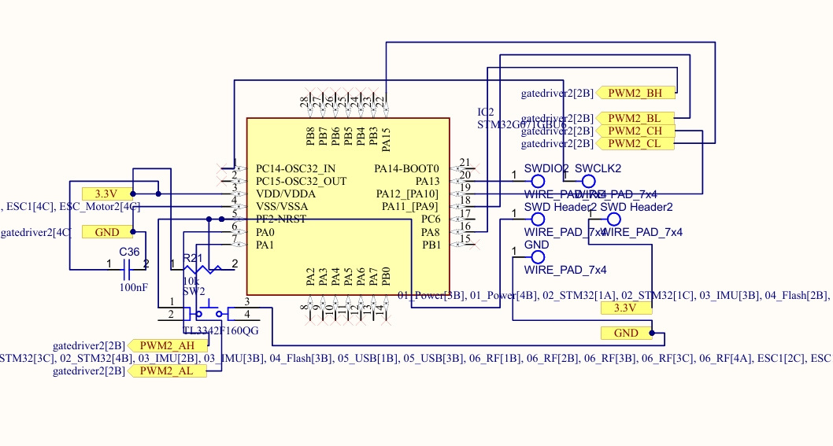

Slide 22
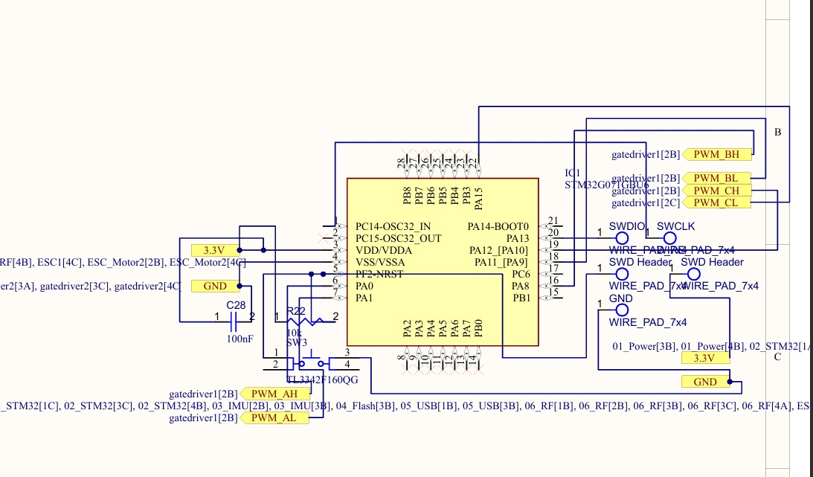

Slide 23
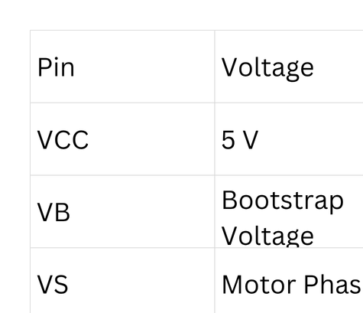
GATE DRIVER & POWER STAGE
FD6288Q THREE-PHASE GATE DRIVER
SIX AON7524 MOSFETS (3 HALF BRIDGES)
BOOTSTRAP CIRCUIT FOR HIGH-SIDE DRIVING
GATE RESISTORS FOR MOSFET PROTECTION
THREE-PHASE MOTOR OUTPUT
POWERED DIRECTLY FROM VBAT
SUPPLY VOLTAGE

Slide 24
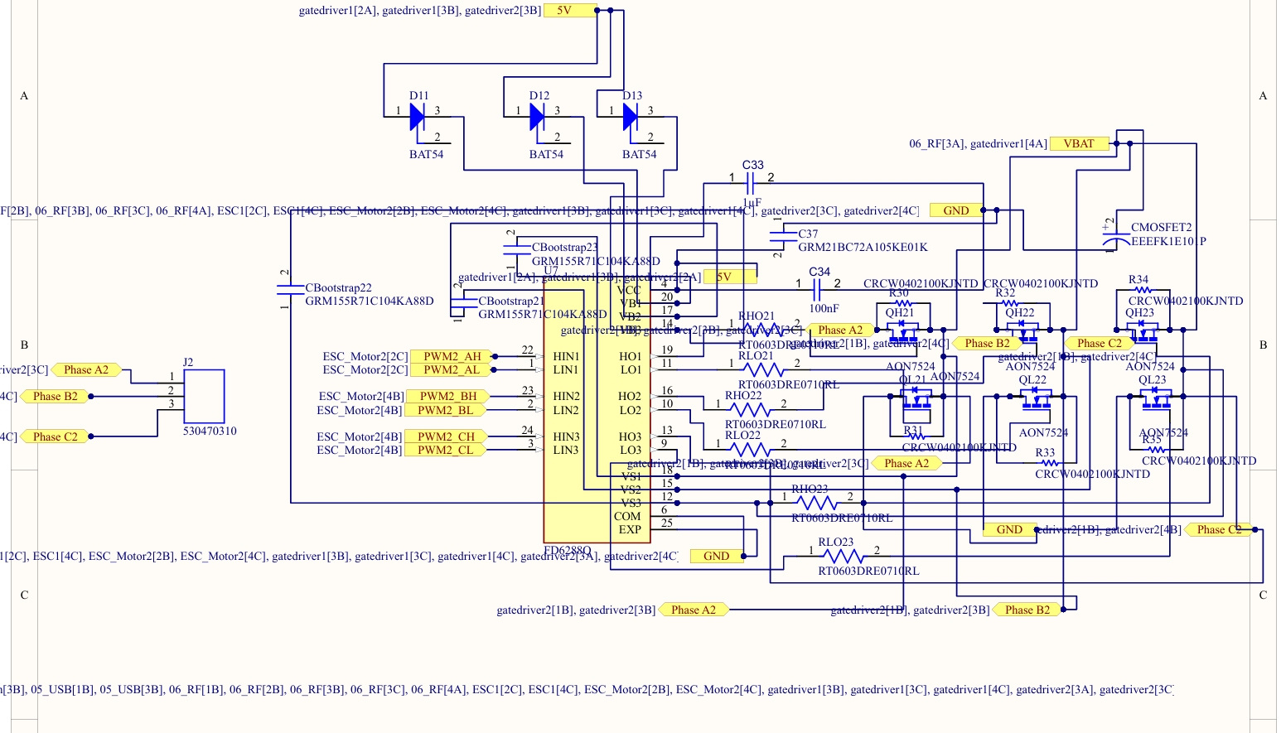

Slide 25
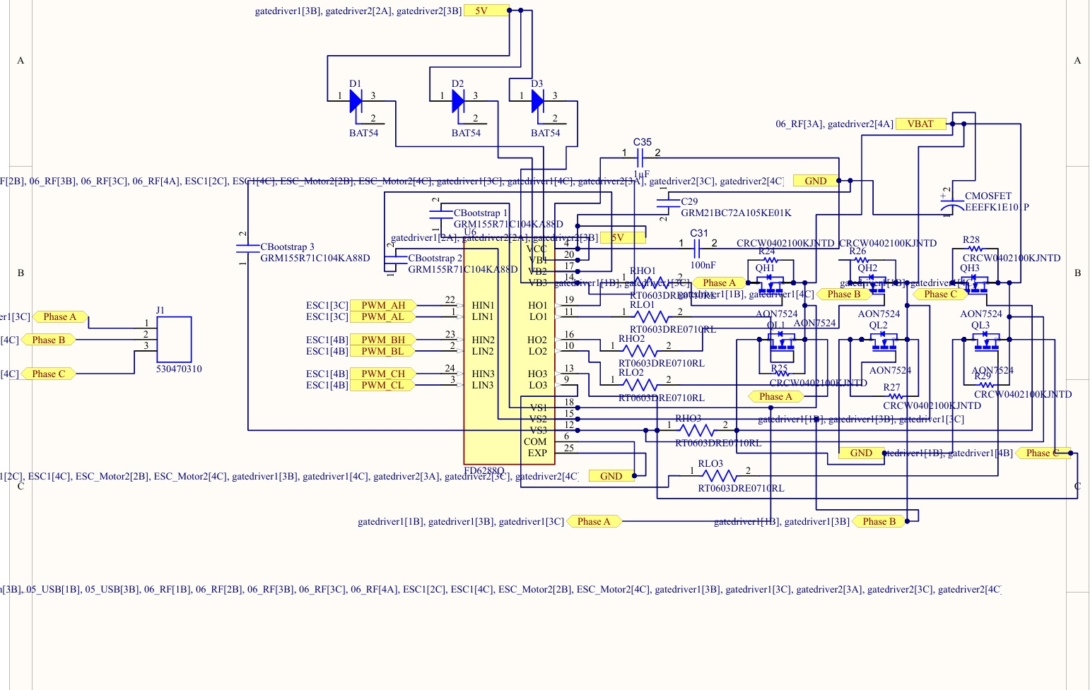

Slide 26
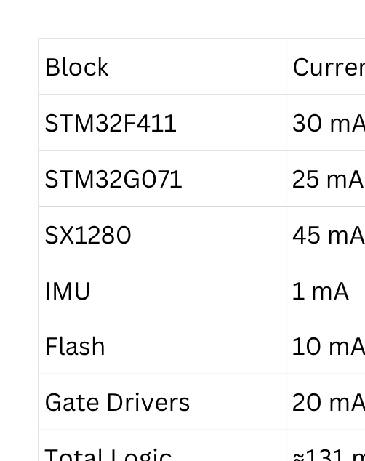
CURRENT CONSUMPTION & POWER BUDGET
POWER SOURCE
BATTERY: 2S LIPO (7.4–8.4 V)
REGULATED 3.3 V SUPPLY USING MPM3610
DIGITAL SECTION TOTAL
RX MODE: ≈100 MA
TX MODE: ≈200 MA (PEAK)
MPM3610 CAPABILITY
OUTPUT VOLTAGE: 3.3 V
MAXIMUM OUTPUT CURRENT: 1.2 A
SAFETY MARGIN: >80% AVAILABLE
ESTIMATED CURRENT CONSUMPTION

Slide 27
COMPLETE SYSTEM SIGNAL FLOW
POWER FLOW
VBAT → BUCK CONVERTER → 3.3V LOGIC SUPPLY
VBAT → ESC GATE DRIVERS → MOSFETS → MOTORS
DATA FLOW
IMU → STM32F411 → FLIGHT CONTROL ALGORITHM
EXPRESSLRS → STM32F411 → CONTROL COMMANDS
FLASH MEMORY ↔ STM32F411
STM32F411 → STM32G071 ×2 → ESC PWM SIGNALS
STM32G071 → GATE DRIVERS → MOSFETS → BLDC MOTORS

Slide 28
CONCLUSION & FUTURE WORK
PROJECT ACHIEVEMENTS
CUSTOM 20 × 20 MM AIO FLIGHT CONTROLLER DESIGNED
COMPLETE SCHEMATIC DEVELOPED
COMPONENT SELECTION COMPLETED
HARDWARE ARCHITECTURE VERIFIED
DESIGN RULE CHECK (DRC)
NEXT PHASE
ADD BATTERY VOLTAGE MONITORING
ADD CURRENT SENSING CIRCUIT
ADD ESC TELEMETRY FEEDBACK
ADD SERVO OUTPUT HEADERS
SUPPORT ROTORFLIGHT ADVANCED FEATURES
INTEGRATE ESP32-S3 VISION MODULE
ADD SONY IMX219 SURVEILLANCE CAMERA
ADD LIVE VIDEO TRANSMISSION

Slide 29
THANK YOU

