Slide 1
Air Quality Index Prediction
By
Vedika Patil - 46
R A Ramya Rajeshwari - 50 Pranjali Shelke - 58
Guide: Prof. Sonali Bodekar

Slide 2
Table of contents
^{O rigination}
Introduction Problem Statement
^{Literature Survey}
^{Existing System}
^{Proposed System}
Workﬂow
Modules of System
Methodology User Relationship
^{Implementation}
^{Software Requirements}
^{Future Scope}
Conclusion

Slide 3
INTRODUCTION
Today, the air pollution in cities is very large. Pollutants have had such a negative impact on humans that problems are occurring in all countries of the world.
Air pollution can also lead to acid rain and the greenhouse effect. Diseases like lung cancer are caused by these harmful pollutants.
Especially in India these days in big cities like Old Delhi and industrial cities like Allahabad, pollution is a huge disadvantage.

Slide 4
PROBLEM STATEMENT
Air Quality Index is an index that is used for reporting daily air quality with which we know how clean or unhealthy our air is, and what associated health effects might be a concern.
It is the concentration of all air pollutants.It’s a single number and easy to understand. Based on AQI, the area can be categorised into: good, satisfying, moderately polluted, poor, very poor and severe.
Once the model is trained we can easily predict the air qualities of the various cities in India and can ﬁnd out the health impacts that can be caused by such quality of air.

Slide 5
LITERATURE SURVEY
PAPER TITLE | OBJECTIVE | TECHNOLOGY USED | OUR INTAKE
Air Pollution Predic- tion System for Smart City Published: In- ternational Research Journal of Engineer- ing Technology (IR- JET), 2019 | To build a system using data mining techniques and ran- dom forest algorithm to predict air quality | Multivariate Multi Step Time Series prediction | To use ran- dom forest classiﬁer
Large scale air pollu- tion prediction with deep convolutional networks Published: Springer, 2021 | To build most accu- rate system based on CNN and build a deep neural network | CNN,DNN, Dense Net, RBF | Increase Speed of Comparison

Slide 6
LITERATURE SURVEY
PAPER TITLE | OBJECTIVE | TECHNOLOGY USED | OUR INTAKE
Air Pollution Predic- tion Using Extreme Learning Machine Published: Spriger, 2018 | To build a system us- ing extreme machine learning to predict AQI based on many pollutants such as, PM10, PM2.5, S02, CO, NOx, NH3 etc. | Multivariable linear regres- sion model | The pollutants to calculate AQI
Forecasting air pol- lution load in Delhi using data analysis Published: Research- gate, 2018 | To Forecast air pol- lution focusing on dataset collected from Central Pollu- tion Control Board (CPCB) by data analy- sis and data cleaning techniques | Time Series Regression, Predictive Analysis | Feature ex- traction, data cleaning, data visualisation

Slide 7
LITERATURE SURVEY
PAPER TITLE | OBJECTIVE | TECHNOLOGY USED | OUR INTAKE
Prediction and Fore- casting of Air Qual- ity Index in Chennai Published: Journal of Engg. Research | AQI monitoring and forecast- ing by the fusion of im- ages taken from the Unmanned Aerial- Vehicle (UAVs). | Adaptive Gaussian Plume (AGPM), ARIMA Model | Using Real- Time Data Sensing for Future Scope
Air Quality Index Using ML Published: Researchgate, 2020 | To build a model based on ranking methods to deter- mine the top pollu- tants and achieve maximum accuracy | Random For- est, Support Vector Ma- chine, | Determining most polluted city and calcu- late accuracy

Slide 8
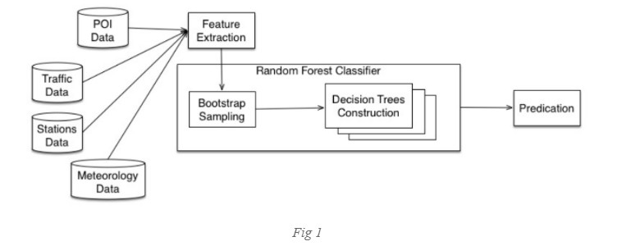
EXISTING SYSTEM

Slide 9
STEPS
Data collection
Point of Interest (POI) data 1.2Trafﬁc and road data 1.3Monitoring station data 1.4Meteorology data
Feature extraction
Bootstrap sampling
Decision tree construction
Prediction

Slide 10
DRAWBACKS
Noise in Trafﬁc Data Collection-> Accuracy Reduces
Cost Ineffective
Time Consuming

Slide 11
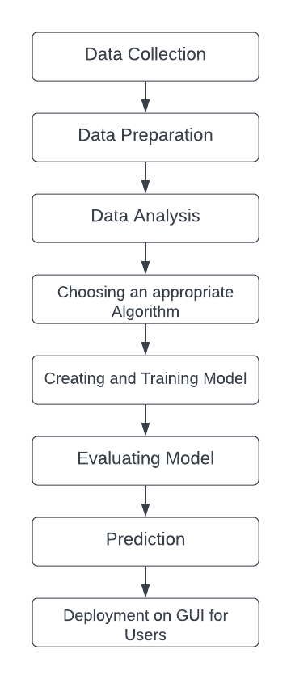
PROPOSED SYSTEM
WORKFLOW

Slide 12
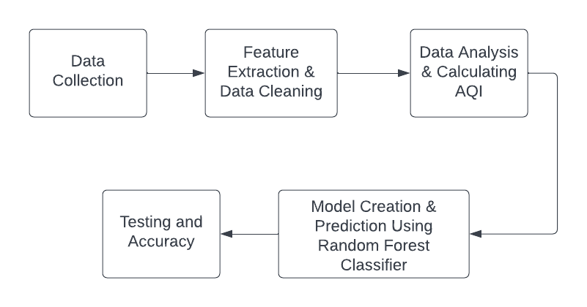
MODULES OF SYSTEM

Slide 13
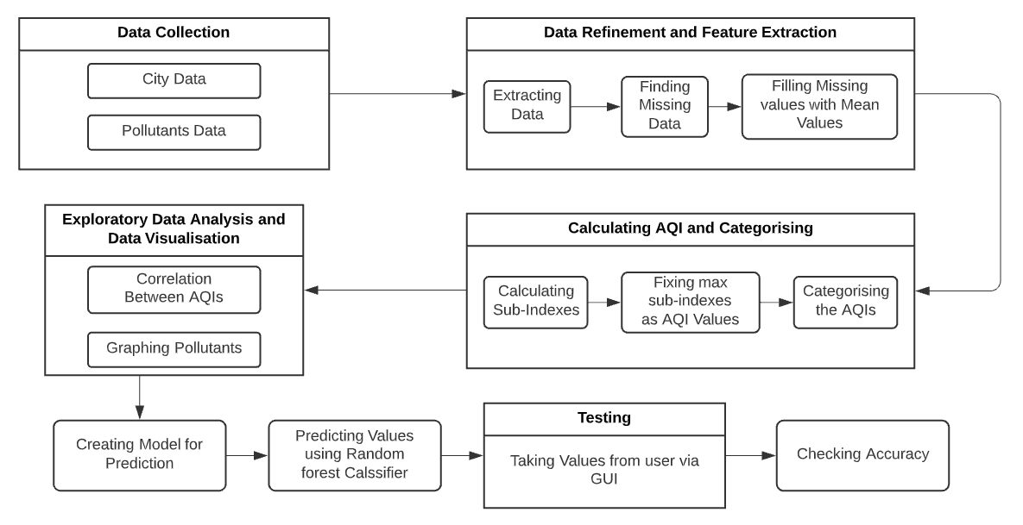
METHODOLOGY

Slide 14
DATA COLLECTION
In the proposed system we have collected data from the existing dataset available on Kaggle. The dataset contains following data:
Information of pollutants for various cities in India from year 2015 to 2020
The concentration of more than 10 pollutants found on different dates in those cities
It also contains two more empty columns of AQI and category from which the AQI belongs

Slide 15
DATA REFINEMENT AND FEATURE EXTRACTION
Extracting data : –Date –PM2.5 (Particulate Matter
2.5-micrometer) –PM10 (Particulate Matter 10-micrometre)
–SO2 (Sulphur Dioxide) –NOx (Any Nitric x-oxide) –NH3 (Ammonia) –CO (Carbon Monoxide) –O3 (Ozone or Trioxygen) –Benzene –Toluene –Xylene –AQI –AQI Bucket
Finding missing values
Filling missing values

Slide 16
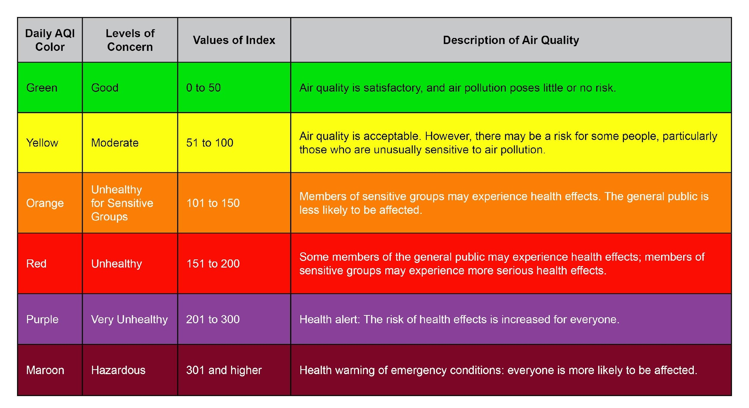
CALCULATING AQI
1.Calculating sub-indexes 2.Filling AQI column 3.Categorising AQIs

Slide 17
DATA VISUALISATION AND CREATING THE MODEL
A heatmap ﬁgure to see the correlation between the AQI and AQI categories
Plots for distribution of different pollutants separately for the 5 years
City wise graph of average AQI values in the 5 years

Slide 18
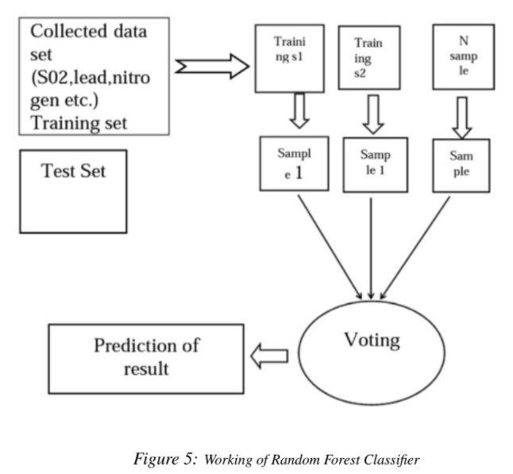
TRAINING AND PREDICTING AQI CATEGORIES
Supervised Learning
Classiﬁcation Problem
Random Forest
Why Random Forest classiﬁer? 1.Good predictions
2.Handle large datasets
3.Higher level of accuracy

Slide 19
TESTING AND CHECKING ACCURACY
Using Confusion matrix to ﬁnd out the accuracy of the code
Confusion Matrix:
A confusion matrix is a table that is often used to describe the performance of a classiﬁcation model (or ”classiﬁer”) on a set of test data for which the true values are known.
Also known as an error matrix, is a speciﬁc table layout that allows visualisation of the performance of an algorithm, typically a supervised learning one.

Slide 20
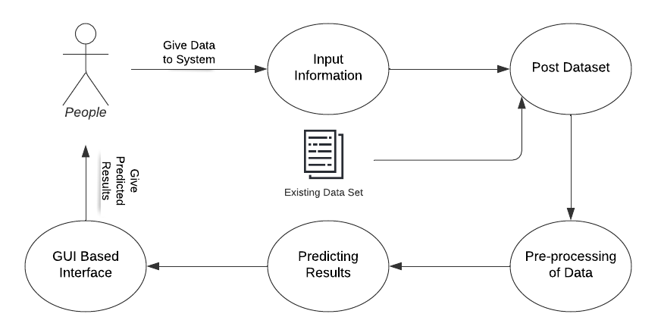
USER RELATIONSHIP

Slide 21
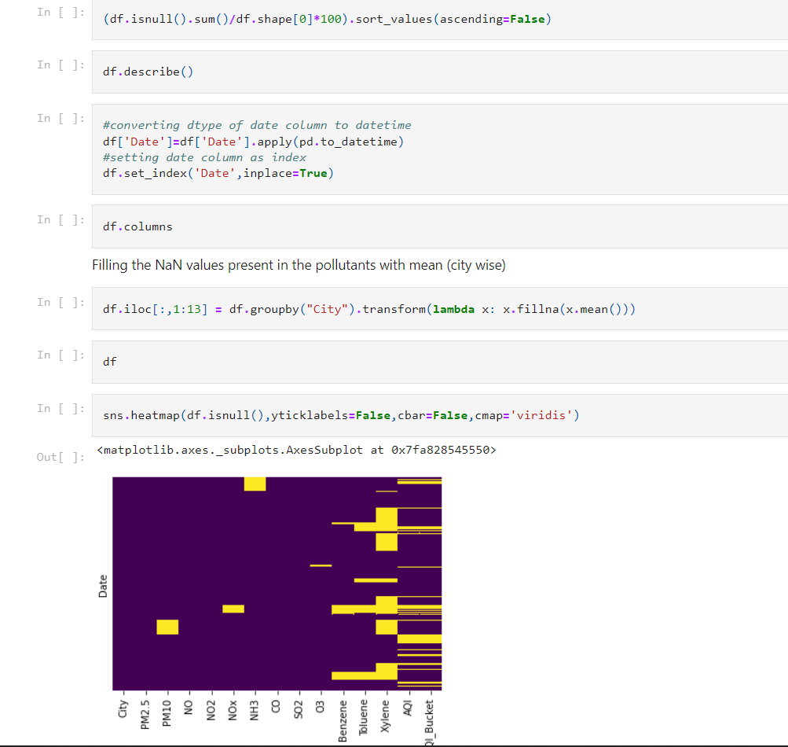
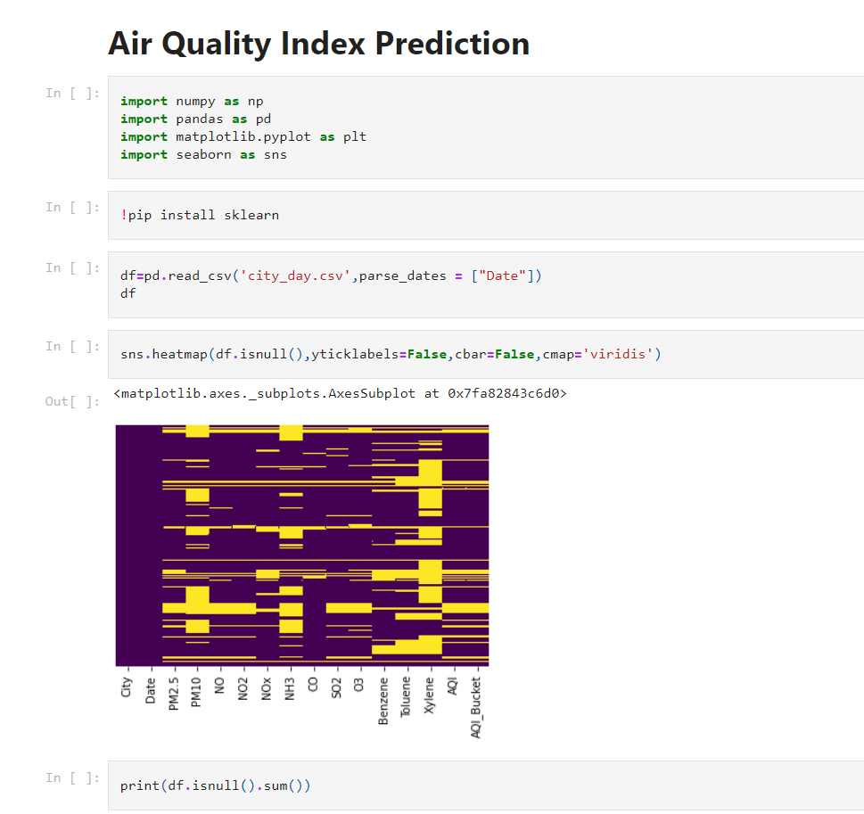
IMPORTING PACKAGES, FINDING AND FILLING MISSING VALUES
IMPLEMENTATION

Slide 22
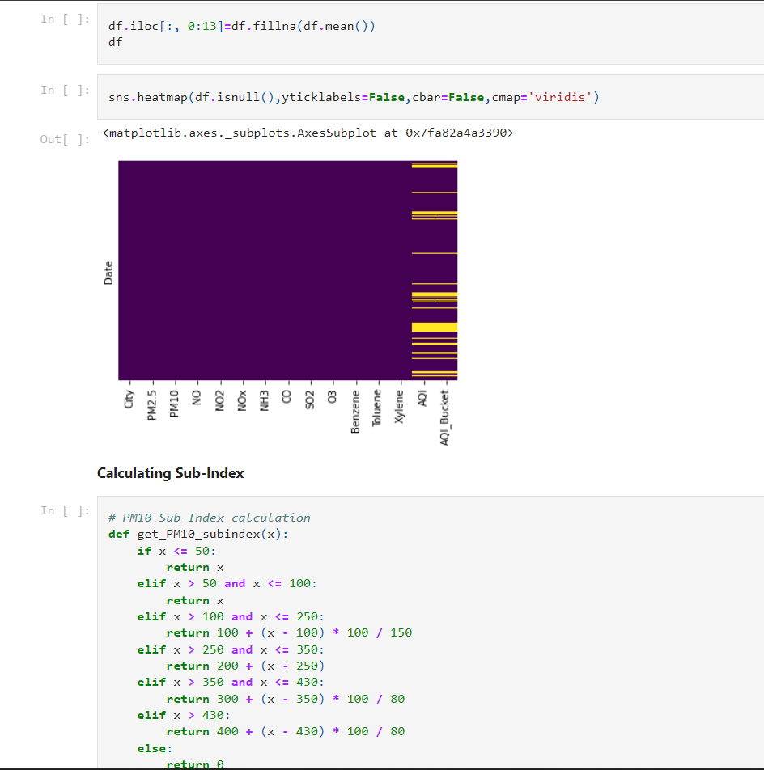
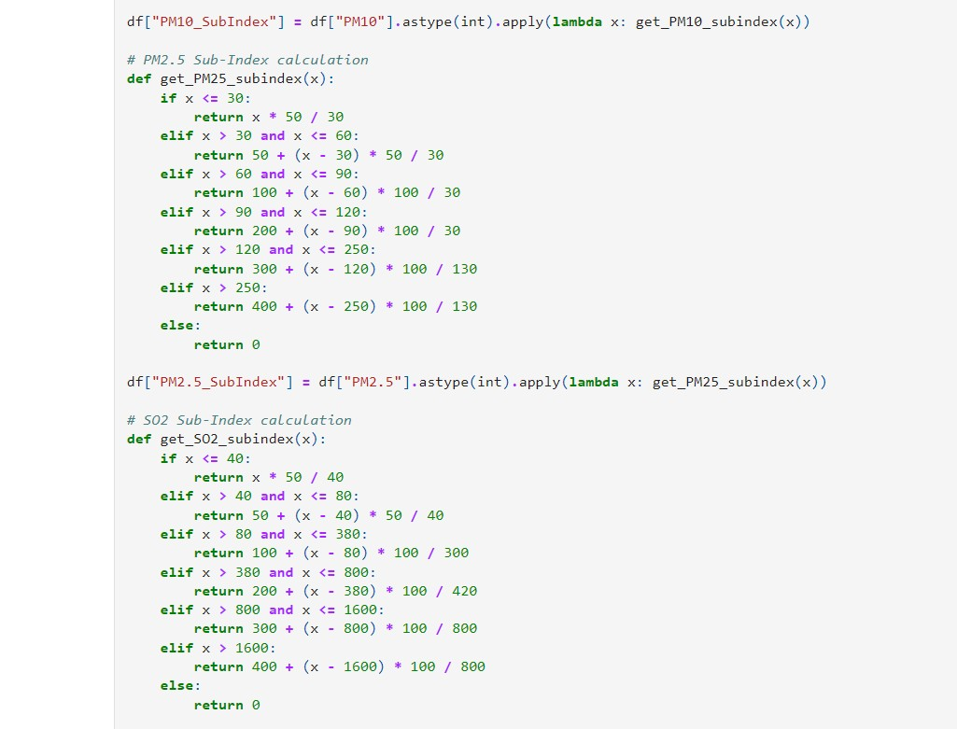
IMPLEMENTATION
CALCULATING SUB INDEXES OF POLLUTANTS

Slide 23
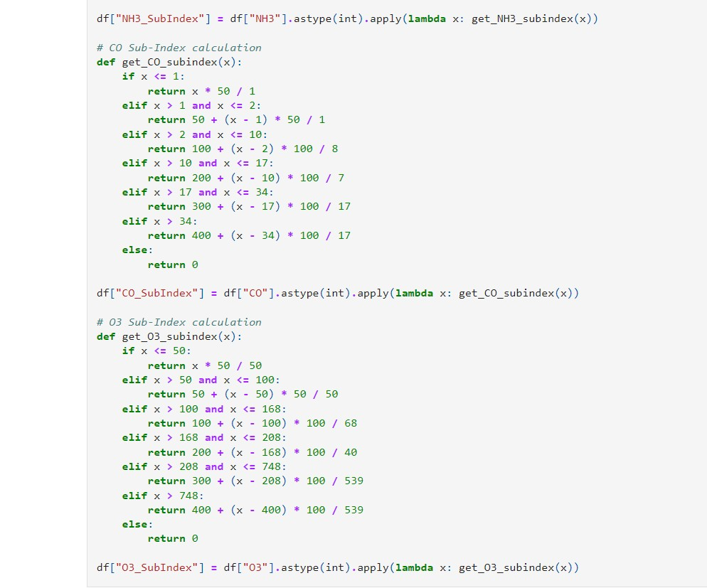
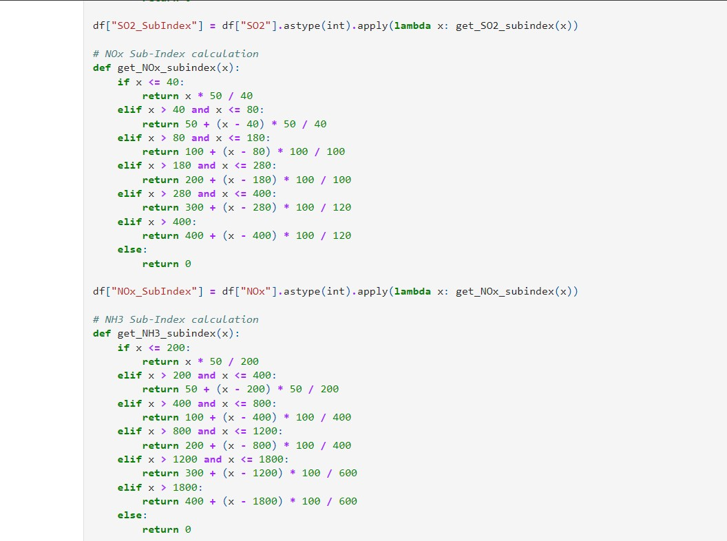
IMPLEMENTATION
CALCULATING SUB INDEXES OF POLLUTANTS

Slide 24
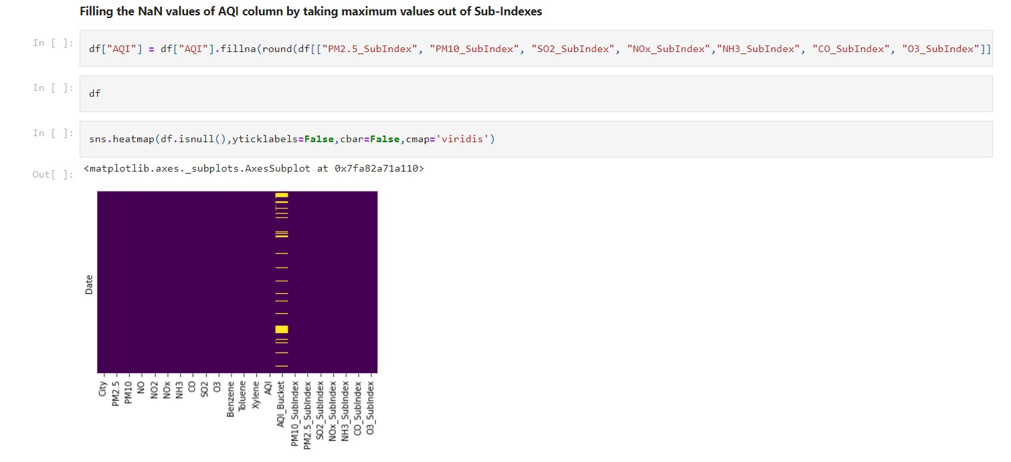
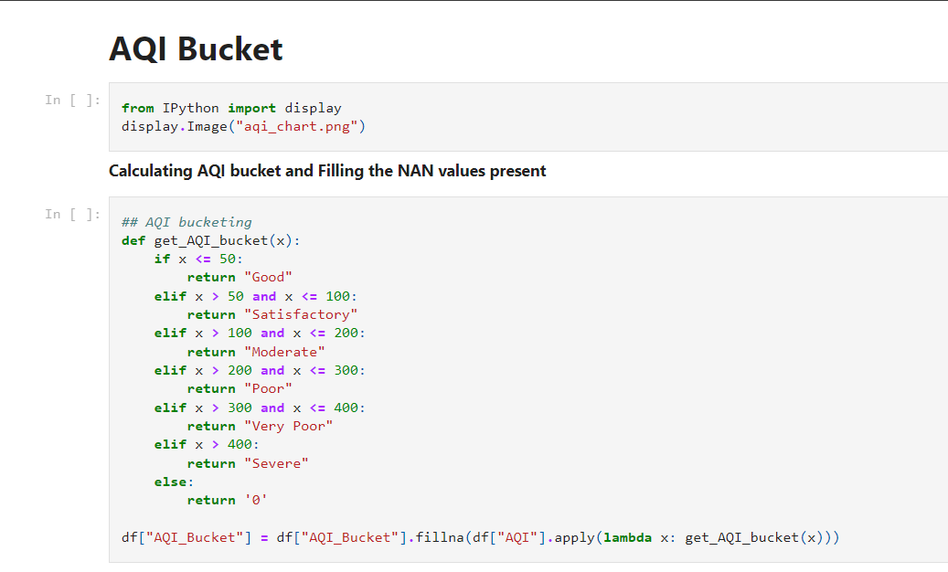
IMPLEMENTATION
FILLING AQI VALUES AND AQI BUCKET

Slide 25
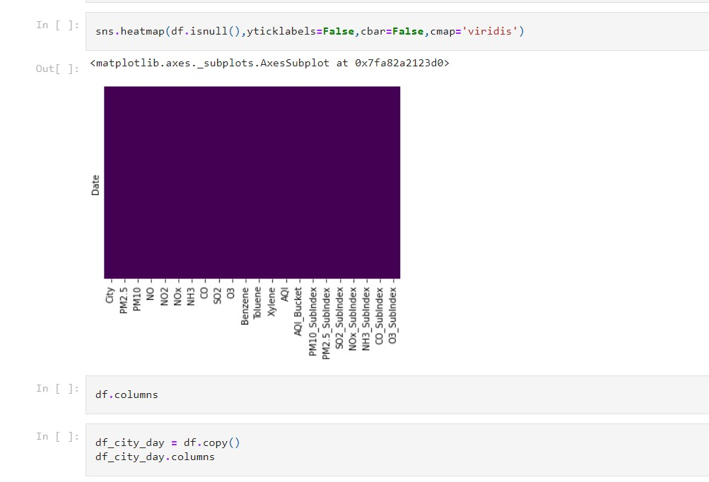
IMPLEMENTATION

Slide 26
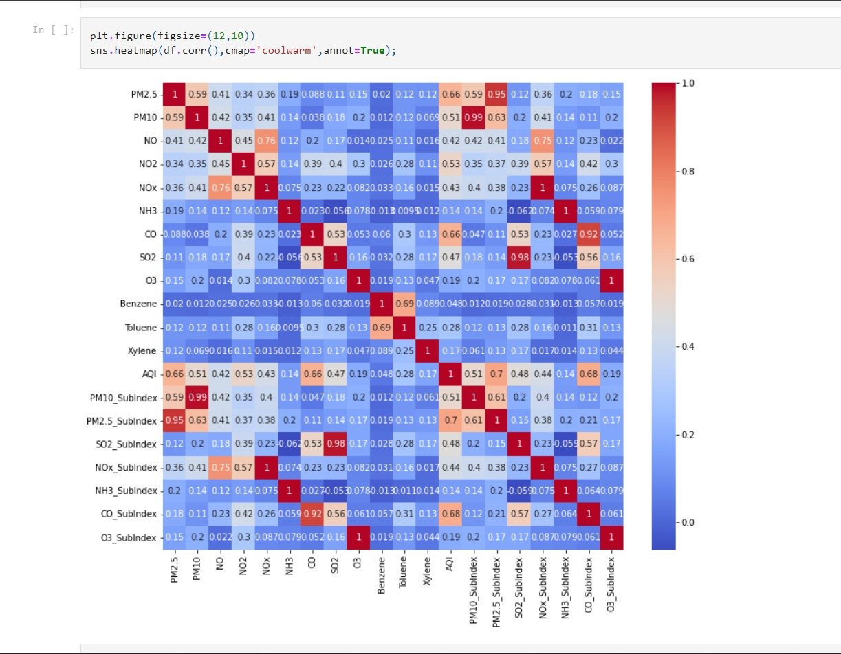
Heatmap for Correlation between AQI and AQI Bucket column
IMPLEMENTATION

Slide 27
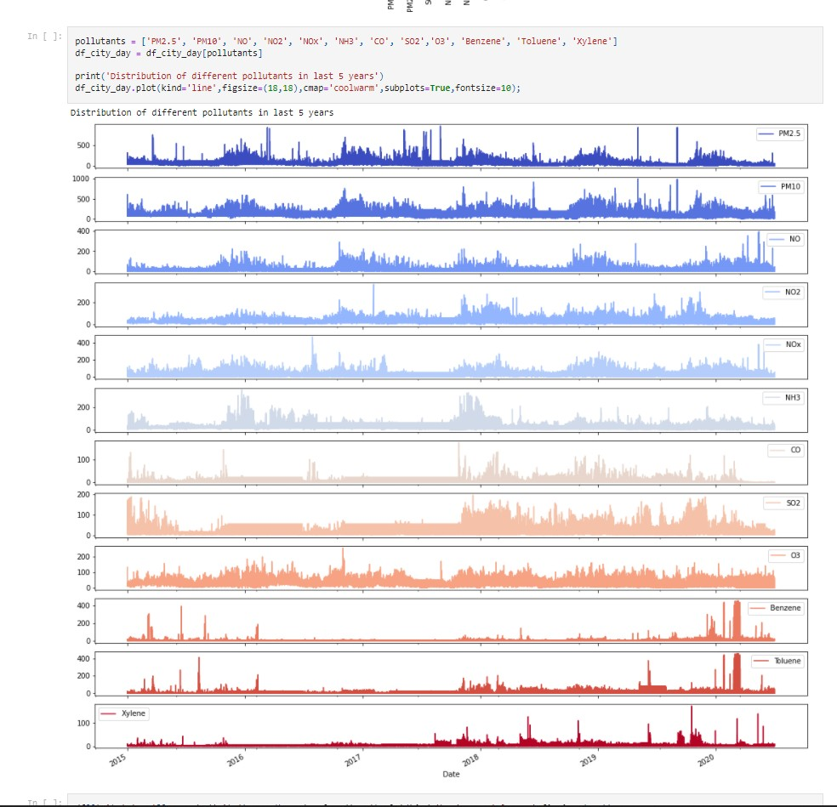
IMPLEMENTATION
GRAPH FOR DISTRIBUTION OF POLLUTANTS

Slide 28
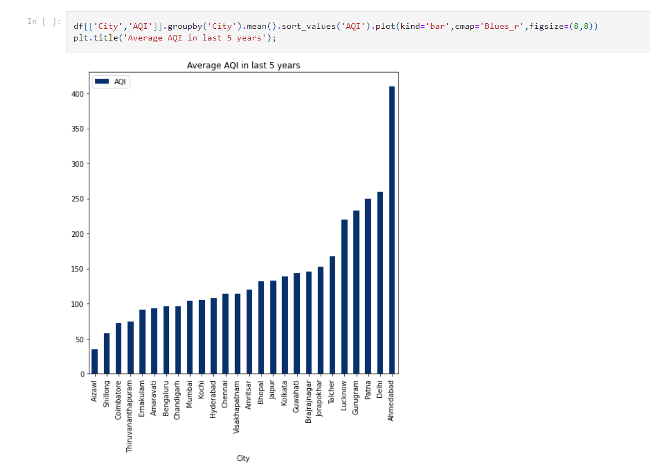
IMPLEMENTATION
GRAPH FOR AVERAGE AQI

Slide 29
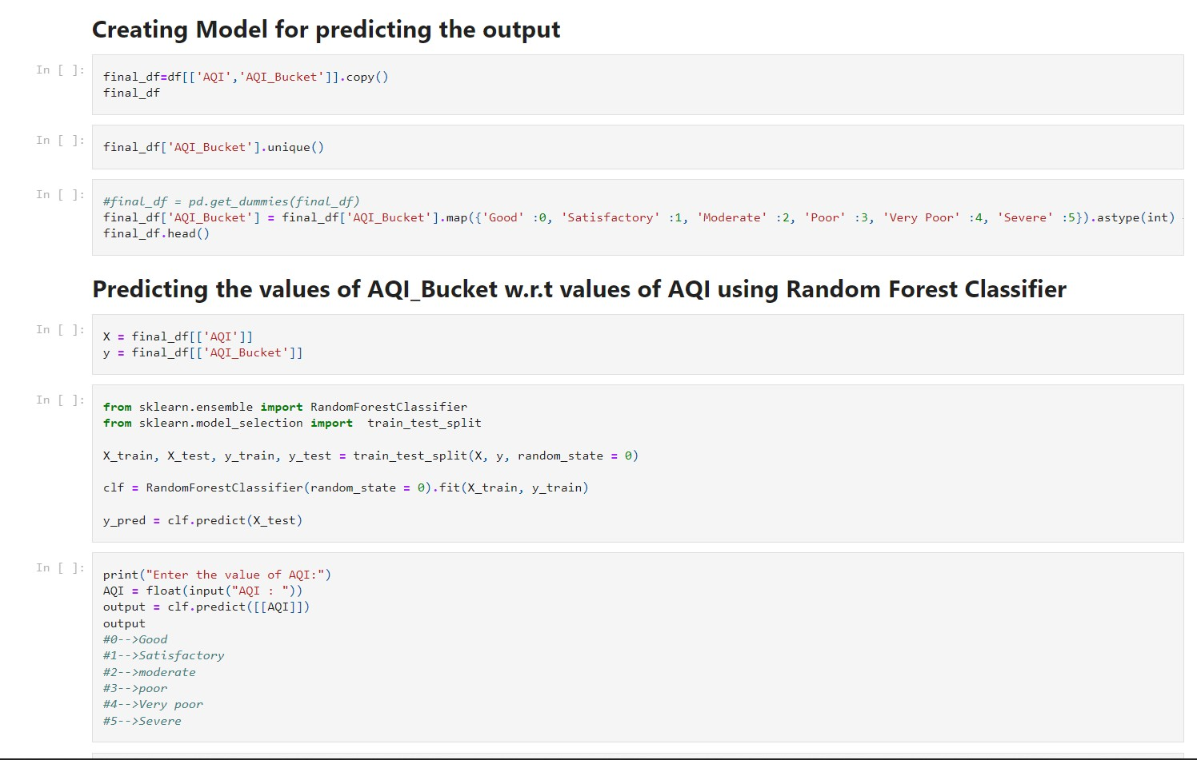
IMPLEMENTATION
CREATING MODEL AND PREDICTING OUTPUT

Slide 30
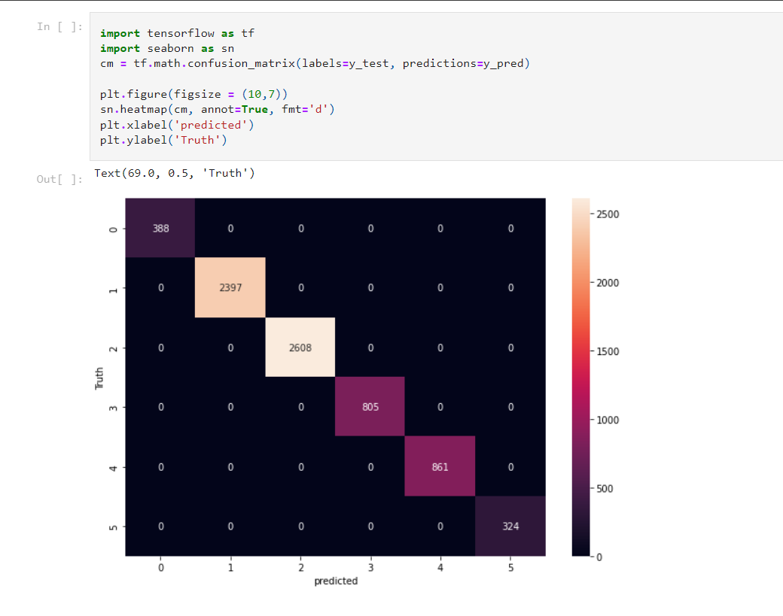
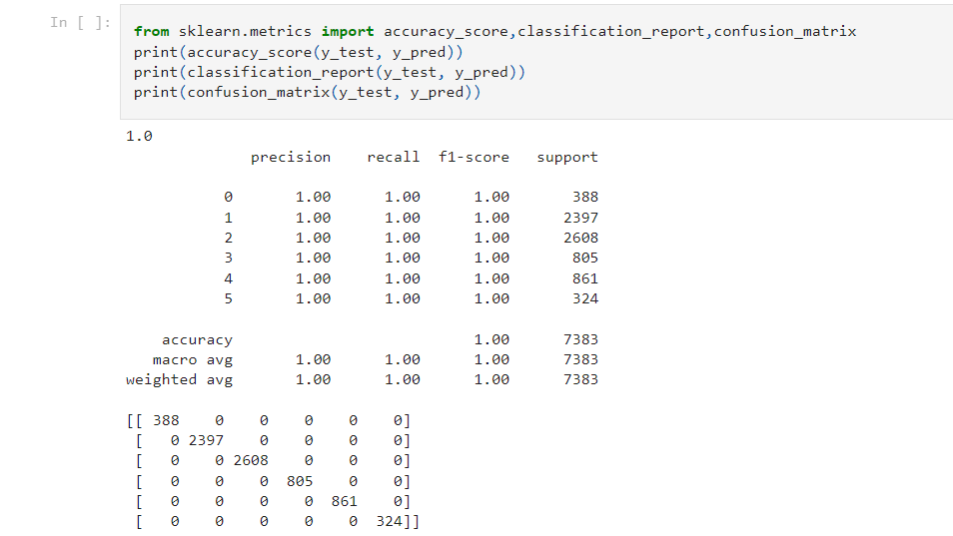
IMPLEMENTATION
CHECKING AND TESTING ACCURACY

Slide 31
SOFTWARE REQUIREMENTS
Python
NumPy
Pandas
Matplotlib
Seaborn
Sklearn

Slide 32
FUTURE SCOPE
AQI simpliﬁes the understanding of their air quality by decoding the quality in terms of unitless numbers and colour, with each ﬁgure and colour representing a different category of associated health risks.The Future work includes:
Adding New Features
AQI across multiple years can be compared: Precise Training 3.Real time deployment of the proposed model
Can be extended to support online learning: Improved Prediction
An IoT enabled air quality monitoring and visualisation system
‹#›

Slide 33
CONCLUSION
Major step to reduce air pollution: Know the factors affecting the quality of air
Thus prevent the deterioration happening to quality of air.
The proposed work is a supervised learning approach using the Random Forest Algorithm.
By knowing the air quality we can prevent the further damage happening
Prevention is better than cure!!
‹#›

Slide 34
AIR QUALITY INDEX PREDICTION
THANK YOU
‹#›

