Slide 1
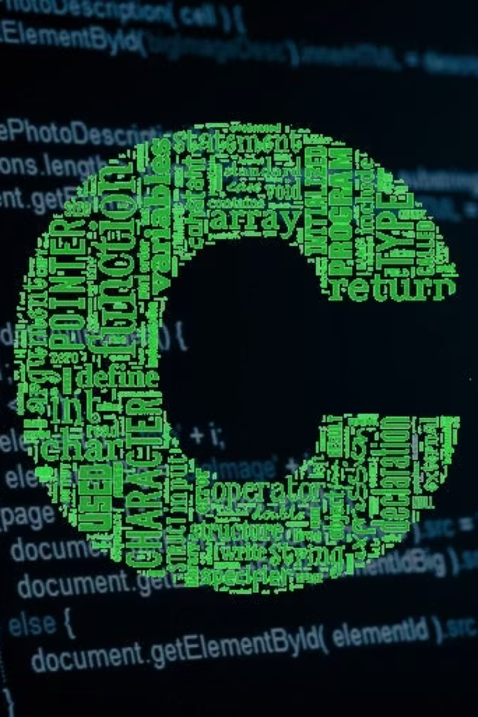
Why C is the Mother of All Programming Languages
Division -4 D2
Team Members :
Uday Pratap Rathore - 1262251287
Vedika Patil - 1262252481
Yugam Jain - 1262253396
Saarthak Deshmane - 1262253032
Samidha Saxena - 1262253502
Notes:
1

Slide 2
Introduction
C is a powerful and influential programming language developed by Dennis Ritchie. It replaced complex assembly language and became the foundation of many modern programming languages. Known for its simplicity, speed, and efficiency, C is widely used in operating systems and software development.

Slide 3
The Timeline of C's Evolution
Key Milestones in C's Journey
1969
1973
1989
2011-2018
Unix Milestone
ANSI C (C89)
Modern Standards
The B Language
(C11 and C18)
1
2
3
4
5
6
7
8
1972
1983
1999
Today
Birth of C
C++ Emergence
C99 Standard
Enduring the legacy of C
Notes:
2

Slide 4
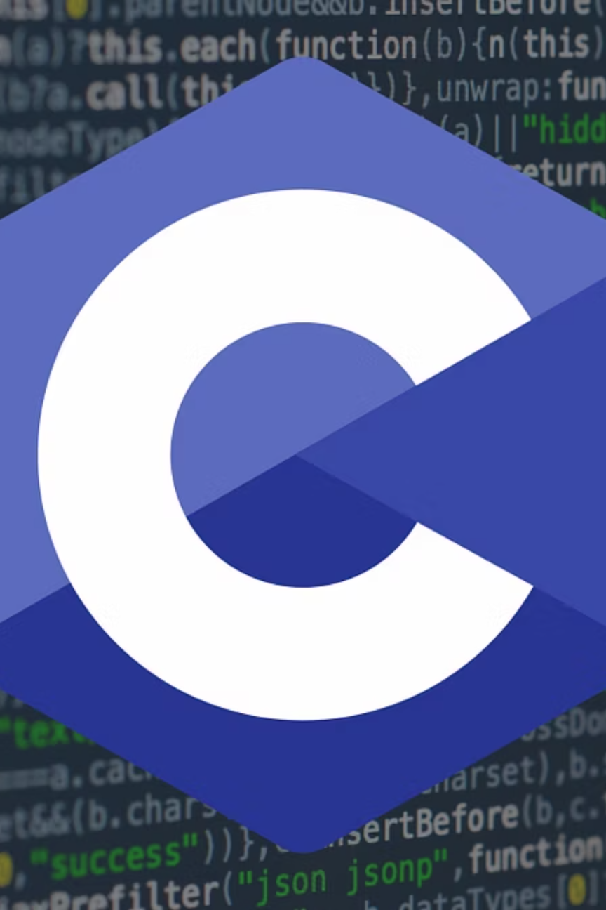
The Roots and Rise of C
The Roots
The Rise
C emerged from BCPL and B languages, inheriting structured programming principles whilst adding low-level memory access capabilities. Dennis Ritchie designed it specifically to rewrite the UNIX operating system.
C's portability, efficiency, and power led to widespread adoption. It became the language of choice for operating systems, compilers, and system software, establishing patterns that influenced generations of languages.
Notes:
3

Slide 5

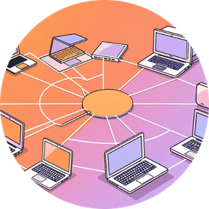
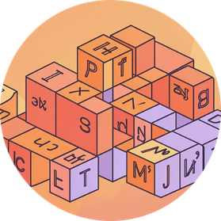
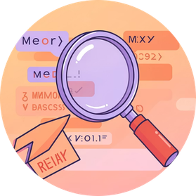
Core Features of C Programming
Efficiency and Performance
Portability
Structured Programming
Direct Memory Access
Write once, compile anywhere. C code can be compiled on virtually any platform, making it ideal for cross-platform development and system programming.
C provides direct access to memory through pointers, enabling highly optimised code that runs close to machine level with minimal overhead.
C supports modular programming with functions, making code organised, reusable, and easier to maintain across large projects.
C provides direct access to memory through pointers, enabling fine-grained control over system resources and hardware interaction for low-level programming tasks.
Notes:
4

Slide 6
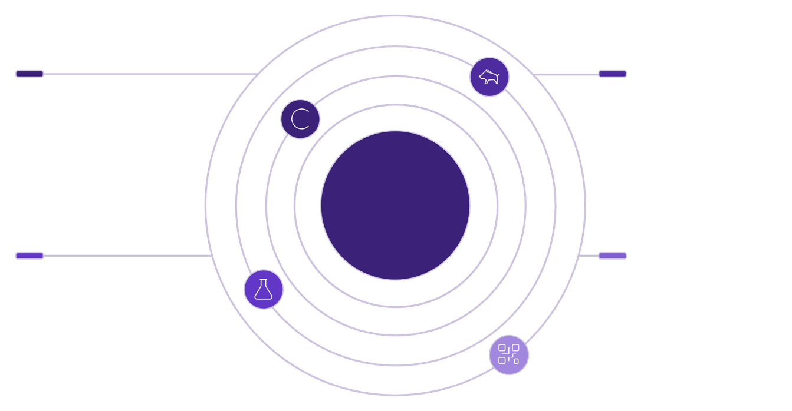




The Influence of C in Modern Programming
Educational Importance
Teaches fundamental programming concepts: variables, control structures, functions, and data structures
Provides deep understanding of memory management and computer architecture
Forms the foundation for learning advanced languages like C++, Java, and Python
C++
Java
Object-oriented extension of C with performance focus
Platform-independent, OOP language influenced by C syntax
C: Root of Many Languages
Python
JavaScript & C#
Practical Significance
High-level, readable language with C roots in syntax and implementation
Scripting and managed languages borrowing C-like syntax
C remains essential for operating systems (UNIX, Linux, Windows kernels), embedded systems, IoT devices, compilers, and performance-critical applications where efficiency matters most.
Notes:
5

Slide 7

C Programming in Our Daily Lives
Operating Systems
Embedded Systems
Every time you use Windows, macOS, Linux, or Android, you're running software built with C. The core kernels and system utilities are written in C for maximum performance.
From smart televisions and washing machines to automotive systems and medical devices, C powers the embedded software controlling billions of everyday gadgets.
Internet Infrastructure
Gaming and Graphics
Web servers, databases, network routers, and protocol implementations rely on C. The internet's backbone runs on C-based software for speed and reliability.
Game engines, graphics drivers, and 3D rendering software use C for real-time performance. Your gaming experience depends on C's computational efficiency.
Notes:
6

Slide 8

Conclusion
C is the foundation of modern programming languages. Developed by Dennis Ritchie, it replaced complex assembly code and provided powerful system-level control with portability and efficiency. Its simple structure, fast performance, and direct memory access make it ideal for operating systems and embedded systems. Through continuous standardization from C89 to C11 and beyond, C remains relevant today. It builds strong programming fundamentals and continues to influence many modern languages, proving its lasting importance in technology.

Slide 9

Thank You
C's legacy continues to shape the future of programming, proving that the mother of all languages remains relevant, powerful, and indispensable in modern computing.
Notes:
7

Slide 10
