Slide 1
Framing Dependencies Introduced by Underground Commoditization
Vedika Bang
CS - 8803 EMS

Slide 2
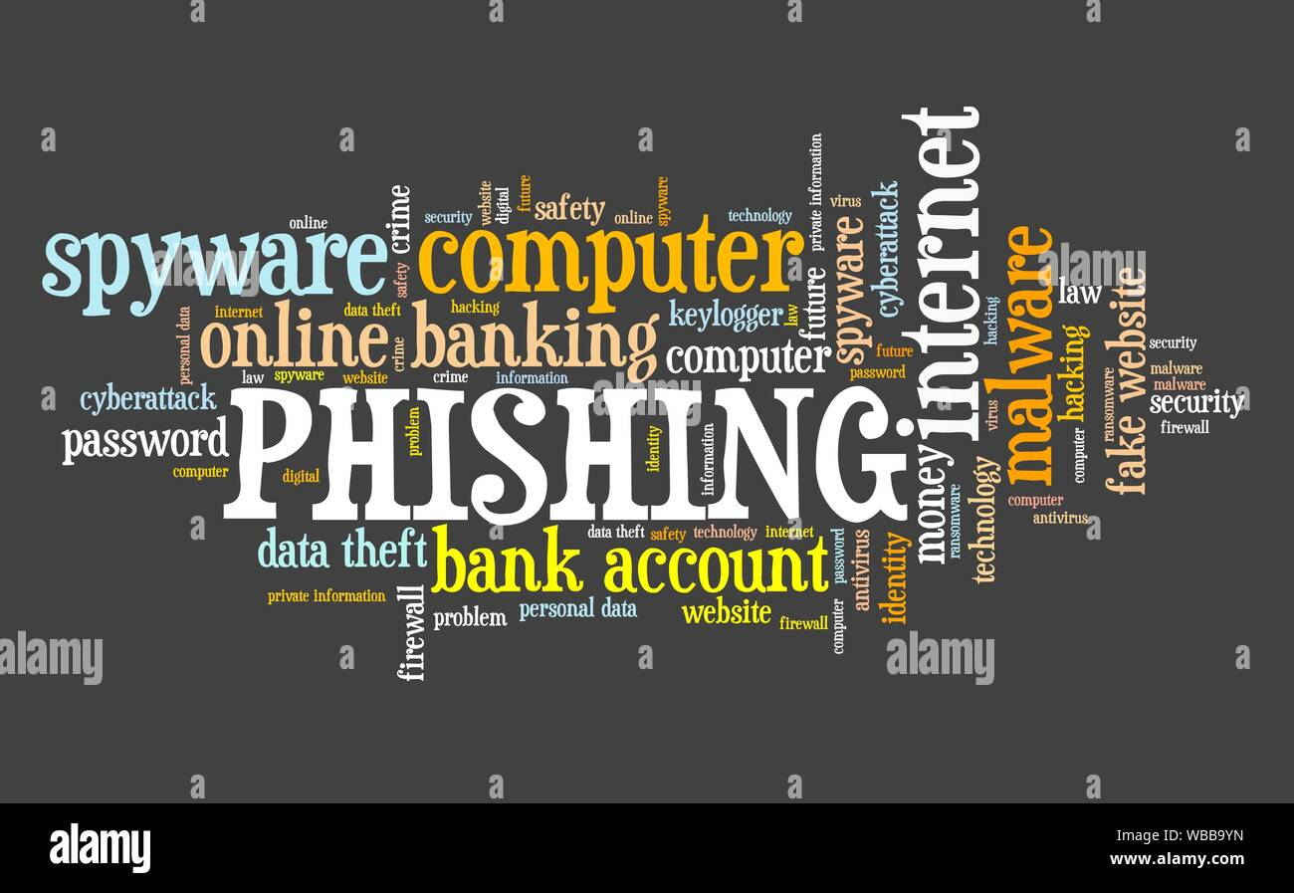
Motivation
Solving technical vulnerabilities isn’t the only way to stop attacks
We need to consider other aspects of the security
“By People, For People - To Exploit People”
Socio-economic view of cybersecurity

Slide 3
Socio-economic view of cybersecurity
Actors (Attackers, Victims, Defenders)
Profit /cost
Relationships
Intentions/capabilities
These are some external key factors that can help us assess a situation in a better way.

Slide 4
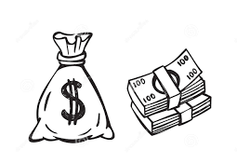

Underground Economy
The underground economy refers to economic transactions that are deemed illegal, either because the goods or services traded are unlawful in nature, or because transactions fail to comply with governmental reporting requirements.
The underground economy is called the shadow economy, the black market, or the informal economy.
Streamlined Abuse : For a fee ! $$$

Slide 5
The underground organization
The underground economy for commoditization involves two centers (key-components) :
Profit Center : represents activities that transfer money from victims and institutions into the underground.
Support Center : critical resources that other miscreants request to streamline abuse.
It provides access to :
Exploit Kits
Compromised Hosts/ Credentials
Human Services (CAPTCHA solver)
Extracting all of this value can be complex and require a range of specialized knowledge and capabilities. Hence, “THE ECOSYSTEM”

Slide 6
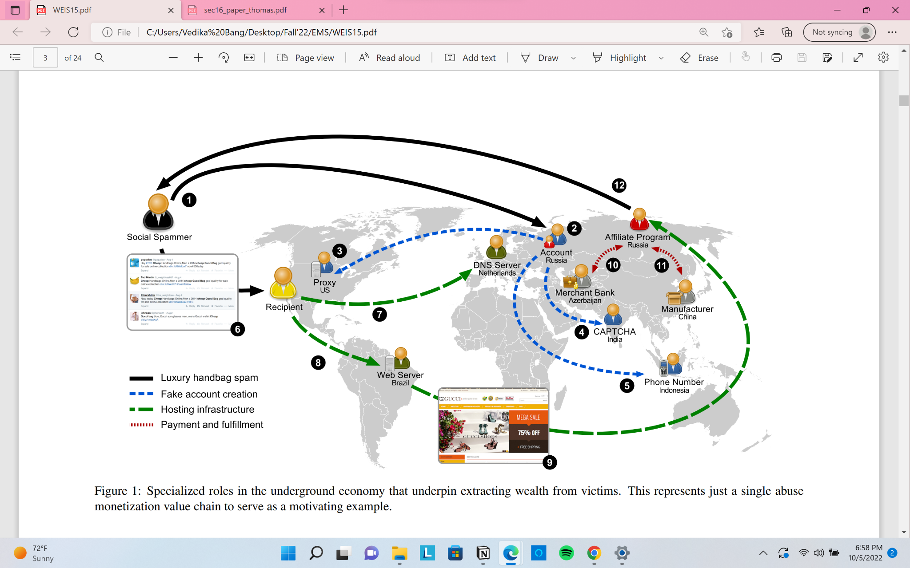
Bird’s-Eye View of a Value Chain

Slide 7
Alternative Profit Sources
Fame & Notoriety: Buying instagram / facebook likes
2B millions views were moved from YT video by sony & universal
Anti-competitive Practices:
taking down the competitor by using various illegal techniques such as DoS, or posting a negative reviews on their website
Political Propaganda, Censorship, and Espionage:
controlling political dialogues
Eg. Cambridge analytica (2016 US election)

Slide 8
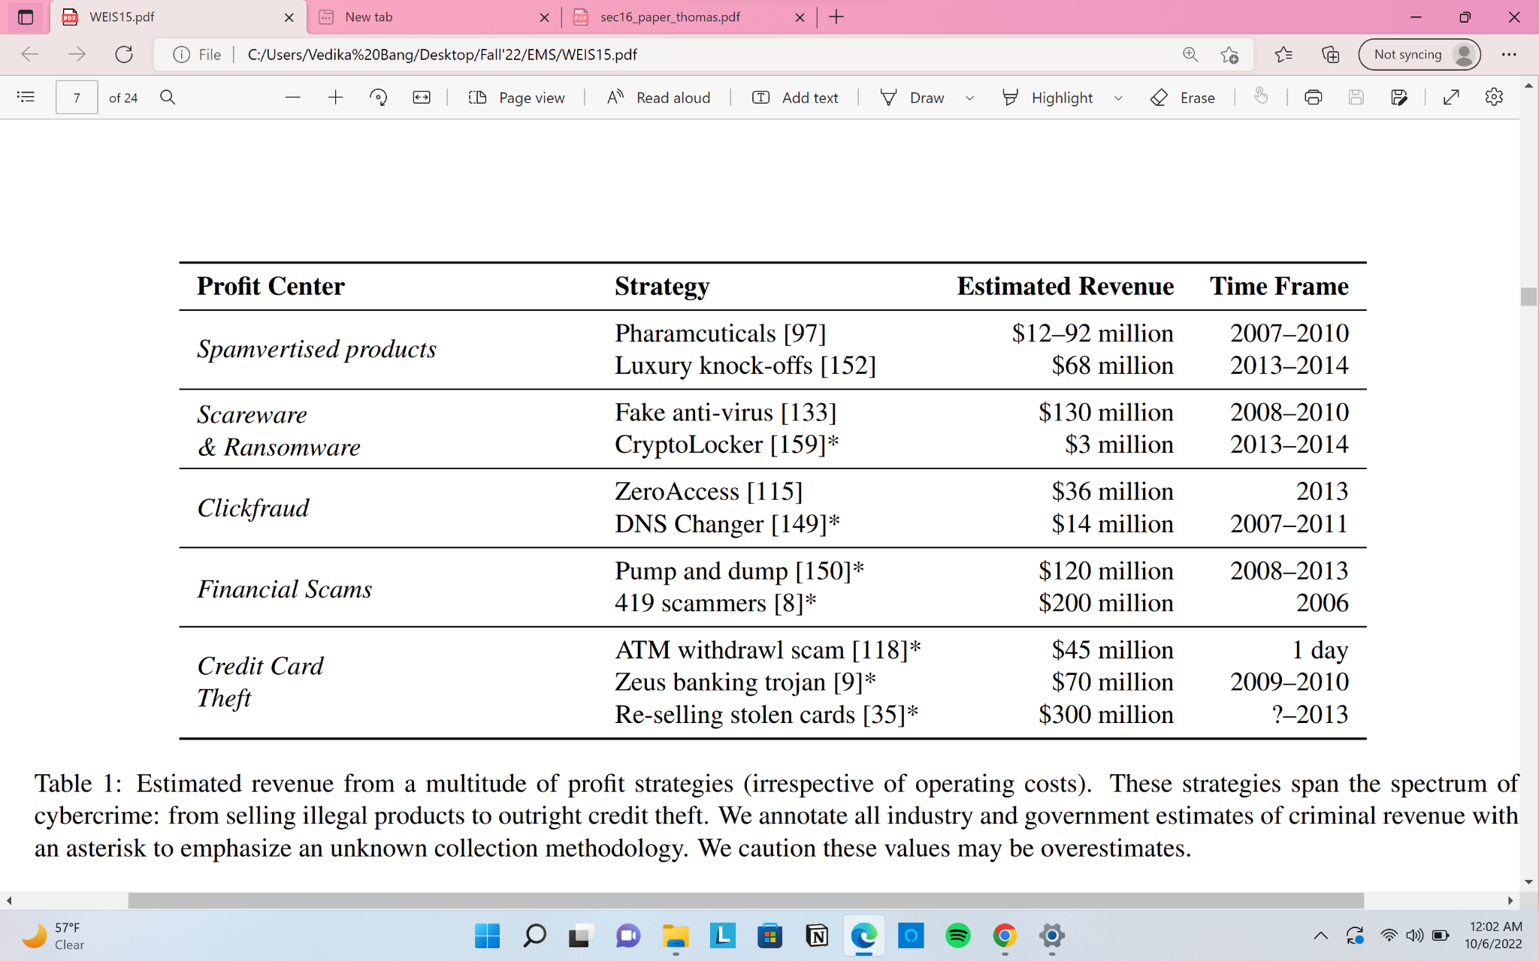
Criminal Profit Centers
Spamvertised Products
selling counterfeits goods
despite botnet takedown & spam filtering
direct financial transaction
Scareware & Ransomware
fake anti-virus
affiliate marketing
cryptolocker
loss over a million dollars

Slide 9
3. Click Fraud
Attackers as publisher and then drive traffic to extract money from advertisers.
monetizing ad via URL shortener
4. Financial Fraud
lucrative offers; cease the conversation and disappears\
pump and dump : miscreants buy low-cost stocks and lure victim by sending a message by beling the current state of the company.
5. Credit Card and Online Banking Theft
point-of-Sale Malware & Skimmers
payment storage breaches
phishing & malware
cashing out stolen cards

Slide 10
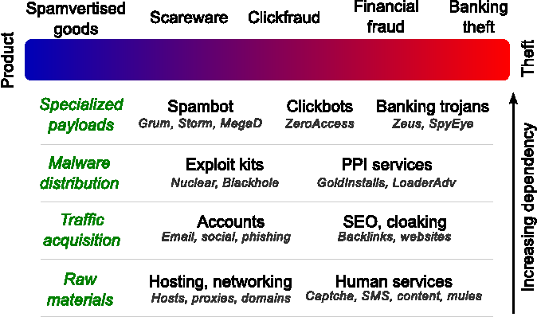
Outsource the contractor and simply run these services for your own purpose.

Slide 11
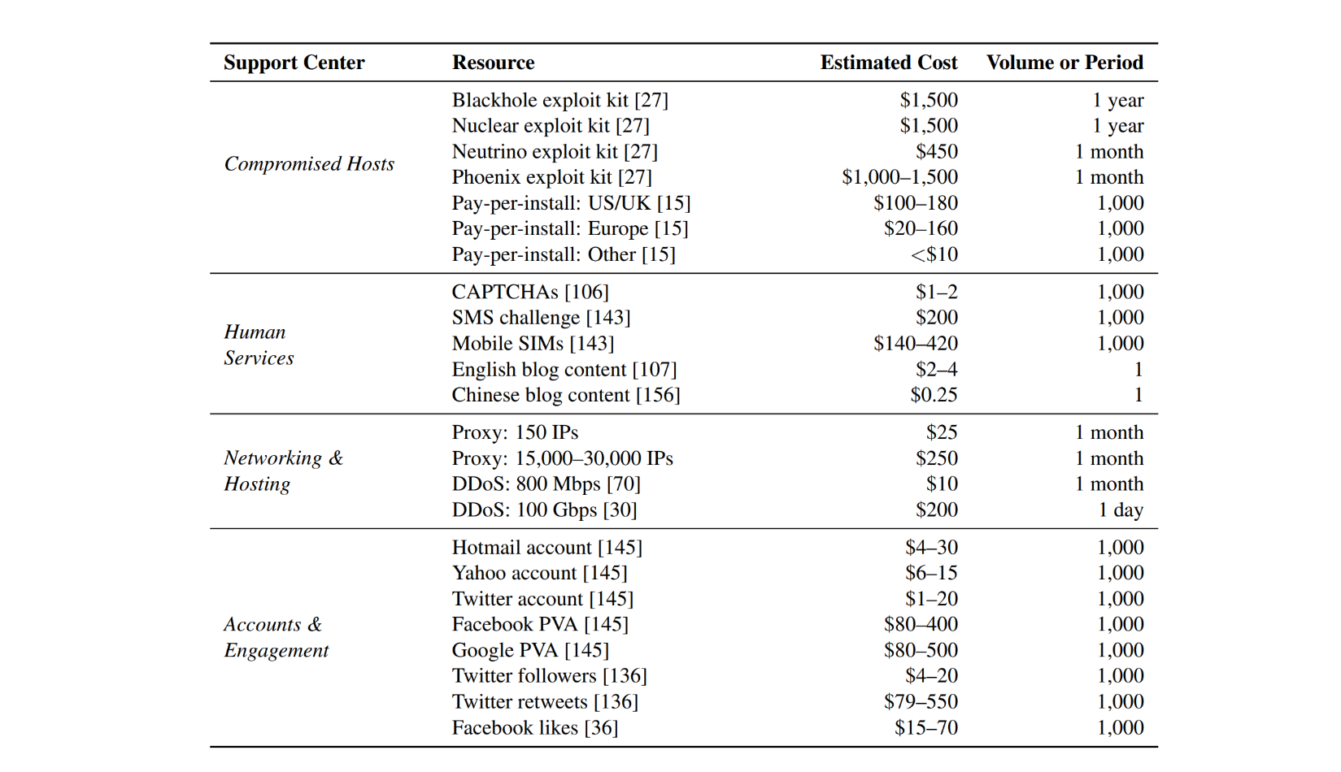
Ecosystem Supporting Abuse

Slide 12
Compromised Machinery
“Lifeblood of fraud and abuse”
Exploit-as-a-Service
traffic is bought, exploits are “rented,” and malware is broadly installed
Attack leverages a vulnerability in a web browser to deliver malware
Pay-Per-Install
extension of exploit-as-a-service, to distribute malware payloads.
Enabled by a class of malware called as “Dropper”
Platforms like TDL, Zeus make it easier for miscreants to install malware w/o developing an exploit.

Slide 13
Human Services
CAPTCHA Solving
Physical labour is involved.
Low wage - leads to the wage disparities between countries [a critical socio-economic component]
Software solver (spamvilla.com)
Phone Verification
abuse to the cost of a physical SIM card rather than a digital resource.
Reduce the cost of SIM
Content Generation
200-250 words with specific keywords
Realistic and grammatically correct content

Slide 14
Networking and Web Hosting
Domains & Hosting
Domain registration & IP hosting
Should be cheap enough to renew
Search Engine Optimization & Cloaking
Drive user traffic to profit center
Miscreants reply on network cloaking to maximize the value of compromised host while evading detection.
Denial of Service
Degrade or disable the victim’s presence
Dirt Jumper made DDoS easier.
Proxies
To mask the identities. Not much research into black market proxies (till 2015)

Slide 15
Accounts & Endorsements
Synthetic followers, likes, subscribes -> “closed-garden web services”
Fraudulent Accounts
One of the best way to monetize the spam.
Readily available in the bulk (remember bird-eye chain ?)
$5 - $500 per thousand accounts
Compromised Accounts
Hijacking accounts
password guessing, re-used passwords leaked by database dumps, phishing, and malware.
Fake Endorsements & Engagements
Youtube subscribers, twitter followers, Facebook likes, Amazon/Yelp reviews.

Slide 16
Standing Challenges for Support Infrastructure
Is pricing accurately reflects the value of resource ? eg. CAPTCHA prices $2 - $20 ????
How to distinguish between the valid and inflated prices ? No way to know because of the complex anonymity!
Understanding ROI per resource, which is subjected to service’s durability.
Payment in the Black Market
Credit Card Processing
Mastercard is responsible for 95% of the transactions ?!!!
Victim, issuing bank, merchant (affiliated program), acquiring bank
Bank charges high transaction fee
Money exchange & Pre-paid vouchers

Slide 17
Curbing the Black Market
Situational Criminology.
Displacement : Offenders eventually adapt to crime prevention strategies & set their attacks vectors around it.
For instance, drug markets, prostitution, stolen goods, etc.
Protecting Users & Systems
Exhausting Resources & Stockpiles
Disrupting Payment : no pay - no service
Targeting Actors

Slide 18
Conclusions:
There is no outright solution to stop cyber criminal activity. However, effective interventions like arresting the criminal can help us combat the issue.
Beware of humans!

Slide 19
Thank you for listening.

