Slide 1

Living off The Land Attacks: Applications IoC Generator
Vedika Bang
Nov 12, 2023
Notes:
I’m Vedika and I’ll be talking about LoLAPP: Application level IoC generator. Imagine a burglar who wants to break into a house. Instead of bringing their own lock-picking tools, they simply use the spare key under the mat, the ladder in the backyard, and the open window to get in. Would you suspect ? No, right ! Now imagine this house to be your company, and just like you – your EDR/SIEM tool fails to detect the presence of a threat actor who is well-blended into the environment. Yes, Fileless malware attacks - These attacks are especially hard to detect since they use legitimate, built-in OS tools. On top of that, these attacks can hide and be fully conducted in memory.

Slide 2
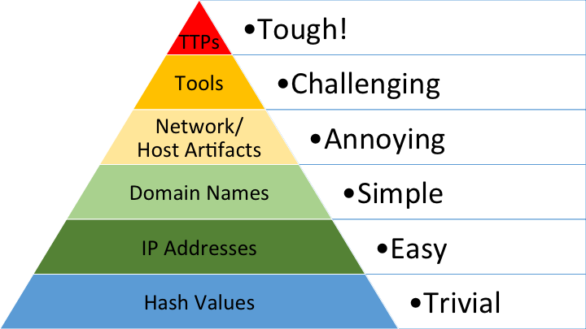

Introduction
71% *Fileless malware attacks
From ScreenConnect to Hive Ransomware in 61 hours
BumbleBee: Round Two [AnyDesk]
LoLBas/GTFOBins
It is difficult to exploit binaries
RMM tools - Free trial for 15 days!!
Notes:
Very recently, Open Source Projects such as LoLBAS and GTFOBin for windows and linux related binaries were incorporated into Splunk for better detection. However, tweaking binaries isn’t that simple of a task and that’s why threat actors have come up with something more easier for minimising the digital footprint and avoiding detection techniques. Softwares!! Dual-use softwares such as RMM tool. If you look at the threat intel data - you’d know 70% ransomwares cases involve usage of RMM tools for lateral movement, data exfiltration and persistence.
Here we’re talking about behaviour of the software rather than software ! These RMM softwares are easy to acquire, easy to use and easy to hide. How this materialises is in free and easy access 15 days demos of the tool. And these trials are also available to threat actors. Most of these tools are cloud based so that takes away another step from TA as they don't have to host their own infrastructure. These tools have verified signatures and are whitelisted across all the platforms. So even if there’s an attack - they’ll end up being part of the spreadsheets - GIGs of logs!!!

Slide 3

*Please press space to play the video, thank you!

Slide 4

Are Existing Solutions Not Enough ?
A SIEM/EDR is only as good as the data you feed it
A SIEM/EDR requires use case implementation
More data does not mean better detection
Lack of context
Notes:
It is a very valid question why someone would use this tool if they already have paid-SIEM/Threat detection tools. Well, I believe that a SIEM is one of the most capable detection solutions available.However, “most capable” does not necessarily mean “best.” . A SIEM is only as good as the data you feed it.A SIEM can’t automate information security domain expertise and application of your logs to your specific needs. Once the data is in your SIEM, you must be the one to tell the SIEM what to do with it. Basically, it is like buying a toy. The batteries are not included. You must go get them and plug them in. Cool toy…no batteries.
There is so much I can fit on this slide but one of my favourites that slows down the process of analysis is SIEM overstuffed with data - useless data. A SIEM should augment analysis, not hinder it. Put simply: less is more.

Slide 5
Extraction of Artifacts – Potential IoCs – Plugins – Better Threat Intel Feed
The project is divided into three parts :
Testing – Detection Rules – Development of Tool
Which directory does it normally execute from?
Where does it normally establish connections to?
What do these tools typically write to the filesystem?
Should I expect child processes?
Is this software approved in environment?
Notes:
The goal of this admittedly non-comprehensive list of questions is to detect abnormalities in our telemetry. I took a baseline of the application’s behaviour and applied best efforts to writing detection logic on commonly observed techniques that adversaries employ. This is useful for Detection engineers who want to cut through the noise as much as possible and find anomalies in vast data sets.
On top of this, each tool’s execution behaviours vary, which makes answering the questions above a time-consuming process for analysts

Slide 6
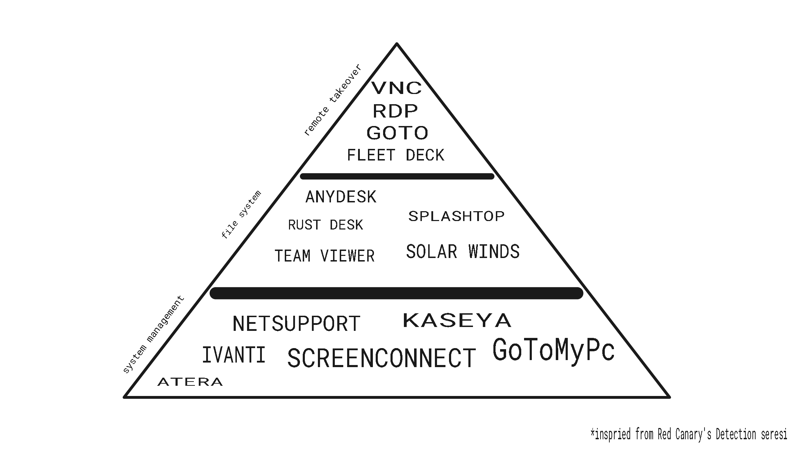
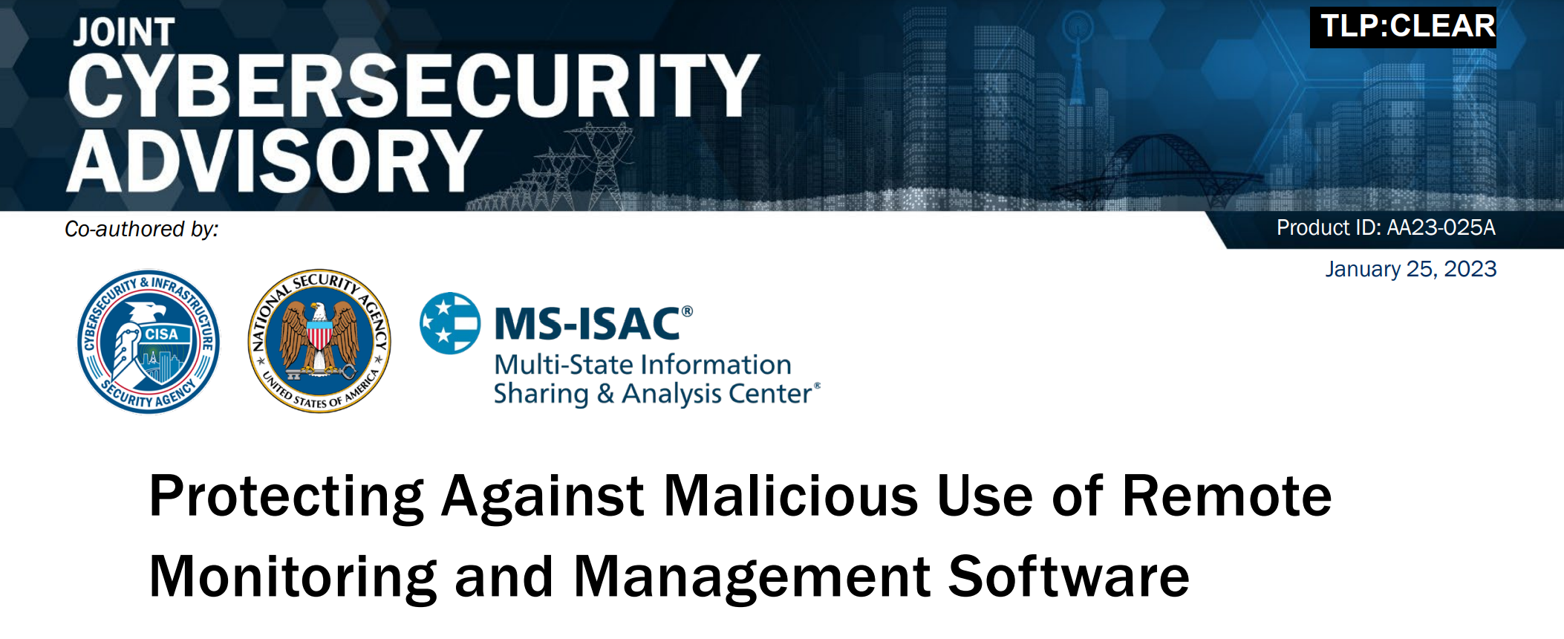
Selection of Applications
- Recent (2023)Threat Intel Reports from CISA , Red Canary, Crowdstrike, Mandiant
- Based on the infamous ransomware cases and popularity amongst threat actors
ScreenConnect
AnyDesk
TeamViewer
Atera
NetSupport*
Notes:
For selection of Application, I conducted a thorough research about recent trends in the cybersecurity industry and chose these five applications for the development of the PoC based on their popularity amongst threat actors. This for just one category, RMM.

Slide 7
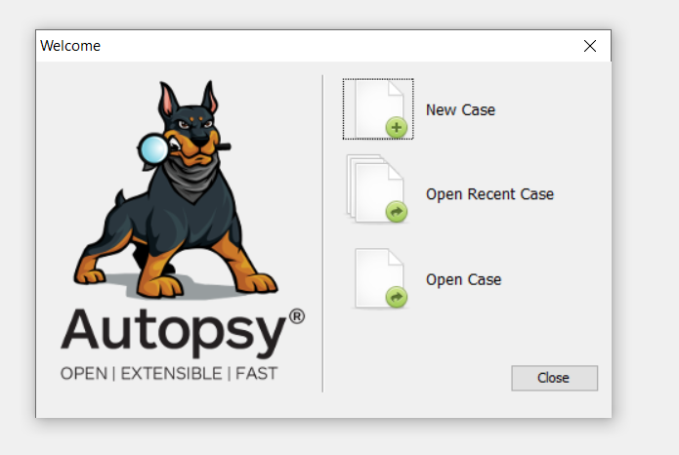

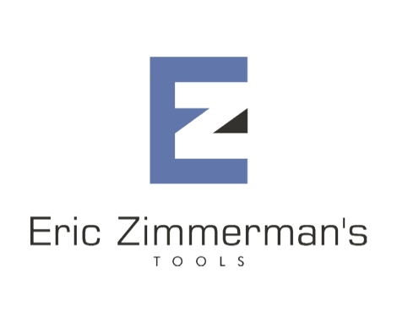
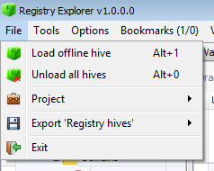

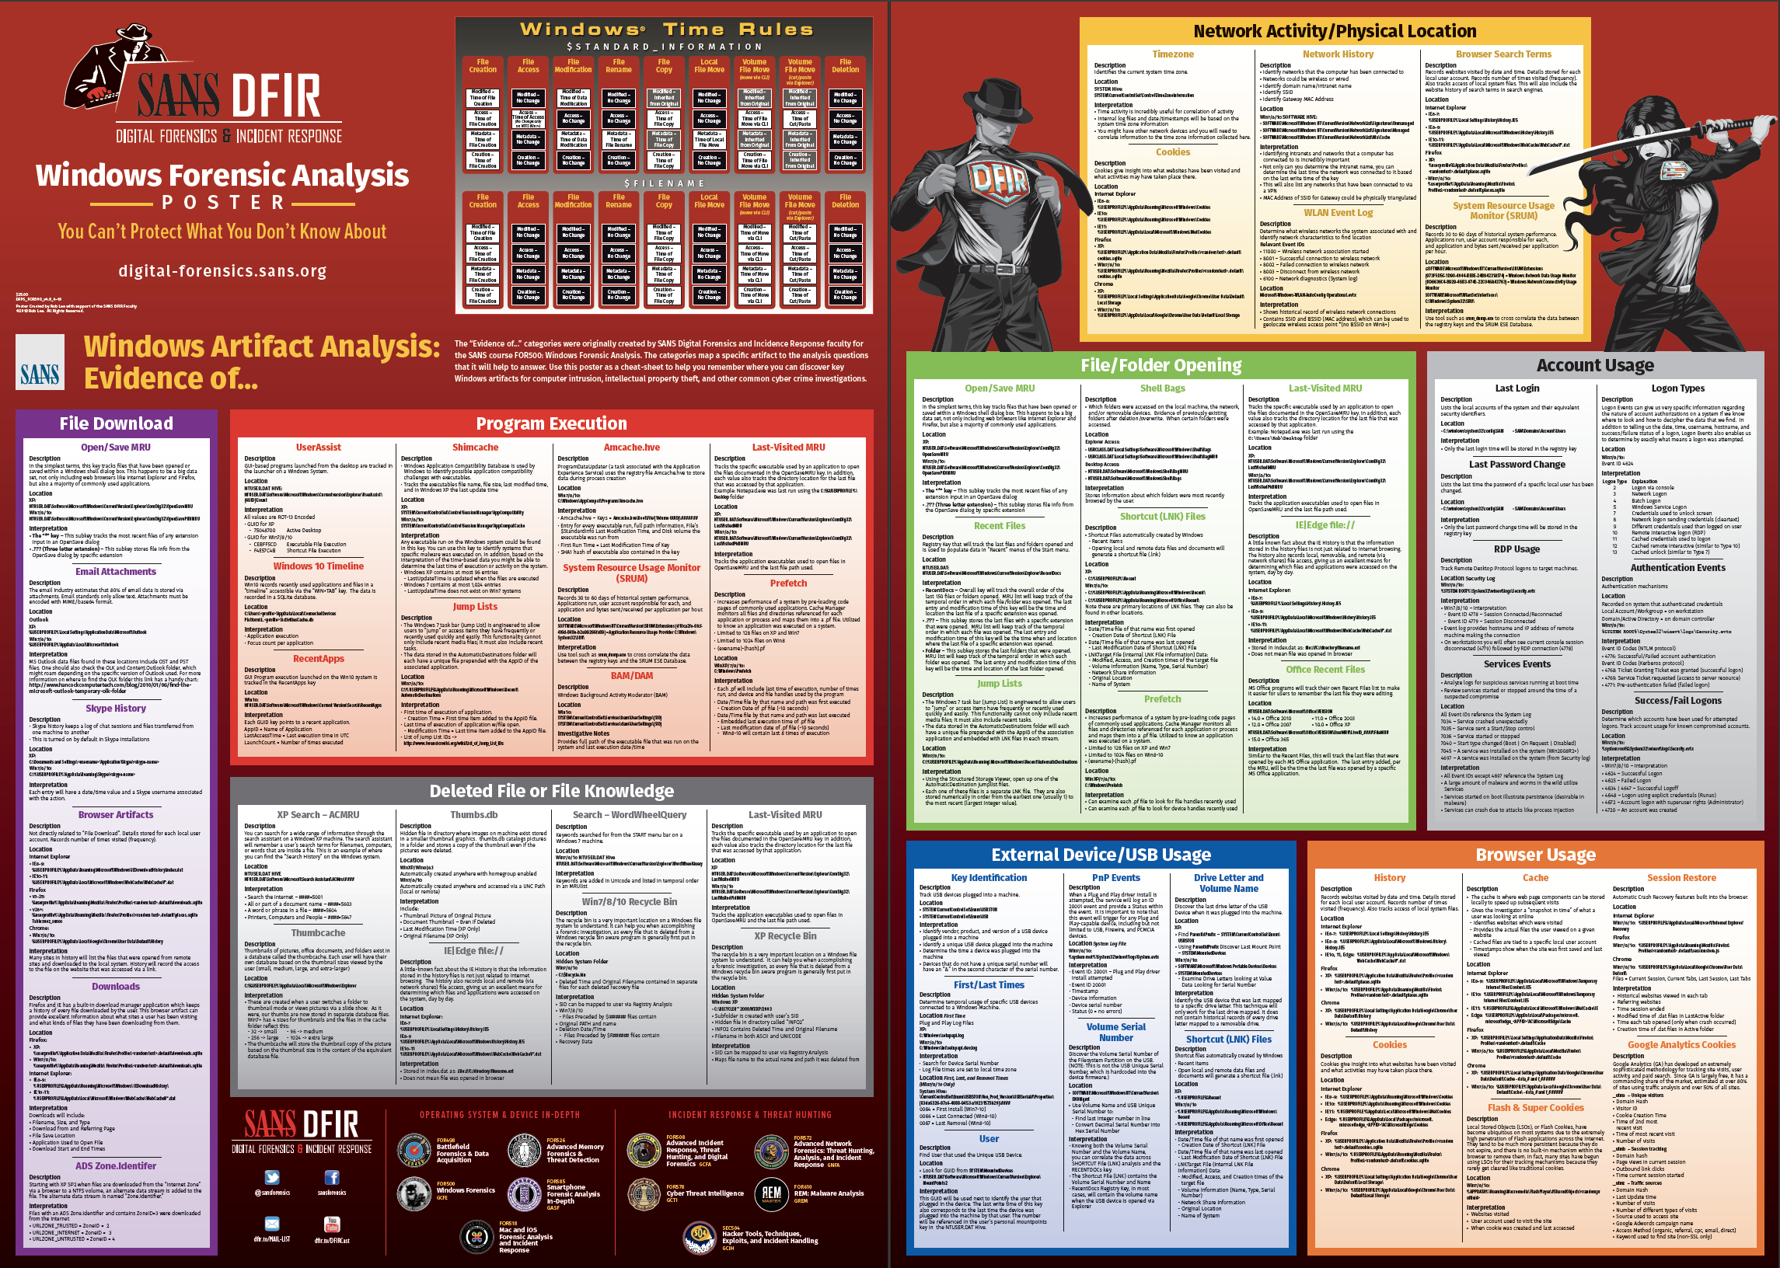
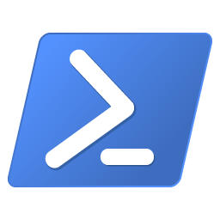
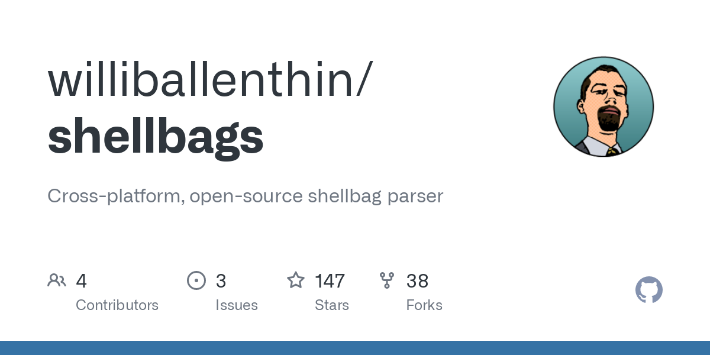
Testing
Tools
Notes:
Testing is one of the most integral parts of this project. As stated earlier, detection rules need to be use-case sensitive - I tested these applications for every feature that they have to provide - analysed their footprints/ windows registry keys/ program related artefacts, windows related artefacts for writing robust detection rules.
Setting up a stable testing environment was very challenging because of resource constraints. It slowed down the execution of the program and the collection of logs. I was able to overcome it after changing extraction tools multiple times. I finally settled on using proven tools such as Autopsy, Eric Zimmerman’s DFIR toolkit, etc.

Slide 8
Testing Rounds
1. Same Network
- Artifact collection in this context can uncover potential vulnerabilities or behaviors that only manifest when the application assumes it is operating in a trusted environment.
Different Network
- The discovery of these artifacts is essential for understanding how the application maintains functionality and security when faced with network variability.
3. VPN*
- expose how the application handles secure connections and transfers data across potentially untrusted networks.
Notes:
For testing, I conducted three rounds to get the possible accurate IoCs with different network settings - one with the same network, different network and VPN. It is interesting to note all of these artefacts vary from app to app on different network settings. For instance, for ScreenConnect I didn’t observe any difference from the same instance across different networks; however, IP addresses changed for AnyDesk even in the same network.

Slide 9
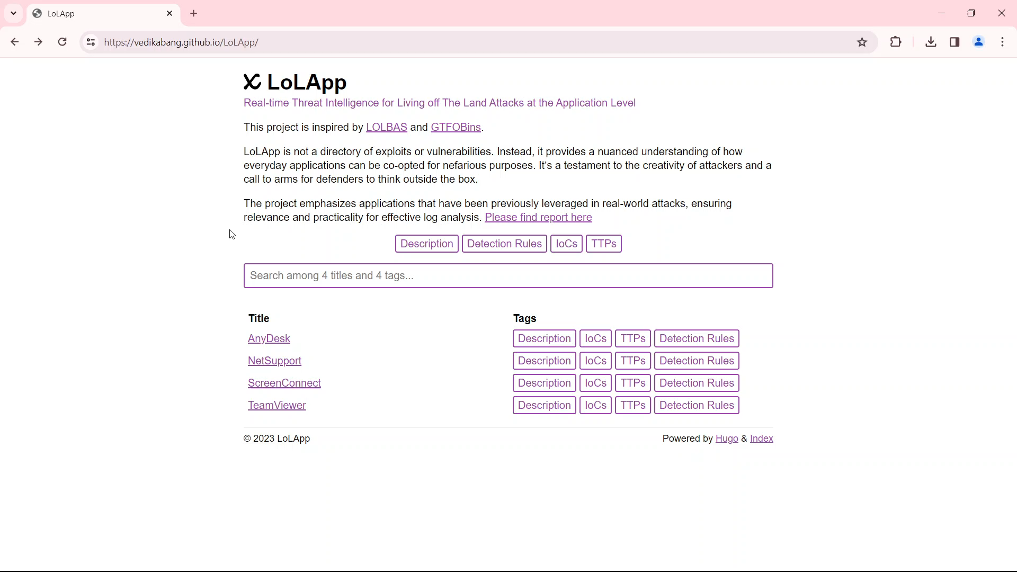
Backend for the tool - WebUI
Notes:
This is how the backend of the tool looks like - a Python based tool which is under development, will extract IoCs from open github repos on demand. This tool can be further integrated with any SIEM/EDR tools with customization. As part of future work, I’ll be updating templates and exposing an API in the python tool to enable other tools to consume data.
For detection rules, I used Sigma. This is a SIEM neutral rule language that allows rules to be written to support any environment and any SIEM. In order for this concept to work, a conversion process takes the SIEM agnostically written rule and translates it specific to a given SIEM.

Slide 10
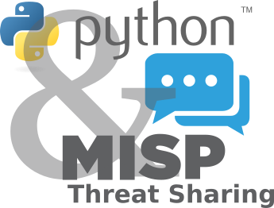


Evaluation :
Potential IoCs and Robust Detection Rules which can be compatible with any EDR/SIEM tool
Elevating threat intel feed,
Pushing to Open Source Projects like PyMISP, IntelOwl
Survey
Notes:
I have 3 ways to evaluate the tool after thorough testing and rule development:
By transforming Indicators of Compromise (IoCs) into plugins for seamless integration with SIEM tools. This step is not just an advancement; it's a game-changer in cybersecurity defense.
I plan to share IoCs with IntelOwl, and more open source threat intel communities. By pushing these IoCs to PyMISP with my colleague Blane, I’d be able to validate my assumptions.
In the next two weeks, I'll try to promote the tool across social platforms. This isn't just for validation; it's a testament to our commitment to delivering top-tier cybersecurity solutions.

Slide 11
Future Scope and final deliverables
For other OS such as Linux, MacOS
Analyzing applications for potential OWASP vulnerabilities
Program analysis : Automating extraction of IoCs maintaining minimum false positives
Adding Pasword Cracking Tools, Network Scanning Tools, Vulnerabilty Scanners
Final deliverables
- Python based lightweight command-line tool which can be easily used by IR/investigators for extracting IoCs and integrate them with in-house SIEM/EDR tools.
- Contributing all the IoCs to PyMISP threat intel feed
Notes:
I'm broadening the scope to include comprehensive support for other operating systems such as Linux and MacOS."
"I plan to analyz applications meticulously to spot potential vulnerabilities that align with OWASP guidelines."
Using program analysis, I can on automating the extraction of Indicators of Compromise while keeping false positives to a bare minimum."
Fot final deliverables, It’ll be the python tool which can be used to create plugins and contribution to earlier mentioned threat intel feed.

