Slide 1
React is a powerful JavaScript library that makes it easy to build dynamic user interfaces. One of the key features of React is its efficient handling of the DOM (Document Object Model). React uses a concept called the Virtual DOM to optimize rendering performance and ensure fast, responsive applications Reconciliation is the process React uses to figure out how to efficiently update the DOM (Document Object Model) when changes occur in the UI. React's goal is to update the page as efficiently as possible, without unnecessary re-rendering or slow performance.

Slide 2
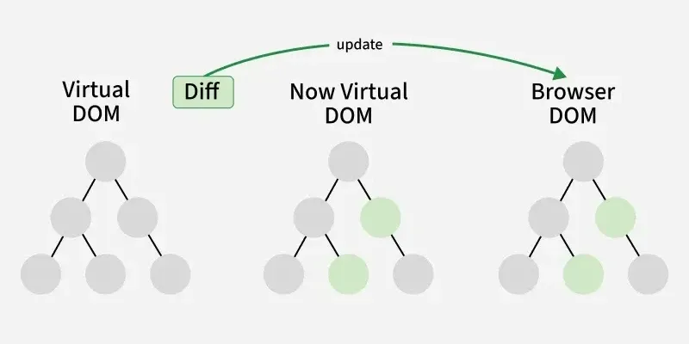

Slide 3
Reconciliation helps in the following ways:
Minimizes unnecessary updates: React only changes the parts of the UI that actually need to be updated, rather than re-rendering the entire page.
Improves performance: By optimizing the update process, React reduces the number of changes to the actual DOM, which improves the performance of your application.
Ensures consistency: React ensures that the UI always matches the current state of your application, even as it changes over time.

Slide 4
1. 🏗️ Mounting Phase: Initial Rendering
The mounting phase is the first stage in the lifecycle of a React component. During this phase, a component is created and added to the DOM for the first time. This is where the initial setup occurs, such as setting up state and rendering the component.
Virtual DOM 🧑‍💻:
React creates the component and builds its virtual DOM structure.
The component’s render method is called, returning the virtual DOM.
Real DOM 🌍:
React reconciles the virtual DOM with the real DOM, applying changes.
After the real DOM is updated, the useEffect hook with an empty dependency array ([]) runs, acting like componentDidMount. Key Hook 🛠️:
useEffect(() => { }, []): Runs once after the component mounts.

Slide 5
2. 🔄 Updating Phase: Rerendering
The updating phase occurs when the component re-renders due to changes in state, props, or when its parent component re-renders. React efficiently updates the UI by comparing the new virtual DOM with the previous one and applying the minimal changes to the real DOM.
Virtual DOM 🧑‍💻:
React detects changes in state or props and re-executes the render method.
A new virtual DOM is created and compared to the previous one.
Real DOM 🌍:
React updates the real DOM based on the changes in the virtual DOM.
After the update, the useEffect hook runs again if dependencies change, similar to componentDidUpdate.
Key Hook 🛠️:
useEffect(() => { }, [dependencies]): Runs after the component updates when specific dependencies change.

Slide 6
3. 🧹 Unmounting Phase: Cleanup
The unmounting phase happens when a component is removed from the DOM. It’s important to clean up resources, such as event listeners or timers, to prevent memory leaks.
Virtual DOM 🧑‍💻:
The component is removed from the virtual DOM structure.
Real DOM 🌍:
The corresponding real DOM nodes are removed.
The cleanup function in useEffect is called before the component is unmounted, allowing for resource cleanup.
Key Hook 🛠️:
useEffect(() => { return () => { } }, []): The cleanup function runs before the component is unmounted, similar to componentWillUnmount.

Slide 7
Phase | Order
useEffect cleanup (unmount) | Parent → Child
useEffect mount (new instance) | Child → Parent
🔑 When key IS PROVIDED (and changes)
👉 Component is unmounted and remounted

Slide 8
Phase | Order
useEffect cleanup (re-run) | Child → Parent
useEffect re-run (mount logic) | Child → Parent
🔑 When key IS NOT PROVIDED 👉 Component is reused (no unmount) 👉 Effect is re-run, not unmounted

Slide 9
Scenario | What React does
key changes | Unmount + Mount
No key | Re-render + Effect re-run

