Slide 1
CITI BRIDGE PROJECT
Presented by : Group :19
Group mENtor : Ms. Rini saren

Slide 2
Statement : 05
Abstract :
Perform the sanctions screening of transactions against a pre-defined list of keywords.
Users can upload a file with transactions database.
The system will validate the transactions and perform sanction screening.
A list of valid and invalid transactions will be displayed on the UI.

Slide 3

Purpose
To prevent transactions of defaulters from getting sanctioned.
To prevent invalid transactions from getting sanctioned.

Slide 4



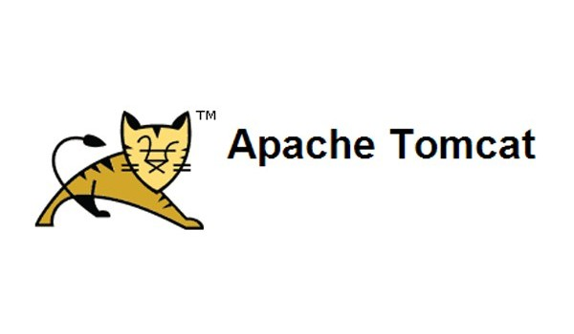

Technologies:

Slide 5
Features and functionality:
File can be uploaded of transactions.
Valid transactions are passed or failed and screen testing is passed or failed.
Tomcat server and JSP are used for the front end designing and building the application which is supported by the MySQL database connected through the servlet.
The data fetched from the uploaded file is retrieved after validations and screening.
The transactions are passed based on keywords and their parameters.

Slide 6
SYSTEM FLOWCHART :
Start
Valid
Upload File
Validate & Sanction
Display transaction
Display All
Valid(Pass)
Valid(Fail)
Screen(Pass)
Screen(Fail)
Stop

Slide 7
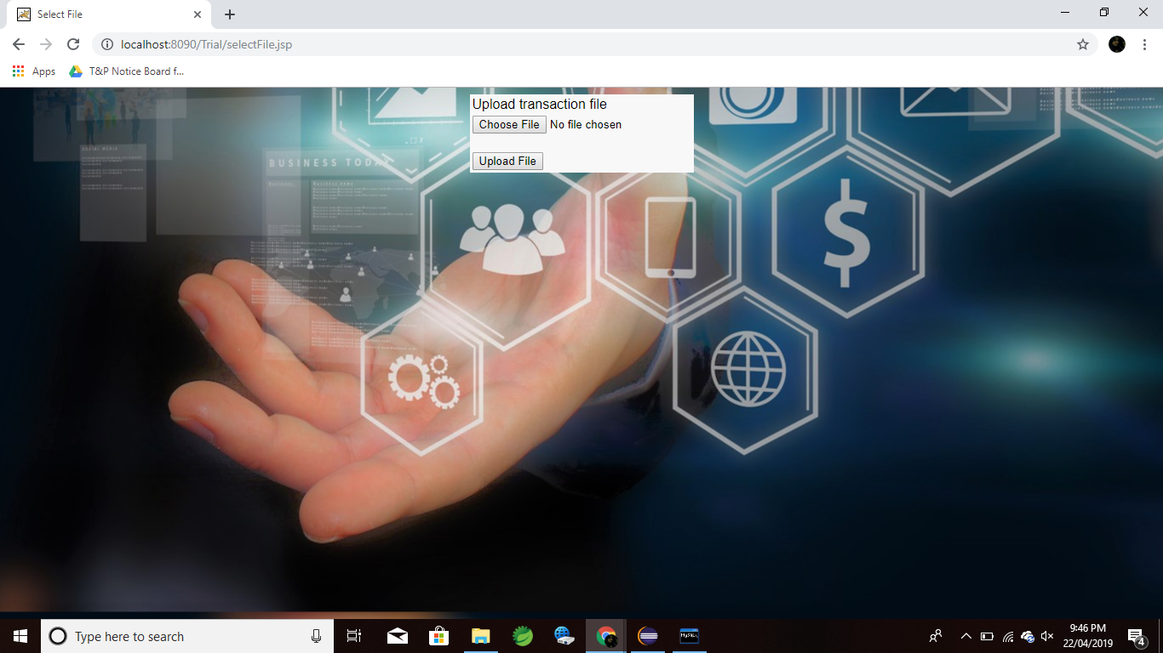
Preview of Home Page

Slide 8
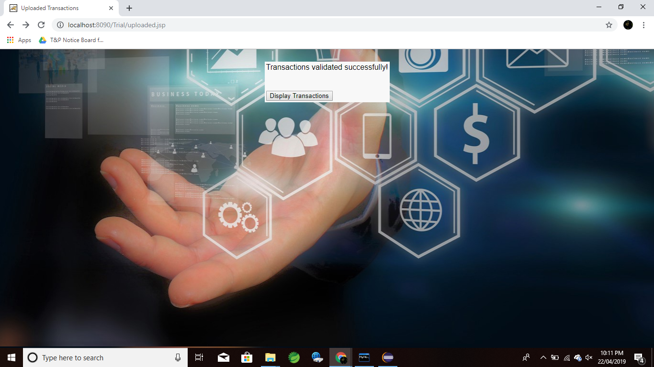
Preview of update on Validated Transactions

Slide 9
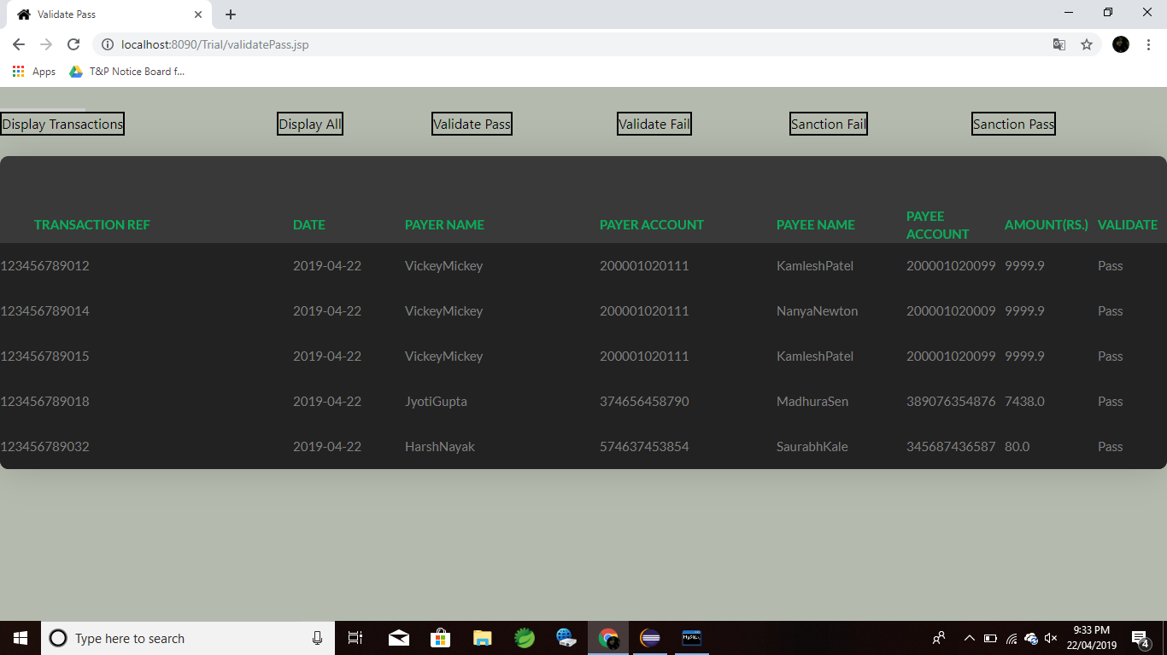
Preview of all displays

Slide 10
Challenges faced:
Project planning and estimation
Identifying a suitable interface and database type
Connections for User Interface and Backend.
Performing validations on data.
1
2
3
4

Slide 11
Future Scope:
Code optimization, display reason for failing validations and providing LogIn for bank employees.
Use artificial intelligence to identify fraud transactions and accounts.
Increase the load handling capacity of the application.
1
2
3

Slide 12
Presented by:
Vedika Ghei
Rutuja Bhamare
Shalmalee Shenolikar
Chitra Dhamane
Sarita Mhantati
We would like to thank Citi for giving us this enriching experience and the opportunity to work on the project.
Special Thanks to our Mentor: Ms. Rini Saren

