Slide 1
WASSERSTOFF AI ENGINEER INTERNSHIP TASK
-VEDIKA HEDA

Slide 2
PROJECT OVERVIEW
Objective: Develop an image processing pipeline for segmentation, object identification, text extraction, summarization, data mapping, and visualization.
Key Components:
Segmentation | Using YOLOv8 for segmenting objects in images.
Object Identification | Used CLIP(Contrastive Language-Image Pre-training) for identification of segmented objects.
Text Extraction | Using Tesseract OCR for text recognition.
Summarization | Done with the BART model to generate concise descriptions.
Data Mapping | Shown in JSON format for structured output.
Visualization | With tools Matplotlib, OpenCV, PIL, and pandas

Slide 3
Approach & Implementation
Step 1: Segmentation
Model Evaluation: Tested DETR, Mask R-CNN, and YOLOv8 models for object segmentation.
Final Choice: YOLOv8 was selected due to its superior performance in segmenting images.
Methodology: Used PIL to process and save segmented objects as separate images.
Step 2: Object Identification
Initial Approach: Used YOLOv8, but the model struggled with identifying segmented objects accurately.
Refined Approach: Switched to CLIP, which provided better identification by using segmentation labels as input.
Result: Achieved significantly higher accuracy in object identification.

Slide 4
Step 3: Text Extraction
Tools Tested: Compared EasyOCR and Tesseract OCR for extracting text from images.
Chosen Tool: Tesseract OCR, selected for its superior accuracy in recognizing and extracting text.
Step 4: Summarization
Approach: Deployed the BART model, leveraging its encoder-decoder architecture, ideal for creating concise and coherent summaries.
Step 5: Data Mapping
Approach: Used JSON for structured mapping of unique IDs, descriptions, extracted text, and summaries to each object. Organized data for easy access and manipulation in subsequent steps.
Step 6: Output Generation & Visualization
Approach: Utilized Streamlit API to create a user-friendly interface for visualizing and interacting with the final results. The original image was annotated with detected objects, and a corresponding table was generated summarizing all mapped data for each object.

Slide 5
RESULTS AND CHALLENGES
Results:
Segmentation & Identification: Successfully segmented and identified objects using YOLOv8 and CLIP, with improved accuracy.
Text Extraction & Summarization: Achieved precise text extraction and generated meaningful summaries.
Data Mapping & Visualization: Efficiently mapped and visualized data using JSON and a combination of visualization tools.
Challenges:
Object Identification: YOLOv8 initially failed to accurately identify segmented objects due to a loss of context, prompting a switch to CLIP.
Segmentation Model Changes: CLIP's dependency on a robust segmentation output highlighted the need for a more powerful segmentation model, considering upgrades to YOLOv8.
Data Mapping: Encountered issues with initial data mapping, which were resolved by enhancing preprocessing steps to ensure accurate data alignment.

Slide 6
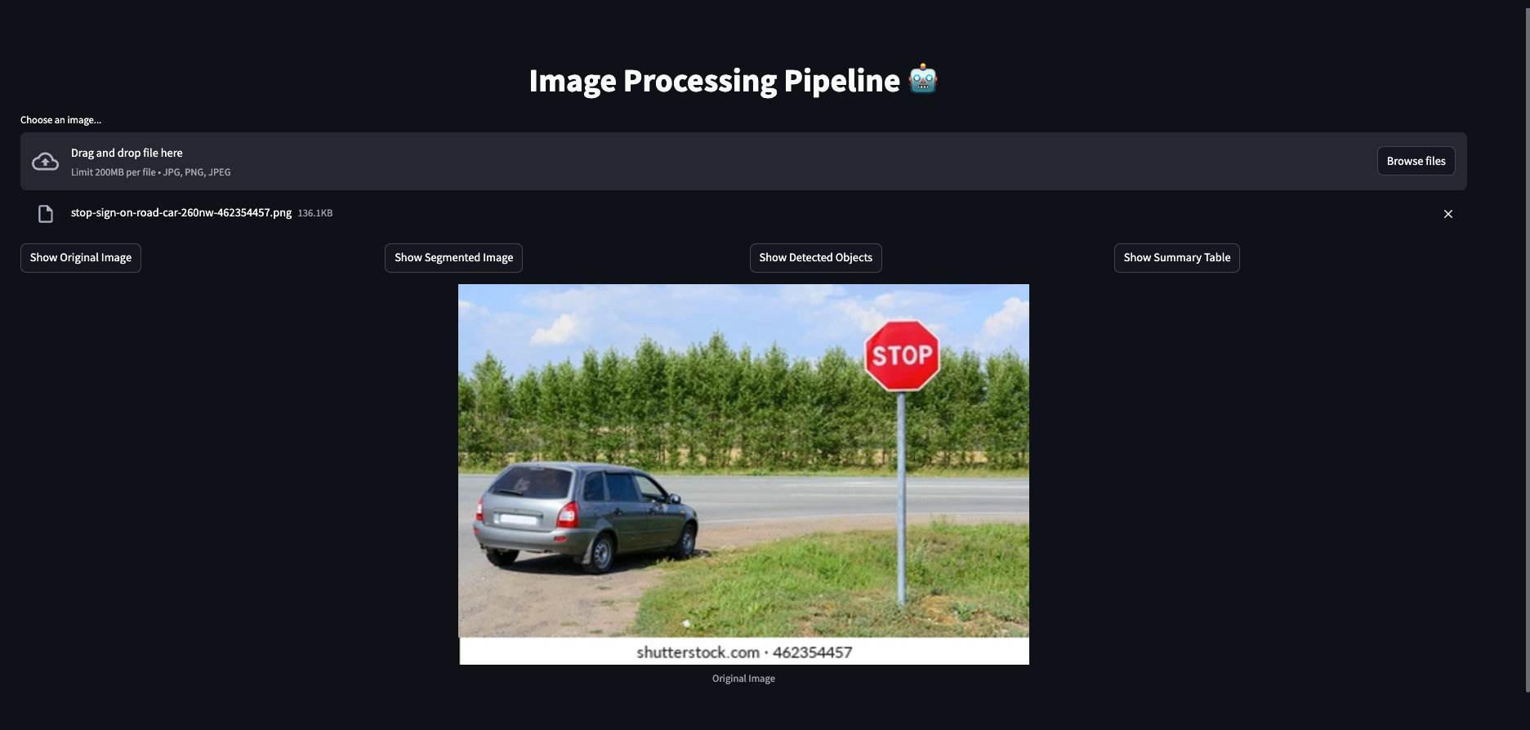
FINAL OUTPUT
Initial view of landing page after user uploads the picture.

Slide 7
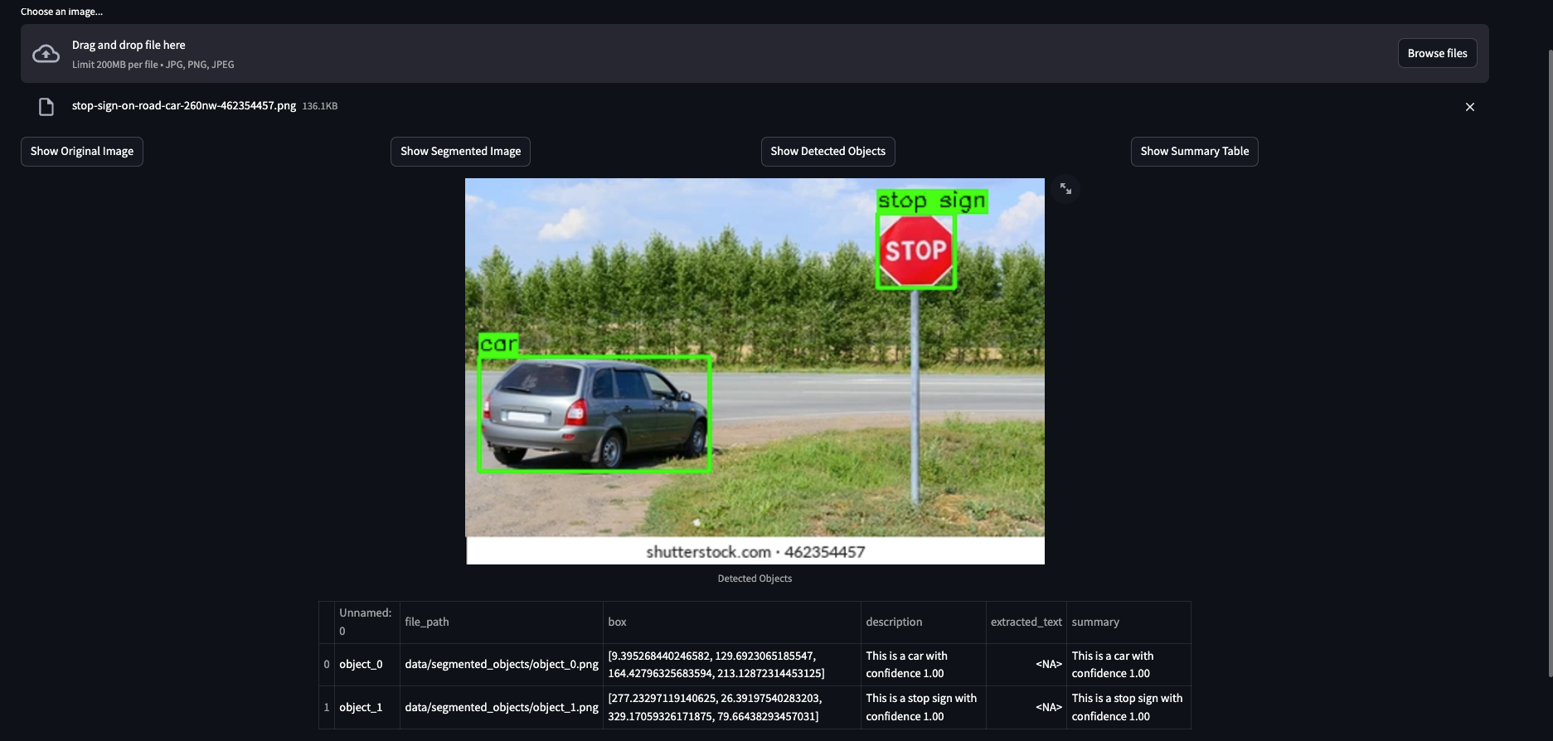
FINAL OUTPUT
View after computing the results, allowing users to interact with the help of buttons.

Slide 8
THANK YOU
I would like to extend my gratitude for providing me with this incredible opportunity to learn.

