Slide 1
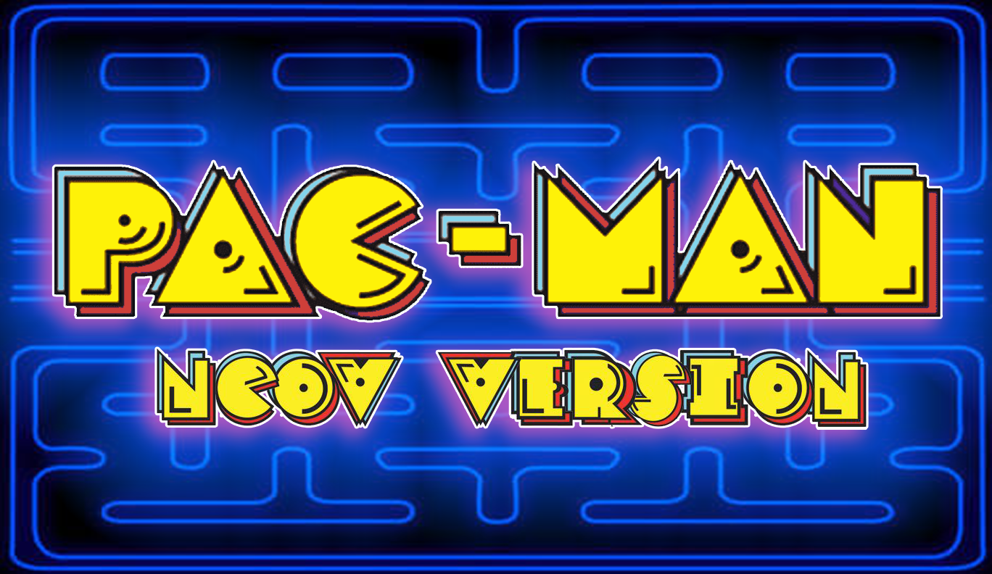



LOST IN SPACE: THE GAME

Slide 2

I. Project Description

Slide 3
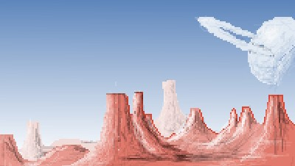

Concept Based on:
* Novel Corona Virus,
a virus that easily transferred from one person to another through body fluids. NCOV can be prevented by the use of facemasks and by practicing healthy Hygiene.

Slide 4
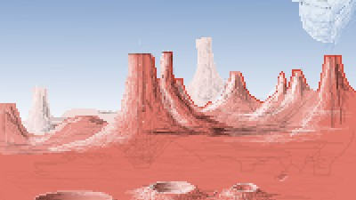

Algorithm and Gameplay based on:
*Pacman, an arcade game from Japan released in 1980. This is considered a classic arcade game. *Our algorithm is based on the collision detection and map of this game, wherein pacman will collect dots and a score will be added.

Slide 5
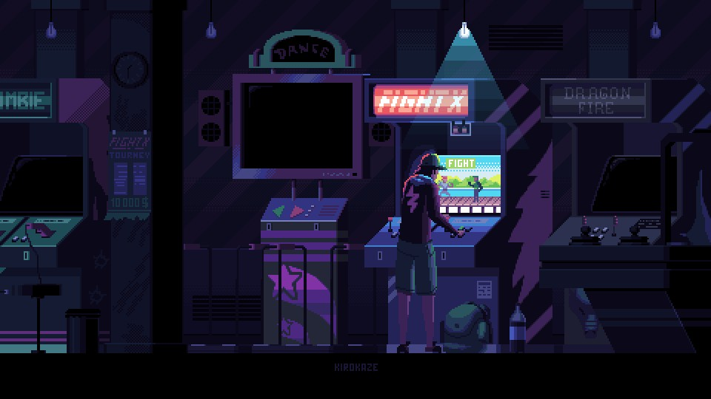
II. Game Description

Slide 6
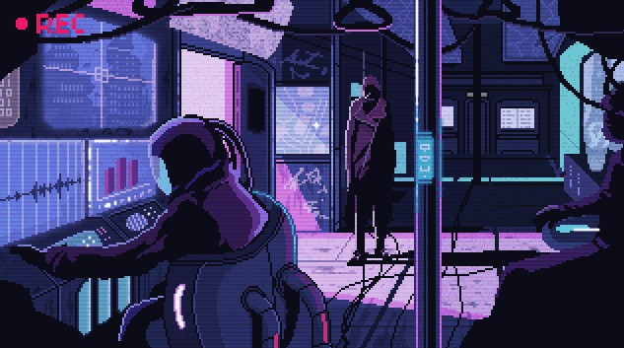
A human wearing facemask collecting all the coins placed in a maze avoiding 4 roaming COVID virus that pursue him. The goal of the game is for the user to control the human and collect all the coins through out the maze while avoiding the COVID virus. The user can get COVID medicine (powerups) placed on the maze allowing him to kill the COVID virus.

Slide 7
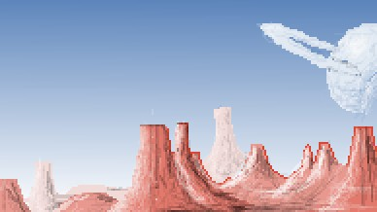
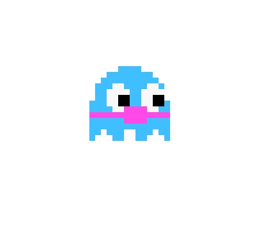

The Human, control this character and collect all the coins to finish the level.
The Coins, collect all coins and win the level.

Slide 8
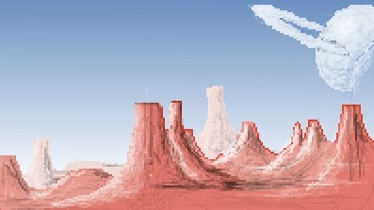
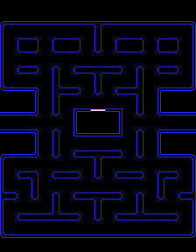

The COVID Medicine, a powerup that allows the human to kill COVID virus but in a limited amount of time only.
The Maze, a neon colored enclosed place.

Slide 9
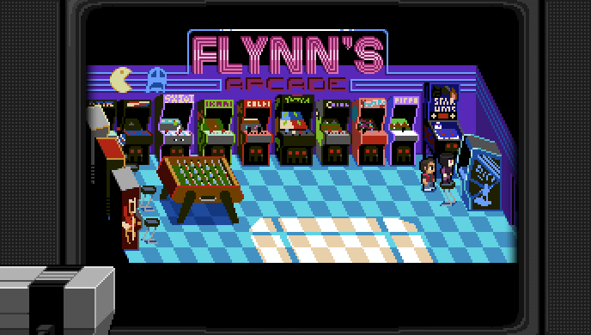
III. Gameplay

Slide 10

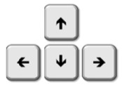
Up, down, left, right keys : makes the character move across the maze.

Slide 11
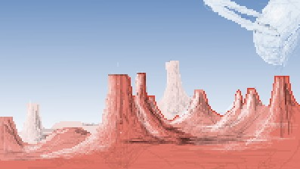

* Space : starts the game.

Slide 12
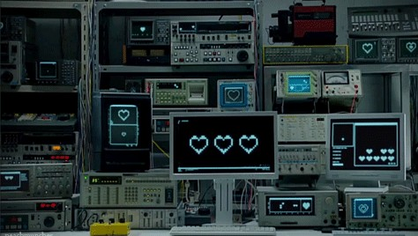
Significant Codes

Slide 13
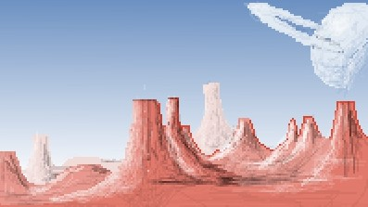
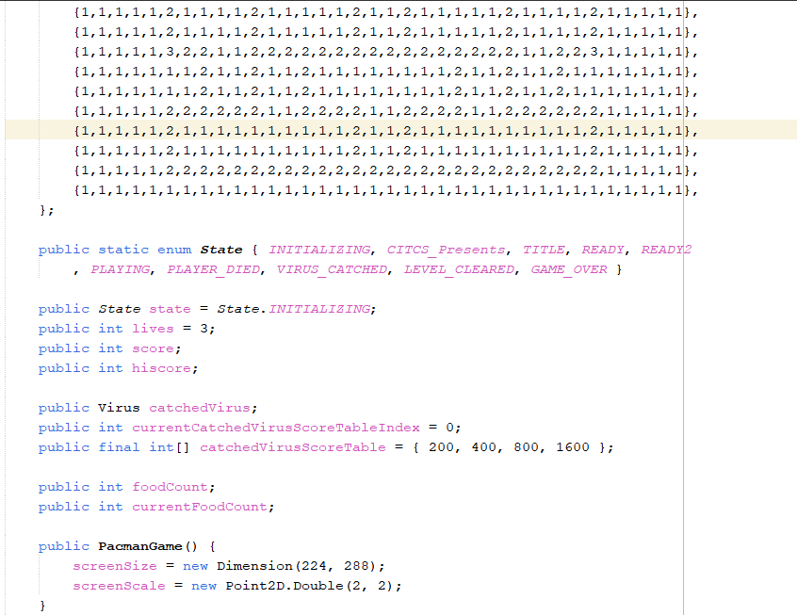
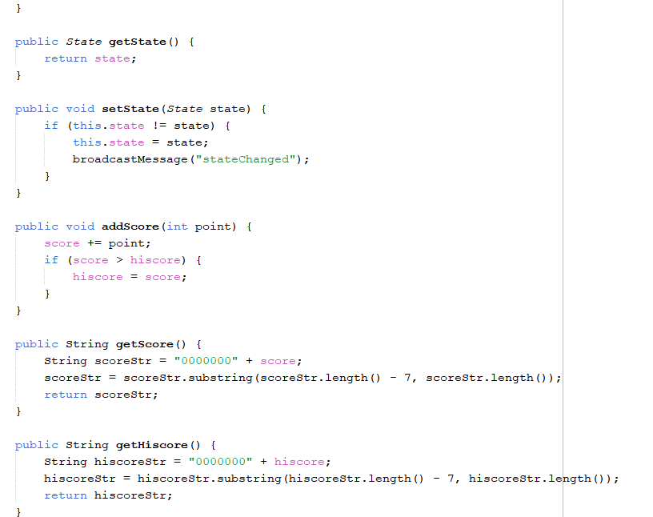
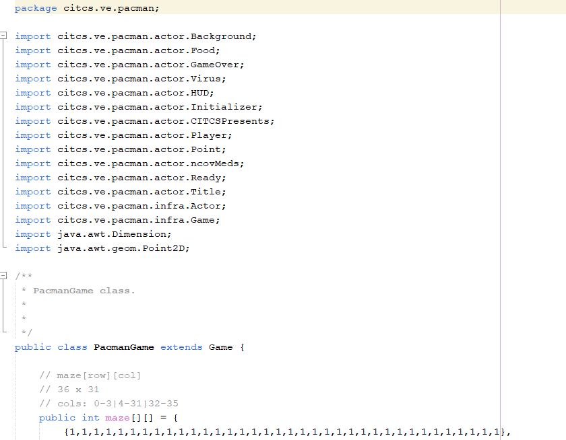
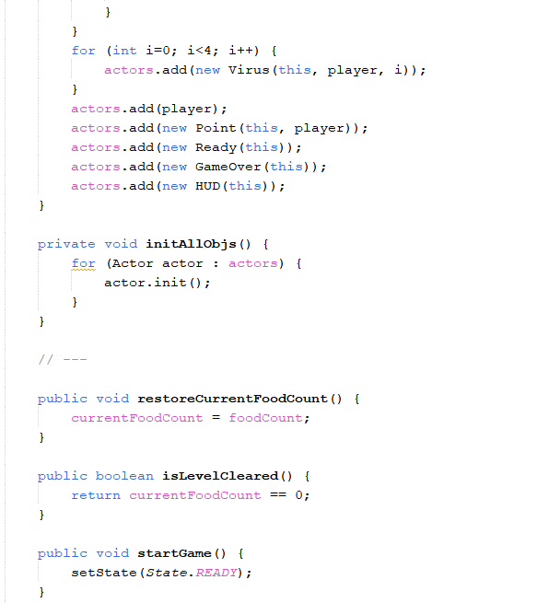
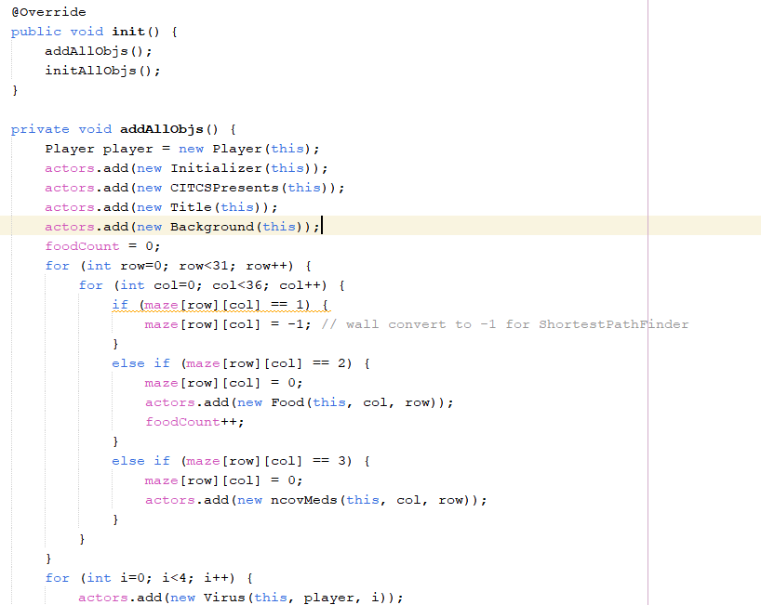
PACMAN GAME

Slide 14
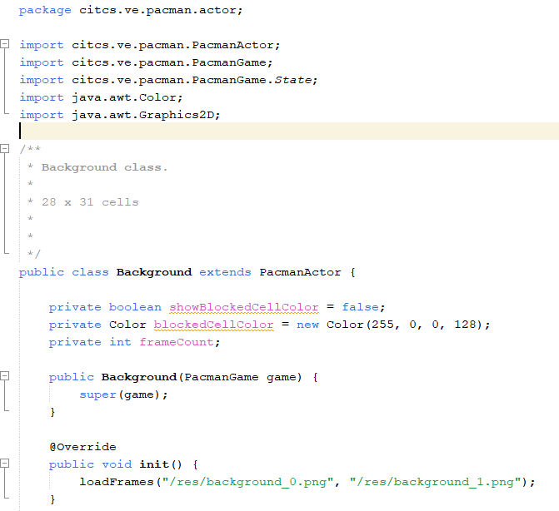
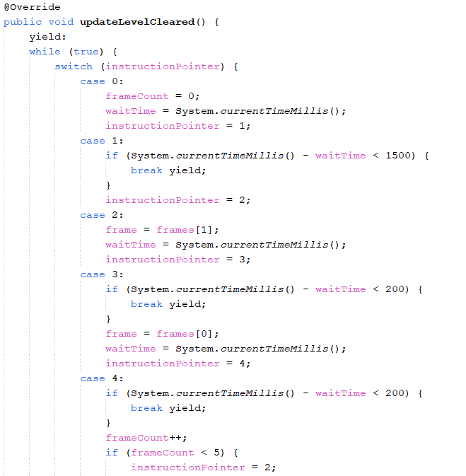
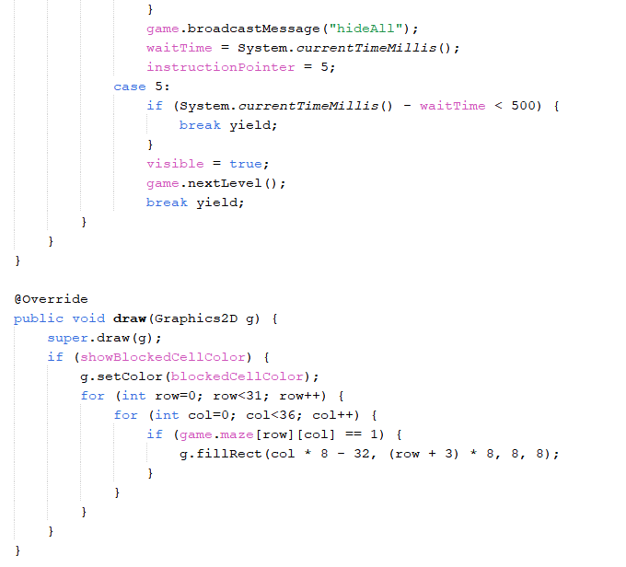
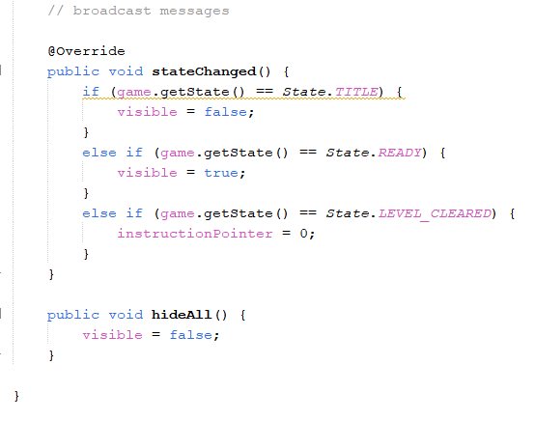
Background

Slide 15
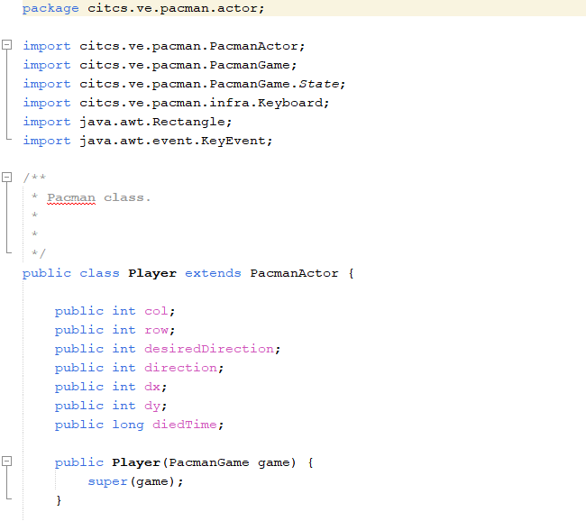
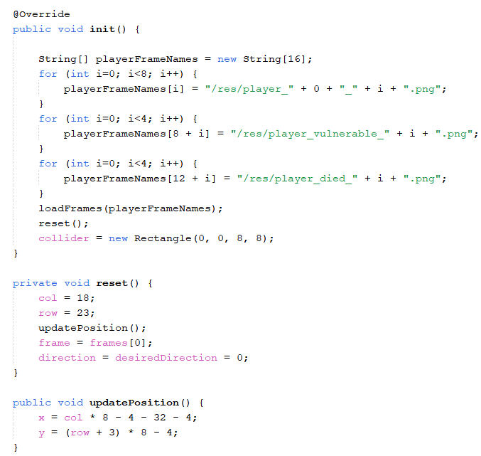
PLAYER

Slide 16
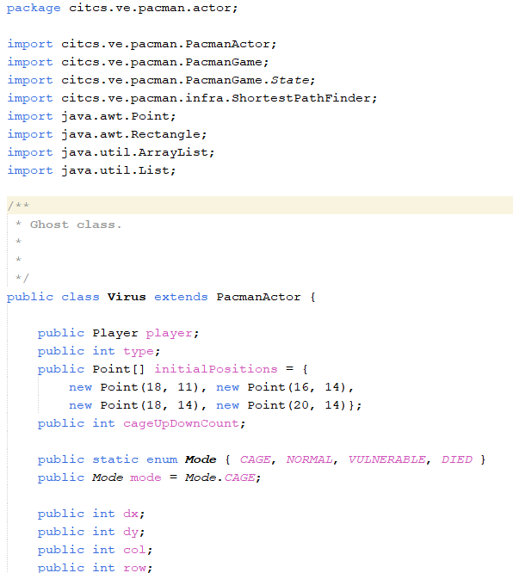
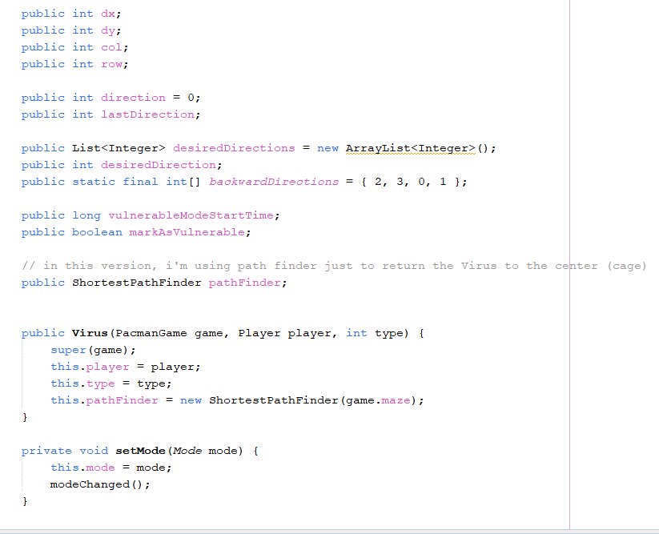
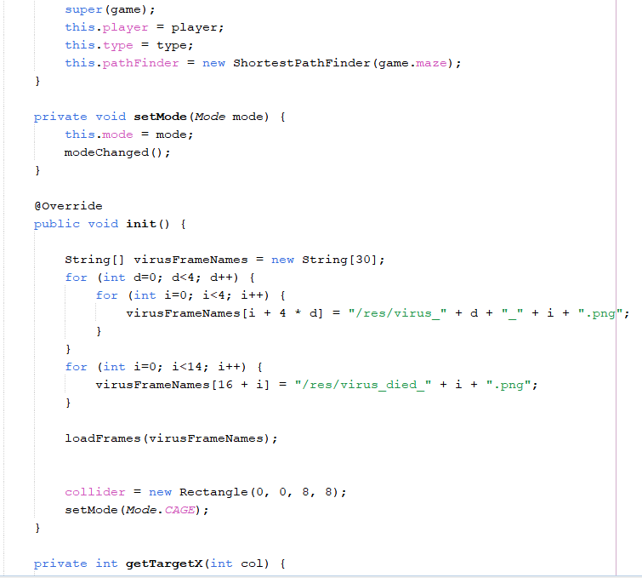
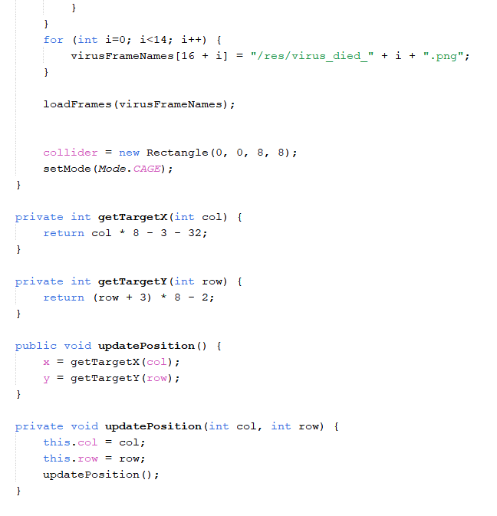
VIRUS

Slide 17
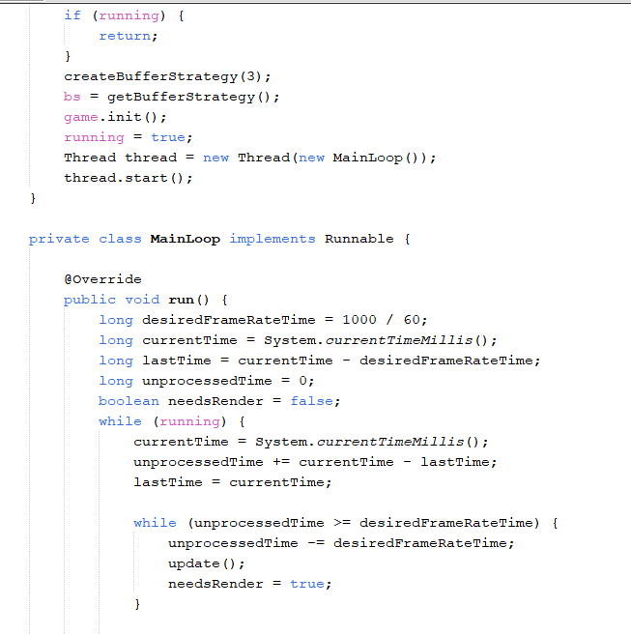
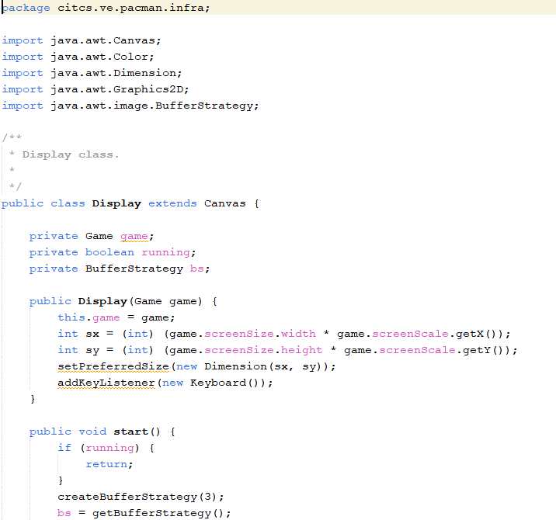
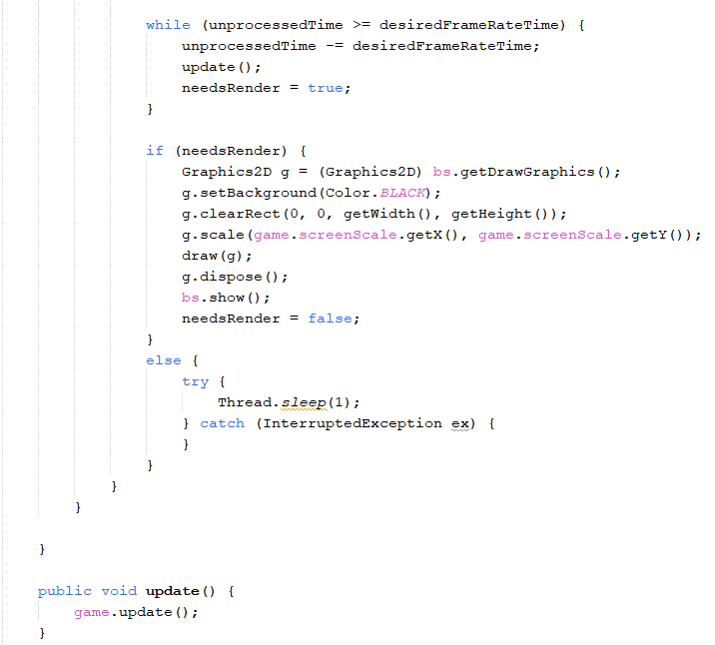
Display

Slide 18
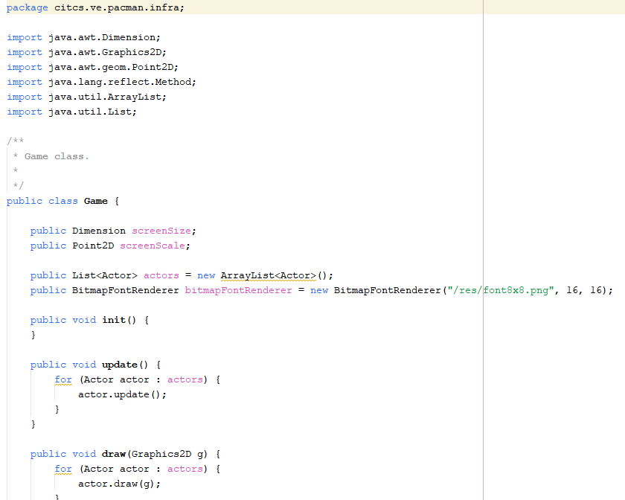
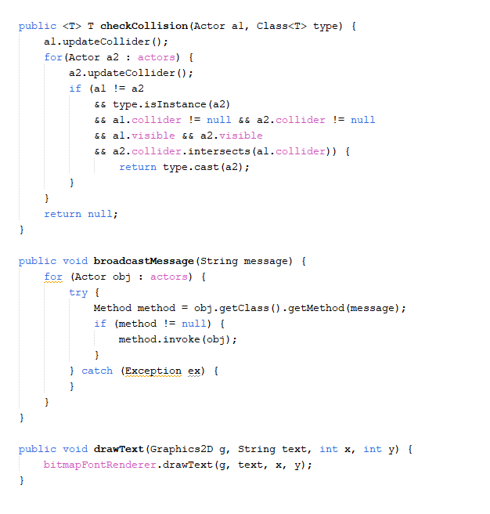
Game

Slide 19
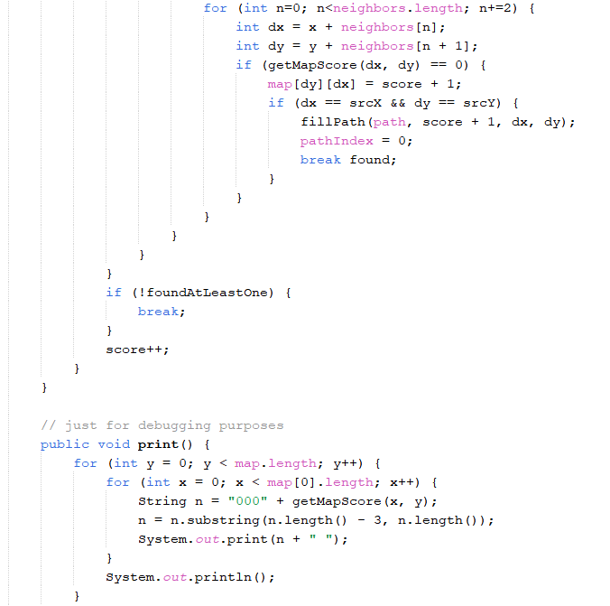
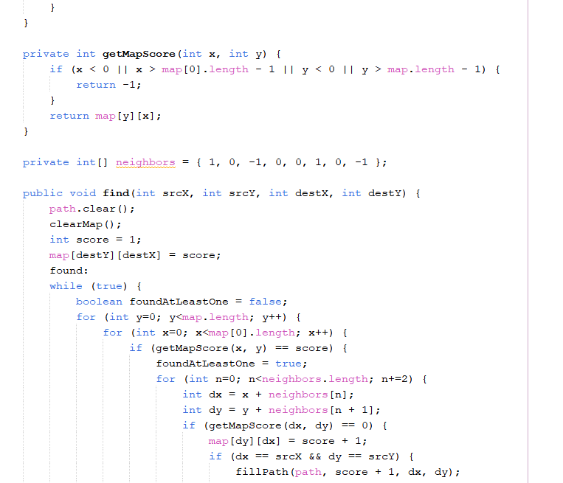
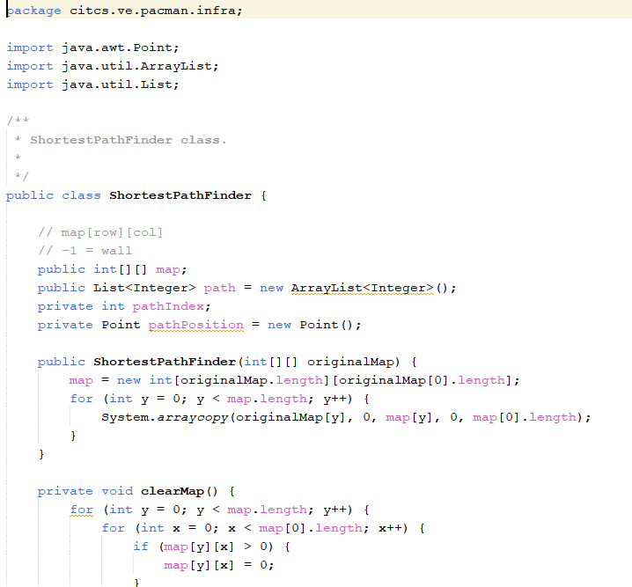
Path Finder

Slide 20
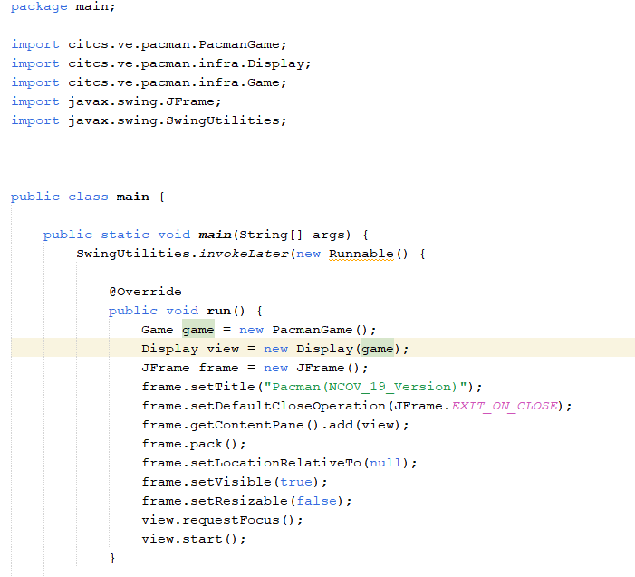
Main

Slide 21
Source Codes:
Pacman : zetcode.com/tutorials/javagamestutorial/ pacman
https://github.com/leonardo-ono/ Java2DPacmanGame

Slide 22
Github Link:
G.A.N.A.P CITCS 1G:
Gayyed, Arnemie
Azlor, Zerlan
Nicolas, Venn Edward
Alvaro, Kyle Joshua
Pepito, Jason
https://github.com/Vedonii/CC3-1G-PacmanNcovVersion

