Slide 1

Project 4: Machine Learning
Predicting NBA Teams’ Chances of Winning

Slide 2
OUR TEAM
John McMullan
Lennox Nguyen
Vedrana Basimamovic
Emmanuel
Yoacel-Okecha
Stephen Jackson
Leon Lee

Slide 3


BACKGROUND
The NBA Finals is the annual championship series of the National Basketball Association.
The Eastern and Western Conference champions play a best-of-seven game series to determine the league champion.
With the growing popularity of sports betting, we wanted to create a simulator that will predict the winner of the NBA games within each Conference.
In particular, a percentage chance of winning or losing Team A vs Team B

Slide 4
GAME PLAN & PREPARATIONS
01
02
03
04
API
PYTHON
Data merging and cleaning
Modeling
Testing
Official NBA Stats API https://www.nba.com/stats
NBA Team Stats
www. hoopsstats.com
SQL
TABLEAU
Create table
Import Data
Create working file
Team Stats
Winning Chance Heat Map
Team Geo Location

Slide 5
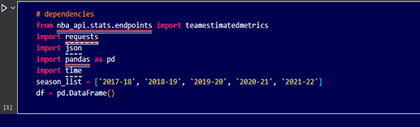
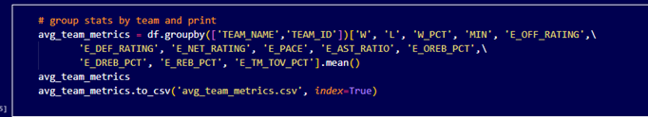
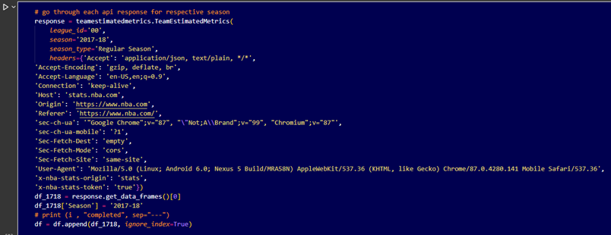
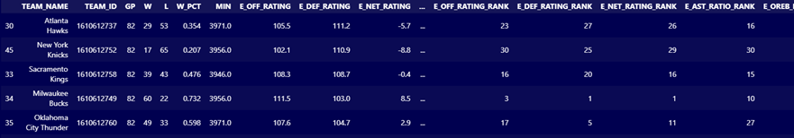
02 Python
Connect to API
Pull team metrics data for seasons from 2017 through 2022
Average the team metrics for overall measures
Export as CSV to apply to model

Slide 6
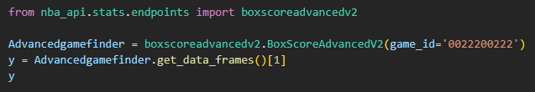
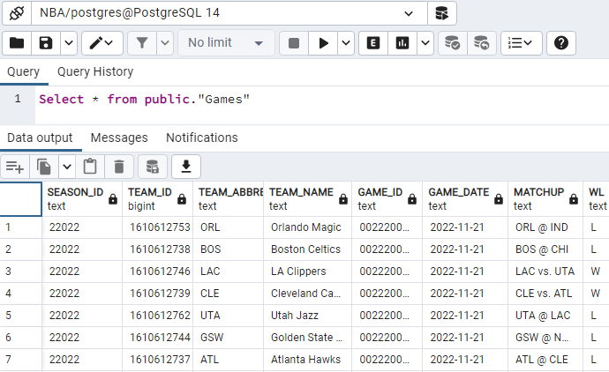
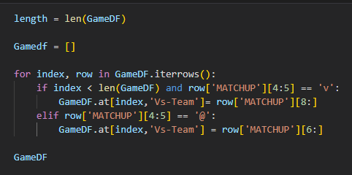
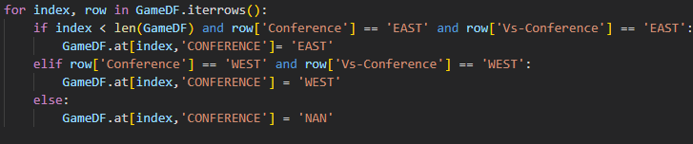
SQL
Connect to API
Pull games data
Separate by Conference
Clean up unused data
Here you give a brief intro of the topic you want to talk about. For example, you can talk about Mercury

Slide 7
Building Model Steps
1. Get Data and Clean
Pull Data from SQL Data frame and drop unwanted data
2. Build Function to Analyze Data
Function needs to run through provided data easily and with reasonable success.
3. Run Data Through Function through results
Take Clean Data and run it through the function to find results.

Slide 8
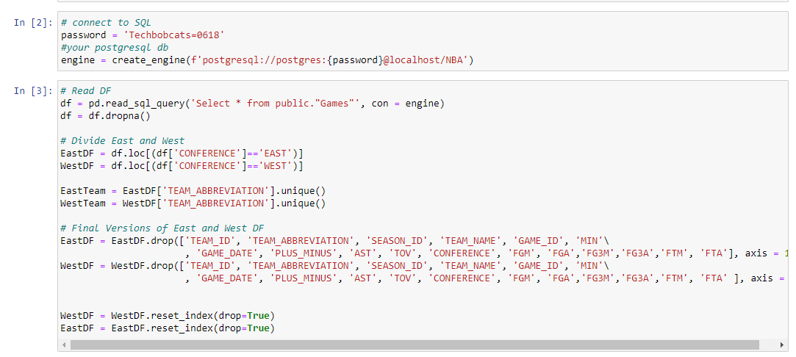
Step 1: Get Data and Clean
Connect and pull Data from SQL

Slide 9
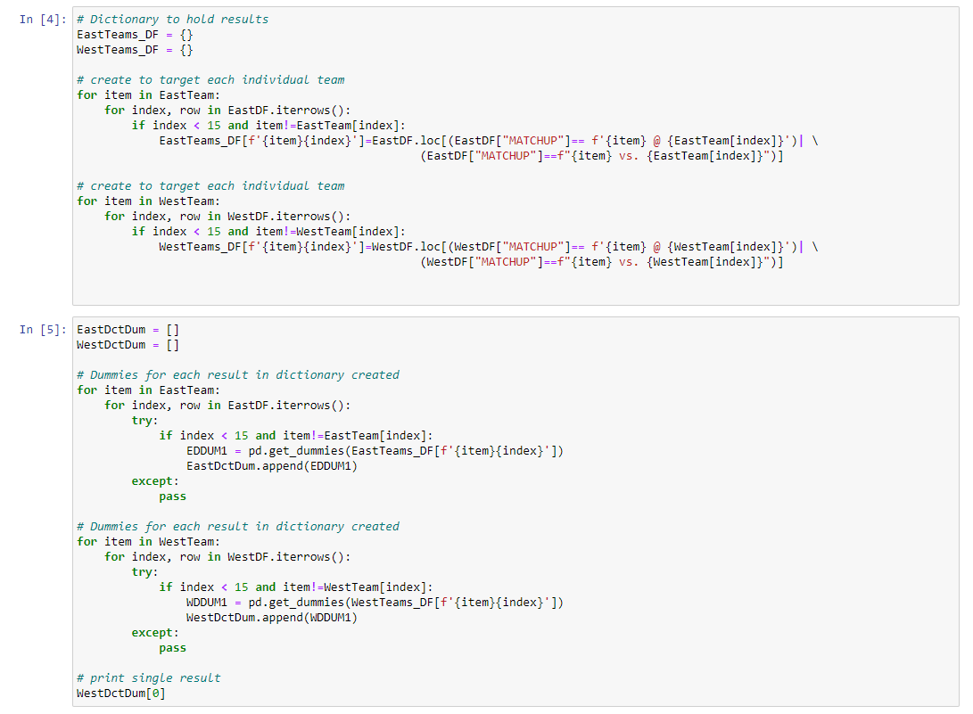
Create groups of Data Frames
for each individual team

Slide 10
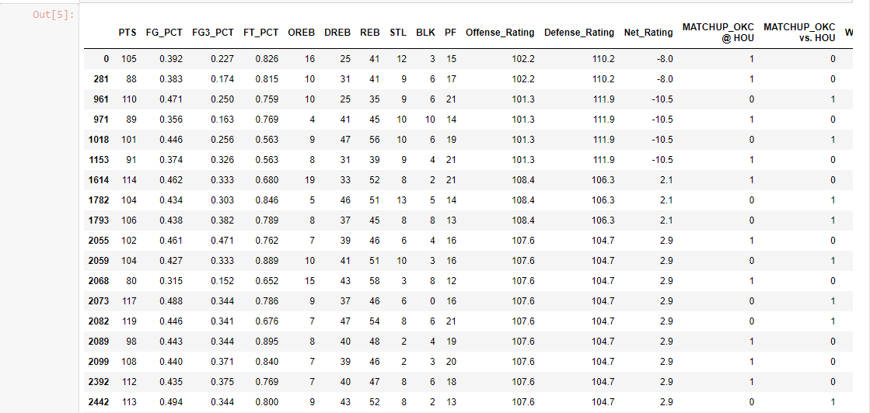
Final Data frame
Each team has a Data Frame for stats vs. each opponent in conference

Slide 11
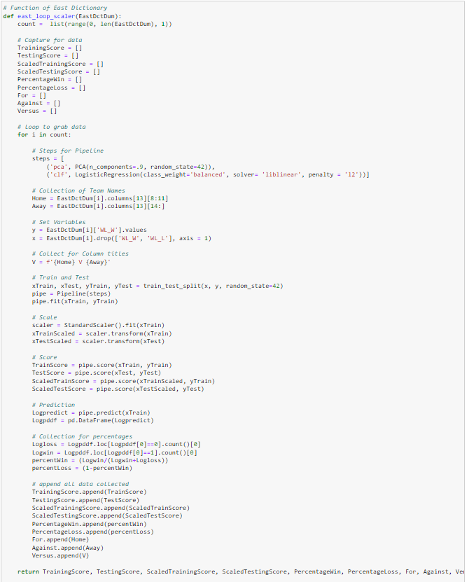
Step 2: Create Function
Function has multiple steps in one loop:
1. Find Home team and Away team
2. Set x and y values
3. Train those values
4. Fit those values to the pipeline created in the loop
5. Scale Values
6. Score Values
7. Use Predict to find win, loss, and percentage values
8. Append all data
This function loops through this for each individual data frame

Slide 12
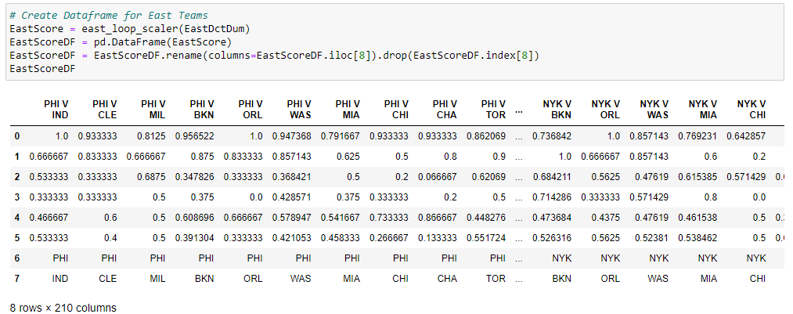
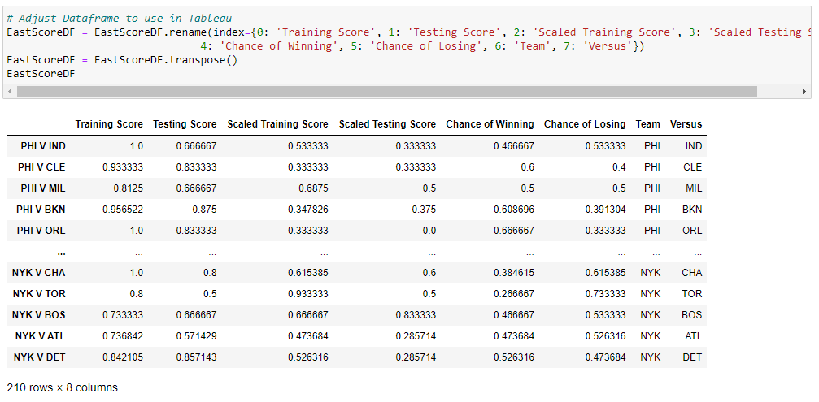

Step 3: Send Data through Function
We take are data and push it through our function and get a data frame that tells use
Training Scores
Testing Scores
Chance to Win
Chance to Lose
For every team in the conference

Slide 13
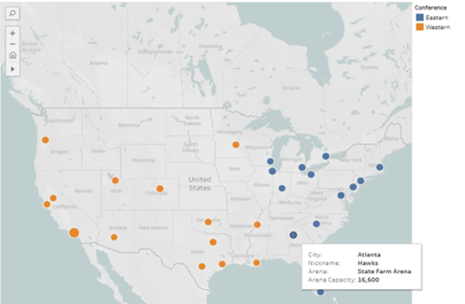
04
Tableau Time!
Visualizations using Tableau

Slide 14
Conclusion
Additionally, it might have been worth exploring into the NBA API for more data, though it turned out to be expensive like having access to the that could improve the performance of the model.
In the future various weights between the model and the average points differential can be used to see if improvements can be made to the prediction accuracy.
Other limitations were in the size of data leading to a split between the Eastern and Western conference for better prediction.

Slide 15
Questions?

