Slide 1
JavaScript 101
Student to student

Slide 2


What is JavaScript
Programming language
Readable
Represents the real world
In browser applications
Growing
Server side

Slide 3
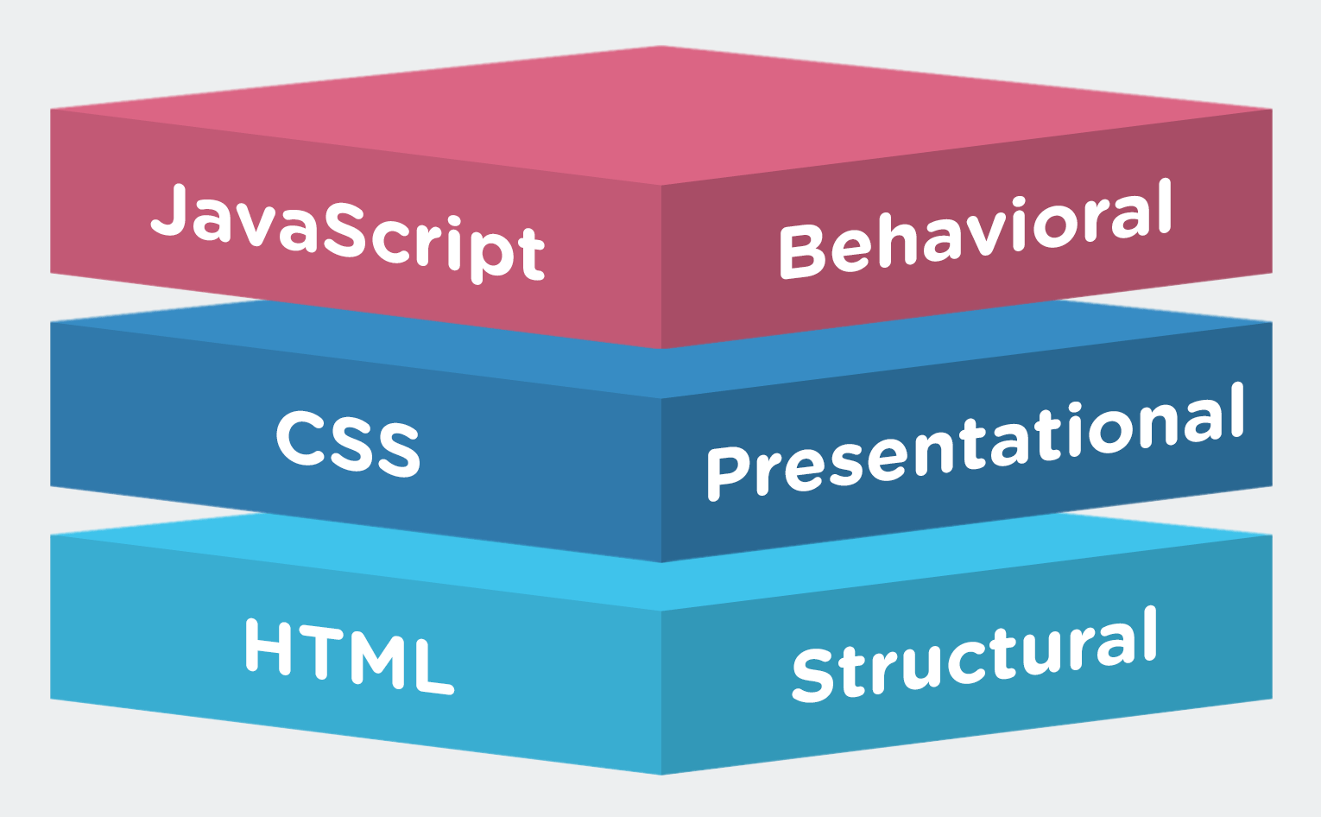
How is it used

Slide 4
What you need to start
Text editor
VS Code, Atom, Other
Browser
Coffee
Zip

Slide 5
What are we learning from this?
Thinking like a problem solver
Keep in mind
Understand the problem
Split task in to smaller sub tasks

Slide 6
Variables
Box
Contains a value
Types

Slide 7
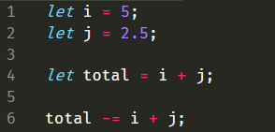
Numbers
how to define a variable
Integers and Doubles
Operators
+ - * / %

Slide 8
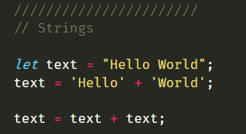
Strings
Text

Slide 9
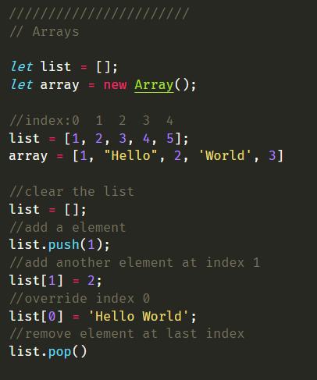
Arrays
List of variables

Slide 10
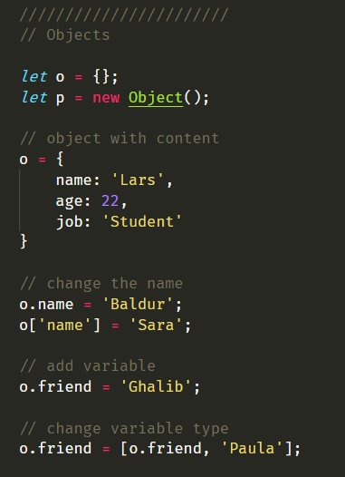
Objects
E.g. a person having
Age
Name
Eye color
Etc.

Slide 11
Task 1.
Create an object containing the following:
Name
Age
Eye color
List of hobbies

Slide 12
Nice! Then what?
Functions
Loops

Slide 13
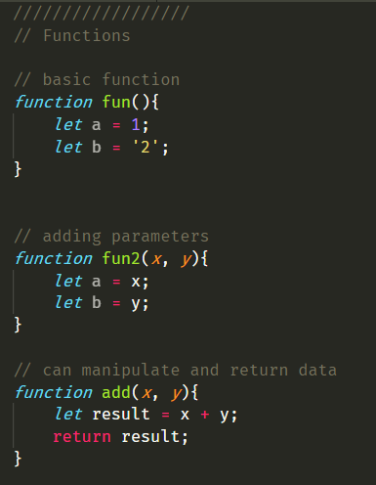
Functions
Activity executed in a specific way

Slide 14
Task 2
Write the function “Triple”, that takes a string as a parameter and returns the string times three.
Eg: Hello => HelloHelloHello

Slide 15
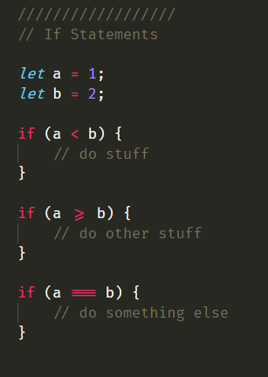
If Statements
Checks
Booleans

Slide 16
Task 3
Compare strings a and b,
Check if they are equal. If they are, set a variable textToPrint to:
‘These are the same!’
Else:
‘These are not the same!’
End the task by printing the textToPrint variable using the print() method.
Try changing the value of a and b

Slide 17
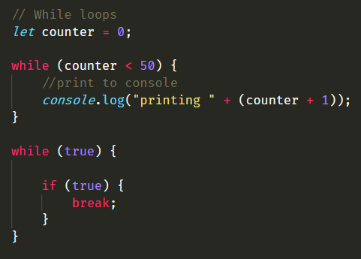
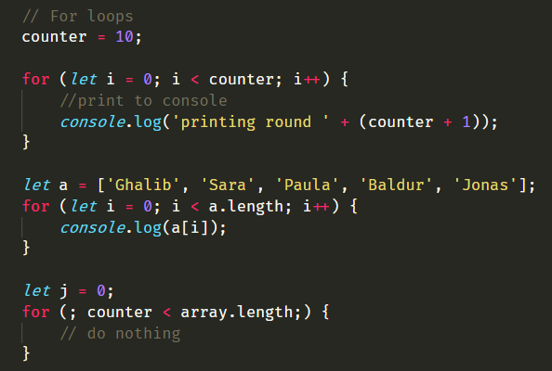
Loops
While loop
For loop

Slide 18
Task 4
Write a function that takes a number as parameter.
the function should print a triangle, with the depth the same as the parameter.
eg: depth = 3 results in:
#
##
###
you should use the print method to output the triangle.

Slide 19
What can I do with this?
This is basics
Finding information (really important!)
Stack overflow
Now the projects!

Slide 20
Project
Look in the projects folder, and see if you can solve the problems

Slide 21
Summary
Problem solving!
Creativeness
Fun!

Slide 22
At last
If (student wants more === true ) {
go to -> https://eloquentjavascript.net/
}

