Slide 1
Code Runners Zinga presents
Income Tax Fraud and Money Laundry Detection System

Slide 2
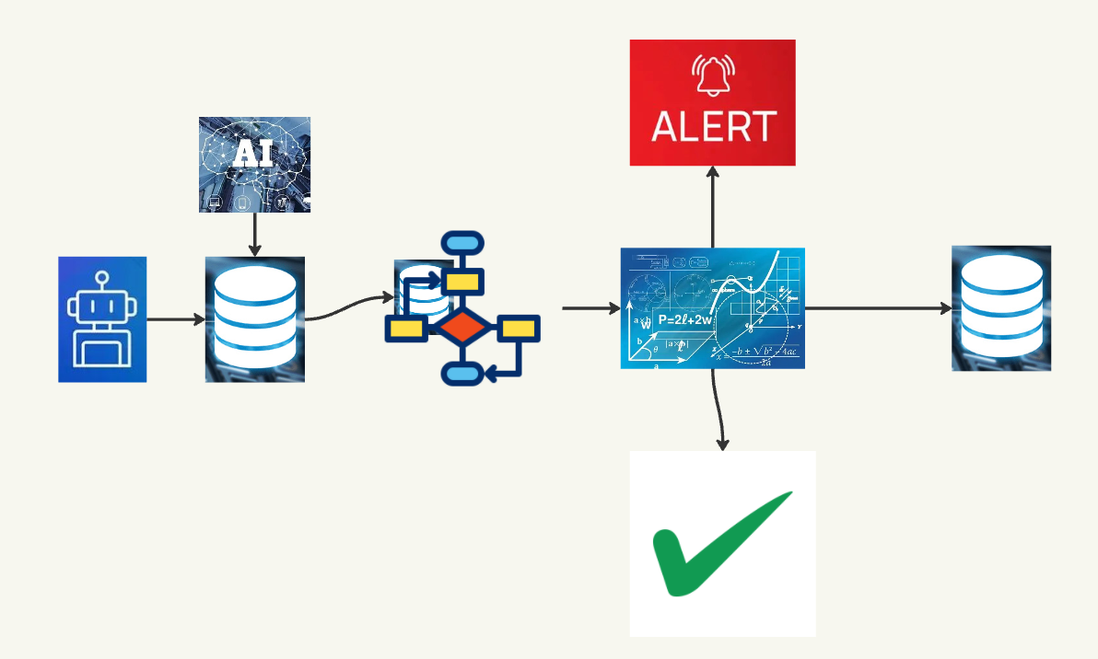

Slide 3
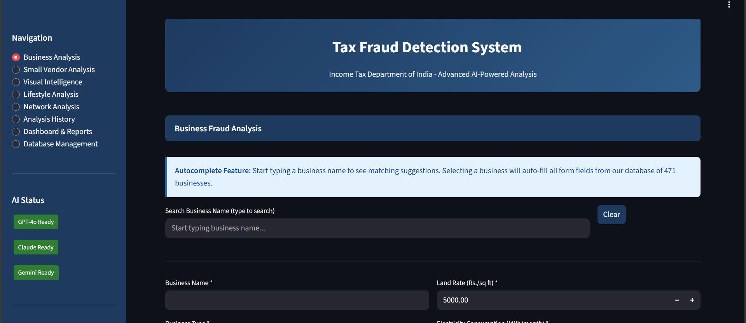

Slide 4
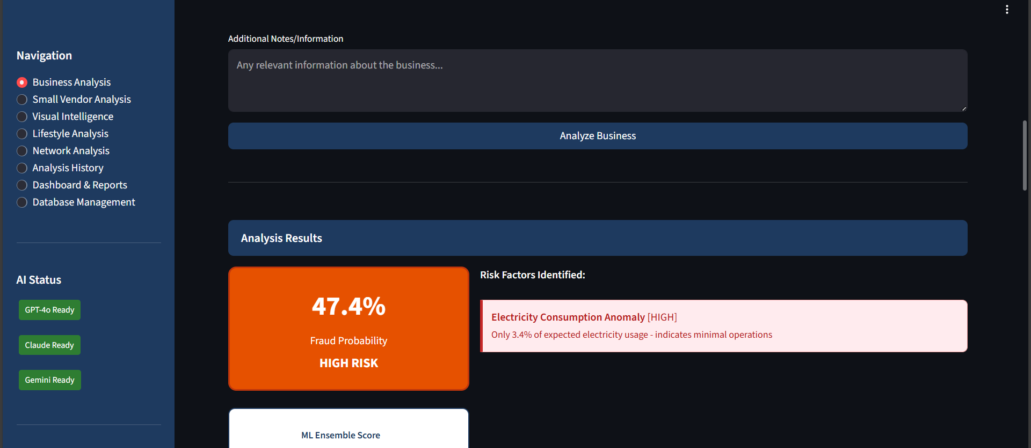

Slide 5
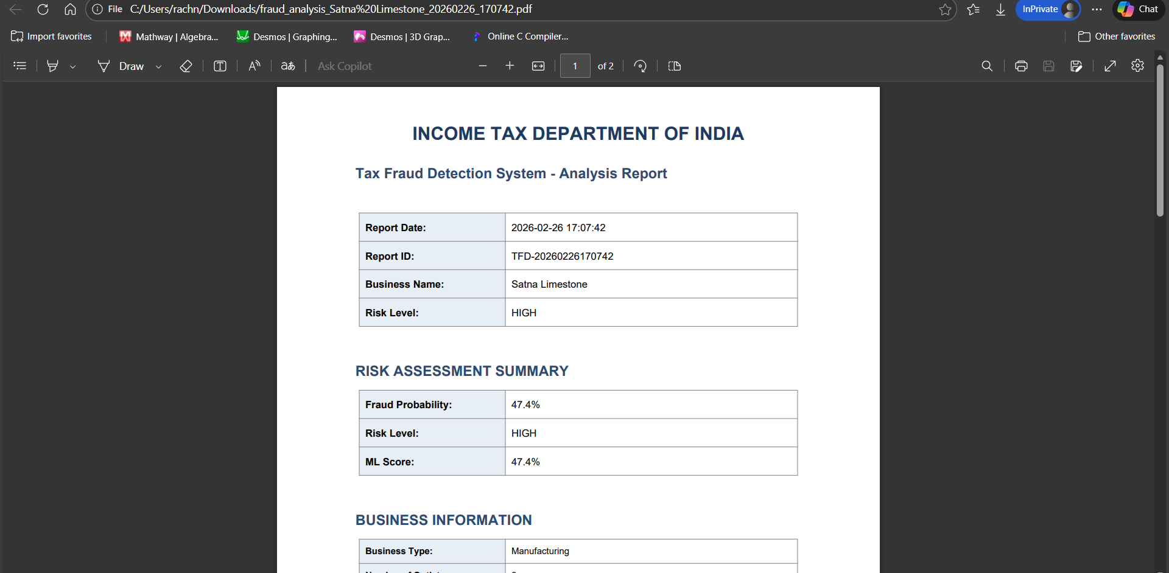

Slide 6
Working
Application works on given mathematical formulas and algorithms to detect cash outflows and anomalies in requirements of the unit to find misguided cash demands.

