Slide 1



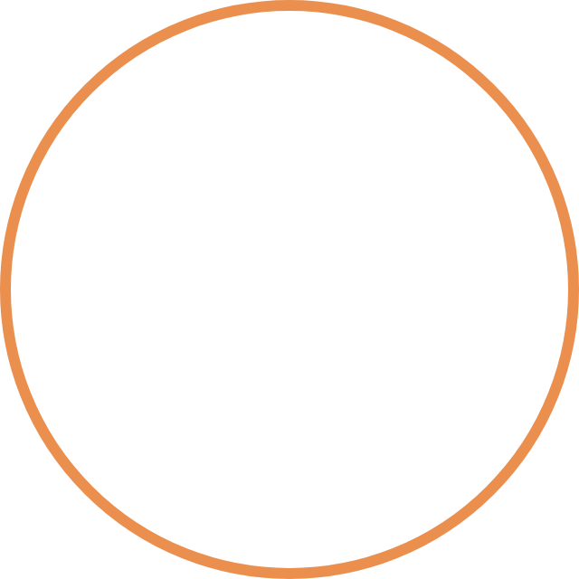
META CHANNELS PERFORMANCE REPORT
Facebook & Instagram Insights
Monthly report, January – April
Notes:
Opening. This report covers four KPIs from the Facebook and Instagram Insights exports and the Ads Manager export for January to April 2023: audience reach growth, Facebook likes versus Instagram followers, total ad spend, and the percentage change in ad spend.

Slide 2
Key performance indicators
THE BRIEF
KPI 1
KPI 2
Calculate the growth rate of Facebook and Instagram audience reach.
Compare Facebook Page likes with Instagram followers.
KPI 3
KPI 4
Show the total amount spent on ads on a trend diagram.
Calculate the percentage increase or decrease in the amount spent on ads.
Meta channels performance
3
Notes:
Four KPIs from the brief. All growth rates are month on month, built from the daily series summed by month.

Slide 3
Terminology
THE BRIEF
Ad Account
Paid Impressions
Paid Reach
The Meta Ads Manager profile that holds payment methods, campaigns, tracking pixels and permissions.
Total times ads were shown on a screen, counting repeat views by the same person.
Individual people who saw a paid ad at least once. Each person is counted once.
Amount Spent
Reach Growth Rate
Audience Velocity
Gross amount billed by Meta to the ad account to run campaigns in the period.
Percentage change in unique users reached (paid and organic) from one month to the next.
Monthly rate at which new fans opt in by liking on Facebook or following on Instagram.
Meta channels performance
4
Notes:
Six terms used throughout. Reach and spend come from the Ads Manager export; Page reach, likes and followers come from the Facebook and Instagram Insights exports.

Slide 4
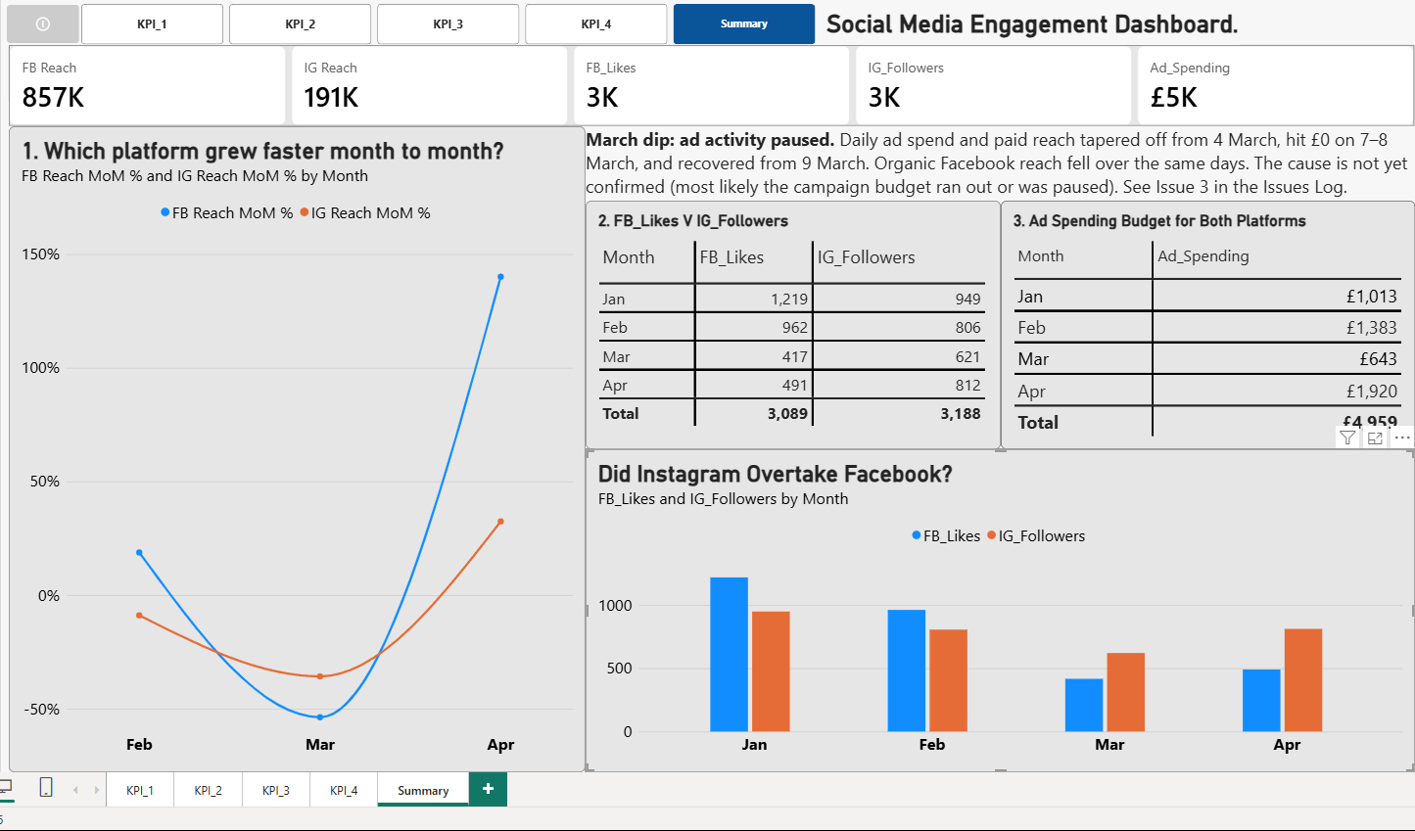
Dashboard summary
RESULTS
£4,959.04
Total ad spending
856,741
Facebook Page reach (sum of daily)
191,037
Instagram reach (sum of daily)
3,089
Facebook Page likes gained
3,188
Instagram followers gained
Meta channels performance
5
Notes:
Totals for January to April 2023, matching the dashboard tiles (shown there as 4.96K, 857K, 191K, 3089 and 3188). Reach totals add up daily unique users, so they are not distinct people; growth rates use the same method every month. Currency is treated as GBP because the export states none.

Slide 5
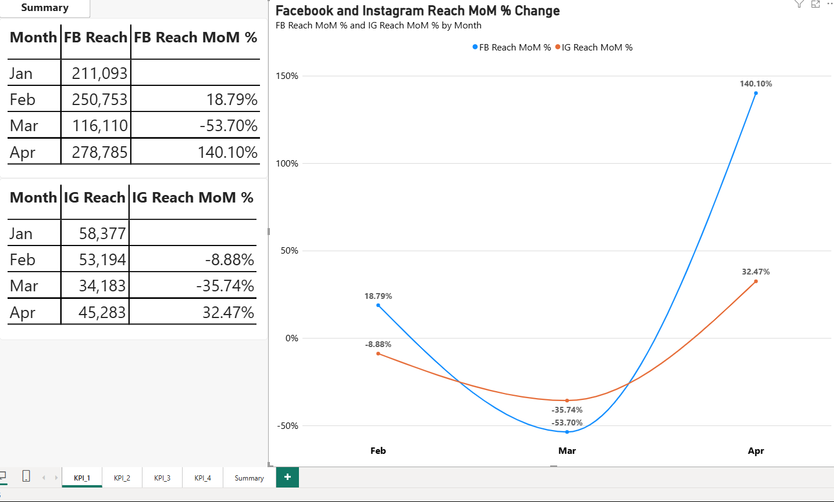
Audience reach growth, month on month
KPI 1
Facebook
Instagram
Facebook swung hardest
+18.79% in February, −53.70% in March, +140.10% in April.
Instagram fell, then partly recovered
−8.88% in February, −35.74% in March, +32.47% in April.
April is a rebound from a low base
Facebook April reach is only +11.2% above February; Instagram is still 14.9% below it.
Monthly reach is the sum of daily reach. January is the base month.
6
Notes:
Monthly reach, January to April. Facebook: 211,093 / 250,753 / 116,110 / 278,785. Instagram: 58,377 / 53,194 / 34,183 / 45,283. March fell on both platforms together. The April increase is measured off a depressed March, so compare it with February as well: Facebook +11.2%, Instagram −14.9%.

Slide 6
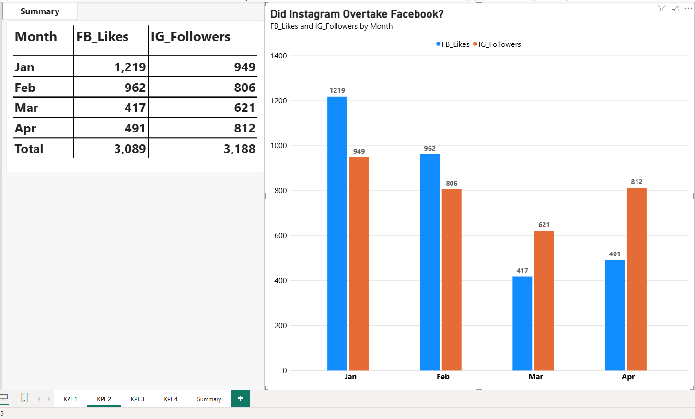
Facebook Page likes vs Instagram followers
KPI 2
Facebook likes
Instagram followers
Near parity overall
3,089 Facebook likes and 3,188 Instagram followers over four months.
Facebook led early
January 1,219 vs 949 and February 962 vs 806.
Instagram led from March
March 621 vs 417 and April 812 vs 491. January to March, Instagram fell 34.6% and Facebook 65.8%.
New likes and followers gained per month.
7
Notes:
Both platforms peaked in January. The crossover is in March, not after it: Instagram 621 against Facebook 417. Instagram is the more resilient platform in relative terms, but its followers also fell between January and March, so this is resilience, not immunity.

Slide 7
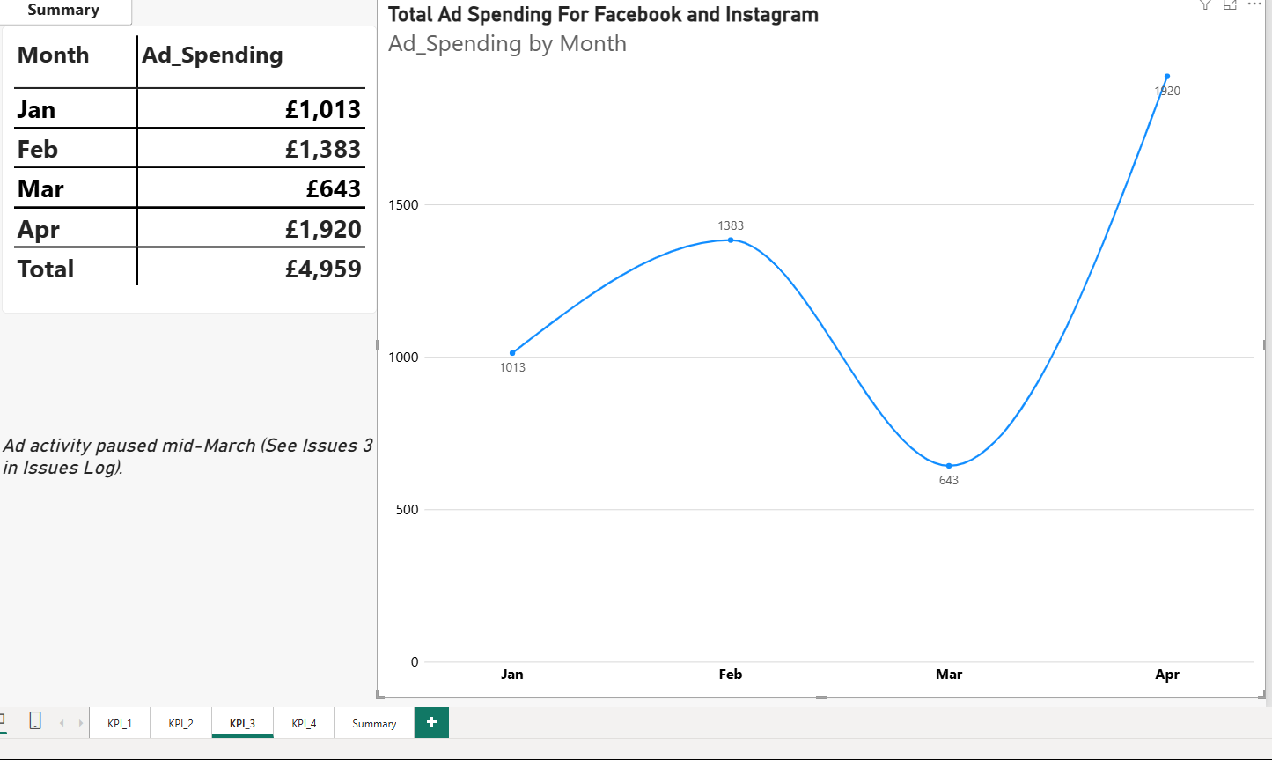
Total ad spend trend
KPI 3
£4,959
Total spend over four months, an average of £1,239 a month.
March was the low point
£642. Spending was £0 on 7–8 March and about £2 a day on 14–21 March.
April was the peak
£1,920 in April, 89.7% higher than January and 38.8% higher than February.
Cause still unconfirmed
A deliberate cut, a pause or an exhausted budget would look alike in the data.
8
Notes:
Monthly spend: £1,012.55, £1,383.26, £642.83, £1,920.40; total £4,959.04. The March fall is not a three-day blip: spend tapered from 4 March, was exactly £0 on 7 and 8 March, recovered to about £38 a day on 10–12 March, then ran at about £2 a day on 14–21 March before building back. The cause is awaiting confirmation from the Ad manager, so describe it as a drop in ad delivery rather than as a budget decision.

Slide 8
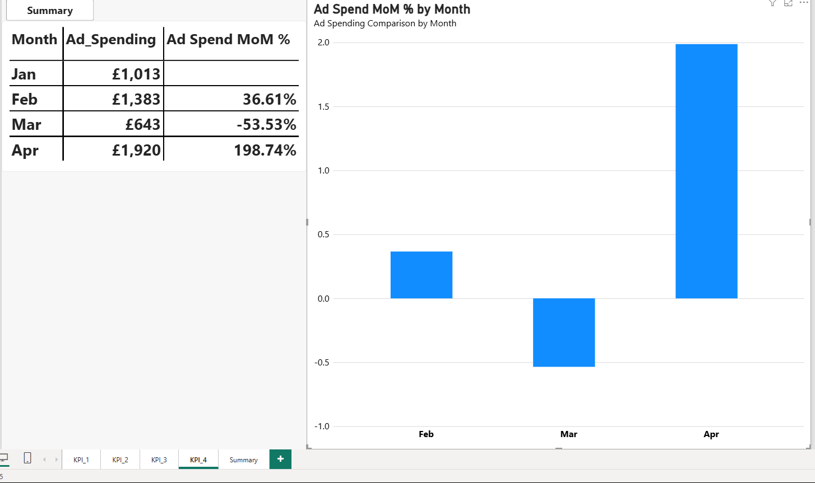
Month-on-month change in ad spend
KPI 4
February: spend up
+36.61%, from £1,013 to £1,383.
March: spend down
−53.53%, to £643, the lowest month. Ad delivery stopped or dropped to about £2 a day on several days.
April: spend surged
+198.74%, to £1,920. Compared with February, the rise is +38.8%, so most of the percentage comes from the low March base.
Percentage change versus the previous month.
9
Notes:
Changes: February +36.61%, March −53.53%, April +198.74%. The size of the April percentage is driven by the depressed March base, so quote the April spend (£1,920.40) and the comparison with February (+38.8%) alongside it.

Slide 9
What the data shows
CONCLUSION
Reach follows ad delivery
Facebook is more spend-sensitive
Daily Facebook reach tracks paid reach (r = 0.99) and ad spend (r = 0.84). On 14–21 March spend ran at about £2 a day and Facebook reach fell to about 1.8K a day, against about 9.0K in February.
Daily spend relates more closely to Facebook reach (r = 0.84) than to Instagram reach (r = 0.47). Facebook Page reach includes paid reach, so the two cannot be separated here.
Audience growth does not track spend
Instagram held up better
February spend rose 36.61% while Facebook likes fell 21.08% and Instagram followers fell 15.07%. April rebounded from a low March: Facebook reach is +11.2% on February, Instagram −14.9%.
From January to March Instagram followers fell 34.6% against 65.8% for Facebook likes. Instagram led in March (621 vs 417) and April (812 vs 491).
Four monthly data points show association, not proof of cause. The March cause is not yet confirmed.
Meta channels performance
10
Notes:
This replaces the claim of a direct causal link. What the data supports: reach moves closely with ad delivery, especially on Facebook. What it does not support: that spend drove every trend. In February spend rose but likes and followers fell, and Instagram reach fell too. Correlations are from 120 daily observations.

Slide 10
Protect delivery and scale in steps
RECOMMENDATIONS 1 OF 2
1
Set a budget floor of £1,000 a month
That is about £33 a day. On 14–21 March spend ran at about £2 a day and Facebook reach fell about 80% below February's daily average. A floor lowers the risk of a repeat; it cannot confirm the March cause.
2
Cap monthly budget changes at about ±20%
Swings this period were +36.61%, −53.53% and +198.74%. Facebook reach per £ fell from 208 in January to 145 in April as spend rose. The ±20% cap is a common guideline to test, not a result from this data.
3
Use Facebook for visibility pushes, scaled in steps
Facebook reach follows spend more closely than Instagram (daily r = 0.84 vs 0.47). April's +140.10% is mostly a rebound: reach is only +11.2% above February on 38.8% more spend. Track reach per £ at each step.
Meta channels performance
11
Notes:
Checked against the data. Floor: £1,000 over 30 days is £33.33 a day; mean Facebook reach on 14–21 March was 1,751 a day against 8,956 in February (−80.4%). Reach per £ for Facebook: January 208.5, February 181.3, March 180.6, April 145.2. April against February: Facebook reach +11.2%, spend +38.8%. The ±20% figure is an industry rule of thumb that our data does not test.

Slide 11
Build the audience and test what works
RECOMMENDATIONS 2 OF 2
4
Anchor organic community on Instagram
January to March, Instagram followers fell 34.6% against 65.8% for Facebook likes, and Instagram led in March and April. This is relative resilience: followers still fell while spend was cut.
5
Test Reels and Stories formats
A hypothesis, not a finding: our exports hold no placement or format breakdown. Run a controlled test and compare reach and follower gains per format before shifting production.
6
Audit January as a template
January had the highest audience growth (Facebook likes 1,219; Instagram followers 949) at £1,013, below the £1,239 monthly average. Review its creative, copy and targeting. Facebook reach itself peaked in April.
Meta channels performance
12
Notes:
Checked against the data. Instagram followers 949 to 621 (−34.6%); Facebook likes 1,219 to 417 (−65.8%). January has the highest likes and followers and the highest Instagram reach (58,377). Recommendation 5 comes from the team's judgement and general practice; nothing in the exports tests it.

Slide 12
Data notes and open points
LIMITS
March cause unconfirmed
Association, not causation
Spend hit £0 on 7–8 March and ran at about £2 a day on 14–21 March. Confirmation from the Ad manager is pending.
Four monthly points and daily correlations show a link, not proof. Spend and reach may share a cause.
Paid and organic overlap
Reach is summed daily
Facebook Page reach includes paid reach (daily r = 0.99), so organic reach cannot be isolated.
Repeat viewers count again: 848,467 summed paid reach vs 339,230 de-duplicated. Growth rates use one method throughout.
Next step
Confirm the March cause with the Ad manager before finalising recommendation 1.
Meta channels performance
13
Notes:
These limits come from the data-quality log kept for this task (Issue 3 covers the March gap). Being open about them makes the conclusions easier to defend.

Slide 13
Thank you
Questions and discussion
Notes:
Close and take questions.

